Slide 2
What Was the Progressive Era?
Key Periods in U.S. History

Slide 3
Essential Question
How does social reform impact a nation?

Slide 4
Learning Objectives
After this lesson, you will be able to:
Explain the goals of the Progressive Era.
Analyze reform movements of the Progressive Era.

Slide 5
I Think/We Think
Under “I Think,” write an idea or definition of what the word progressive might mean.

Slide 6
Progressive Era Photographs
Silently evaluate the photographs from the Progressive Era.
Take notes about what you think each photograph is depicting.
Add more notes to describe what the Progressive Era was about in the “I Think” column.

Slide 7
Women who supported the Temperance Movement
Notes:
Unknown photographer. (1916). Women support prohibition. Grand Rapids History & Special Collections, Archives, Grand Rapids Public Library, Grand Rapids, MI.

Slide 8
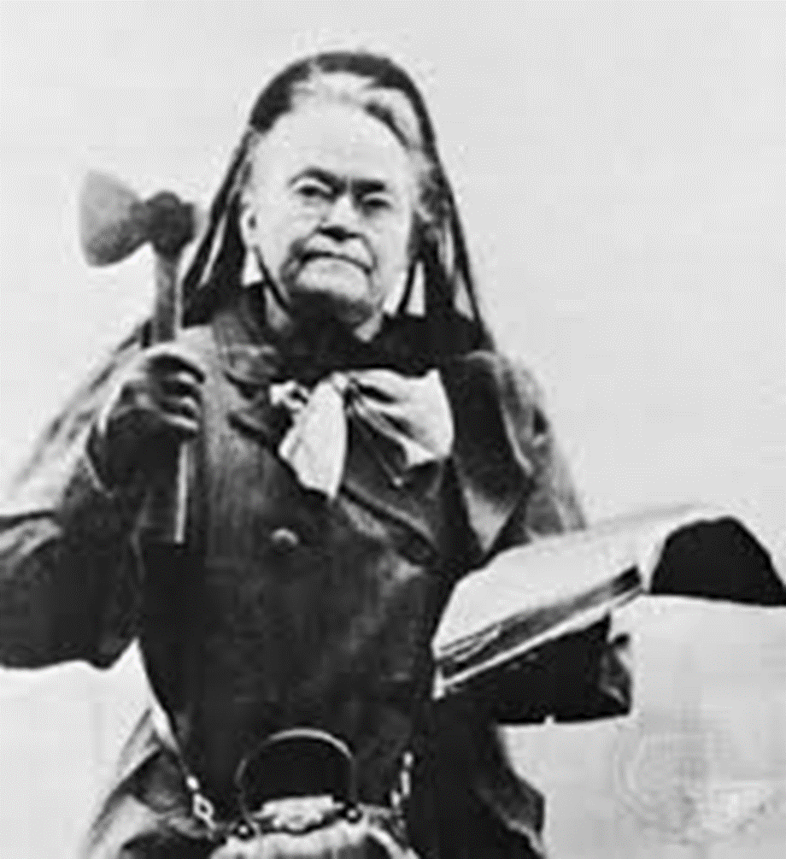
Carrie Nation, seen holding a Bible in one hand and an axe in the other. Nation was an active member of the Temperance Movement.
Notes:
Unknown. (c. 1900). Carry A. Nation with hatchet and bible. Wikimedia Commons. https://commons.wikimedia.org/wiki/File:Carry_A._Nation_with_hatchet_and_bible.jpg

Slide 9
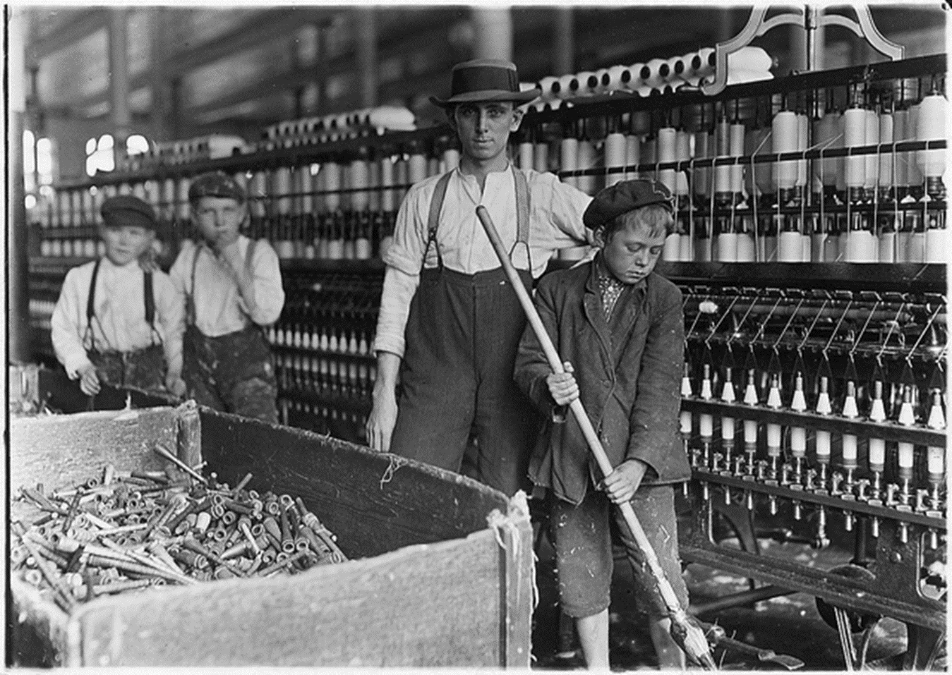
Children working in a cotton mill
Notes:
Hine, L. (1908, December 1). Sweeper and doffer boys in Lancaster Cotton Mills. U.S. National Archives and Records Administration Collection. Wikimedia Commons. https://commons.wikimedia.org/wiki/File:Sweeper_and_doffer_boys_in_Lancaster_Cotton_Mills._Many_more_as_small._Lancaster,_S.C._-_NARA_-_523120.jpg

Slide 10
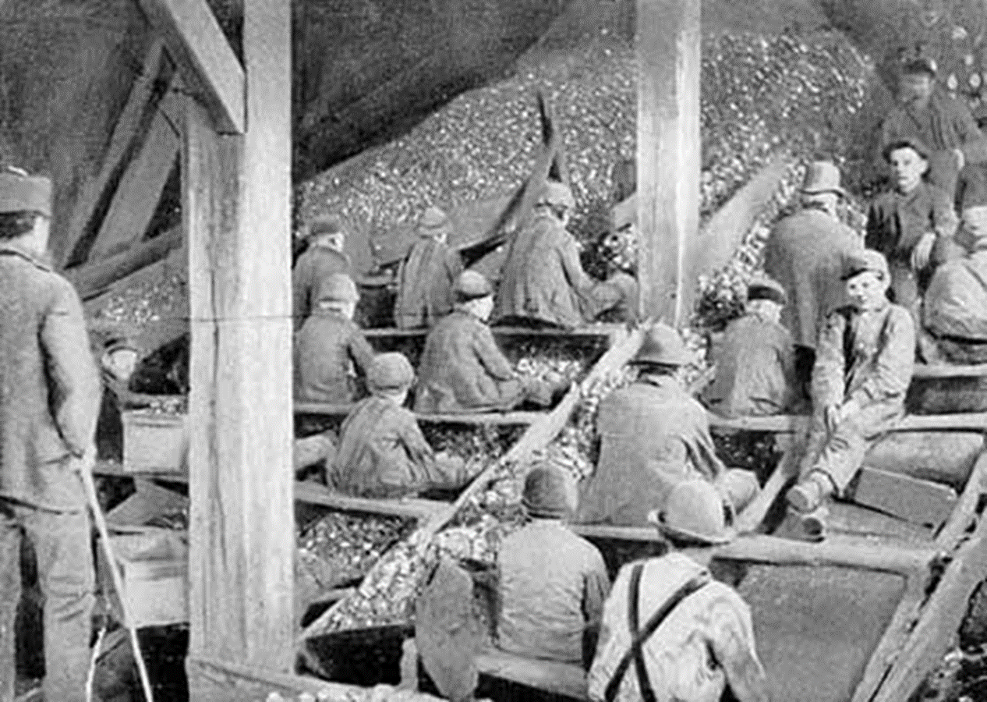
Children working in a coal mine
Notes:
The Ohio State University. (n.d.). The boys in the breakers. ehistory. https://ehistory.osu.edu/exhibitions/gildedage/content/breakerboys

Slide 11
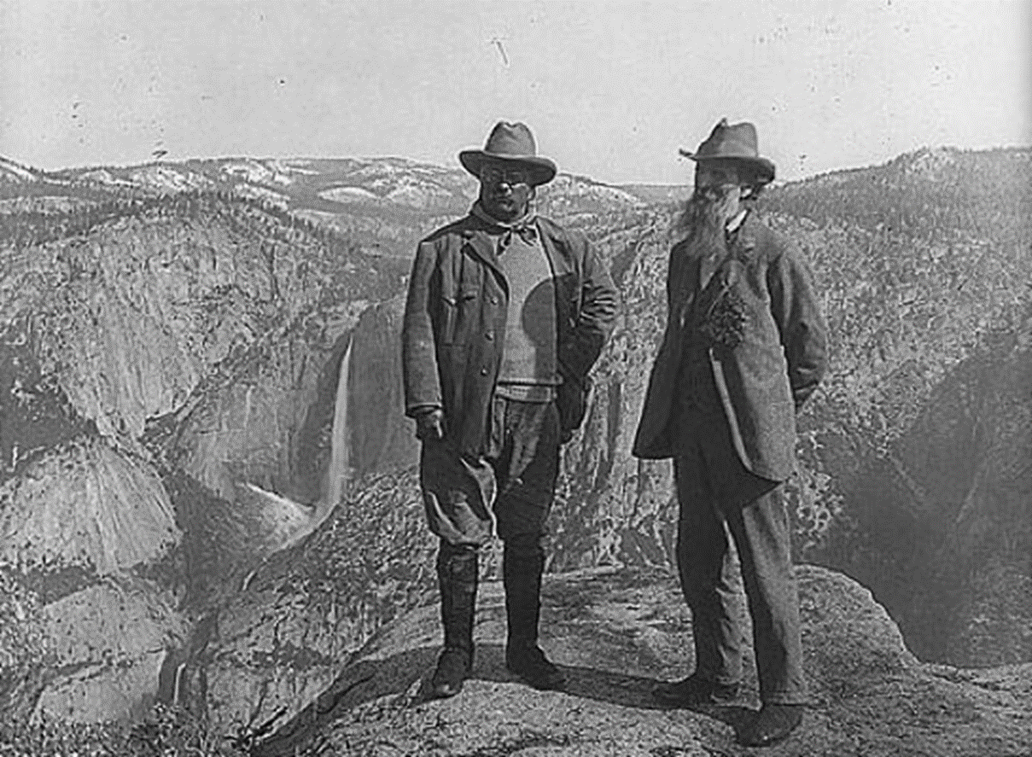
President Teddy Roosevelt and John Muir at the top of Glacier Point in Yosemite National Park
Notes:
Underwood & Underwood. (1906). U.S. president Theodore Roosevelt (left) and nature preservationist John Muir, founder of the Sierra Club, on Glacier Point in Yosemite National Park. In the background: Upper and lower Yosemite Falls. Library of Congress Collection. Wikimedia Commons. https://commons.wikimedia.org/wiki/File:Muir_and_Roosevelt_restored.jpg

Slide 12
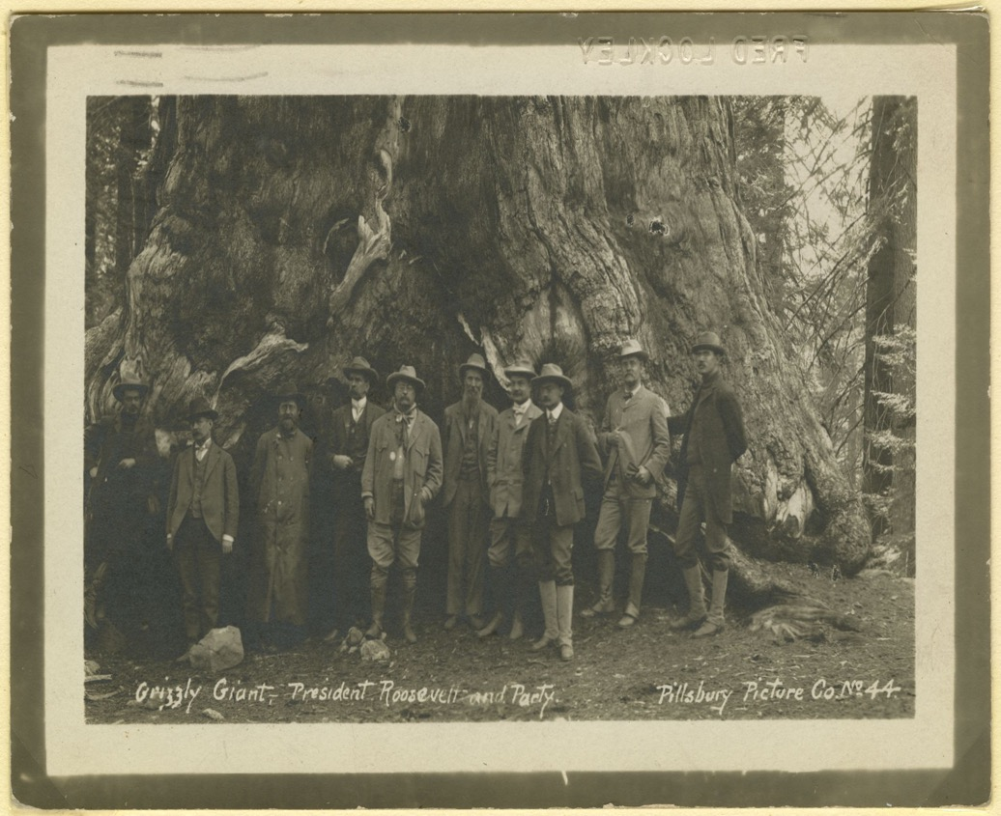
President Teddy Roosevelt in front of “Grizzly Giant” redwood in Yosemite National Park
Notes:
Pillsbury Picture Co. (1903). Grizzly giant, President Roosevelt and party. Theodore Roosevelt Birthplace National Historic Site. https://www.theodorerooseveltcenter.org/Research/Digital-Library/Record?libID=o286618

Slide 13
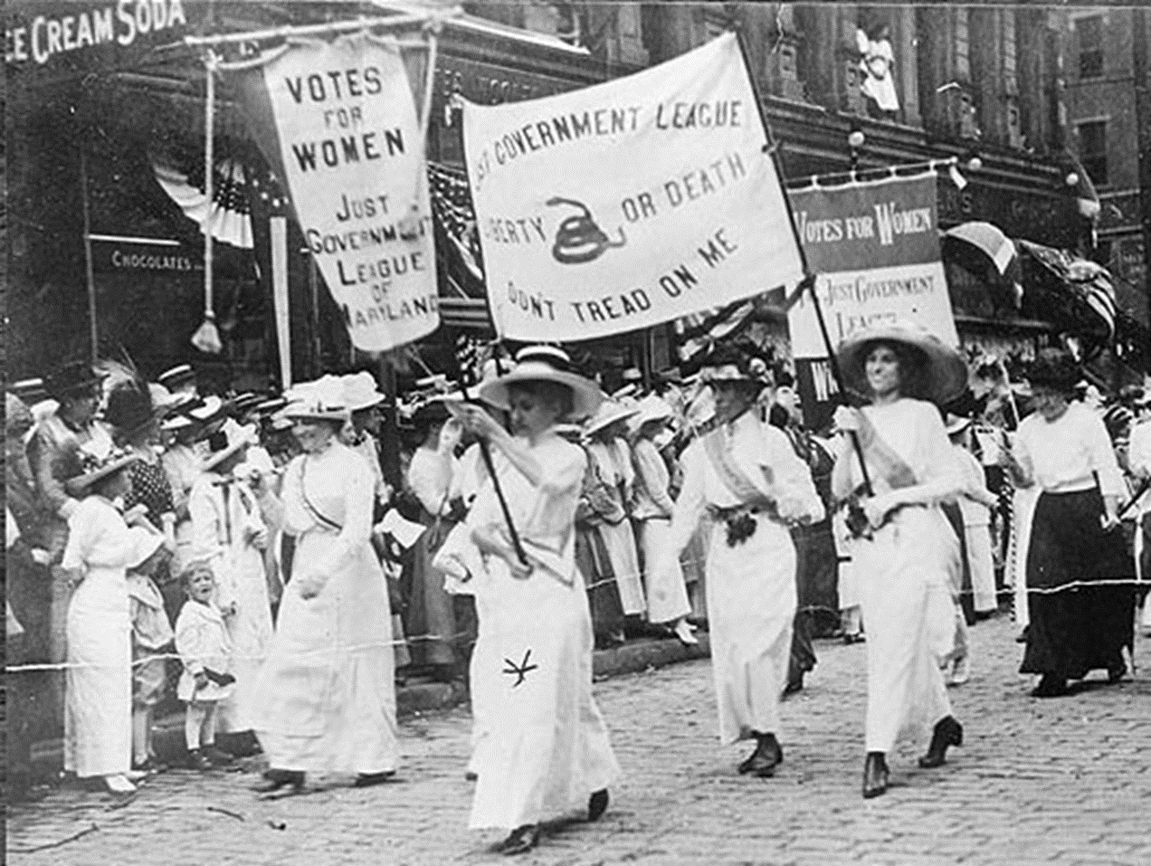
Women marching for the vote
Notes:
Unknown. (1913, March 3). The Just Government League of Maryland marching for women’s suffrage, Washington, DC, March 3, 1913. Maryland State Archives. MSA SC 2167-35. https://msa.maryland.gov/msa/stagser/s1259/153/html/0044/womenhist/wmenvote.html

Slide 14
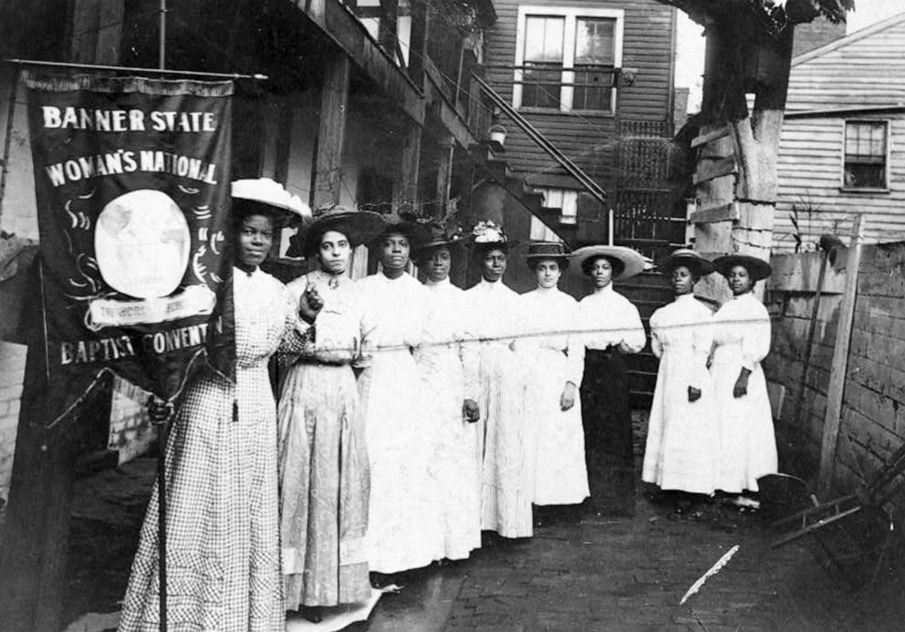
Women marching for the vote
Notes:
Unknown photographer. (c. 1905-1915). Nine African-American women posed, standing, full length, with Nannie Burroughs holding banner reading, "Banner State Woman's National Baptist Convention.” Library of Congress. https://www.loc.gov/item/93505051/

Slide 15
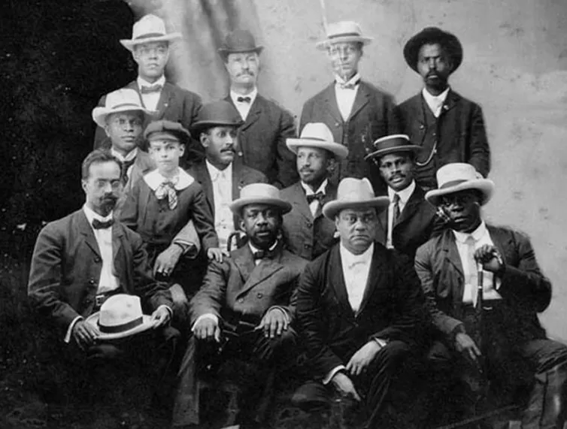
W. E. B. Du Bois seated with other men at the Niagara Conference to discuss suffrage and equal opportunity
Notes:
Unknown author. (1905). Niagara Movement: Meeting in Fort Erie, Canada, 1905. Library of Congress Collection. Wikimedia Commons. https://commons.wikimedia.org/wiki/File:Niagara_movement_meeting_in_Fort_Erie,_Canada,_1905.jpg

Slide 16
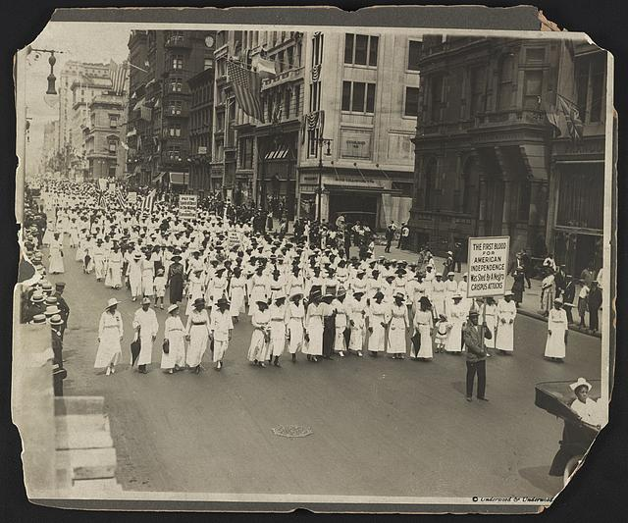
Silent Parade in New York City to protest lynchings
Notes:
Underwood & Underwood. (c. 1917). Silent protest parade in New York [City] against the East St. Louis riots, 1917. Library of Congress. https://www.loc.gov/item/95517074/

Slide 17
I Think/We Think
In groups of four, discuss the definitions of progressive from the “I Think” portion of your papers.
Discuss what the Progressive Era was about and add your common definition to the “We Think” portion of your papers.

Slide 18
Analyzing Primary Sources
Read the primary sources from the Progressive Era and use the CUS and Discuss strategy to:
Circle new words.
Underline details to support the main ideas.
Star the main ideas.
Discuss in your group what you have circled, underlined, and starred.

Slide 19
Reform Movement Presentations
Work with your group to research your assigned social reform movement and create both of the following:
A platform speech
Research the social reform movement in your textbook and online.
Clearly explain in 1-3 paragraphs why the reform is important to the nation.
Each student must speak during the presentation.
A poster
The poster should be well designed and promote your cause.

