Slide 2
More Attractive Than You Think
Newton’s Law of Gravitation

Slide 3
Essential Questions
What variables affect the force of gravity?
Why do objects attract each other?
How do graphs show the relationships between different variables?

Slide 4
Lesson Objectives
Students will intuitively understand that the force of gravity is directly related to the mass of both objects and indirectly related to the distance squared between the objects.
Students will use Newton’s Law of Gravitation to calculate the attractive force between two objects.
Given an equation, students will choose what variables to graph to create a linear relationship between the variables and will relate the slope of this graph back to the original equation.

Slide 5
Justified True Or False
In your groups, decide if the question on each slide is true or false and then write out your evidence and reasoning on your scratch paper.

Slide 6
Justified True Or False
1) The force of gravity from the earth is the same on all objects.
True | False | Justification Using Evidence
Notes:
False - If you go to a different planet or even to a different altitude on the earth, then the acceleration of gravity would change. This question is ignoring the effects of air resistance since it is specifically referencing the effect of gravity alone.

Slide 7
Justified True Or False
2) The acceleration of gravity is always 9.8m/s².
True | False | Justification Using Evidence
Notes:
False - If you go to a different planet or even to a different altitude on the earth, then the acceleration of gravity would change. This question is ignoring the effects of air resistance since it is specifically referencing the effect of gravity alone.

Slide 8
Justified True Or False
3) Accelerating downward in an elevator decreases the acceleration of gravity.
True | False | Justification Using Evidence
Notes:
False - The acceleration of the object is due to the net force on the object, which would change when the elevator accelerates. However, the acceleration of gravity is only dependent on the force of gravity divided by the mass of the object.

Slide 9
Relating Variables Graphically
In your groups, match the original graph with the description of how the original x and y variables could be graphed to create a linear graph.
Each group will be assigned to write a description of the relationship between the original x and y variable for one of the graphs for the class.

Slide 10
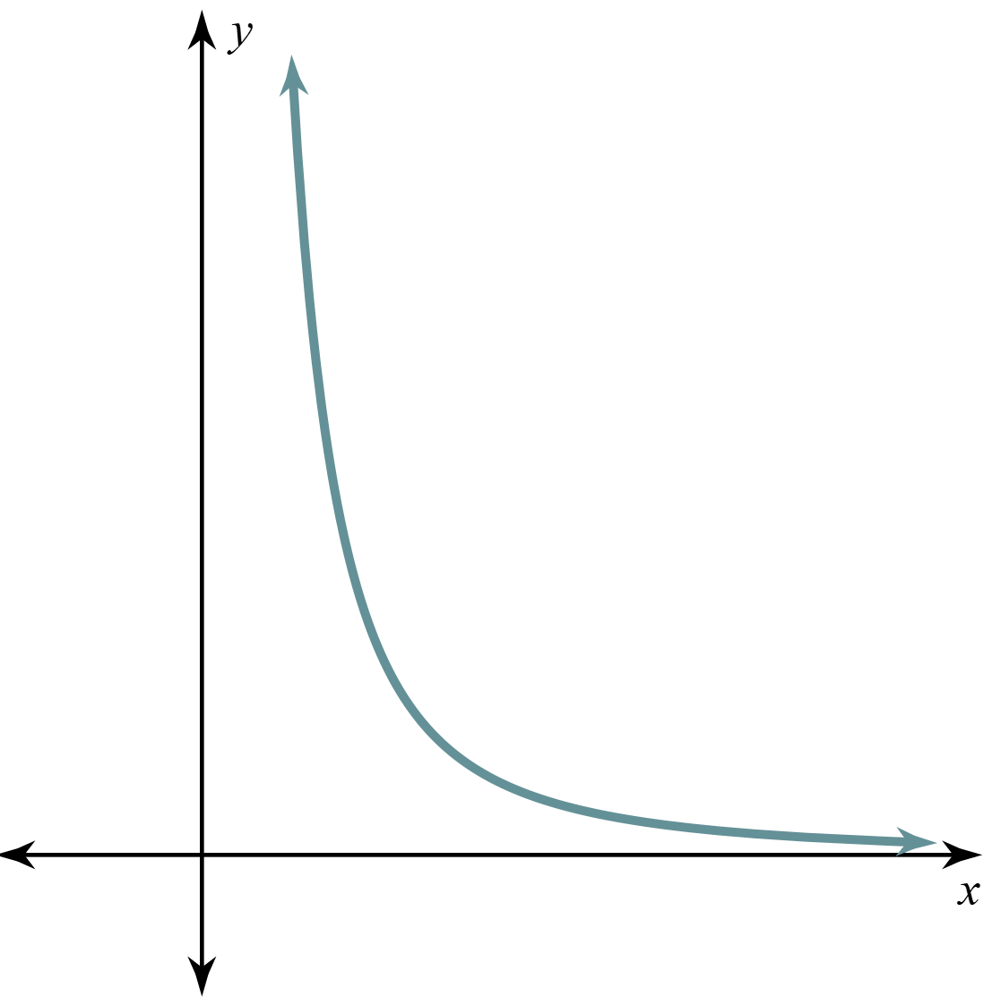
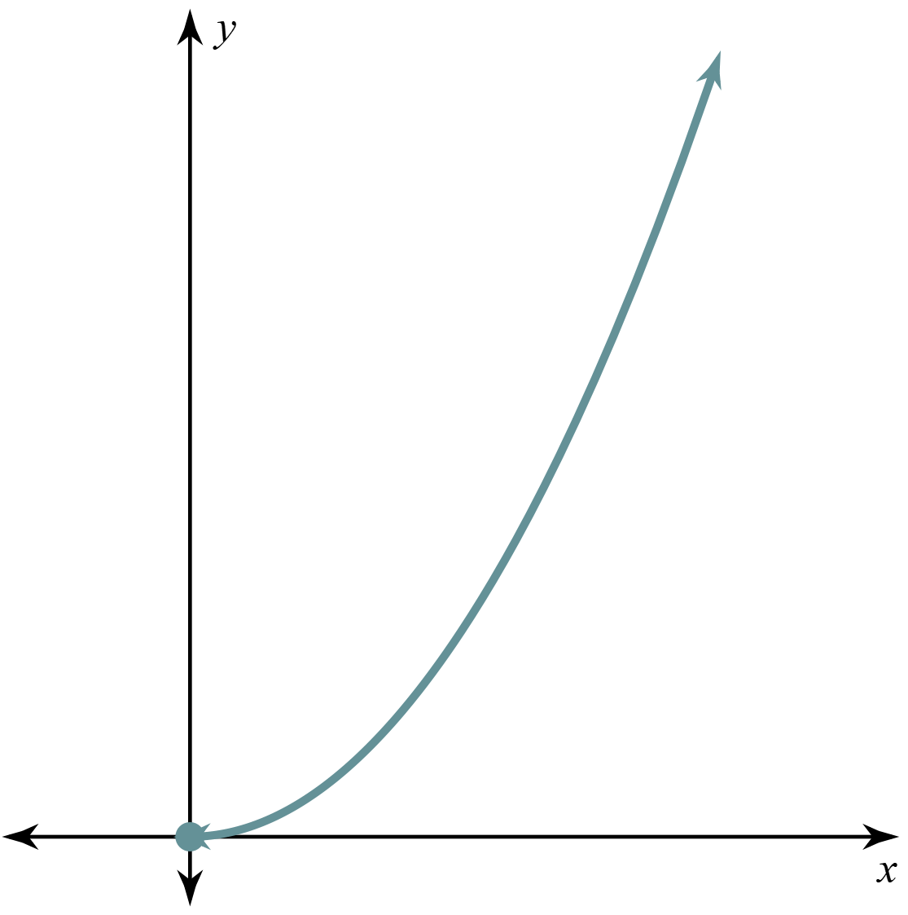
Relating Variables Graphically
x | y
1 | 4
2 | 1
3 | .44
4 | .25
If graphing y vs. x for the top graph creates the graph on the bottom, what could you try next to create a linear graph?
x⁻¹ | y
1 | 4
.5 | 1
.33 | .44
.25 | .25

Slide 11
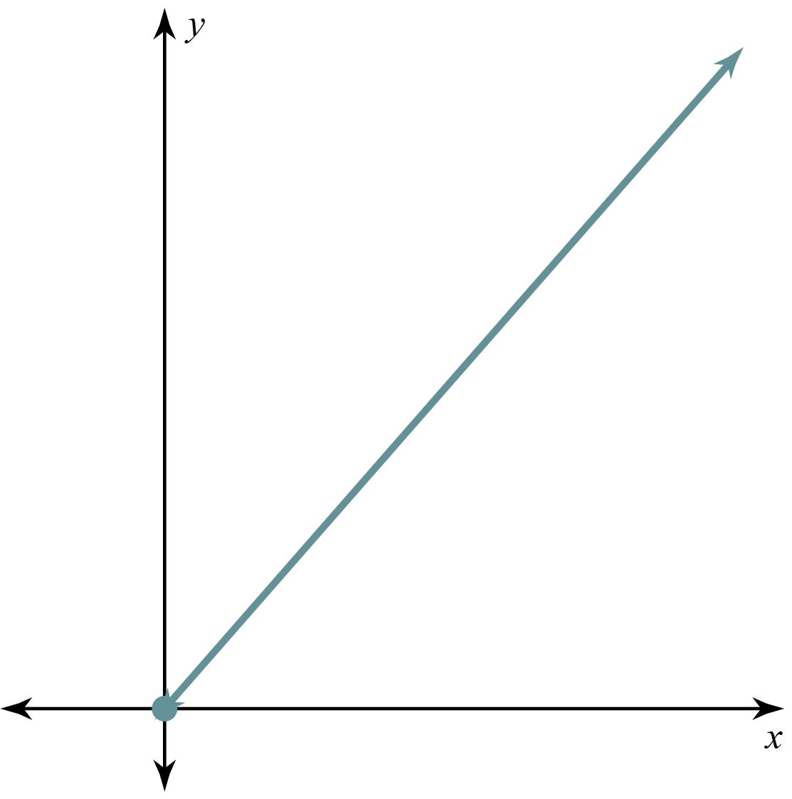
Plot y vs x
Plot y vs x⁻¹
Plot y vs. (x²)⁻¹
x | y
1 | 4
2 | 1
3 | 0.44
4 | 0.25
x⁻¹ | y
1 | 4
.5 | 1
.33 | .44
.25 | .25
(x²)⁻¹ | y
1 | 4
.25 | 1
.11 | .44
.06 | .25

Slide 12
Gravity Simulation
Work through the gravity simulation handout with a partner.
https://phet.colorado.edu/en/simulations/gravity-force-lab
Notes:
Gravity Force Lab. PhET. (n.d.). https://phet.colorado.edu/en/simulations/gravity-force-lab

Slide 13
Gravity Simulation
Write the equation you came up with in number 7 on a sticky note, and stick it on the wall.
The first group just puts their sticky note up. Every new group needs to read what is already posted.
If it agrees with one of the equations that is already posted, put the sticky note in the same column right above it.
If it is a different equation, start a new column.

Slide 14
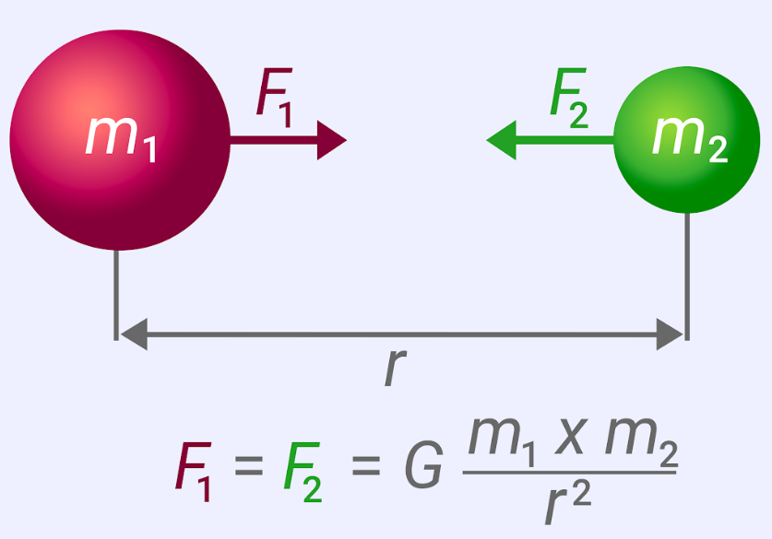
Newton’s Law of Gravitation
Complete the assigned question on the Newton’s Law of Gravity handout.
Divide into pairs to solve the question assigned to your group.

Slide 15
Newton’s Law of Gravitation
Originally Assigned | Build Consensus On
Question 1 | Question 2
Question 2 | Question 3
Question 3 | Question 4
Question 4 | Question 5
Question 5 | Question 6
Question 6 | Question 1
Each group has all of the responses for a different question to review and build consensus about what the correct answer should be.
Choose one person from the group to present the solution to the class.

Slide 16
Finding the Gravitational Constant
1) As you watch two videos, use the “I Notice / I Wonder” table on the Determining the Gravitational Constant handout to reflect on the content.
Think about how Henry Cavendish applied Newton’s Law of Gravitation to measure the gravitational constant using a torsional balance in 1798.

Slide 17
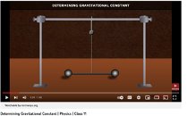
Finding the Gravitational Constant
https://www.youtube.com/watch?v=4wt0135G8kM&t=38s

Slide 18
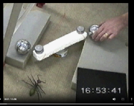
Finding the Gravitational Constant
https://www.fourmilab.ch/gravitation/foobar/videos/foobar1.webm

Slide 19
Finding the Gravitational Constant
Individually Answer:
2) Using the data table on the Gravitational Constant handout and Newton’s Universal Law of Gravity, decide what should be graphed on the x and y axis to make a linear graph and show how the slope of that graph can be used to help you calculate the Gravitational constant, G.

Slide 20
Finding the Gravitational Constant
With a Partner Answer:
3) Using the data table on the Gravitational Constant handout and Newton’s Universal Law of Gravity, decide what should be graphed on the x and y axis to make a linear graph and show how the slope of that graph can be used to help you calculate the Gravitational constant, G.

Slide 21
Finding the Gravitational Constant
As a class answer:
4) Using the data table on the Gravitational Constant handout and Newton’s Universal Law of Gravity, decide what should be graphed on the x and y axis to make a linear graph and show how the slope of that graph can be used to help you calculate the Gravitational constant, G.

Slide 22
Finding the Gravitational Constant
With a partner answer the following questions on your Gravitational Constant handout.
Turn the handout in once finished.

Slide 23
Exit Ticket
1) In a two-mass system, the mass of one of the objects and the distance between the objects was doubled.
a) Explain which factor would matter more to the force
of gravity calculation.
b) If both factors were doubled, explain if the overall
force of gravity would increase, decrease, or remain
the same.

Slide 24
Exit Ticket
2) In a two-mass system, the two spherical objects are located .6m apart. If one of the masses is 1,000 kg, the force of gravity between the objects is 5 x 10⁻⁵N and the Gravitational Constant is 6.67 x 10⁻¹¹ Nm² / kg², then what is the mass of the other object?

