Slide 2
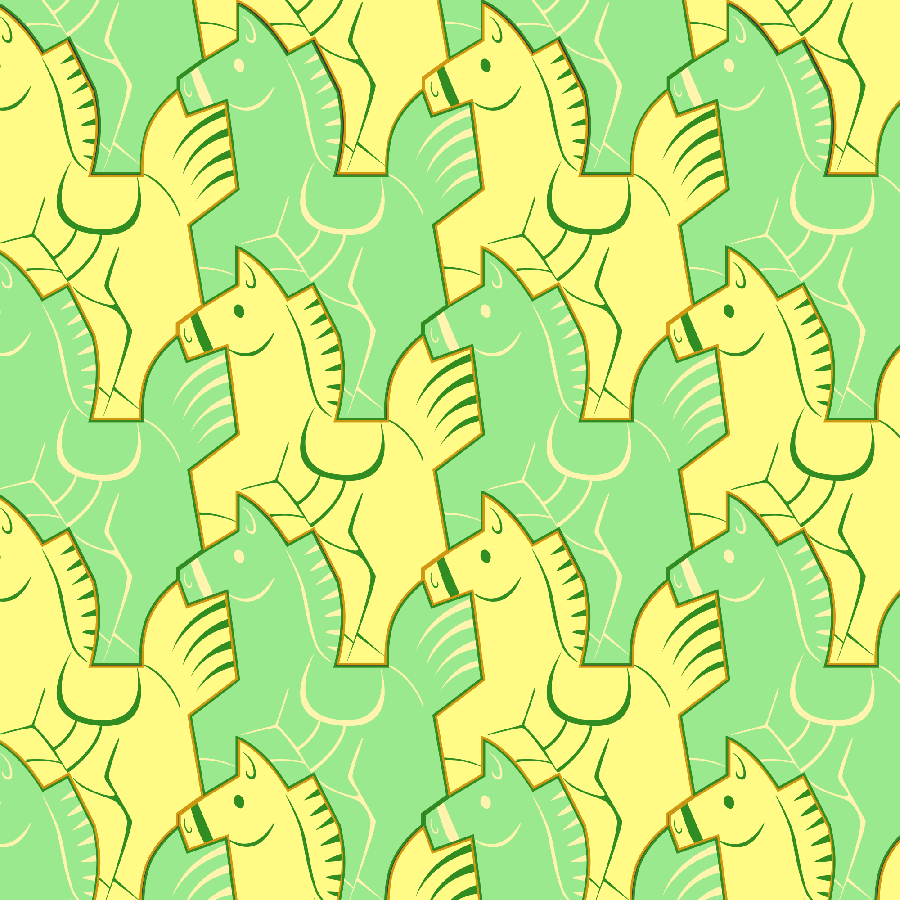
Escher's Terrific Tessellations: The Art of Tile Transformations
Comparing the Quilts of Indigenous Plains People with Tessellations of M.C. Escher

Slide 3

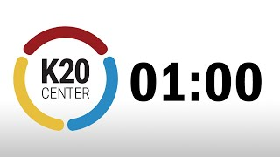
Tell Me Everything
Write everything you know about tessellations on a sheet of paper.

Slide 4
Tell Me Everything
Share what you wrote down with a partner.
As your partner shares what they wrote down, add anything to your list that you didn’t already have.

Slide 5
Essential Questions
How can an artist use the principles of design to create effective art?
How can the principles of design help an artist convey mood and meaning?

Slide 6
Learning Objectives
Students will be able to:
Understand the Principles of Design
Analyze the work of M.C. Escher

Slide 7

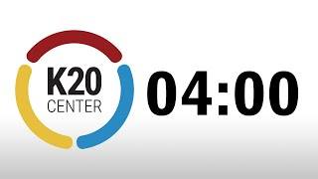

Escher Sketch
Notes:
Eschersketch. EscherSketch. (n.d.). Retrieved February 7, 2023, from https://eschersket.ch/

Slide 8
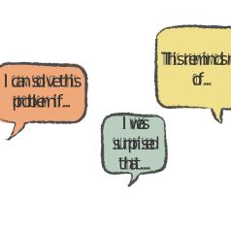
Say Something!
Write down two statements that help you share your initial thoughts and experiences using the Escher Sketch tool.
Be prepared to share these with a partner.

Slide 9
Two of a Kind: Multiple Discoveries AKA Simultaneous Invention is the Rule
“Multiple discovery also known as simultaneous invention is the hypothesis that most scientific discoveries and inventions are made independently and more or less simultaneously by multiple scientists and inventors. Great minds think alike.”
– James H. Lubowiz, Jefferson C. Brand, and Michael J. Rossi
Notes:
Lubowitz JH, Brand JC, Rossi MJ. Two of a Kind: Multiple Discovery AKA Simultaneous Invention is the Rule. Arthroscopy. 2018 Aug;34(8):2257-2258. doi: 10.1016/j.arthro.2018.06.027. PMID: 30077243.

Slide 10
Multiple Discoveries: Examples
1600s: Isaac Newton and Gottfried Leibniz both discover calculus.
1800s: Charles Darwin and Alfred Russel Wallace both describe natural selection.
1950s: Jonas Salk and Albert Bruce Sabin invent the polio vaccine.
2015: Takaaki Kajita and Arthur B. McDonald’s discoveries of neutrinos.

Slide 11
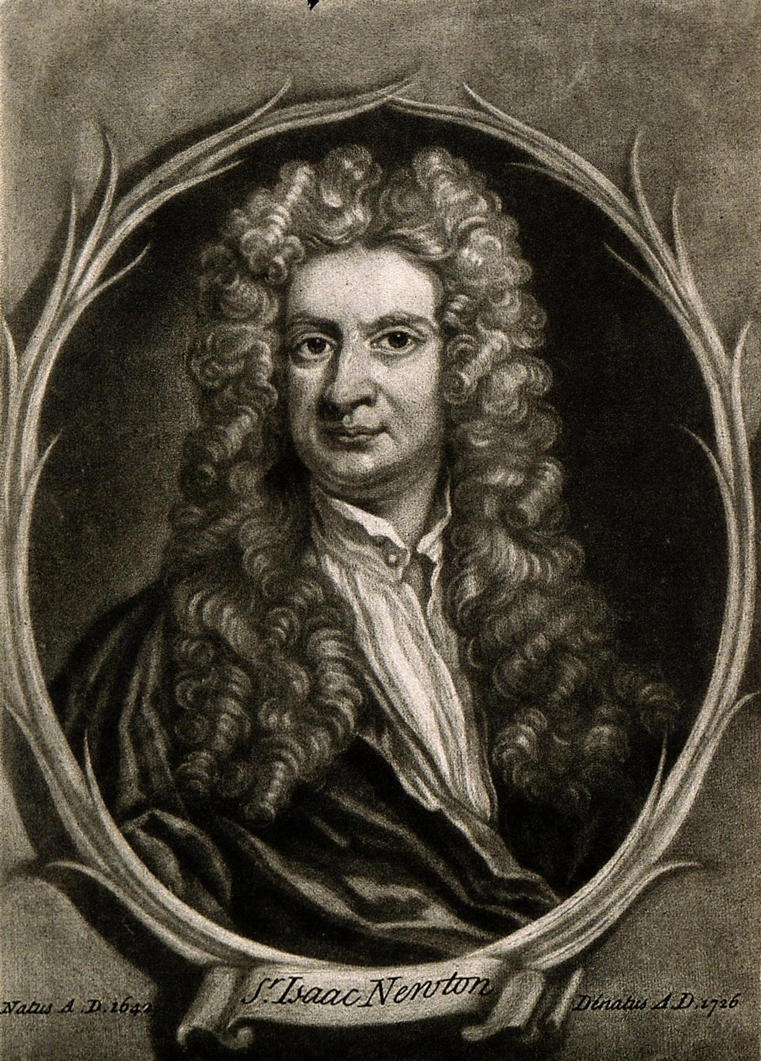
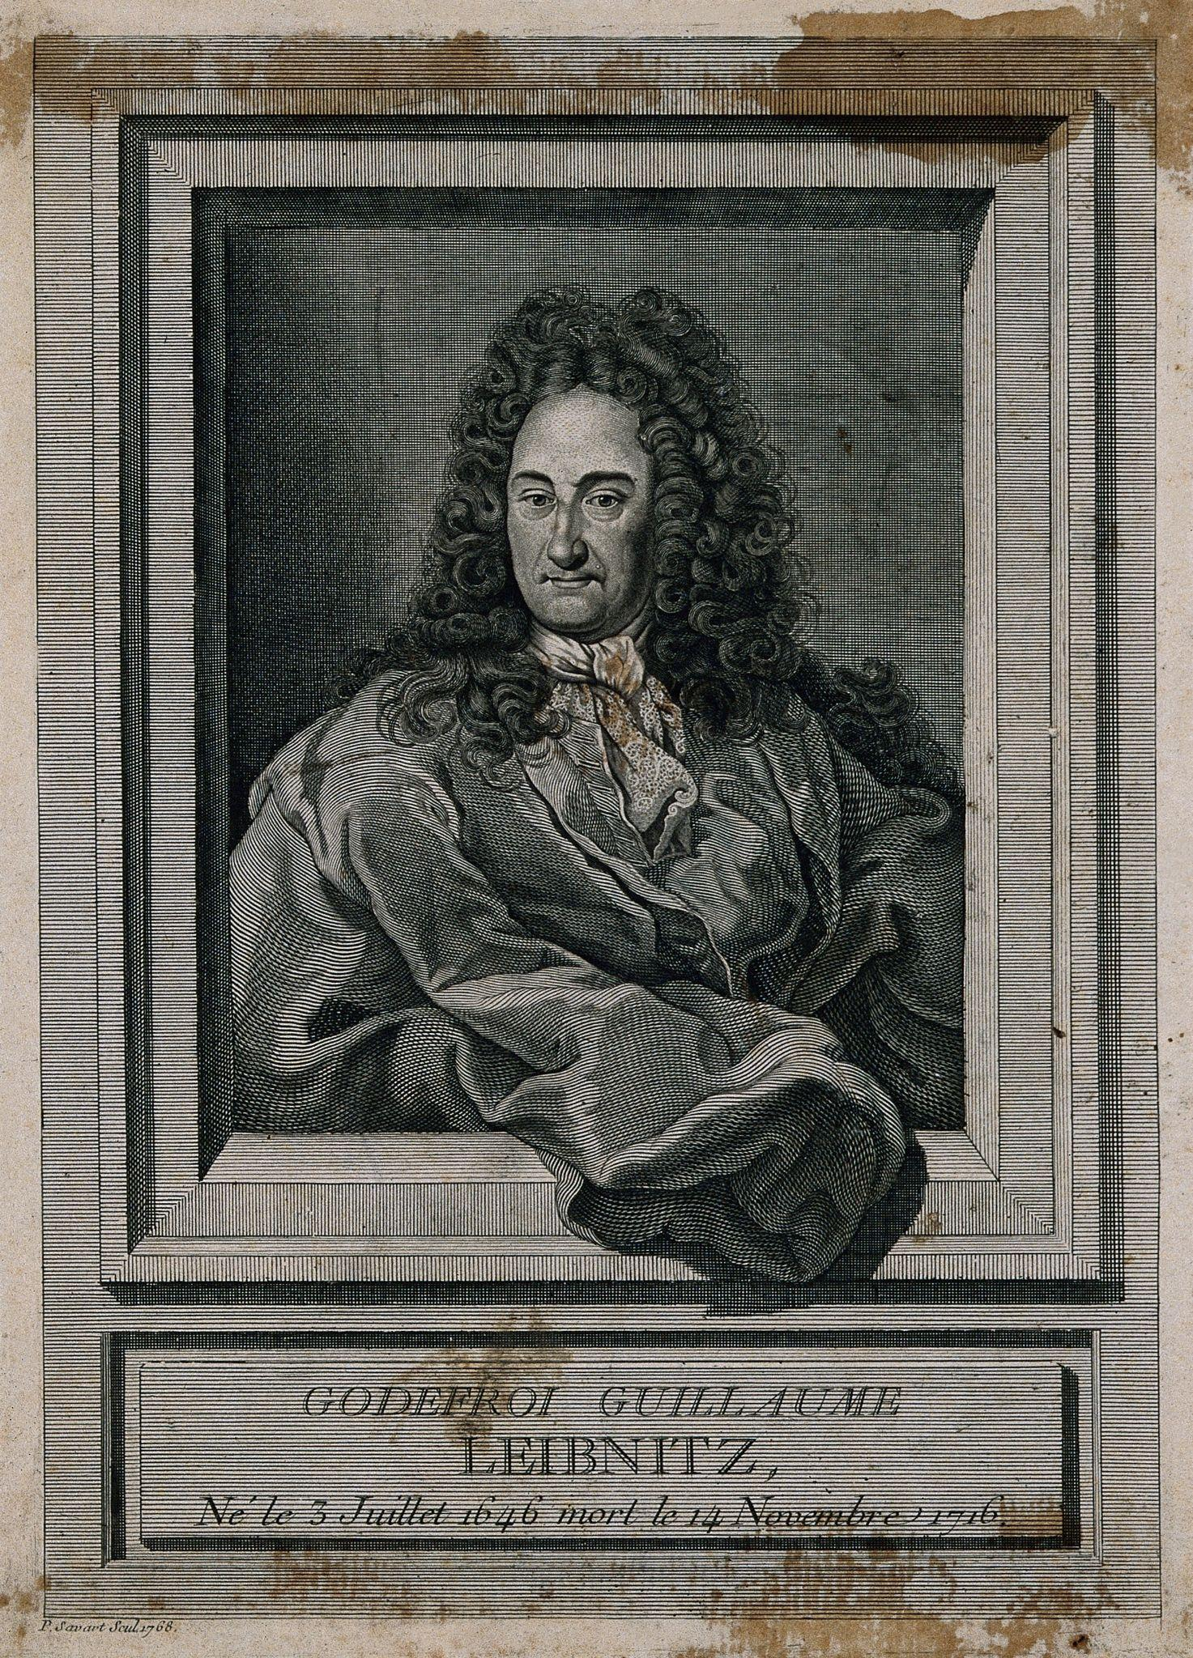
Isaac Newton and Gottfried Wilhelm Leibniz
Both discovered calculus.
Leibniz published Nova Methodus pro Maximis et Minimis in 1684.
Newton claimed he made the same discovery twenty years prior.
Leibniz asked the English Royal Society, the world’s oldest scientific academy, to investigate. The ERS found Leibniz guilty of plagiarism.
Although the ERS found Leibniz guilty, the modern consensus is that the two men both discovered calculus independently.
Isaac Newton
Gottfried Leibniz
Notes:
Fæ. (2014). Sir Isaac Newton. Wikimedia Commons. Retrieved June 26, 2023, from https://commons.wikimedia.org/wiki/File:Sir_Isaac_Newton._Wellcome_V0006785EL.jpg.
Fæ. (2014a). Gottfried Wilhelm, Baron von Leibniz. Line engraving by P. S. Wikimedia Commons. Retrieved June 26, 2023, from https://commons.wikimedia.org/wiki/File:Gottfried_Wilhelm,_Baron_von_Leibniz._Line_engraving_by_P._S_Wellcome_V0003475.jpg.

Slide 12
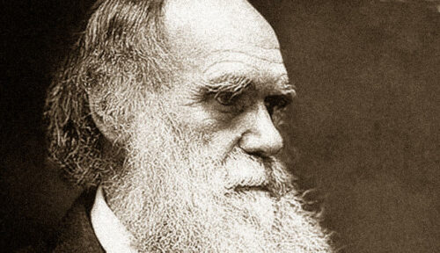
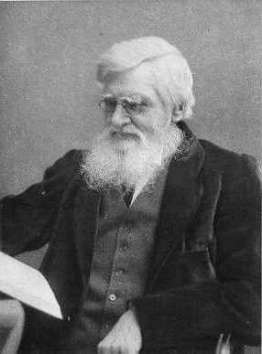
Alfred Russel Wallace Page and Charles Darwin
Both discovered natural selection.
Both cited Thomas Malthus’s Essay on the Principle of Population as inspiration.
Darwin started his research in the 1830s but didn’t publish. Wallace supplied Darwin with birds for those studies. Wallace sent Darwin a theory in 1858 that mirrored Darwin’s own theory.
Both were invited to present to the Linnaean Society in 1858.
Darwin publish On the Origin of Species in 1859 while Wallace continued to study biogeography.
Charles Darwin
Alfred Wallace
Notes:
UC Museum of Paleontology. (2021, November 16). Natural selection: Charles Darwin & Alfred Russel Wallace - Understanding evolution. Understanding Evolution - Your one-stop source for information on evolution. Retrieved February 8, 2023, from https://evolution.berkeley.edu/the-history-of-evolutionary-thought/1800s/natural-selection-charles-darwin-alfred-russel-wallace/

Slide 13
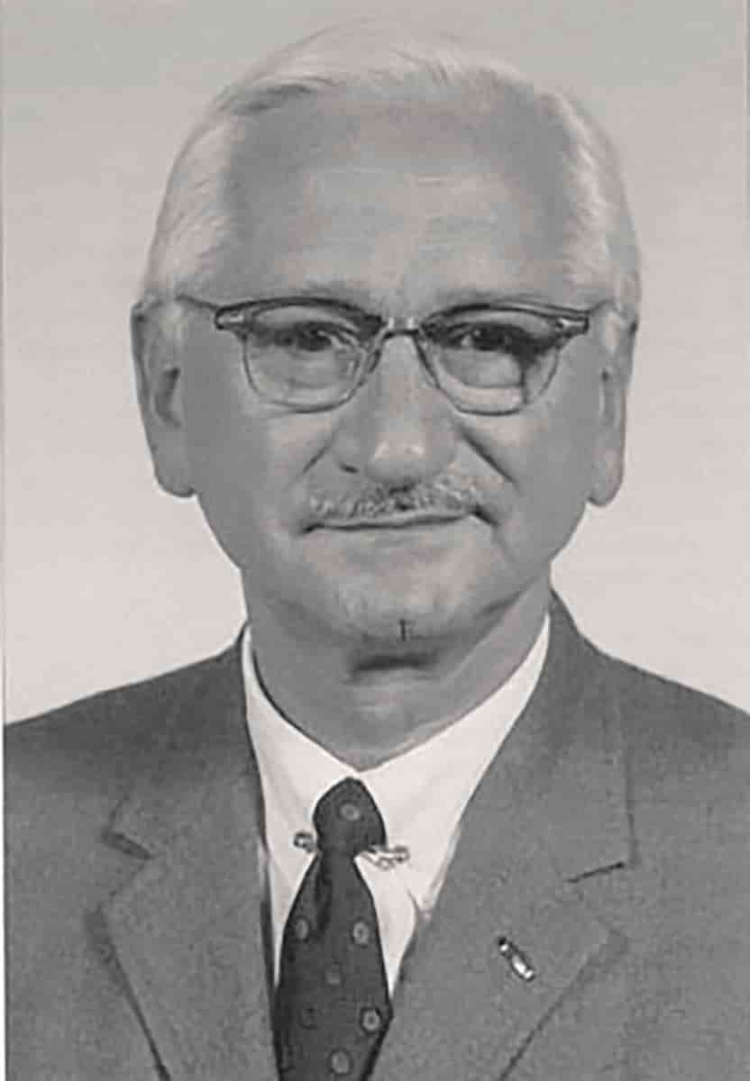
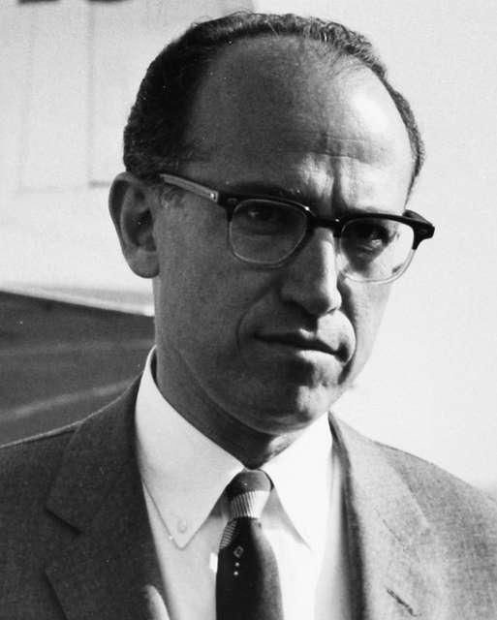
Jonas Salk and Albert Bruce Sabin
Both are prominent scientists who made significant contributions to the field of polio vaccination.
Jonas Salk was a medical researcher who developed the first successful killed-virus polio vaccine in the 1950s.
  The vaccine used inactivated injected polio virus
  It also provided immunity against three strains of poliovirus.
Albert Bruce Sabin, also a medical researcher, developed the oral polio vaccine.
  Sabin used a weakened live polio virus.
  The vaccine provided immunity to the intestinal and respiratory routes of the virus.
Jonas Salk
Albert Bruce Sabin
Notes:
SAS Scandinavian Airlines. (n.d.). Dr Jonas Edward Salk. picryl. Retrieved June 26, 2023, from https://picryl.com/media/dr-jonas-edward-salk-cropped-cropped-15a73f.
Saperstejn, A. (n.d.). Albert Bruce Sabin. STORE NORSKE LEKSIKON. Retrieved June 26, 2023, from https://snl.no/Albert_Bruce_Sabin.

Slide 14
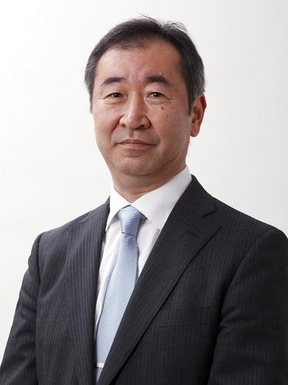
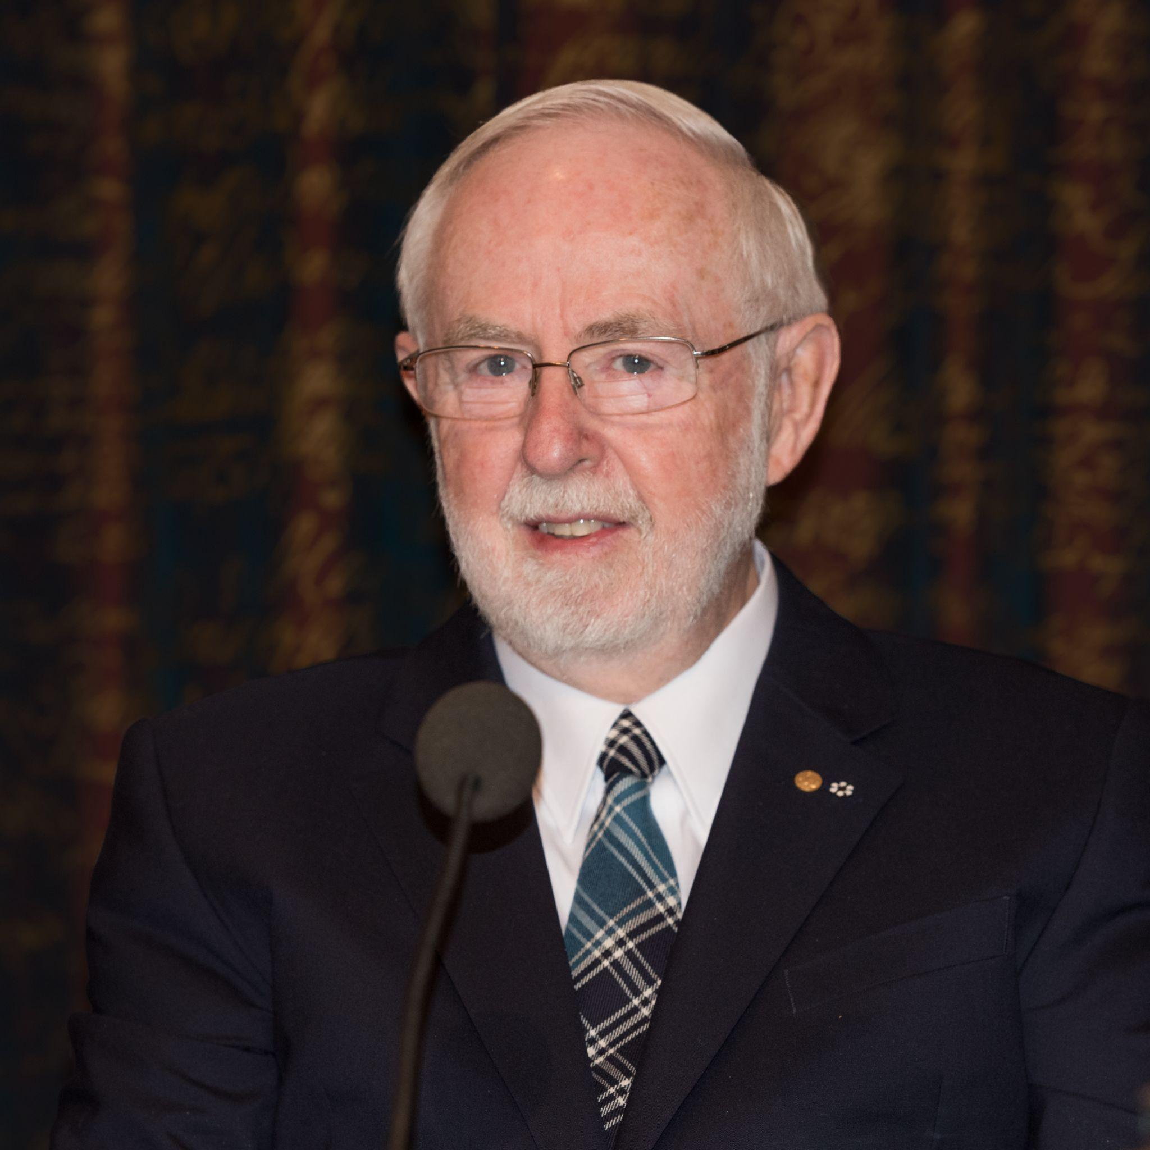
Takaaki Kajita and Arthur B. McDonald
Both are renowned physicists who were awarded the Nobel Prize in Physics in 2015 for their discoveries of neutrinos.
They both focused on subatomic particles that are neutral and have nearly zero mass which originated from cosmic sources, such as the sun and supernova.
They independently made significant discoveries that demonstrate that neutrinos undergo a phenomenon known as neutrino oscillation, which implies that they can change their flavor (types of particles they are) as they travel through space!
  Takaaki Kajita, a Japanese physicist, conducted his research at the Super-Kamiokande detector in Japan.
  Arthur B. McDonald conducted his experiments at the Sudbury Neutrino Observatory in Canada.
Arthur B. McDonald
Takaaki Kajita
Notes:
Nyman, B. (2015). Arthur B. McDonald. Wikimedia Commons. Retrieved June 26, 2023, from https://commons.wikimedia.org/wiki/File:Arthur_B._McDonald_5139-2015.jpg.
Takaaki Kajita. (n.d.). Wikimedia Commons. Retrieved June 26, 2023, from https://commons.wikimedia.org/wiki/File:Takaaki_Kajita_cropped_1_Takaaki_Kajita_202010.jpg.

Slide 15
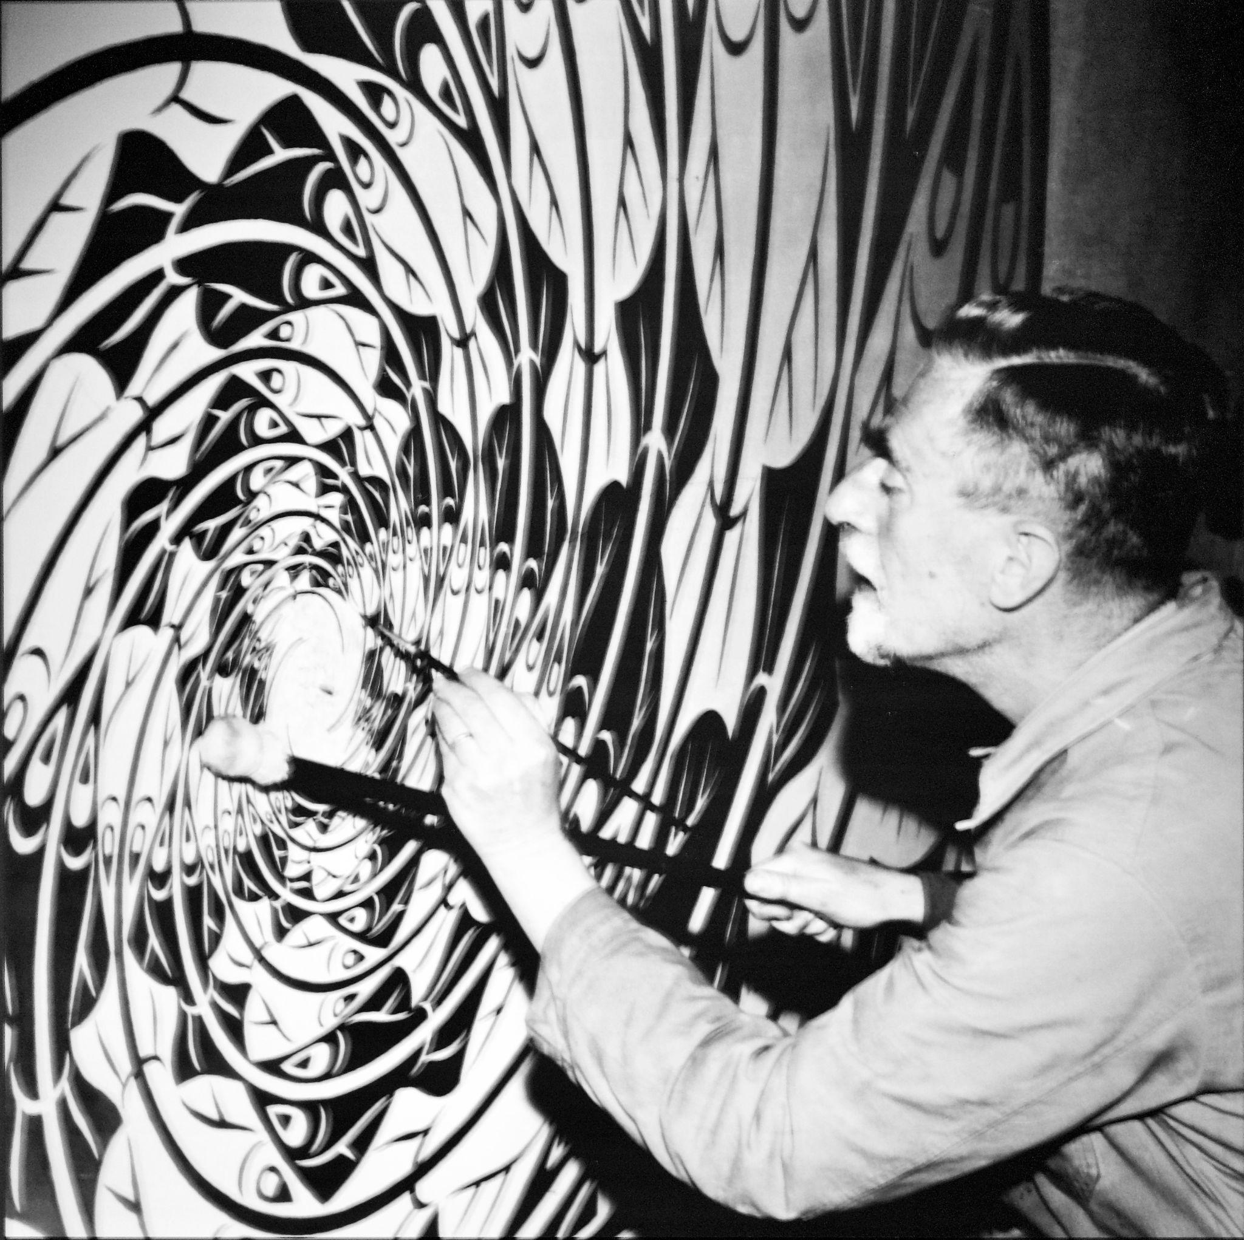
Who was M.C. Escher?
Maurits Cornelis Escher
Born: June 17, 1898
Died: March 27, 1972
Notable work:
  Hand with Reflecting Sphere (1935)
  Relativity (1953)
  Waterfall (1961)
Notes:
Simōes, P. R. (2017). The Artist -Maurits Cornelelius Escher- working at his Atelier. Wikimedia Commons. Retrieved March 1, 2023, from https://commons.wikimedia.org/wiki/File:The_Artist_-Maurits_Cornelelius_Escher-_working_at_his_Atelier_%2850385403156%29.jpg.

Slide 16
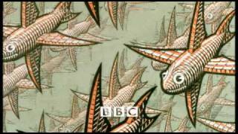
The Mathematical Art of M.C. Escher
Notes:
YouTube. (2009). The Mathematical Art Of M.C. Escher. YouTube. Retrieved February 7, 2023, from https://www.youtube.com/watch?v=Kcc56fRtrKU&t=238s.

Slide 17
Tessellation
/ˌtesəˈlāSH(ə)n/
noun
An arrangement of shapes closely fitted together, especially of polygons in a repeated pattern without gaps or overlapping.

Slide 18
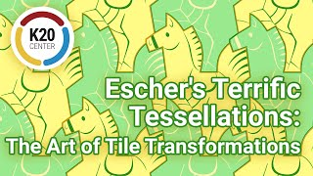

Slide 19
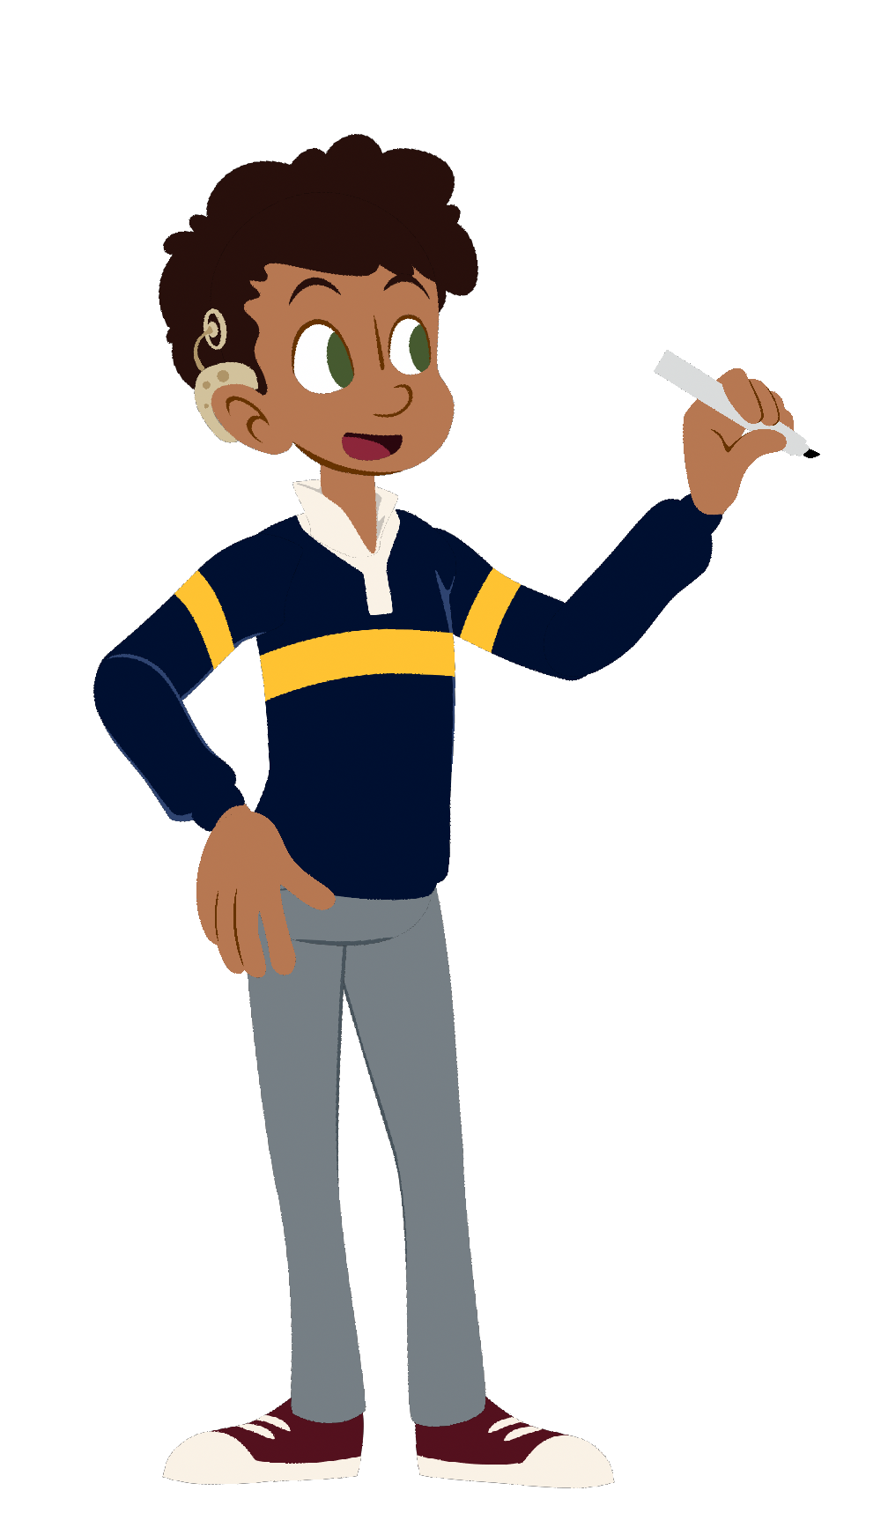
Create a Tessellation of Your Own
Create your own pattern with a sticky note.
Lightly trace the pattern onto your paper.
Color and detail your pattern using two alternate colors.

Slide 20
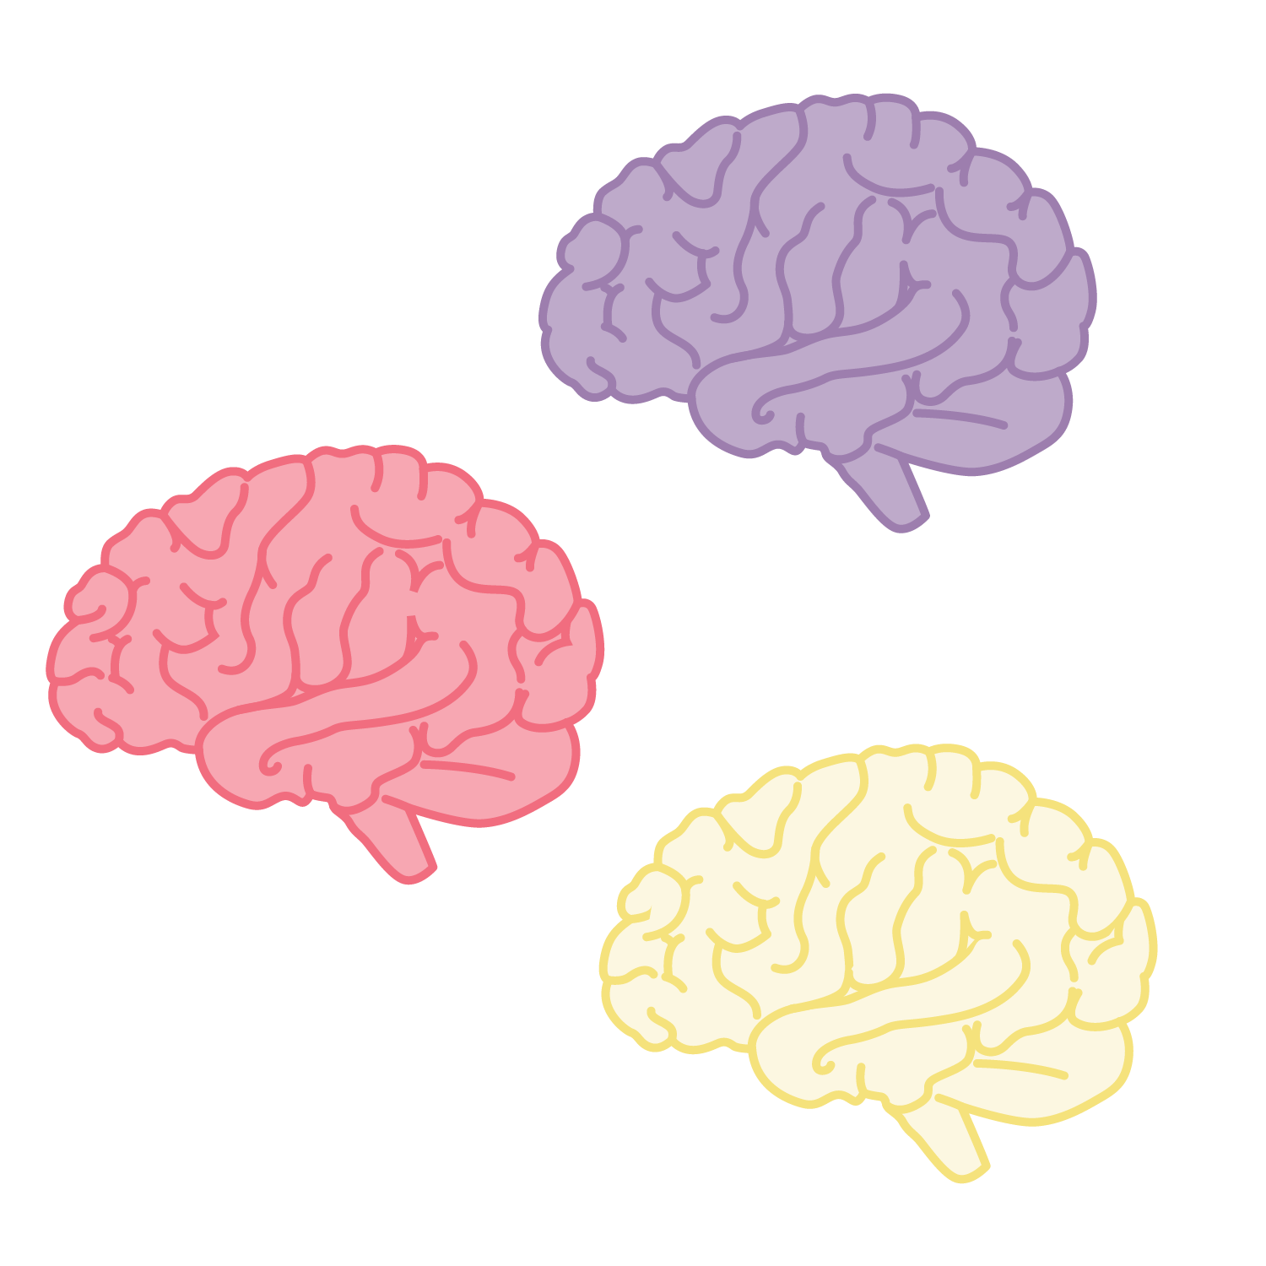
Collective Brain Dump
What word would you use to describe your tessellation project?

Slide 21
Design Principles
Consider the words you just used to describe your work.
Do any of the principles of design match what you described?
Did you see those same principles in the first activity?

Slide 22
Balance
A distribution of visual weight on either side of the vertical axis.
Symmetrical balance uses the same characteristics.
Asymmetrical uses different but equally weighted features.

Slide 23
Emphasis or Focal Point
Used to make certain parts of an artwork stand out. It creates the center of interest or focal point. It is the place in which an artist draws your eye to first.

Slide 24
Contrast
Difference in theme, imagery, and color to strengthen the other principles of the piece.
The arrangement of opposite elements in a composition so as to create visual interest.
  Light versus dark
  Rough versus smooth
  Small versus large

Slide 25
Movement
How the eye moves through the composition, leading the attention of the viewer from one aspect of the work to another.
Using line, shape, and form to create the illusion of motion.

Slide 26
Pattern
Systematic and repetitive use of the same motif or design.
The repetition of specific visual elements such as a unit of shape or form.
A method used to organize surfaces in a consistent regular manner.

Slide 27
Rhythm
Regular repetition or alteration in elements to create cohesiveness through aspects like elements, shapes, colors, or patterns with intentional subtle variations.

Slide 28
Unity
Using compositional elements to create harmony and wholeness to a work.
Visually pleasing agreement among the elements in a design.
The feeling that everything in the work of art works together and looks like it fits.

Slide 29
Variety
Using compositional elements to create tension and dissonance in a work.

Slide 30
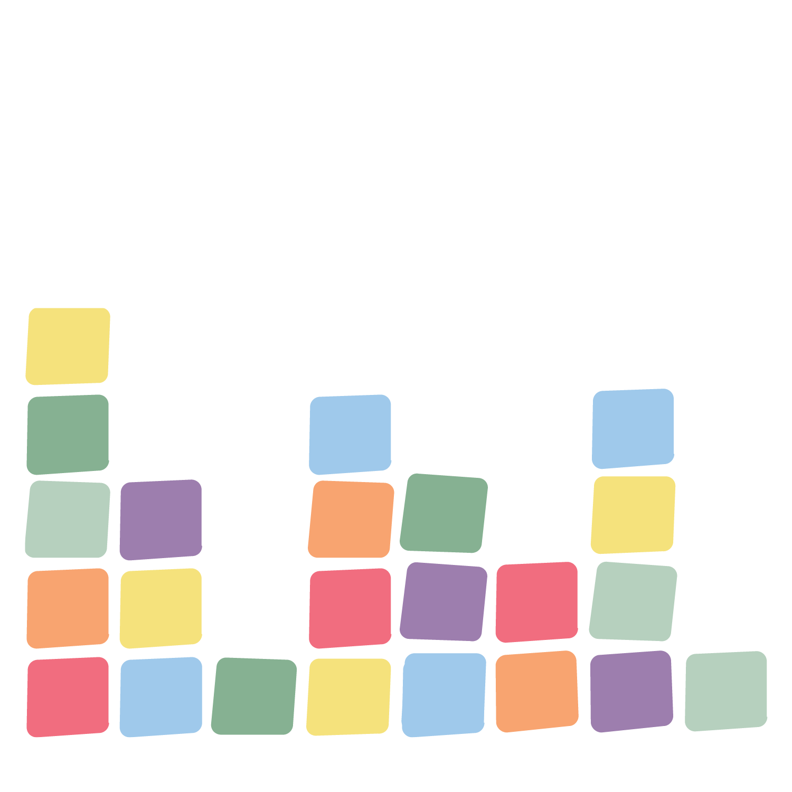

Sticky Bars
Place your sticky note on the board under the principle of design that best represents your tessellation design.
With those who selected the same principle as you, discuss why you believe it is the most applicable design to your work.

Slide 31
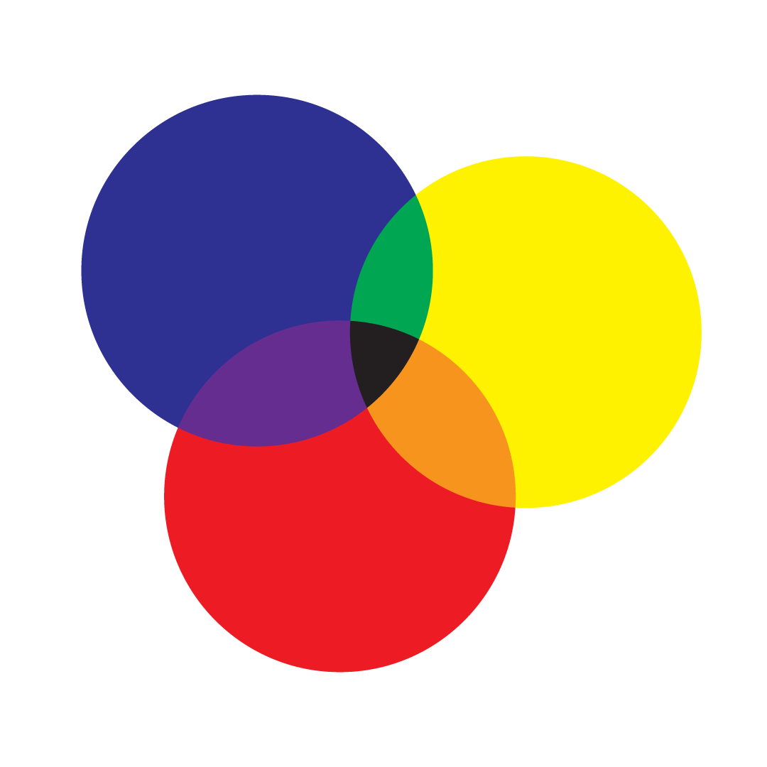
Venn Diagram
Take a few minutes to reflect on the two activities;
  Quilt patterning from the Plains Tribes
  Tessellations of M.C. Escher
How are they unique?
How are they similar?
Fill in your Venn diagram as you reflect on your work.

Slide 32
Venn Diagram
Similar characteristics
Quilting patterns from the Plains tribes
Tessellations of M.C. Escher

