Slide 2
Stick to the Script

Slide 3
Essential Questions
How can a screenwriter correctly write a screenplay that can be read by actors, directors, and producers?
Why is it important to align your screenplay to the elements of story structure?

Slide 4
Learning Objectives
Recognize the difference between a script and the final version of a scene in a movie.
Write an abbreviated script for a movie scene.
Apply the different elements of script formatting to a movie script.

Slide 5
Script Versus Screen Venn Diagram
As you watch the video consider:
The script along the bottom of the screen
The actor, director, and producer’s interpretation of the script
How are they unique?
How are they similar?
Fill in your Venn diagram as you watch the clip
Notes:
K20 Center. (n.d.). Venn diagram. Strategies. Retrieved from https://learn.k20center.ou.edu/strategy/2918

Slide 6
Venn Diagram
What is present in both the script and what you see on screen?
Script - What is present in the script but does not appear on screen?
Screen - What appears on screen but is not present in the script?
Notes:
K20 Center. (n.d.). Venn diagram. Strategies. Retrieved from https://learn.k20center.ou.edu/strategy/2918

Slide 7
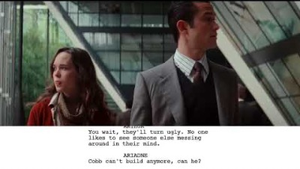
Inception
https://www.youtube.com/watch?v=Gi8eTnk844E
Notes:
From Script to Screen. (2017a). From Script to Screen - Inception - Paradoxical Architecture Scene. YouTube. YouTube. Retrieved from https://www.youtube.com/watch?v=Gi8eTnk844E.

Slide 8
Venn Diagram
What is present in both the script and what you see on screen?
Script - What is present in the script but does not appear on screen?
Screen - What appears on screen but is not present in the script?
Notes:
K20 Center. (n.d.). Venn diagram. Strategies. Retrieved from https://learn.k20center.ou.edu/strategy/2918

Slide 9
Mingle
While the music is playing, ”mingle” around the room.
Notes:
K20 Center. (n.d.).Mingle. Strategies. Retrieved from https://learn.k20center.ou.edu/strategy/53

Slide 10
Mingle
Create a group of four (4).
Compare what you put in your Venn Diagram with your classmates.
Add any new details and ideas on your paper.
Notes:
K20 Center. (n.d.).Mingle. Strategies. Retrieved from https://learn.k20center.ou.edu/strategy/53

Slide 11
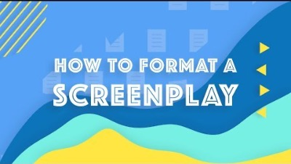
How to Format a Screenplay
https://youtu.be/_2uZ7IabVOM
Notes:
StudioBinder. (2017). How to Format a Screenplay: Screenplay Formatting 101. YouTube. Retrieved from https://youtu.be/_2uZ7IabVOM.

Slide 12
What is a Table Read?
A table read (also known as a read-through) is an organized reading of a script in which the speaking parts, stage directions, and scene headings are read out loud.
Notes:
K20 Center. (n.d.). Fishbowl. Strategies. Retrieved from https://learn.k20center.ou.edu/strategy/3053?rev=24998

Slide 13
Fishbowl
Inner Circle
Outer Circle
Participates in a table read
Interprets the script according to the post-production notes
Be prepared to answer questions about how and why they interpreted the script the way they did
Observes the table read
Takes notes on how the group interpreted their script
Ask questions of the group about how and why they interpreted the script the way they did
Notes:
K20 Center. (n.d.). Fishbowl. Strategies. Retrieved from https://learn.k20center.ou.edu/strategy/3053?rev=24998

Slide 14
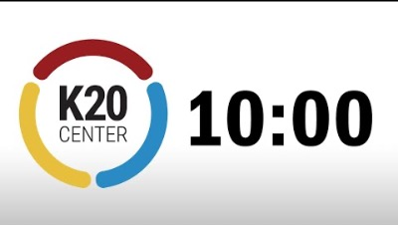
View scripts-Fishbowl
Take 10 minutes to review the script with your group and determine how you will interpret what you are reading.
Notes:
K20 Center. (n.d.). Fishbowl. Strategies. Retrieved from https://learn.k20center.ou.edu/strategy/3053?rev=24998
YouTube. (2021b, September 21). K20 Center 10 minute timer. YouTube. https://www.youtube.com/watch?v=9gy-1Z2Sa-c

Slide 15
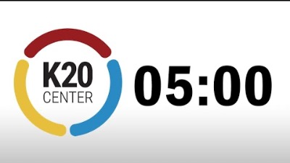
View scripts-Fishbowl
Take 5 minutes to review the script with your group and determine how you will interpret what you are reading.
Notes:
K20 Center. (n.d.). Fishbowl. Strategies. Retrieved from https://learn.k20center.ou.edu/strategy/3053?rev=24998
YouTube. (2021, September 21). K20 Center 5 minute timer. YouTube. https://www.youtube.com/watch?v=EVS_yYQoLJg

Slide 16
Fishbowl
Inner Circle
Outer Circle
Participates in a table read
Interprets the script according to the post-production notes
Be prepared to answer questions about how and why you interpreted the script the way you did
Observes the table read
Takes notes on how the group interpreted their script
Ask questions of the group about how and why they interpreted the script the way they did
Notes:
K20 Center. (n.d.). Fishbowl. Strategies. Retrieved from https://learn.k20center.ou.edu/strategy/3053?rev=24998

Slide 17
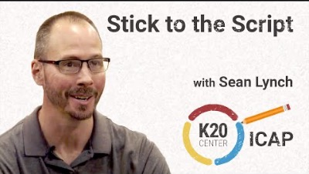
ICAP Video
https://www.youtube.com/watch?v=wVt_5tNS9c4
Notes:
YouTube. (2023, August 30). K20 ICAP - Professor of Digital Cinema - stick to the script. YouTube. https://www.youtube.com/watch?v=wVt_5tNS9c4

Slide 18
Point of Most Significance (POMS)
What was the most significant point from the video?
Notes:
K20 Center. (n.d.). Poms: point of most significance strategies. Retrieved from https://learn.k20center.ou.edu/strategy/101​​​​​​​

Slide 19
Script Writing
Split into teams/groups of three
Each member selects one of the following roles to complete on their own:
Scene Description
Character Description/Post-Production
Dialogue
Once you combine your writing, the group will complete post-production together

Slide 20
Script Reader
A Script Reader (or Script Analyst) - reads the script to evaluate the components of a screenplay to determine if a studio or produce would consider it. They focus on:
Plot (summary)
Characterization
Themes
Tones
Markability
Then they write a report over the script called coverage.

Slide 21
I Used to Think…But Now I Know
Reflect on what you knew, or thought you knew, about script reading before and after participating in this activity.
Notes:
K20 Center. (n.d.). I used to think . . . but now I know. Strategies. Retrieved from https://learn.k20center.ou.edu/strategy/137

