Slide 2
When the Hurly-Burly’s Done
Examining Intrinsic & Extrinsic Motivation Through Character Analysis in Macbeth

Slide 3
Essential Questions
What drives your actions?
What drives Shakespeare’s characters in Macbeth?

Slide 4
Lesson Objectives
Identify and describe the assigned character’s intrinsic and extrinsic motivations.
Explain that character’s significance in the story of Macbeth.

Slide 5
Bell Ringer
What drives your everyday actions?
Why do you go or not go to school?
Why do you complete or not complete assigned work?
Why do you go to work or not go to work?
Why do you go to church or not go to church?
Notes:
K20 Center. (n.d.). Bell Ringers and Exit Tickets. Strategies. https://learn.k20center.ou.edu/strategy/125

Slide 6
Extrinsic VS. Intrinsic: What Motivates Us
My actions are motivated by the outcome.
Maybe I will get a promotion, a bonus, or a raise.
What is the prize, benefit, or perk?
My actions are motivated by my interest and joy.
I will complete this task because I find it interesting.
The perk is expressing myself.
Extrinsic: Motivated by external things
Intrinsic: Motivated by internal things

Slide 7
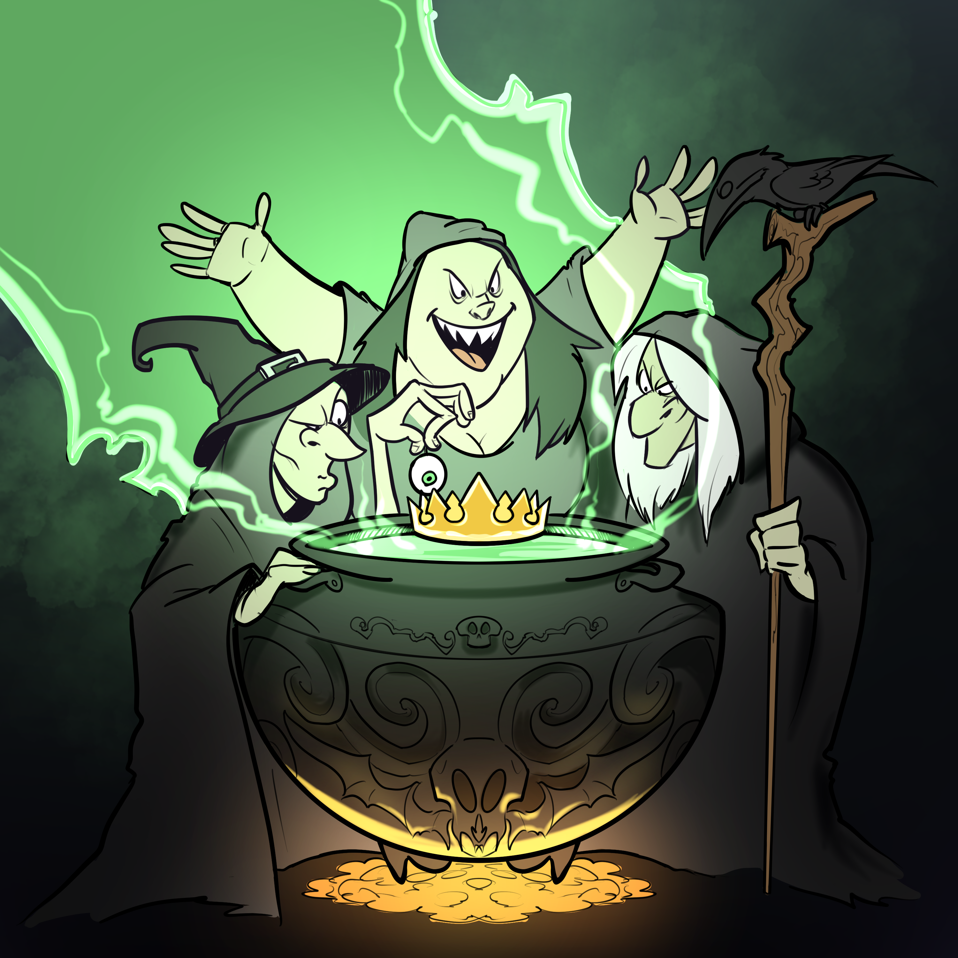
Which Macbeth Character Are You?
Read each question on the MacBeth Personality Quiz handout.
Circle the response that best represents you.

Slide 8
Which Macbeth Character Are You?
Which response did you mostly select?
Mostly A’s: Lady Macbeth
Mostly B’s: Macbeth
Mostly C’s: Banquo
Mostly D’s: Duncan
Mostly E’s: One of the Three Witches

Slide 9
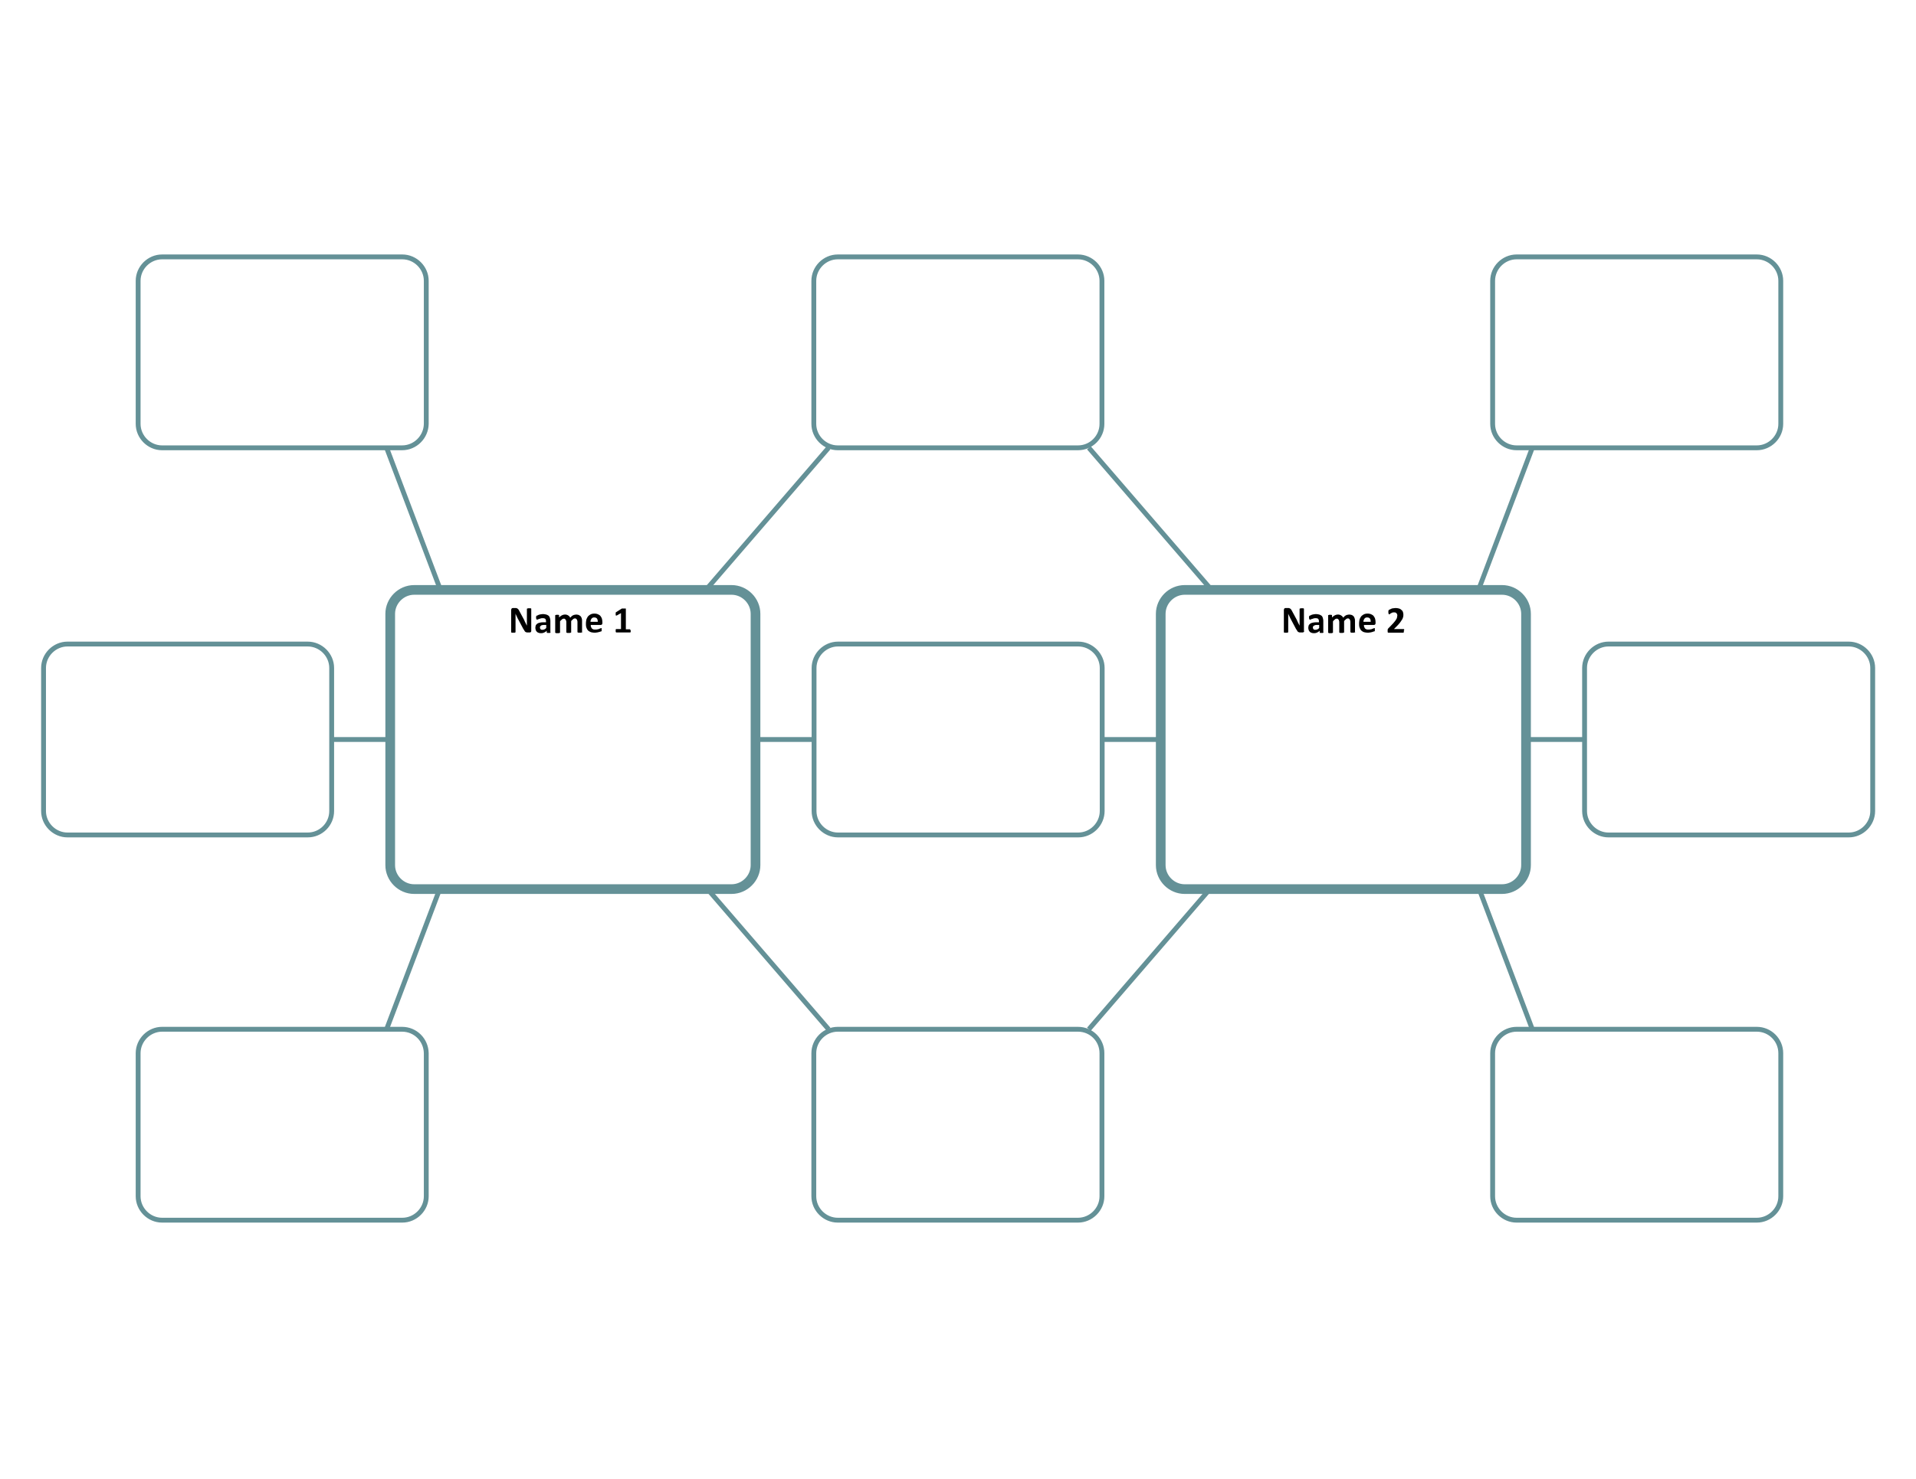
Double Bubble Map
In the Double Bubble Map handout, write your matched Macbeth character’s name in the Name 1 box.
Notes:
K20 Center. (n.d.). Double Bubble Map. Strategies. https://learn.k20center.ou.edu/strategy/3035

Slide 10
Double Bubble Map
Pick another fictional or nonfictional character for comparison. Write the name in the Name 2 box.
Macbeth Character
Notes:
K20 Center. (n.d.). Double Bubble Map. Strategies. https://learn.k20center.ou.edu/strategy/3035

Slide 11
Body Biography: Overview
Trace a group member on butcher paper. Ask a volunteer to lie down and trace around them.
Use crafting supplies and your Double Bubble Map to complete:
A life-size visual (on butcher paper)
A written character analysis (on notebook paper)
Hang the body biography on the wall.

Slide 12
Body Biography: Guidelines
Head: Choose three direct quotes from the play that summarize and encompass your character. Put these on your character’s head or in thought bubbles.
Heart: Consider what this character loves most. What shape should it be? What colors, symbols, or images could be used? The heart is a good place for illustrating what/who is most important in their life. Place this on your character’s chest.

Slide 13
Body Biography: Guidelines
Backbone: This is the character’s main objective within the story that makes up their spine. What is their most important goal? What drives their thoughts and actions? How can you illustrate it using symbols?
Example: Romeo’s (Romeo & Juliet by William Shakespeare) spine might look like an ornate, red blindfold because he is blinded by love to the point that he hurts himself and others for it.

Slide 14
Body Biography: Guidelines
Feet: What fundamental beliefs and philosophies does this character live by? This should be a symbolic representation of what they stand for.
Example: Guy Montag (Fahrenheit 451 by Ray Bradbury) could be standing on a pile of books because he believes knowledge paves the path to liberty and freedom; or he could stand on burning books because he believes ignorance is what paves the path toward harm and self-imprisonment.

Slide 15
Body Biography: Guidelines
Hands: What does the character hold in their hands and why is it significant? Choose items that are associated with the character either literally or figuratively.
Example: Harry Potter (Harry Potter series by J.K. Rowling) may hold a wand, lightning bolt, or Tom Riddle’s journal.
Colors: Color symbolism is often used through literary texts. What color(s) do you associate with your character and why? These colors should be incorporated throughout your body biography and in the visuals of each body part.

Slide 16
Body Biography: Supporting Evidence
Written Response and Textual Evidence: Excluding the head, create a written response for each body part that follows the Claim-Evidence-Reasoning (CER) format and includes one quote from the text to serve as your evidence.
Put the written responses on a separate sheet of paper. Each response should be no more than one paragraph long.
Each person in your group is responsible for writing at least 2 of the 5 responses: heart, backbone, feet, hands, and colors.

Slide 17
Claims, Evidence, Reasoning (CER)
CER Video

Slide 18
CER Paragraph: Example
Guy Montag’s heart is represented by an open book behind prison bars because he thirsts for knowledge, but he is still guarded about this desire. For example, Montag states, “There must be something in books, something we can’t imagine, to make a woman stay in a burning house; there must be something there. You don’t stay for nothing,” (Bradbury 48). This moment was a turning point for his character because he realizes people are willing to die for what is in these books; they’re willing to die for knowledge, information, fantasy, and this piques his curiosity. Furthermore, he reflects on his role in destroying the thoughts of his fellow man, “It took some man a lifetime maybe to put some of his thoughts down, looking around all the world and life, and then I come along in two minutes and boom! It’s all over,” (Bradbury 49). This epiphany is why his heart is an open book because it was pried open by his own conscious thoughts and that frightens him.

Slide 19
Body Biography: Get Started
In small groups, have one person lie down on the butcher paper; have another person trace them.
DO NOT label your character’s name on the butcher paper.
Use crafting supplies and your Double Bubble Map to complete a life-size visual character analysis by examining your character’s role and motivations in the story of Macbeth.
Use colored construction paper, glue sticks, scissors, markers, crayons, and/or colored pencils on your butcher paper.
On notebook paper, write your supporting evidence.
Hang your body biography on the wall.

Slide 20
Gallery Walk
Take a moment to view each group’s body biography.
Reflect on the following questions and be prepared to discuss afterward.
Was it easy to determine the group’s character? How could you tell?
Did they have the same character as you? If they did, how did they portray that character the same or differently as your group?
Did the symbols and quotes they chose for their character make sense?
How did examining their motivations help you understand that character better?

Slide 21
Character Analysis Essay: Expectations
Write a 5-paragraph essay in response to the following question:
How do your character’s intrinsic and extrinsic motivations make them a significant character in Macbeth?

Slide 22
Character Analysis Essay: Outline
Introduction: Write a paragraph with a clearly stated thesis statement.
Body Paragraph 1: What is their intrinsic motivation?
Body Paragraph 2: What is their extrinsic motivation?
Body Paragraph 3: How do their motivations make them a significant character in the story of Macbeth?
Conclusion: Write a paragraph with a clear summary or conclusion.

Slide 23
Character Analysis Essay: In-Text Citations
(Abbreviation of play. Act #.Scene #.Line #s)
Example:
(Mac. 1.3.14-17)

Slide 24
Character Analysis Essay: CER Format
CER Format for Body Paragraphs | Column Header
Claim | [Insert answer to question.]
Evidence | For example, [insert paraphrased textual evidence], (Mac., Act #., Scene #. Line #s).
Reasoning | [Insert explanation of the significance of the evidence.]
Evidence | Furthermore, [insert paraphrased textual evidence], (Mac., Act #., Scene #. Line #s).
Reasoning | [Insert explanation of the significance of the evidence.]

Slide 25
Character Analysis Essay: Example
Guy Montag’s intrinsic and extrinsic motivations change throughout the novel, and this is what forces him to evolve as a character, therefore, making him significant. For example, Montag states, “There must be something in books, something we can’t imagine, to make a woman stay in a burning house; there must be something there. You don’t stay for nothing,” (Bradbury 48). This moment was a turning point for his character because he realizes people are willing to die for what is in these books; they’re willing to die for knowledge, information, fantasy, and this piques his curiosity. It creates a shift in his intrinsic motivations because he’s suddenly conscientious of his own actions and begins to question them. Furthermore, he reflects on his role in destroying the thoughts of his fellow man, “It took some man a lifetime maybe to put some of his thoughts down, looking around all the world and life, and then I come along in two minutes and boom! It’s all over,” (Bradbury 49). This epiphany is what drives his evolution as a character. He is the perfect example of what happens when a person who has been stuck on autopilot for years suddenly awakens.

Slide 26
Peer Review
Using a highlighter, highlight where textual evidence is used.
Is the textual evidence useful or not in proving your peer’s claim?
Using 2 sticky notes,
Sticky Note #1: Write 2 things that your peer did well.
Grammar, sequencing, vocabulary, paraphrasing, etc.
Sticky Note #2: Write 1 thing that they need to improve.
Avoid summarizing the story and answer prompt; use more relevant textual evidence, etc.

