Slide 2
Wave Properties Of Light
Quantum Mechanics

Slide 3
Essential Question
Is light a wave or a particle?

Slide 4
Lesson Objectives
Apply the principle of superposition of waves to visualize the sum of two waves.
Recognize that interference patterns are created by the constructive and destructive interference of waves.
Justify how changing the wavelength, distance from the screen, and distance between the slits affects the distance between the interference bands in the double slit experiment.
Identify results from the photoelectric effect that contradicted the classical wave theory and showed that the current theory was incomplete.

Slide 5
Wave Interactions - Setting Up
Mark off a 6-meter spot on the floor.
Use masking tape to mark the following spots:
  0 meters (starting location)
  3 meters (center location)
  6 meters (ending location)
Each mark should be 1 meter long
to measure the amplitude of the wave.
1 meter long, centered on the 6 meter-long line
3 Meters Distance
3 Meters Distance
Starting Location - 0 meters
Center Location - 3 meters
Ending Location - 6 meters

Slide 6
Wave Interactions - Round 1
Student Roles
Student A and Student C: Quickly snap the long spring at the same time in the same direction.
  Start at the center of the meter marker.
  Snap to the far left of the meter marker.
  Return immediately to the center of the meter marker.
Student B: Makes and records observations of the displacement.
Student A - 0 meters
Student B - 3 meters
Student C - 6 meters

Slide 7
Wave Interactions - Round 1
How does the displacement at Student B’s location compare to the displacement at Student A’s location?
Draw three (3) pictures of the waves:
  Before they meet in the middle.
  When they meet in the middle.
  After they meet in the middle.
Student A - 0 meters
Student B - 3 meters
Student C - 6 meters

Slide 8
Wave Interactions - Round 1
What do you think has happened to the two waves when they combine?
Student A - 0 meters
Student B - 3 meters
Student C - 6 meters

Slide 9
Wave Interactions - Round 2
Student Roles
Student A and Student C: Quickly snap the long spring at the same time but in OPPOSITE directions.
Student B: Makes and records observations of the displacement.
Student A - 0 meters
Student B - 3 meters
Student C - 6 meters

Slide 10
Wave Interactions - Round 2
How does the displacement at Student B’s location compare to the displacement at Student A’s location?
Draw three (3) pictures of the waves:
  Before they meet in the middle.
  When they meet in the middle.
  After they meet in the middle.
Student A - 0 meters
Student B - 3 meters
Student C - 6 meters

Slide 11
Wave Interactions - Round 2
Does your hypothesis about what happened when the waves combined from Wave Interactions - Round 1 still make sense?
Student A - 0 meters
Student B - 3 meters
Student C - 6 meters

Slide 12
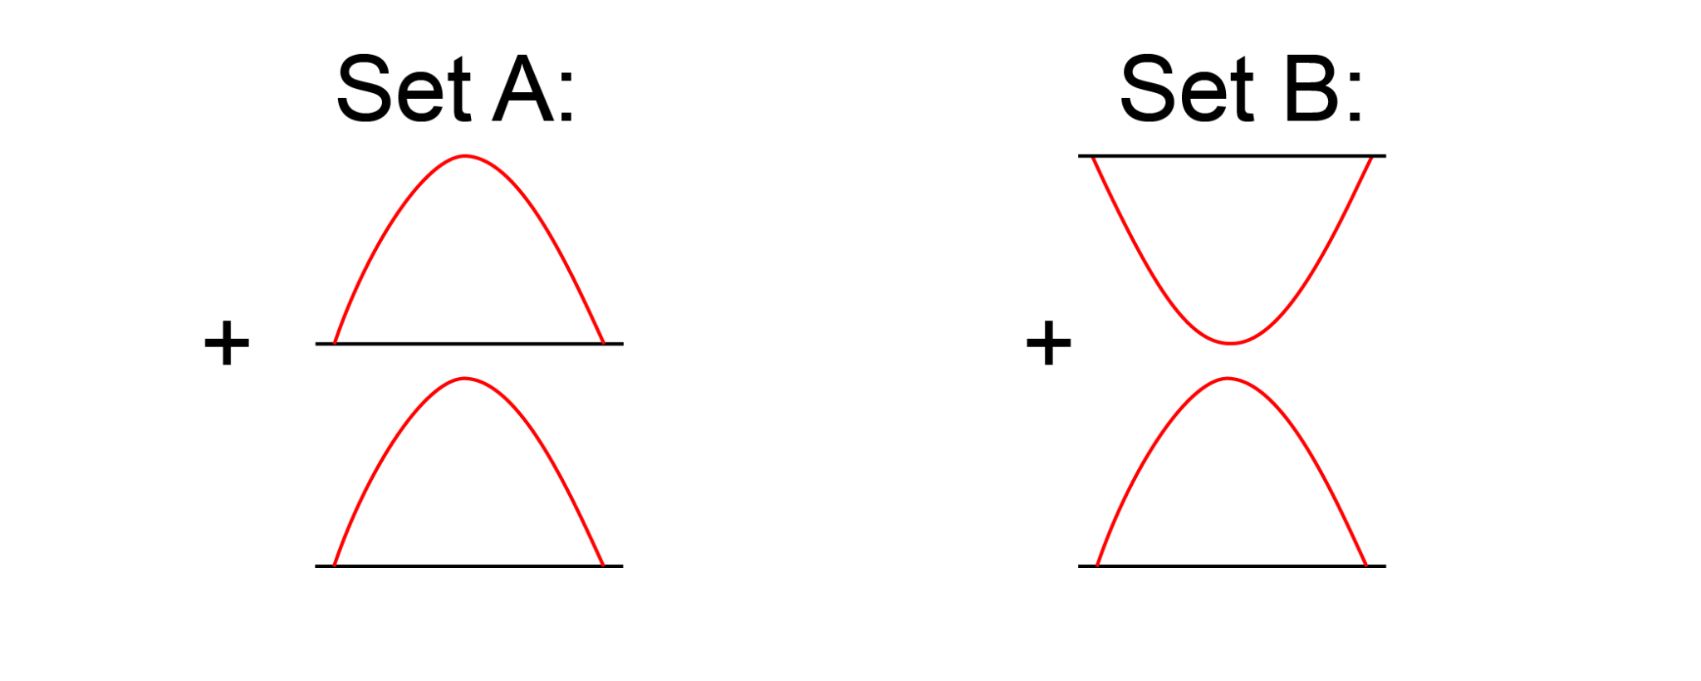
Wave Interactions - Prediction 1
How would the waves combine?
Think about math: how do positive and negative numbers combine?

Slide 13
Wave Interactions - Prediction 2
How would the waves combine?

Slide 14
Wave Interactions - Prediction 1
This represents Constructive Wave Interference.
In your own words, define this term.

Slide 15
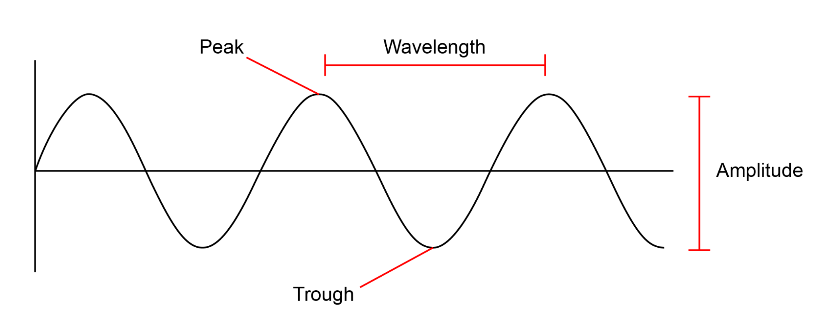
Wave Interactions
Constructive Interference:
Waves combine peak + peak or trough + trough to produce a wave of larger amplitude.

Slide 16
Wave Interactions - Prediction 2
This represents Destructive Wave Interference.
In your own words, define this term.

Slide 17
Wave Interactions
Destructive Interference:
Waves combine peak + trough so that amplitudes cancel one another.

Slide 18
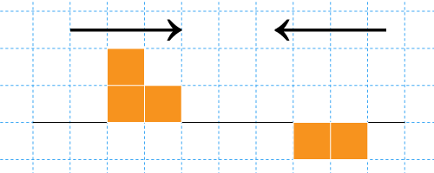
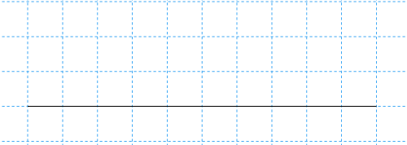
Wave Interactions
If two pulse waves are sent through a spring in opposite directions, what would the result be the instant they combine?
Is this constructive or destructive interference?

Slide 19
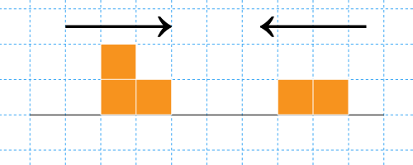
Wave Interactions
If two pulse waves are sent through a spring in opposite directions, what would the result be the instant they combine?
Is this constructive or destructive interference?

Slide 20
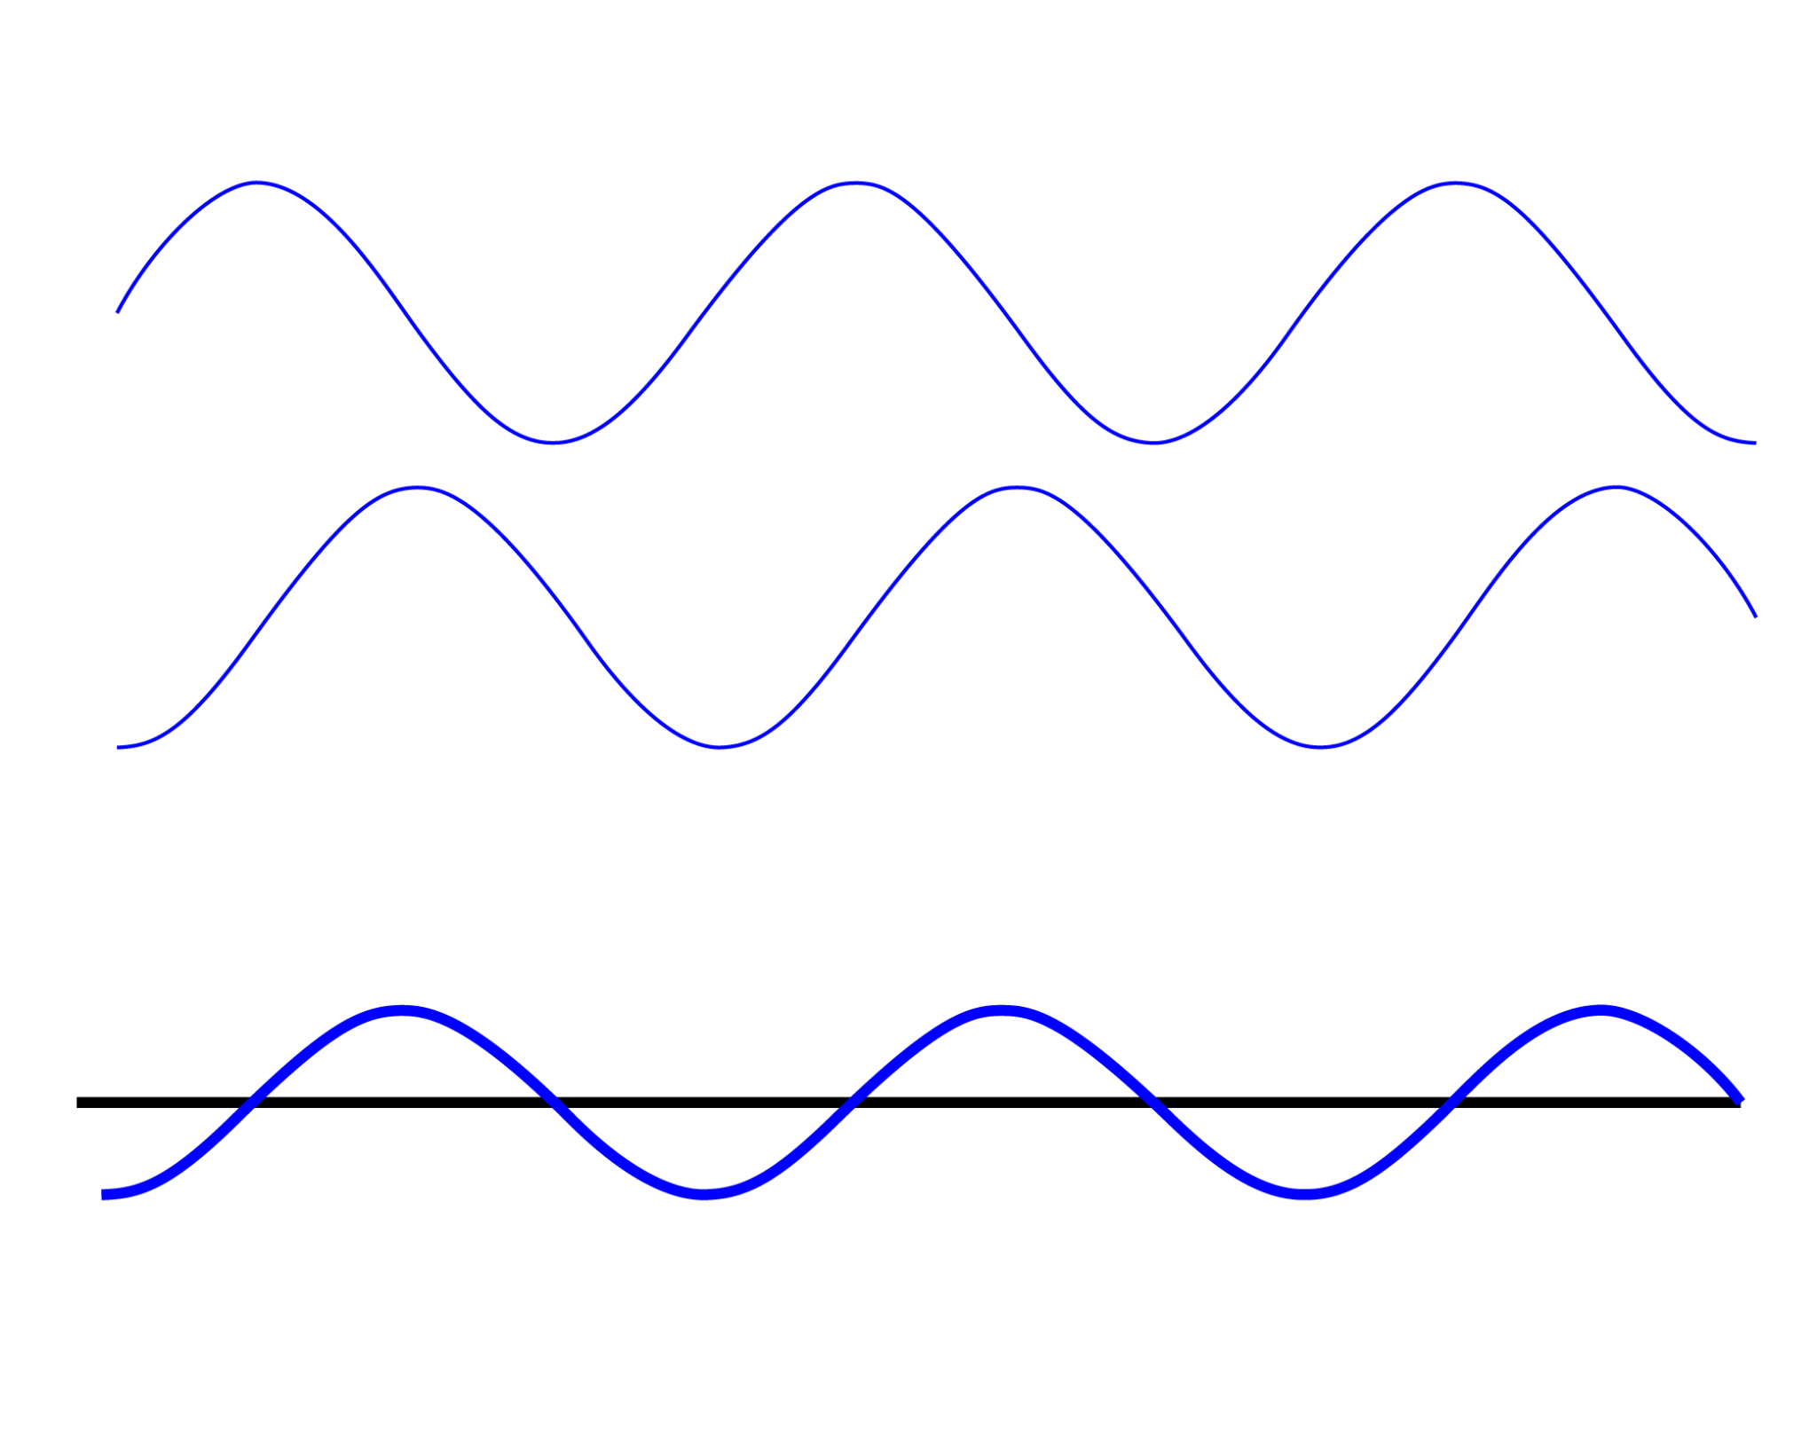
Wave Interactions
Interference occurs when two or more waves combine additively. The addition of the waves is called the superposition of the waves, which is the sum of the amplitude of all of the waves at one point for all of the points along the wave.
Like positive and negative numbers, the wave amplitudes can either increase or cancel out.
Notes:
GIF Image Source: https://www.acs.psu.edu/drussell/Demos/superposition/superposition.html
Images at this website may have a Creative Commons license.

Slide 21
Wave Interactions
On a sheet of paper, summarize how waves interact with each other. Trade with your neighbor and compare answers before turning in the paper.

Slide 22
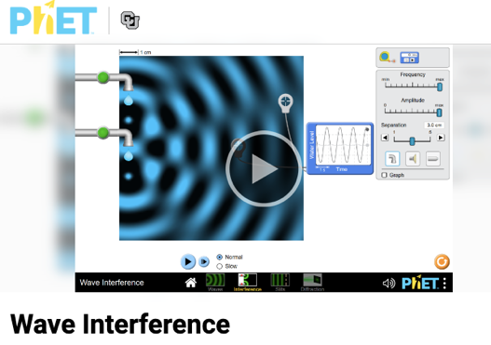
Part 1: Diffraction of Light
With your partner open up the PhET Wave Simulation:
https://phet.colorado.edu/en/simulation/wave-interference
Click play on the simulation.
Notes:
Wave interference. PhET. (n.d.-d). https://phet.colorado.edu/en/simulations/wave-interference

Slide 23
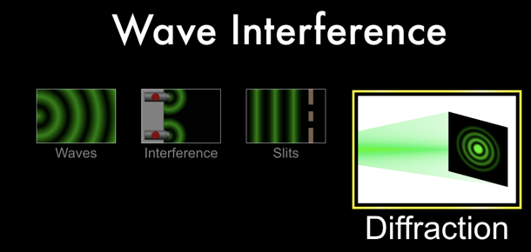
Part 1: Diffraction of Light
Click on the “Diffraction” option.
Notes:
Wave interference‬ - phet interactive simulations. (n.d.-p). https://phet.colorado.edu/sims/html/wave-interference/latest/wave-interference_en.html

Slide 24
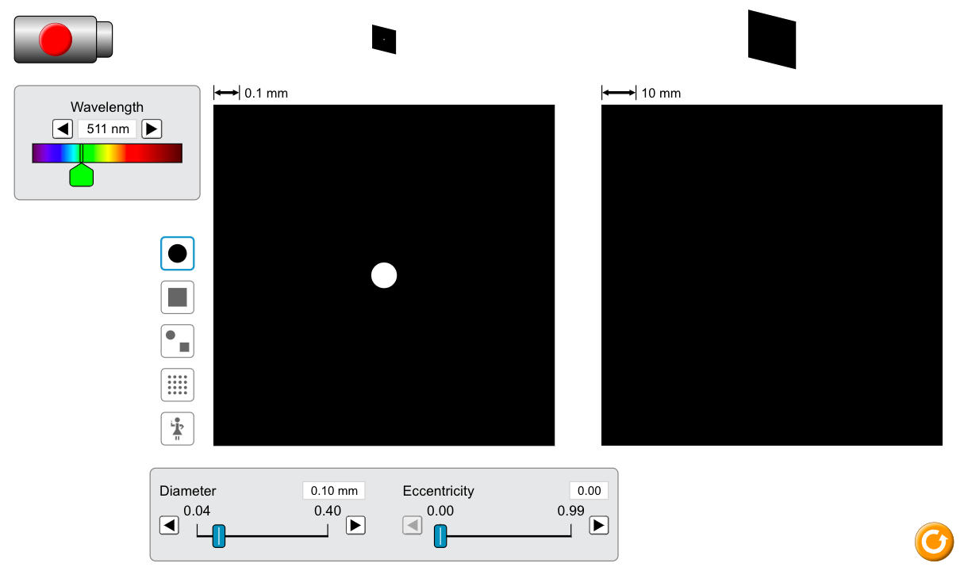
Part 1: Diffraction of Light
Follow the instructions and answer the questions on the handout.
Notes:
Wave interference‬ - phet interactive simulations. (n.d.-p). https://phet.colorado.edu/sims/html/wave-interference/latest/wave-interference_en.html

Slide 25
Part 2: Double Slit Experiment
With your partner open up the PhET Wave Simulation:
https://phet.colorado.edu/en/simulation/wave-interference
Click play on the simulation.
Notes:
Wave interference. PhET. (n.d.-d). https://phet.colorado.edu/en/simulations/wave-interference

Slide 26
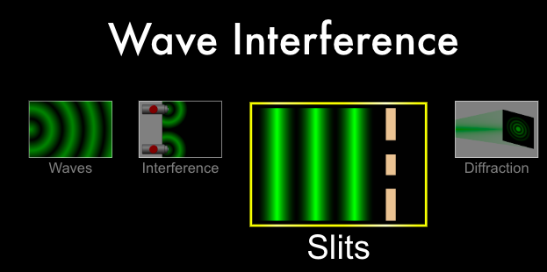
Part 2: Double Slit Experiment
Click on the “Diffraction” option.
Notes:
Wave interference‬ - phet interactive simulations. (n.d.-p). https://phet.colorado.edu/sims/html/wave-interference/latest/wave-interference_en.html

Slide 27
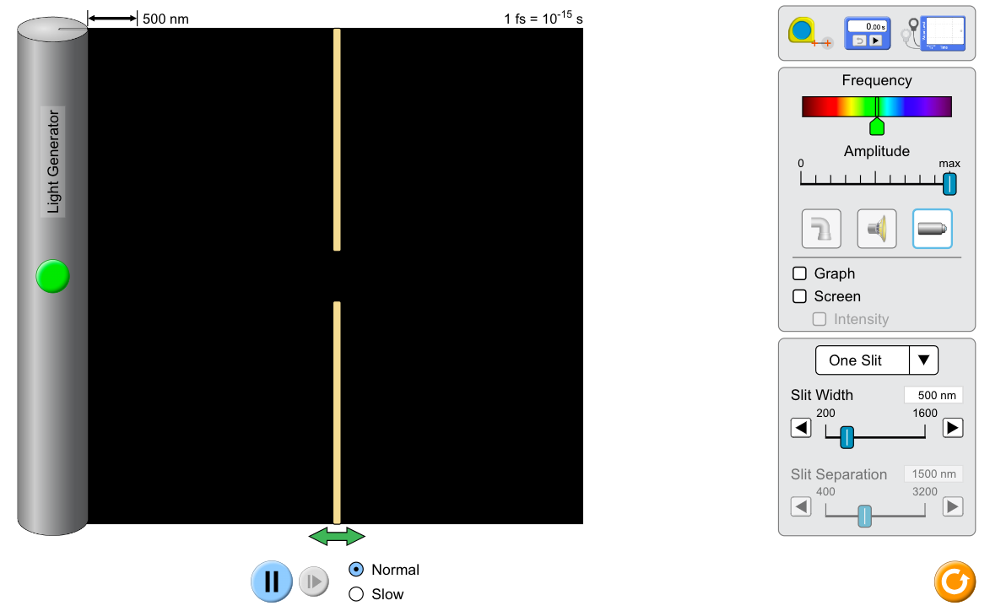

Part 2: Double Slit Experiment
Follow the instructions and answer the questions on the handout.
Click on the light icon in the
toolbar on the right.
Notes:
Wave interference‬ - phet interactive simulations. (n.d.-p). https://phet.colorado.edu/sims/html/wave-interference/latest/wave-interference_en.html

Slide 28
What Did I Learn Today?
1a) Why can you hear your friend yelling from around the corner even though you cannot see him? Both light and sound are waves that diffract so why is there a difference? (Hint: Refer back to question 3 in part 1.)
1b) A flute is higher pitched than a drum, but explain why it is hard to hear the difference between the two when the sound from each instrument would come to you around the corner as the marching band came down the hallway while it is not hard to tell that you hear the instruments before you see the marching band?

Slide 29
What Did I Learn Today?
2.) State the effect of increasing each of the variables on the distance from the central bright spot to the next bright spot (y) in the interference pattern. The variables are the distance from the double slit to the screen (D), the wavelength of the light used (ℷ), and the distance between the slits (d).

Slide 30
Behavior of Light As A Wave
Individually read the Behavior of Light as a Wave handout, and in small groups, answer the following questions on a sheet of paper for the group.
1.) Qualitatively explain why increasing D has the effect it does on the distance between fringes.
2.) Qualitatively explain why increasing ℷ has the effect it does on the distance between fringes.
3.) Qualitatively explain why increasing d has the effect it does on the distance between fringes.

Slide 31
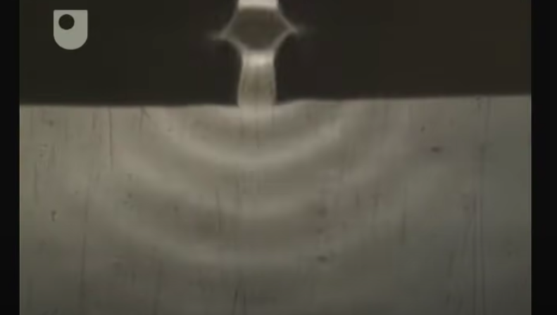
Behavior of Light As A Wave
Video about how much water waves diffract based on the size of the opening.
Notes:
YouTube. (2011, July 26). Apertures and diffraction - exploring wave motion (3/5). YouTube. https://www.youtube.com/watch?v=BH0NfVUTWG4&list=PLFE829A78F461BD20&index=3

Slide 32
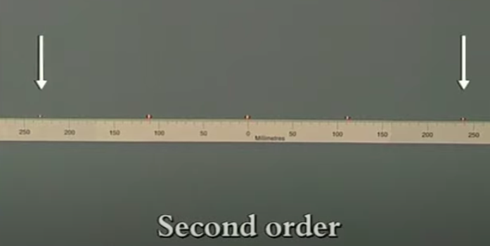
Behavior of Light As A Wave
Video about how interference pattern of light changes.
Notes:
YouTube. (2011b, July 26). Passing light through multiple apertures - exploring wave motion (5/5). YouTube. https://www.youtube.com/watch?v=cKY9KzMezdY&list=PLFE829A78F461BD20&index=5

Slide 33
Classical Wave Theory Of Light
The photoelectric effect became an exciting experiment in the late 19th century. It was discovered that when light was absorbed by a piece of metal, the metal could absorb enough energy from the light to eject electrons with their own kinetic energy. Scientists wanted to use the Classical Wave Theory to explain what was happening.

Slide 34
Classical Wave Theory Of Light
Classical Wave Theory says that light is an electromagnetic wave that can be described by its brightness and color.
The brightness of light is its intensity, which is proportional to the square of the amplitude of the wave.
Remember that the amplitude is the distance between the crest of the wave and its equilibrium position.
The color of light is related to its frequency, which represents how many cycles per second that it completes.
Classic Wave Theory says that the energy of the wave is related to the brightness of the wave, not the color of the wave.

Slide 35
Classical Wave Theory Of Light
For each of the following four slides follow these instructions:
In 2 minutes, individually write down the answer to the question and the justification on a sheet of paper.
Each new group will then have approximately 2 minutes to combine and select the group response.
Grab a partner to be a group of 2.
Combine with another group to be a group of 4.
Combine with another group to be a group of 8.
Share response to class, and use class discussion to build consensus.

Slide 36
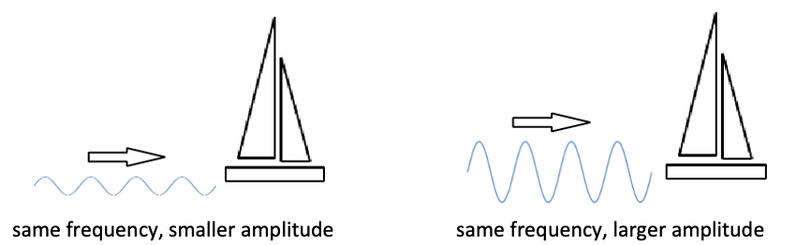
Classical Wave Theory Of Light
1) What does Classical Wave Theory predict happens to the kinetic energy of the ejected electrons when the brightness (intensity) of the light is increased? Hint: Think of a wavefront launching a boat across the water. Which wavefront will move the boat more quickly?

Slide 37
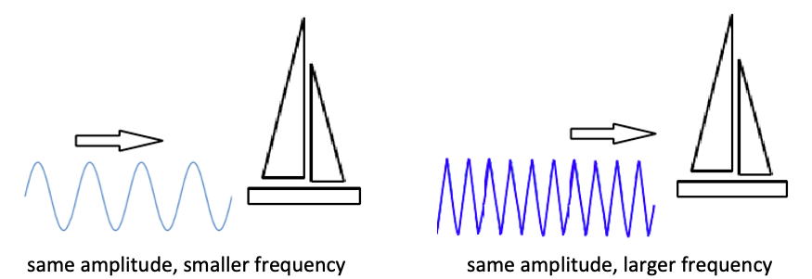
Classical Wave Theory Of Light
2) What does Classical Wave Theory predict happens to the kinetic energy of the ejected electrons when the color (frequency) of the light is increased? Hint: Think of waves launching a boat across the water. Which wavefront will move the boat more quickly?

Slide 38
Classical Wave Theory Of Light
3) What does Classical Wave Theory predict happens to the rate at which electrons eject from the surface of the metal when the color (frequency) of the light is increased?

Slide 39
Classical Wave Theory Of Light
4) What does Classical Wave Theory predict about the time it takes to eject an electron from different types of metal. The bonds in some materials are stronger, and it takes more energy to enable the electron to break free from the surface.

Slide 40
Classical Wave Theory Of Light
Three results from the Photoelectric Effect that contradict Classical Wave Theory.
1) Brightness (Intensity) of light is found to have no effect on the kinetic energy of the ejected electrons. The color (frequency) of light is found to have a direct effect on the kinetic energy of the ejected electrons.
2) Regardless of the energy required to eject the electron from different metal surfaces, there is almost no delay to build up the energy to eject the electrons.
3) There is a threshold frequency required to eject electrons from a specific surface. Regardless of how bright (intense) the light, the electron will not be ejected if the frequency of the light is less than the minimum value.

Slide 41
Exit Ticket
For the following three questions write down on your own paper the explanation of how and why the interference pattern is changing when the following variables change:
  Distance between the slits and the screen (D)
  Wavelength of the light (ℷ)
  Distance between the slits (d)

Slide 42
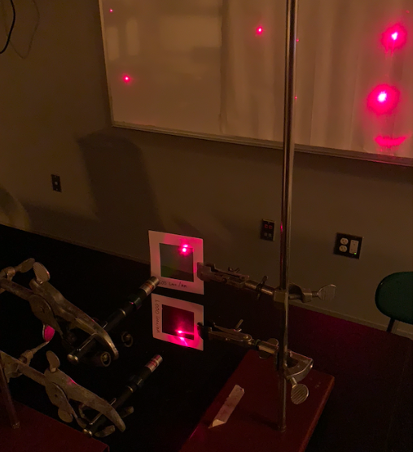
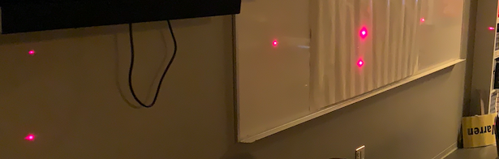
Exit Ticket
1) Red laser light shines through the diffraction grating from a close distance to the screen and a large distance from the screen. In the picture on the left, D is small and in the picture on the right, D is big.

Slide 43
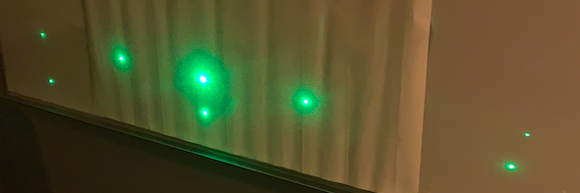
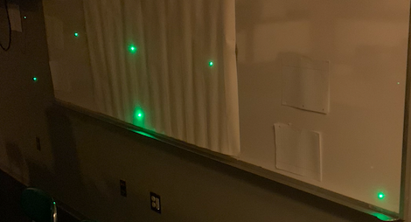
Exit Ticket
1) Green laser light shines through the diffraction grating from a close distance to the screen and a large distance from the screen. In the top picture, D is small and in the bottom picture, D is big.

Slide 44
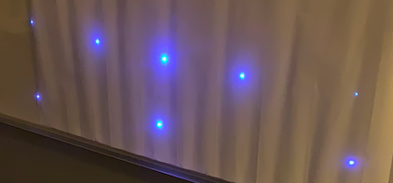
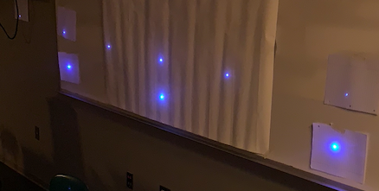
Exit Ticket
1) Blue laser light shines through the diffraction grating from a close distance to the screen and a large distance from the screen. In the top picture, D is small and in the bottom picture, D is big.

Slide 45
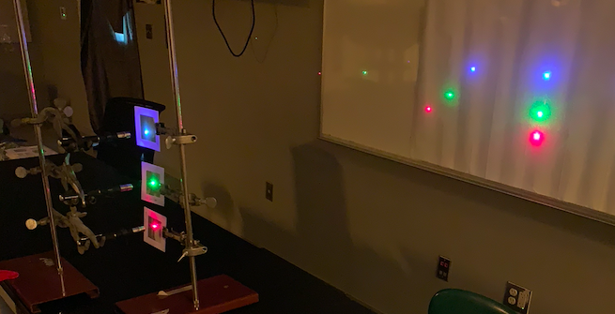
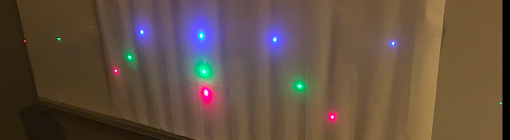
Exit Ticket
2) Laser light of different wavelength shines through the diffraction grating at the same distance from the screen and the same number of slits/mm (red laser = 650nm, green laser = 510nm, and blue laser = 475nm).

Slide 46
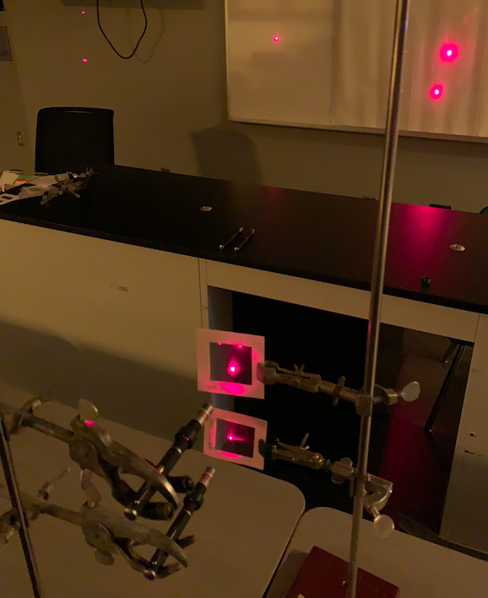
Exit Ticket
3) Red laser light shines through the diffraction grating with slits that are close together (bottom line) and with slits that are farther apart (top line) at the same distance from the screen.

Slide 47
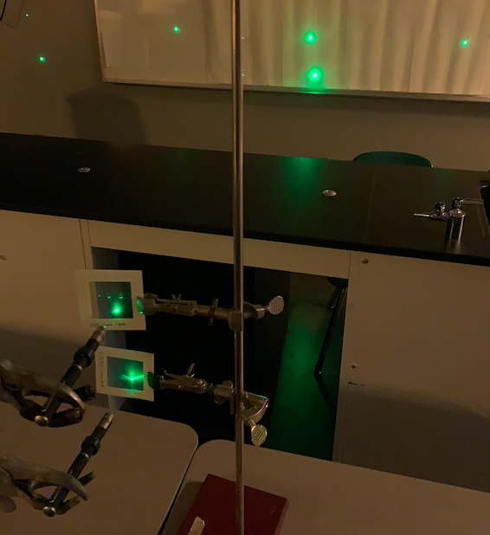
Exit Ticket
3) Green laser light shines through the diffraction grating with slits that are close together (bottom line) and with slits that are farther apart (top line) at the same distance from the screen.

Slide 48
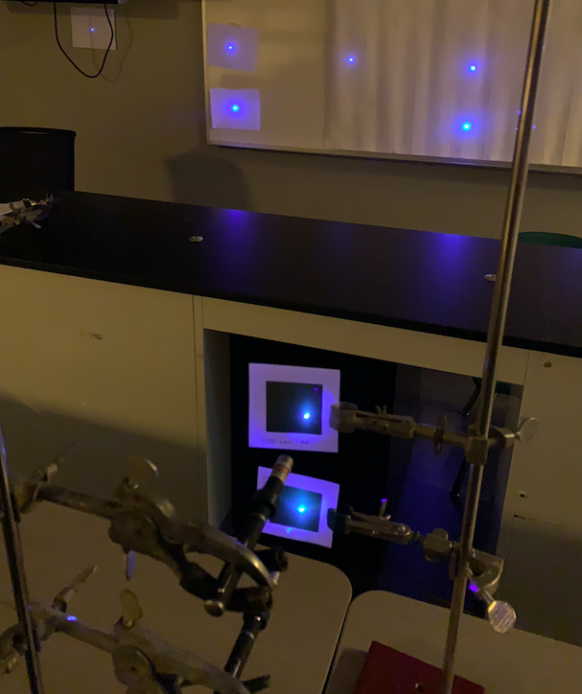
Exit Ticket
3) Blue laser light shines through the diffraction grating with slits that are close together (bottom line) and with slits that are farther apart (top line) at the same distance from the screen.

Slide 49
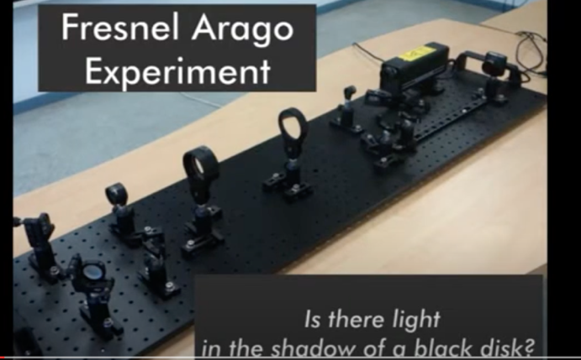
Exit Ticket
4a) Watch the video on the Arago spot and explain how there is a bright spot in the shadow of an opaque object.
4b) Explain why there is a bright spot in the very middle of the shadow specifically.
https://www.youtube.com/watch?v=xHHhbR5evq0
Notes:
Institut Fresnel. (n.d.) Fresnel Diffraction Experiment 2: “Arango Spot.” https://www.youtube.com/watch?v=xHHhbR5evq0

