Slide 2
It is a Platypus,
Not a Duck or a Beaver
Quantum Mechanics

Slide 3
Essential Question
Is light a wave or a particle?

Slide 4
Lesson Objectives
Identify when wave and particle behavior will appear in an experiment.
Apply De Broglie Wavelength to demonstrate understanding that just like waves exhibit particle properties, particles exhibit wave properties.
Demonstrate understanding of the Heisenberg Uncertainty Principle and communicate that it is a property of nature, not a measurement issue.
Apply Fourier Transformation to explain why there is some uncertainty in the combination of position and momentum.

Slide 5

Is Light a Wave or a Particle?
On a separate sheet of paper, create a table with two columns labeled “I Notice” and “I Wonder.”
As you watch the video, write observations in the I Notice column and questions in the I Wonder column.

Slide 6
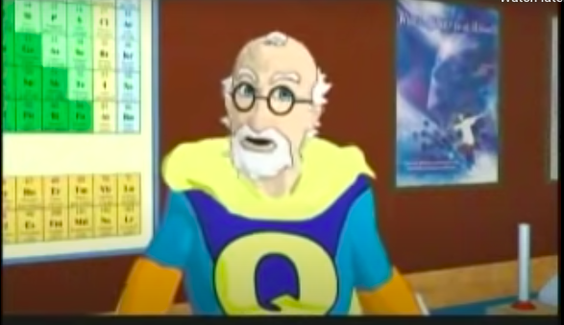
Is Light a Wave or a Particle?
https://www.youtube.com/watch?v=Q1YqgPAtzho
Notes:
YouTube. (2010, December 27). Dr. Quantum - double slit experiment. YouTube. https://www.youtube.com/watch?v=Q1YqgPAtzho

Slide 7
Is Light a Wave or a Particle?
Watch the video a second time and answer the following questions. Use your notes from your I Notice / I Wonder table.
Which claims of the video support light as a wave as in Lesson 1?
Which claims of the video support light as a particle as in Lesson 2?
Which claims of the video are new?

Slide 8
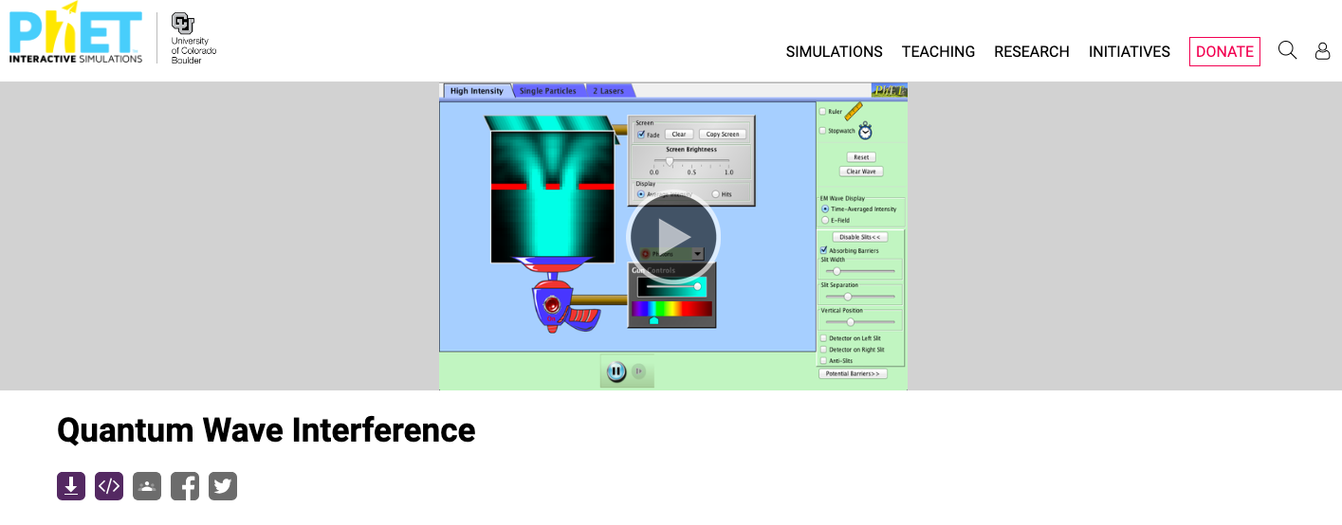
Quantum Wave Interference
With your partner, open the PhET Wave Simulation:
https://phet.colorado.edu/en/simulation/quantum-wave-interference
Click play on the simulation.
Notes:
Quantum Wave Interference. PhET. (n.d.-b). https://phet.colorado.edu/en/simulations/quantum-wave-interference

Slide 9
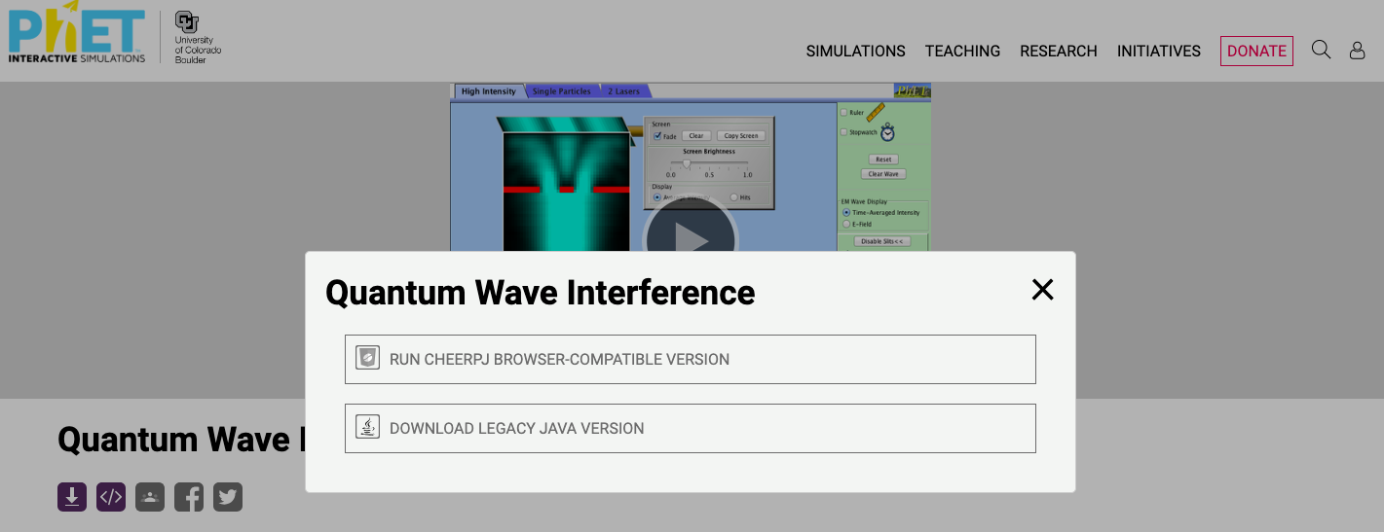
Quantum Wave Interference
Click on the “RUN CHEERPJ BROWSER-COMPATIBLE VERSION” option.
Notes:
Quantum Wave Interference. PhET. (n.d.-b). https://phet.colorado.edu/en/simulations/quantum-wave-interference

Slide 10
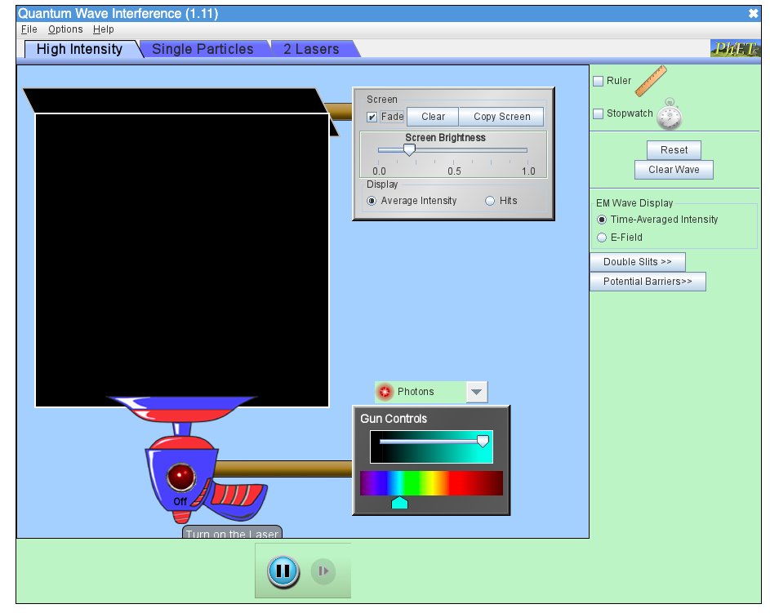
Quantum Wave Interference
Follow the instructions and answer the questions on the handout.
Notes:
Phet simulation. (n.d.). https://phet.colorado.edu/sims/cheerpj/quantum-wave-interference/latest/quantum-wave-interference.html?simulation=quantum-wave-interference

Slide 11

What Did I Learn Today?
Take five minutes to write out some of the key ideas covered in class.
Include a list of when an interference pattern will and will not form when using a double slit.

Slide 12
What Does All Of This Mean?
In groups of two watch videos in the Wakelet assigned to your group and take notes over the video content.
All groups with the same number will make a presentation over the videos watched and present it to the class.
Access videos at http://k20.ou.edu/quantumwakelet
Notes:
K20 Center. (n.d.). Explaining quantum phenomenon. Wakelet. https://wakelet.com/wake/WYN3jVuJiNTdvyJHv7sgT

Slide 13
What Does All of This Mean?
PowerPoint Requirements:
6-8 Slides total
1 Screenshot Per Slide
Follow Guidelines for question prompts for each group

Slide 14
What Does All of this Mean?
Create a 3-to-4-minute presentation.
  Plan 30 seconds of explanation on each slide.
Each member must present at least one slide.
Allow a few minutes after presentation for questions and a chance for class to take notes and to sketch diagrams.
Take notes over presentations in the Note Catcher.
  Notes can be used to answer questions at the end of the lesson.

Slide 15
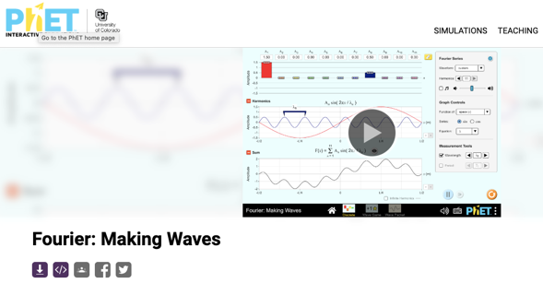
Fourier Making Waves Simulation
Click the play button.
Notes:
Fourier: Making waves. PhET. (n.d.-a). https://phet.colorado.edu/en/simulations/fourier-making-waves/about

Slide 16
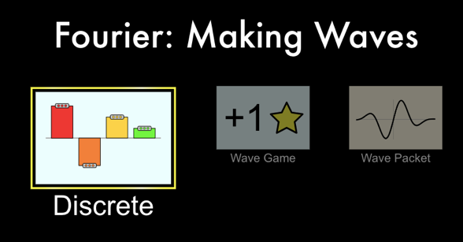
Fourier Making Waves
Click on “Discrete.”
Drag the different amplitude bars in the top third of the simulation up or down.
  Each amplitude bar that you move away from 0 amplitude adds another individual wave in the middle section of the simulation.
  The bottom third of the simulation shows the superposition of all the waves together.
Notes:
Fourier: Making Waves‬ - Phet Interactive simulations. (n.d.-n). https://phet.colorado.edu/sims/html/fourier-making-waves/latest/fourier-making-waves_en.html

Slide 17
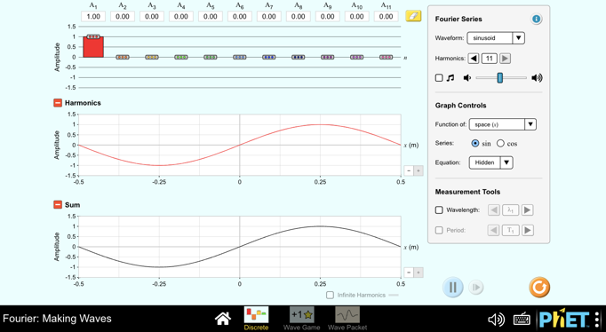
Fourier Making Waves
Hit “Wave Game” at the bottom of the screen.
Notes:
Fourier: Making Waves‬ - Phet Interactive simulations. (n.d.-n). https://phet.colorado.edu/sims/html/fourier-making-waves/latest/fourier-making-waves_en.html

Slide 18
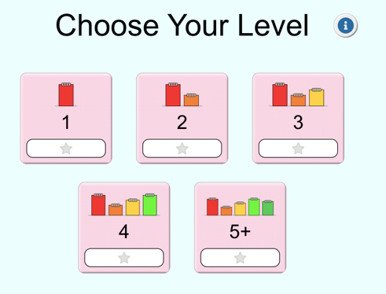
Fourier Making Waves
Choose level 1 to start with and increase the difficulty as you succeed in matching each wave.
Spend 10 minutes leveling up on the game trying to match the waves by changing the individual amplitudes of additional waves.
Notes:
Fourier: Making Waves‬ - Phet Interactive simulations. (n.d.-n). https://phet.colorado.edu/sims/html/fourier-making-waves/latest/fourier-making-waves_en.html

Slide 19
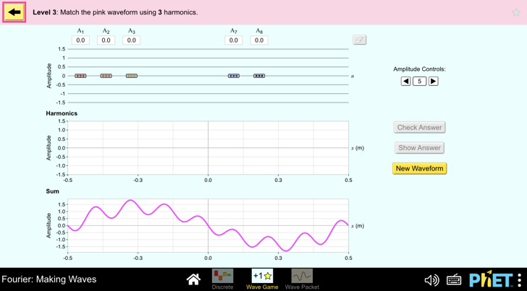
Fourier Making Waves
Go back to the first simulation by hitting “Discrete” at the bottom of the screen.
Follow the remaining instructions on the Fourier Making Waves Worksheet.
Notes:
Fourier: Making Waves‬ - Phet Interactive simulations. (n.d.-n). https://phet.colorado.edu/sims/html/fourier-making-waves/latest/fourier-making-waves_en.html

Slide 20
Addition of Waves
On notebook paper, summarize the following:
  Waves add together. How is it possible to create a wave pulse by adding a number of sine waves?
Trade with your neighbor and compare answers before turning in your paper.

Slide 21
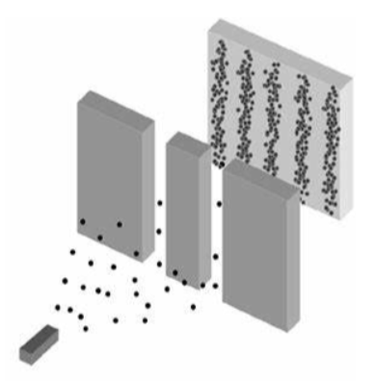
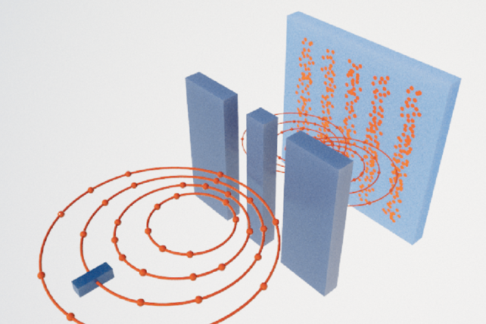
Exit Ticket
Imagine that electrons are being shot through a double slit as shown in the top image and the result is being shown on the screen.
  Explain why this result is counterintuitive to what was expected.
  How did this result force scientists to view the situation more like the image on the bottom?

Slide 22
Exit Ticket
According to De Broglie Wavelength (𝜆 = h / p ), why do we not see the wave nature of objects such as a person?

Slide 23
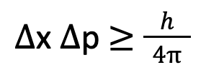
Exit Ticket
Heisenberg’s Uncertainty Principle:
  Explain what each variable on the left side of the equation means.
  Why do we not notice the effect of the Heisenberg Uncertainty on objects like a soccer ball?

Slide 24
Exit Ticket
One way of observing a small particle is to shoot a high energy photon at it. This will give the particle a big kick.
  Watch the video clip from the video, “What is the Heisenberg Uncertainty Principle: Explained in Simple Words:” 1:15-2:15.
  Is the act of measuring a particle’s position or momentum altering the particle’s position or momentum the reason for the uncertainty in Heisenberg’s Uncertainty Principle?
https://www.youtube.com/watch?v=m7gXgHgQGhw&t=3s
Notes:
YouTube. (2020d, November 25). What is the Heisenberg Uncertainty Principle: Explained in simple words. YouTube. https://www.youtube.com/watch?v=m7gXgHgQGhw

Slide 25
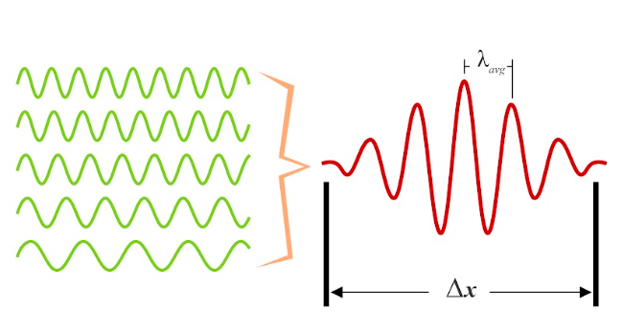
Exit Ticket
How does adding all of the waves on the left to create the wave pulse on the right fit with Heisenberg’s Uncertainty Principle?

