Slide 2
Watch Out for Sharks!
Lesson Vocabulary

Slide 3
Essential Question
What is necessary to develop a business plan?

Slide 4
Lesson Objectives
Use elements of a business plan to create a business pitch.
Use mathematical models to represent real-world, business-plan scenarios.

Slide 5
Essential Components of a Business Plan
Business Description
Product/Service Description
Market Analysis
Marketing Strategy
Operations Plan
Financial Plan

Slide 6
Business Description
What is your company name?
Where will your business be located?
How many employees are you going to have?
What problem are you trying to solve?

Slide 7
Product/Service Description
What is the name of your product or service?
How is your product or service different from your competitors?
What is your selling price?

Slide 8
Selling Price and Markup
The selling price is the amount a customer will pay you for your product or service.
The markup of a product is the difference between the selling price and the cost of making the product.
For example, if you spend $5 on the supplies to create 1 delicious sandwich, and you sell the 1 sandwich for $8, then the markup is $3.

Slide 9
Verbal Model to Algebraic Model
We can create mathematical models to represent relationships between variables.
Verbal Model:
Algebraic Model:
Solve or Evaluate:

Slide 10
Market Analysis
Do we have any competitors?
What are the selling prices of our competitors or of those with similar products?

Slide 11
Marketing Strategy
Who is your target audience?
A target audience is the group you anticipate buying your product/service.
Examples: parents, OKC residents, etc.
How do you plan to promote or advertise your product or service?
How are you going to make sure that your product or service sells?

Slide 12
Operations Plan
What does it cost for your business to operate?
It’s the total of fixed & variable costs.
Fixed costs are expenses that are not dependent on how many items you sell.
Examples: property, insurance, etc.
Variable costs depend on the number of items you sell.
Example: How many sandwiches you sell determines how much money you spend on sandwich supplies.

Slide 13
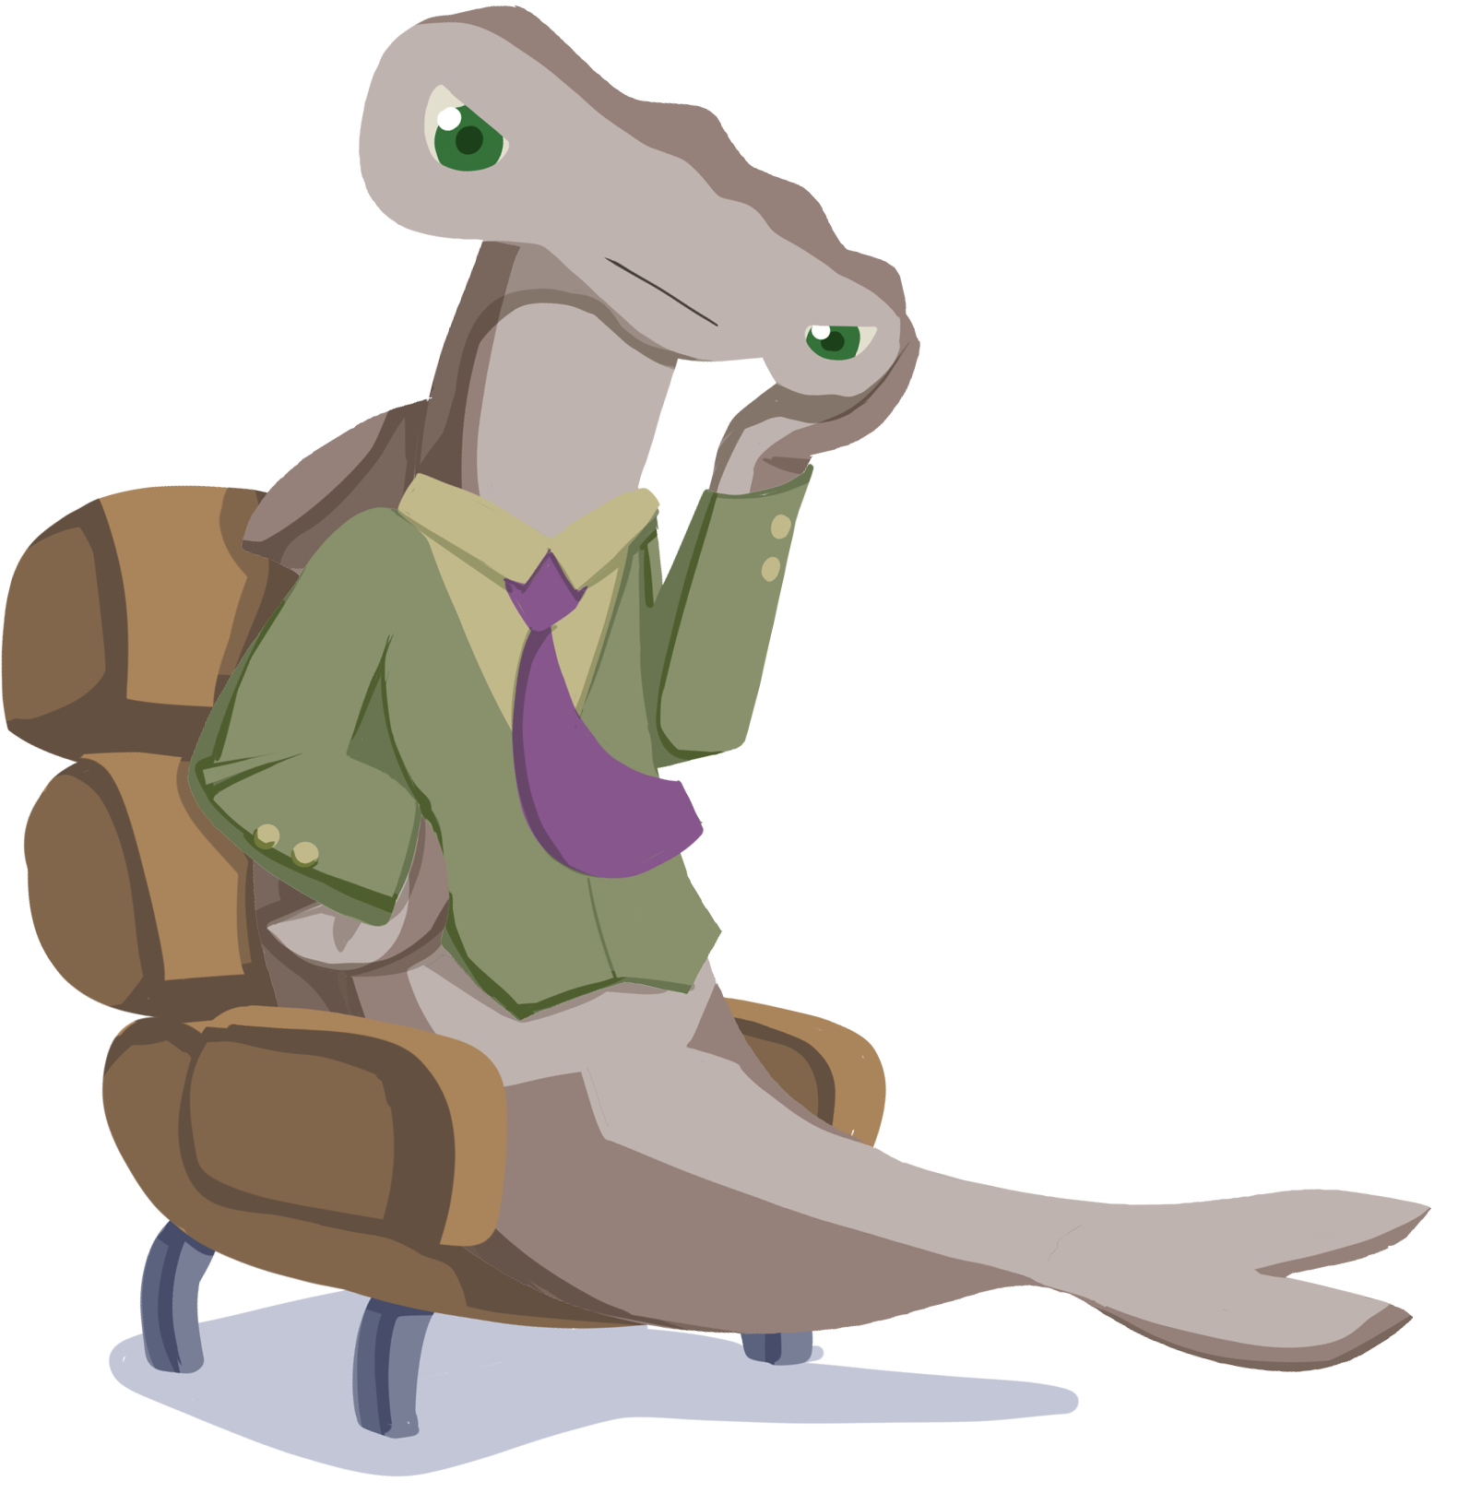
Financial Plan
If you want a business to be successful, then you need to understand the financial side.
Are you going to make or lose money?
How many items do you need to sell to cover all of your expenses?

Slide 14
Profit and Revenue
Profit is the difference between your revenue and your expenses.
Your revenue is the amount of money your company brings in from selling n items, where n is the number of items.

Slide 15
Profit and Expenses
Your expenses are the sum of your fixed costs and variable costs.

Slide 16
Profit and Math Modeling

Slide 17
Profit and Breaking Even
The break-even point is the number of items you need to sell to cover all of your expenses.
What do you think that means for our profit equation?

