Slide 2
Watch Out for Sharks!
Draft a Business Plan Using Shark Tank

Slide 3
Essential Question
What is necessary to develop a business plan?

Slide 4
Lesson Objectives
Brainstorm and synthesize business ideas
Understand the benefits of a well-developed business plan
Research, complete, and pitch a business plan

Slide 5
While watching the video, reflect on the handout.
Scrub Daddy’s Pitch
Notes:
Shark Tank Global. (2022, February 25). A bidding war breaks out during scrub daddy’s pitch | shark tank us | shark tank global [Video]. YouTube. https://www.youtube.com/watch?v=ae5MssJ8en4

Slide 6
While watching the video, reflect on the handout.
Haven’s Pitch
Notes:
Shark Tank Global. (2022, May 27). The “best pitch ever!” on shark tank with Haven | Shark Tank Us | Shark Tank Global [Video]. YouTube. https://www.youtube.com/watch?v=D83MdEeYe6g

Slide 7
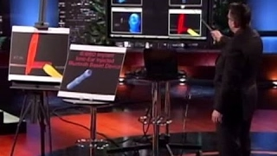
While watching the video, reflect on the handout.
Ionic Ear’s Pitch
Notes:
Max Road. (2017, February 1). Shark Tank Worst Pitch ever #1 ionic ear [Video]. YouTube. https://www.youtube.com/watch?v=bDkDg33uGuc

Slide 8
Collective Brain Dump
Write one idea for each of the following prompts on a separate sticky note:
A problem that you see in your community.
A situation people encounter that can be made easier with an invention.
An idea for something that can make a lot of money.
When you are done, place your sticky notes on the corresponding posters.
Notes:
K20 Center. (n.d.). Collective brain dump. Strategies. Retrieved from https://learn.k20center.ou.edu/strategy/111

Slide 9
Gallery Walk
In groups of four:
Go to each of the three posters.
Read all the ideas.
Take one sticky note from each poster
back to your group.
Notes:
K20 Center. (n.d.). Gallery walk / carousel. Strategies. Retrieved from https://learn.k20center.ou.edu/strategy/118

Slide 10
Company Brainstorming
Complete the Company Brainstorming document as a group.
Place the sticky note you collected from each poster on the corresponding page of the brainstorming document.
After completing the first three pages:
Synthesize two of the three ideas (problem & makes money, situation & makes money, etc.).
Determine what product or service can be created to accomplish this.
Name the product and the company.

Slide 11
Sharing Company Ideas
Each group will share with the class their product/company ideas.
Consider the following prompts for each group:
It is legal?
It is feasible?
What two ideas were combined?
What questions do you have about the product or service?
Will the company be web based, brick and mortar, etc.?

Slide 12
Mathematical Models
Equations and calculations.
Used by businesses to calculate:
The price to sell a product/service.
The markup of a product.
A marketing strategy to reach the target audience.
A budget for each component of the business.
Example: Selling price - cost of product/service = markup
Notes:
Lazunova, T. (2020). Math Theory. iStock. photograph. Retrieved August 8, 2023, from https://www.istockphoto.com/vector/math-theory-mathematics-calculus-on-class-chalkboard-algebra-and-geometry-science-gm1265965042-371021094.

Slide 13
Mathematical Models
Equations and calculations.
Used by businesses to calculate:
The price to sell a product/service.
The markup of a product.
A marketing strategy to reach the target audience.
A budget for each component of the business.
Turn to your elbow partner and decide what you think the most important model for a successful business is.
Notes:
K20 Center. (n.d.). Elbow partners. Strategies. Retrieved from https://learn.k20center.ou.edu/strategy/116
Lazunova, T. (2020). Math Theory. iStock. photograph. Retrieved August 8, 2023, from https://www.istockphoto.com/vector/math-theory-mathematics-calculus-on-class-chalkboard-algebra-and-geometry-science-gm1265965042-371021094 .

Slide 14
Business Plan
A document setting out a business’s future objectives and strategies for achieving them.
A business plan is a roadmap that outlines the goals, strategies, and financial projections of a business.
Business plans help individuals clarify their vision, identify potential challenges, and make informed decisions.

Slide 15
Failed Businesses
The Coolest Cooler
Just over $13 million raised through Kickstarter.
The company struggled with development, pricing, production, and distribution.
They had to sell their inventory to Amazon at a loss to pay debts.
Very few original purchasers ever got their product.
Notes:
Schlosser, K. (2019, December 10). Coolest Cooler shuts down after 5-year saga, leaving 20,000 backers without Kickstarter reward. GeekWire. https://www.geekwire.com/2019/coolest-cooler-shuts-5-year-saga-leaving-20000-backers-without-kickstarter-reward/

Slide 16
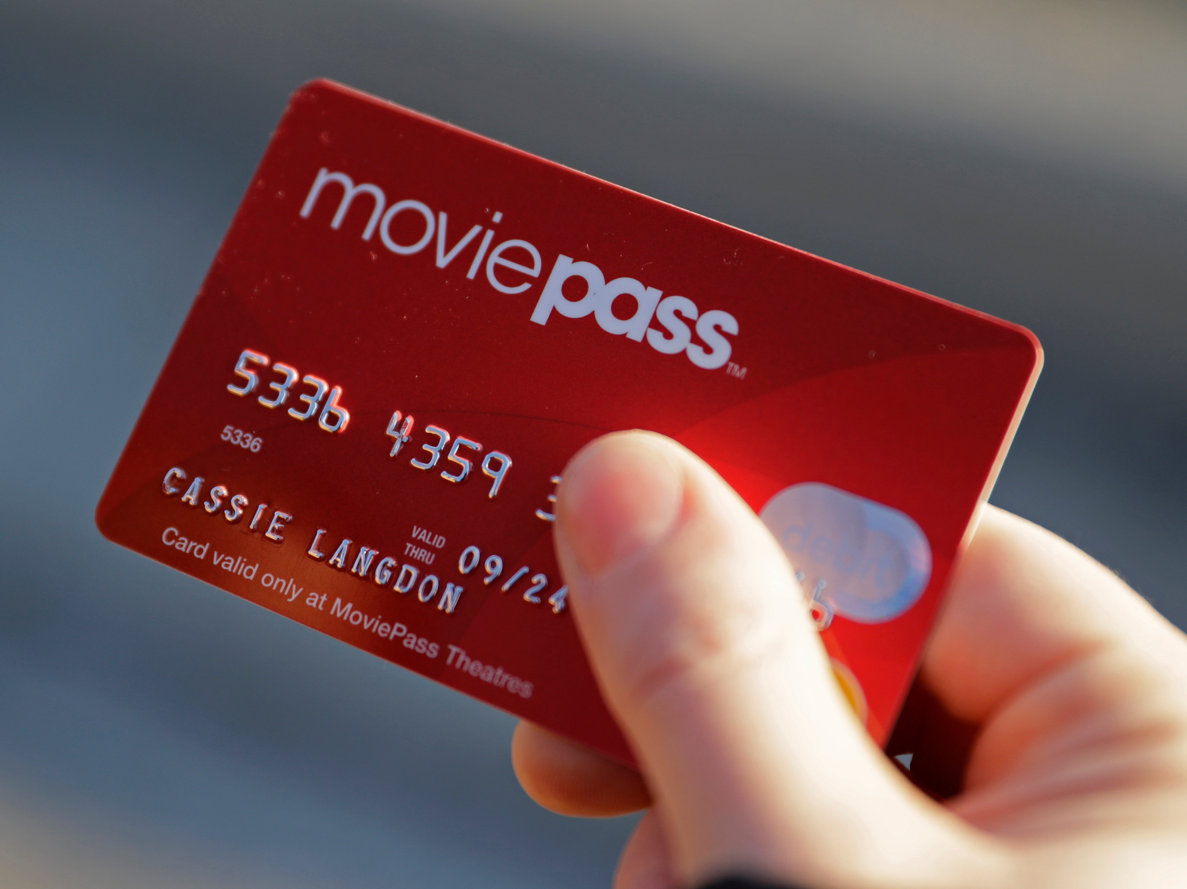
Failed Businesses
MoviePass
$5 monthly subscription an individual can use to purchase unlimited movie tickets.
Too many subscribers, lack of restrictions, and too low of a monthly fee caused the company to shut down with short notice.
Notes:
Sarahelizberger, S. (2018, August 1). Here’s what all of MoviePass’s recent problems could mean for you. CNBC. https://www.cnbc.com/2018/08/01/what-moviepasss-problems-mean-for-subscribers.html

Slide 17
Successful Businesses
Squatty Potty
The company leveraged social media to create a viral video in 2015, which brought in $20 million in revenue.
Advertising on medical talk shows raised another $174 million in revenue.
This lifestyle product was advertised to have physical benefits and marketed toward a target audience of adult and elderly buyers.
Notes:
Amazon. (n.d.). Product description for Squatty Potty original toilet stool 2.0 base 7”, white, 1 count. https://www.amazon.com/Squatty-Potty-Original-Bathroom-Toilet/dp/B07JBPD8K5

Slide 18
Successful Businesses
Sleep Styler
A foam overnight hair curler.
The original product brought in $100 million in revenue.
The product was so popular other companies began producing their own version.
Social media and influencers were leveraged in the marketing of this product.
Notes:
Kileen (2017). MY SLEEP STYLER REVIEW: STYLE YOUR HAIR WHILE YOU SLEEP! [Photograph]. cute & little: petite fashion + lifestyle. https://cuteandlittle.com/wp-content/uploads/2017/09/img_5977.jpg
https://cuteandlittle.com/sleep-styler-review/

Slide 19
Benefits of a Well-Developed Business Plan
Strategic Direction: A business plan helps align the business's goals, strategies, and resources, providing a clear direction for growth and success.
Investor Confidence: Investors and lenders are more likely to support a business with a solid plan, as it demonstrates the entrepreneur's commitment and ability to deliver.
Risk Management: A business plan allows entrepreneurs to identify potential risks and develop contingency plans to mitigate them.
Financial Forecasting: Through financial projections, a business plan helps entrepreneurs evaluate the financial feasibility of their ideas and make informed decisions.

Slide 20
Essential Components of a Business Plan
Executive Summary
Business Description
Operations Plan
Financial Plan
Market Analysis
Marketing Strategy

Slide 21
Building Out Your Business
Each group will draw cards to determine the following about their business:
Assets
Liabilities
Each group will have access to the resource library:
Marketing options
Retail space
Pricing strategies
Calculating markup
Markup examples

Slide 22
Business Plan Outline
Transfer the information from your Asset and Liability cards to your group’s outline.
Return the cards to me.
Complete the remainder of the outline with your group.
Use a web-based search engine for market research information.
Use the resource library for all remaining sections.

Slide 23
Creating Business Plans
Once you complete the outline, use the Business Plan Expectations handout to understand the format.
Group member to-dos:
All group members are expected to contribute equally.
Report should be typed in a word processing tool.
One original business plan should be submitted per group.
One narrative should be submitted with all group members’ names attached.

Slide 24
Group Presentations
Using the Presentation Rubric, watch the Shark Tank pitch and grade the group.
Chill Systems Pitch
Notes:
Shark Tank Global. (2022, January 25). “it only holds three cans?” The sharks question chill systems | shark tank us | shark tank global [Video]. YouTube. https://www.youtube.com/watch?v=ULws5gyPTHY&t=2s

Slide 25
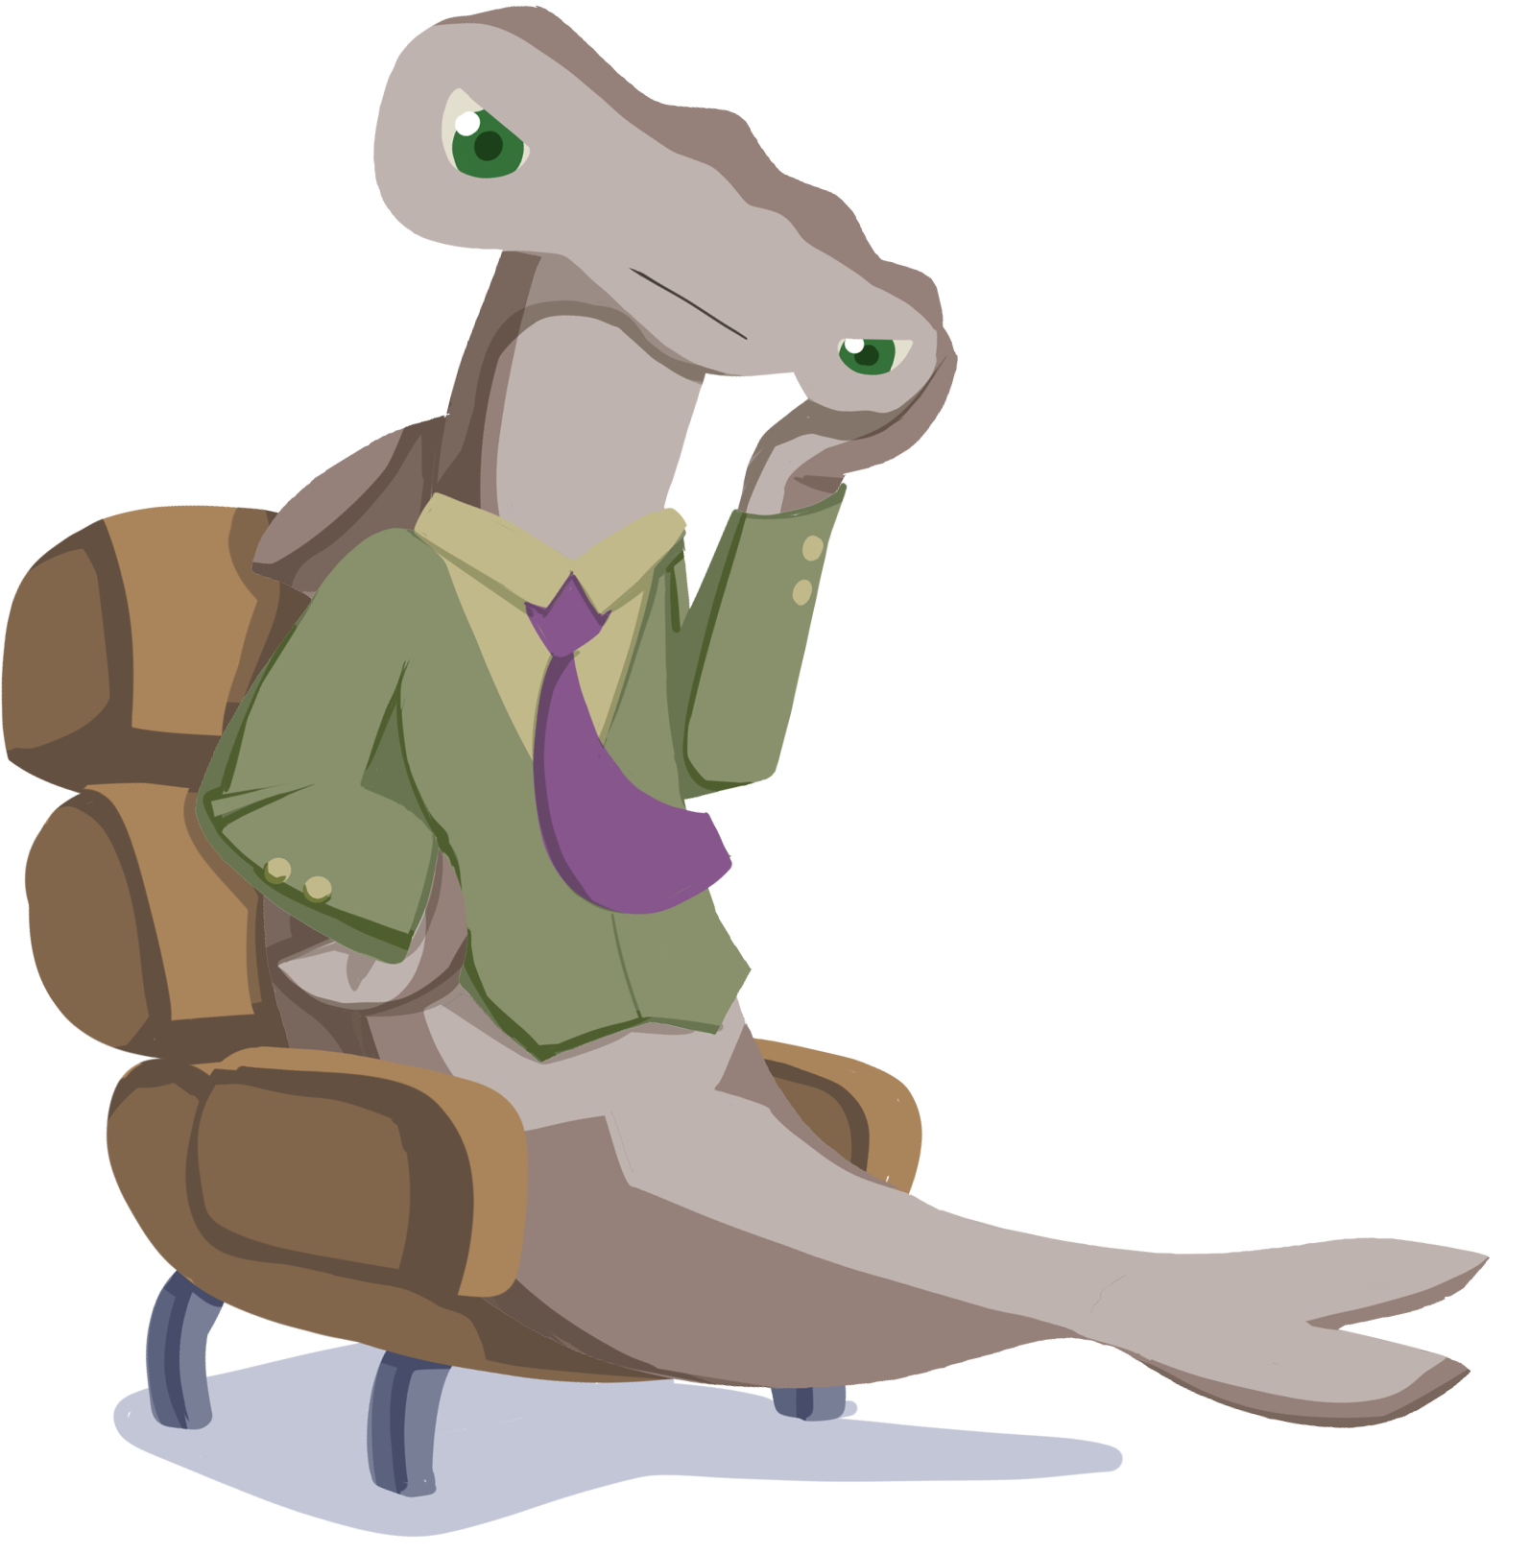
Reflect on Video
What grade did the Shark Tank pitch receive?
What went well?
What could be improved?

Slide 26
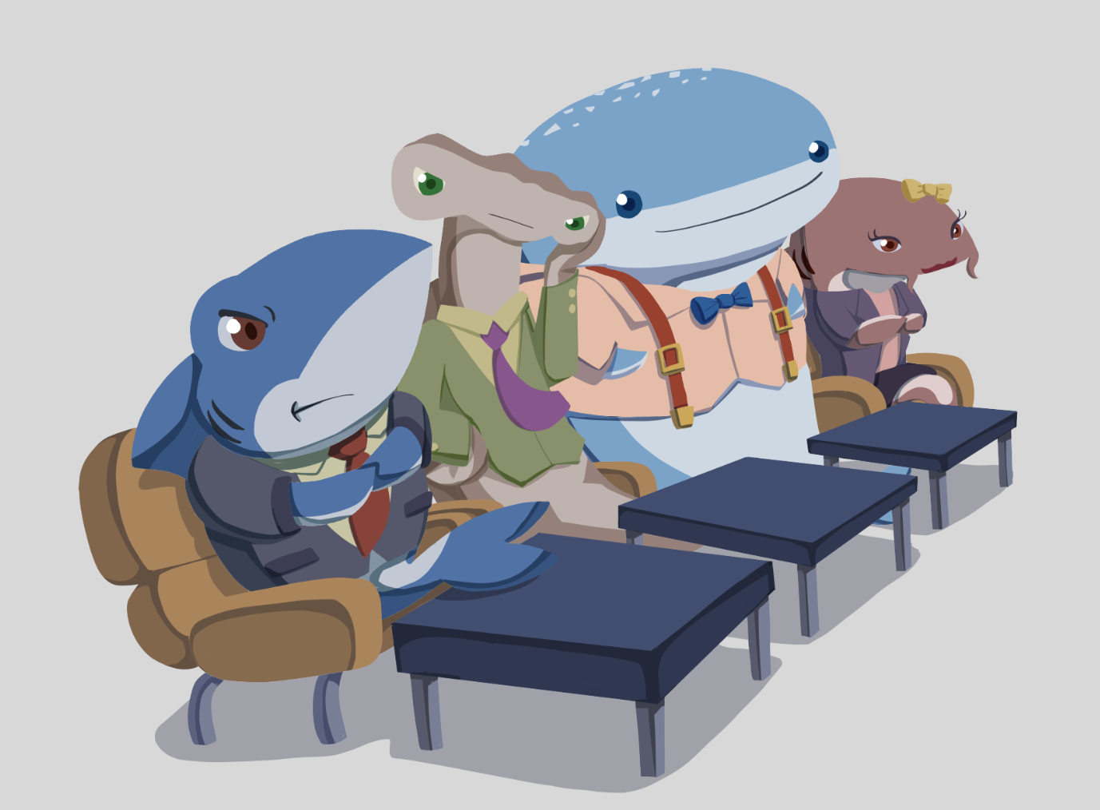
Continue Working on Business Plans and Presentations
Your business plan should be typed and in paragraph form.
Follow the Business Plan Expectations handout.
Your presentation should be in a digital format.
Both will be turned in to the instructor.

Slide 27
Evaluate
Business plans are typed and turned in.
Group presentations are happening now.

Slide 28
Continue Working on Business Plans
Your business plan should be typed and in paragraph form.
Follow the business plan format guidelines.

Slide 29
What Do You Meme?
Watch the video of entrepreneur Mark Cuban.
Pay attention to:
How Mark Cuban became an entrepreneur.
What moves he made to reach his goals.
What advice he gives people who want to be entrepreneurs.
Any information that is surprising or interesting to you.
Notes:
K20 Center. (n.d.). What Do You Meme?. Strategies. Retrieved from https://learn.k20center.ou.edu/strategy/984

Slide 30
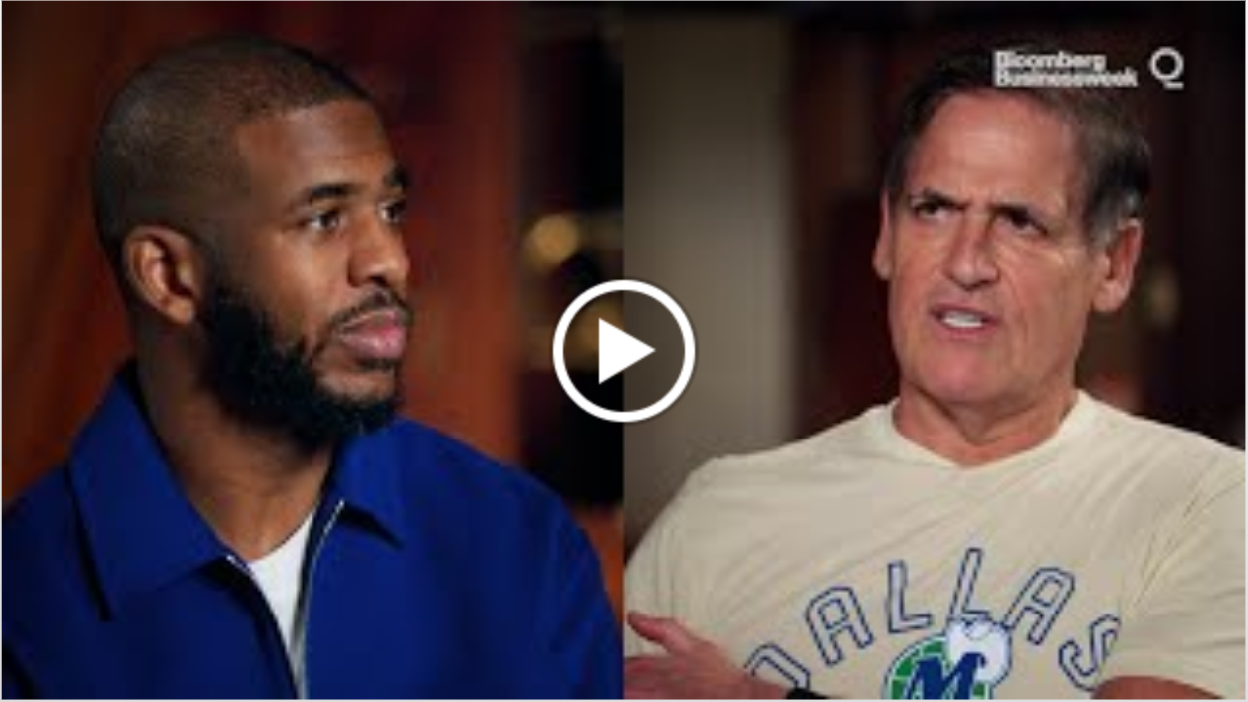
ICAP: Becoming an Entrepreneur (Full Video)
Mark Cuban On Becoming An Entrepreneur (Full Video)
Notes:
Bloomberg Talk. (2022, April 20). Mark Cuban on becoming an entrepreneur: How I got here with Chris Paul. [Video]. YouTube. https://youtu.be/B73ebBNrjmg

Slide 31
ICAP: Becoming an Entrepreneur
Mark Cuban: Becoming an Entrepreneur
Notes:
Bloomberg Talk. (2022, April 20). Mark Cuban on becoming an entrepreneur: How I got here with Chris Paul. [Video]. YouTube. https://youtu.be/B73ebBNrjmg

Slide 32
ICAP: The Journey
Mark Cuban: The Journey
Notes:
Bloomberg Talk. (2022, April 20). Mark Cuban on becoming an entrepreneur: How I got here with Chris Paul. [Video]. YouTube. https://youtu.be/B73ebBNrjmg

Slide 33
ICAP: The Business of Basketball and Shark Tank
Mark Cuban: The Business of Basketball and Shark Tank
Notes:
Bloomberg Talk. (2022, April 20). Mark Cuban on becoming an entrepreneur: How I got here with Chris Paul. [Video]. YouTube. https://youtu.be/B73ebBNrjmg

Slide 34
ICAP: Conclusion
Mark Cuban: Conclusion
Notes:
Bloomberg Talk. (2022, April 20). Mark Cuban on becoming an entrepreneur: How I got here with Chris Paul. [Video]. YouTube. https://youtu.be/B73ebBNrjmg

Slide 35
Creating and Sharing Memes
Create a Meme that shows your reaction to the video you just watched.
https://imgflip.com/
Be ready to share your meme and rationale with the class.

