Slide 2
Watch Out for Sharks!
Draft a Business Plan Using Shark Tank

Slide 3
Essential Question
What is necessary to develop a business plan?

Slide 4
Lesson Objectives
Use elements of a business plan to create a business pitch.
Use mathematical models to represent real-world businessplan scenarios.

Slide 5
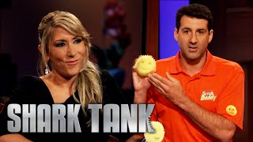
Pitch Reflection
Scrub Daddy’s Pitch
Notes:
Shark Tank Global. (2022, February 25). A Bidding War Breaks Out During Scrub Daddy’s Pitch | Shark Tank US | Shark Tank Global [Video]. YouTube. https://www.youtube.com/watch?v=ae5MssJ8en4

Slide 6
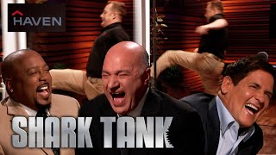
Pitch Reflection
Haven Lock’s Pitch
Notes:
Shark Tank Global. (2022, May 27). The “Best Pitch Ever!” on Shark Tank With Haven | Shark Tank US | Shark Tank Global [Video]. YouTube. https://www.youtube.com/watch?v=D83MdEeYe6g

Slide 7
Pitch Reflection
Fort’s Pitch
Notes:
Sony Pictures Television. (2022, September 3). Shark Take US | Sharks Struggle to Get Behind Fort’s Business Model [Video]. YouTube. https://youtu.be/LxuegyltzTw?si=bCApf6IQutPijdRh

Slide 8
Pitch Reflection
Questions | Scrub Daddy | Haven Lock | Fort
Problem Being Solved | makes cleaning easier | people breaking into your home | Stop using nice furniture to make pillow forts
Requested Investment | $100K for 10% stake | $500K for 6% stake | $500K for 10% stake
Target Audience | someone who does dishes | homeowners | parents who want easier clean-up
Similar Product | scratch pad, steel wool, sponge | deadbolt lock | Modular cushions / misc. fort-building kits
Math Used | QVC orders 30% more from me each time | costs to make the product and what they’re selling it for | $2 million raised in 2 hours; big products cost more to ship
Pros/Cons | pro: versatile; con: more expensive than competitors | pro: keep schools safe; con: only selling online | pro: lot of interest; con: similar products are cheaper

Slide 9
Collective Brain Dump
Write one idea for each of the following prompts on a separate sticky note:
A problem that you see in your community.
A situation that can be made easier with an invention.
A way to make a lot of money.
When you are done, place your sticky notes on the corresponding posters.
Notes:
K20 Center. (n.d.). Collective brain dump. Strategies. Retrieved from https://learn.k20center.ou.edu/strategy/111

Slide 10
Collective Brain Dump
Community Problem
Tough Situation
Money Maker
Dog owners not picking up pet waste
Taking care of family members
Food truck that serves cold food and drinks
Notes:
K20 Center. (n.d.). Collective brain dump. Strategies. Retrieved from https://learn.k20center.ou.edu/strategy/111

Slide 11
Gallery Walk
In groups:
Go to each of the three posters.
Read all the ideas.
Return to each poster and take one sticky note from each poster.
Notes:
K20 Center. (n.d.). Gallery walk / carousel. Strategies. Retrieved from https://learn.k20center.ou.edu/strategy/118

Slide 12
Company Brainstorming
Work together to complete your handout.
Place the sticky note you collected from each poster on the corresponding page of the handout.
After completing the first three pages:
Choose one or combine two ideas to determine what product or service you want for your business.
Name the product and the company.

Slide 13
Sharing Company Ideas
Each group will share with the class their idea for their company.
Let’s help each other by listening and asking questions to help improve their product/service.
It is legal?
It is feasible?
What questions do you have about the product or service?
Will the company be web-based, brick and mortar, etc.?

Slide 14
Collaboration Time
T: Tell what you like about their idea.
A: Ask a question about their idea.
G: Give one suggestion about their idea.
Notes:
K20 Center. (n.d.). TAG Me!. Strategies. https://learn.k20center.ou.edu/strategy/2873

Slide 15
Company Revisions
In your group, discuss the feedback you received.
What changes do you want to make?
What do you still need to figure out?
What are you going to keep (and not change)?
Work towards a final decision. You will develop your business around this product or service for the remainder of this project. Choose wisely.

Slide 16
Business Plan
A document setting out a business’s future objectives and strategies for achieving them
A business plan is a roadmap that outlines the goals, strategies, and financial projections of a business.
Business plans help individuals clarify their vision, identify potential challenges, and make informed decisions.

Slide 17
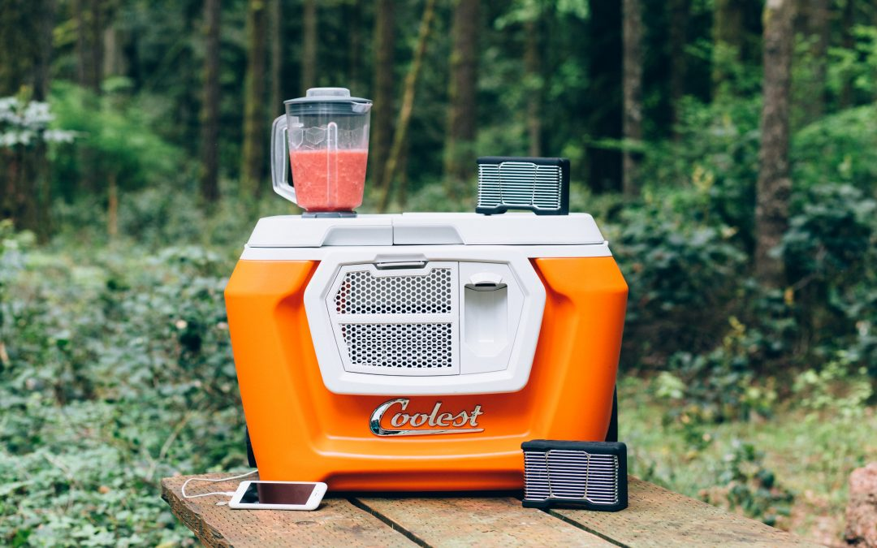
Failed Businesses: The Coolest Cooler
Some of the amazing features:
Built-in blender & LED-lit lid
Removable Bluetooth speaker
Waterproof USB charger
Tie-down bungee to stack
Built-in organization and storage
Wide wheels
What would you pay for it?
Notes:
Schlosser, K. (2019, December 10). Coolest Cooler shuts down after 5-year saga, leaving 20,000 backers without Kickstarter reward. GeekWire. https://www.geekwire.com/2019/coolest-cooler-shuts-5-year-saga-leaving-20000-backers-without-kickstarter-reward/

Slide 18
Failed Businesses: The Coolest Cooler
The selling price was $200 (including shipping).
Just over $13 million raised through Kickstarter BEFORE they calculated the expenses of the company.
The amount they sold the cooler for was less than the amount it costs to make the cooler. Very few original purchasers ever got their product or their money back.
Notes:
Schlosser, K. (2019, December 10). Coolest Cooler shuts down after 5-year saga, leaving 20,000 backers without Kickstarter reward. GeekWire. https://www.geekwire.com/2019/coolest-cooler-shuts-5-year-saga-leaving-20000-backers-without-kickstarter-reward/

Slide 19
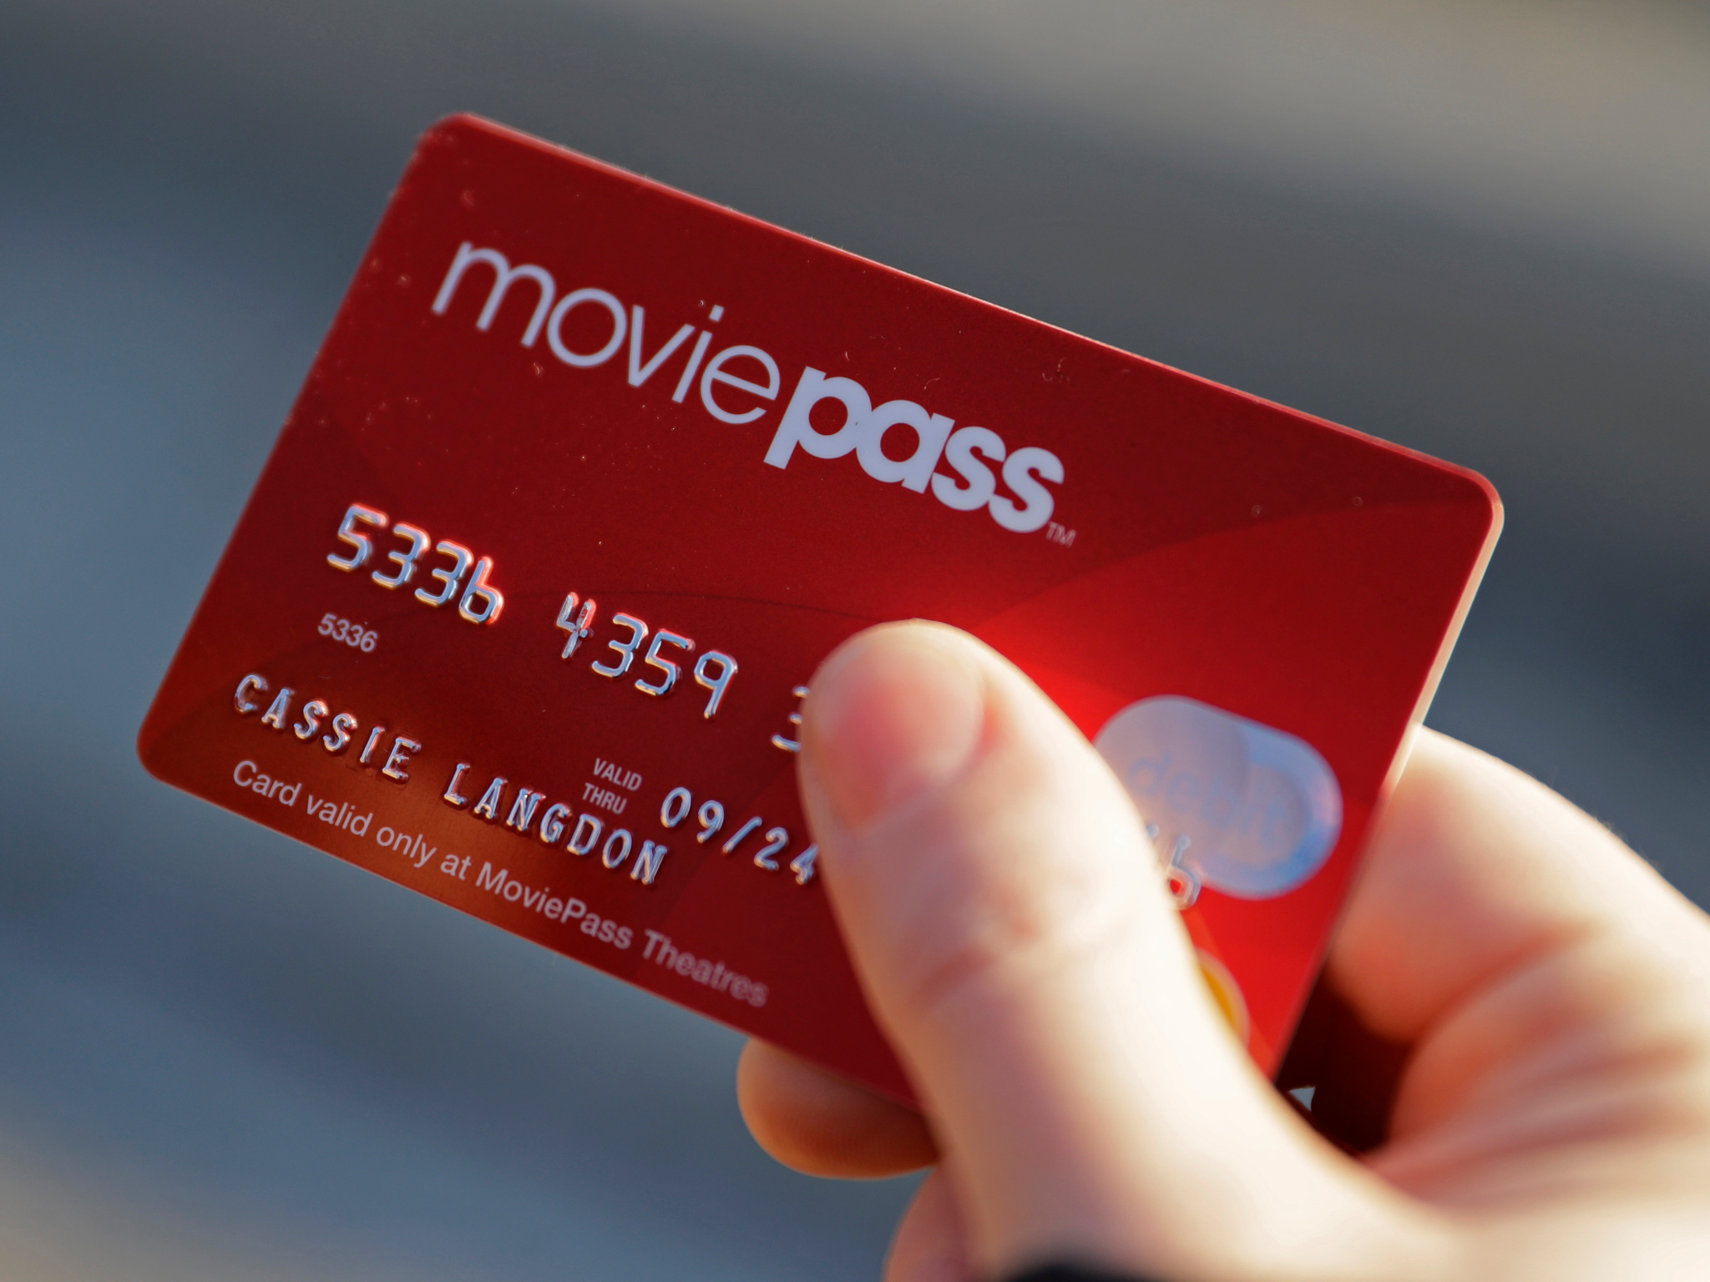
Failed Businesses: MoviePass
Some of the amazing features:
For a monthly fee, you could go see one movie per day.
You pick the theater and show time from the available options in the app.
What would you pay for it?
Notes:
Sarahelizberger, S. (2018, August 1). Here’s what all of MoviePass’s recent problems could mean for you. CNBC. https://www.cnbc.com/2018/08/01/what-moviepasss-problems-mean-for-subscribers.html

Slide 20
Failed Businesses: MoviePass
It started as a $5 monthly subscription.
Students were the primary subscribers.
They had to pay the theater for every movie, and the monthly fee was less than what they had to pay. So, they were losing money.
Some theatres found success when they created their own version, changed pricing, and limited access.
Notes:
Sarahelizberger, S. (2018, August 1). Here’s what all of MoviePass’s recent problems could mean for you. CNBC. https://www.cnbc.com/2018/08/01/what-moviepasss-problems-mean-for-subscribers.html

Slide 21
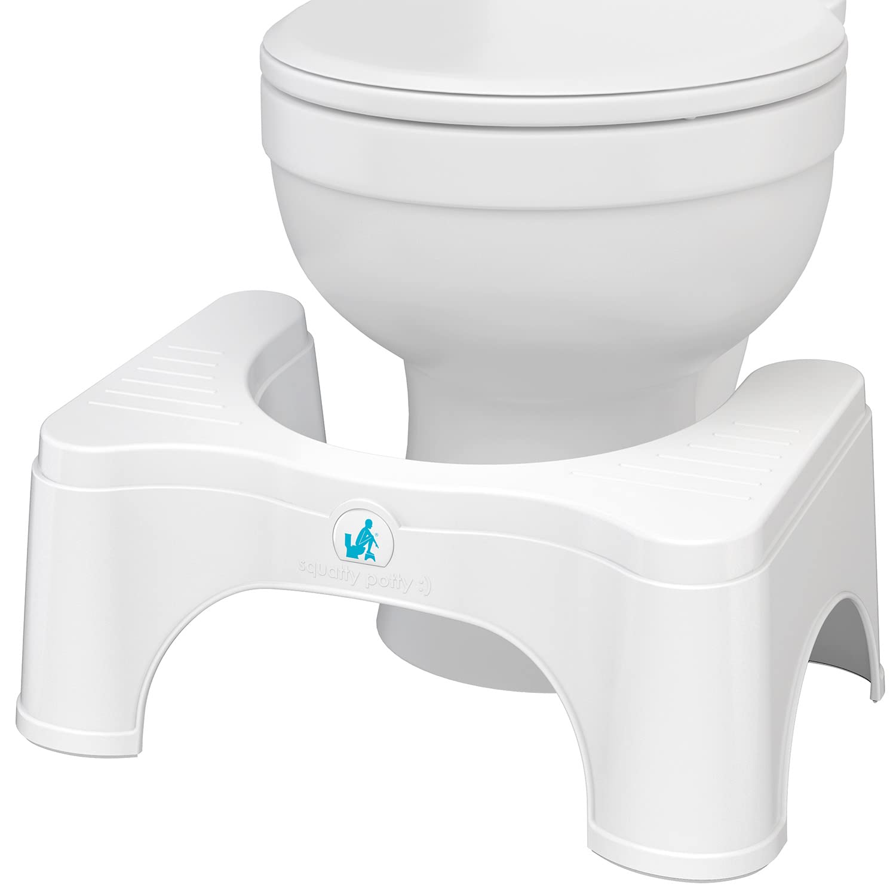
Successful Businesses: Squatty Potty
Some of the amazing features:
Change the angle your waste passes as it exits your person
Comfortably get your feet 7” off of the floor
350-pound weight capacity
Anti-slip surface for both your feet and the floor
What would you pay for it?
Notes:
Amazon. (n.d.). Product description for Squatty Potty original toilet stool 2.0 base 7”, white, 1 count. https://www.amazon.com/Squatty-Potty-Original-Bathroom-Toilet/dp/B07JBPD8K5

Slide 22
Successful Businesses: Squatty Potty
The selling price is $25.
The company leveraged social media to create a viral video in 2015, which brought in $20 million in revenue.
Advertising on medical talk shows raised another $174 million in revenue.
Because of its simple, plastic design, the cost to make this product was low making it easy to make profit.
Notes:
Amazon. (n.d.). Product description for Squatty Potty original toilet stool 2.0 base 7”, white, 1 count. https://www.amazon.com/Squatty-Potty-Original-Bathroom-Toilet/dp/B07JBPD8K5

Slide 23
Successful Businesses: Sleep Styler
Some of the amazing features:
Effortless curls: dry and curl your hair at the same time!
Comfortable to wear while you sleep!
Made of soft memory foam
What would you pay for it?
Notes:
Kileen (2017). MY SLEEP STYLER REVIEW: STYLE YOUR HAIR WHILE YOU SLEEP! [Photograph]. cute & little: petite fashion + lifestyle. https://cuteandlittle.com/wp-content/uploads/2017/09/img_5977.jpg
https://cuteandlittle.com/sleep-styler-review/

Slide 24
Successful Businesses: Sleep Styler
The selling price is $55.
They leveraged social media and influencers in the marketing of this product.
The original product brought in $100 million in revenue.
The product was so popular, other companies began producing their own version of the curlers.
Notes:
Kileen (2017). MY SLEEP STYLER REVIEW: STYLE YOUR HAIR WHILE YOU SLEEP! [Photograph]. cute & little: petite fashion + lifestyle. https://cuteandlittle.com/wp-content/uploads/2017/09/img_5977.jpg
https://cuteandlittle.com/sleep-styler-review/

Slide 25
Business Plan Outline
Think about what might have caused these businesses to succeed or fail.
Work in your group to start your Business Plan Outline.
Use the search engines to find information about what is already on the market.
Find facts online as needed to complete the handout.
Select at least one marketing strategy. Circle your selection.
Select one property type: online only, brick-and-mortar, mobile, or other. Circle your selection.

Slide 26
Essential Components of a Business Plan
Business Description
Product/Service Description
Market Analysis
Marketing Strategy
Operations Plan
Financial Plan

Slide 27
Business Description
What is your company name?
Where will your business be located?
How many employees are you going to have?
What problem are you trying to solve?

Slide 28
Product/Service Description
What is the name of your product or service?
How is your product or service different from your competitors?
What is your selling price?

Slide 29
Selling Price and Markup
The selling price is the amount a customer will pay you for your product or service.
The markup of a product is the difference between the selling price and the cost of making the product.
For example, if you spend $5 on the supplies to create 1 delicious sandwich, and you sell the 1 sandwich for $8, then the markup is $3.

Slide 30
Verbal Model to Algebraic Model
We can create mathematical models to represent relationships between variables.
Verbal Model:
Algebraic Model:
Solve or Evaluate:

Slide 31
Market Analysis
Do we have any competitors?
What are the selling prices of our competitors or of those with similar products?
What makes our product stand out from the competition?

Slide 32
Marketing Strategy
Who is your target audience?
A target audience is the group you anticipate buying your product/service.
Examples: parents, OKC residents, etc.
Who would be the target audience for the following products?
A PC-Based Survival Game
A Children’s Clothing Store
An Athletic Shoe Company

Slide 33
Marketing Strategy
How do you plan to promote or advertise your product or service?
A PC-Based Survival Game
A Children’s Clothing Store
An Athletic Shoe Company

Slide 34
Marketing Strategy
How do you plan to promote or advertise your product or service?
A PC-Based Survival Game
A Children’s Clothing Store
An Athletic Shoe Company
How are you going to make sure that your product or service sells?

Slide 35
Operations Plan
What does it cost for your business to operate?
It’s the total of fixed & variable costs.
Fixed costs are expenses that are not dependent on how many items you sell.
Examples: property, insurance, etc.
Variable costs depend on the number of items you sell.
Example: How many sandwiches you sell determines how much money you spend on sandwich supplies.

Slide 36
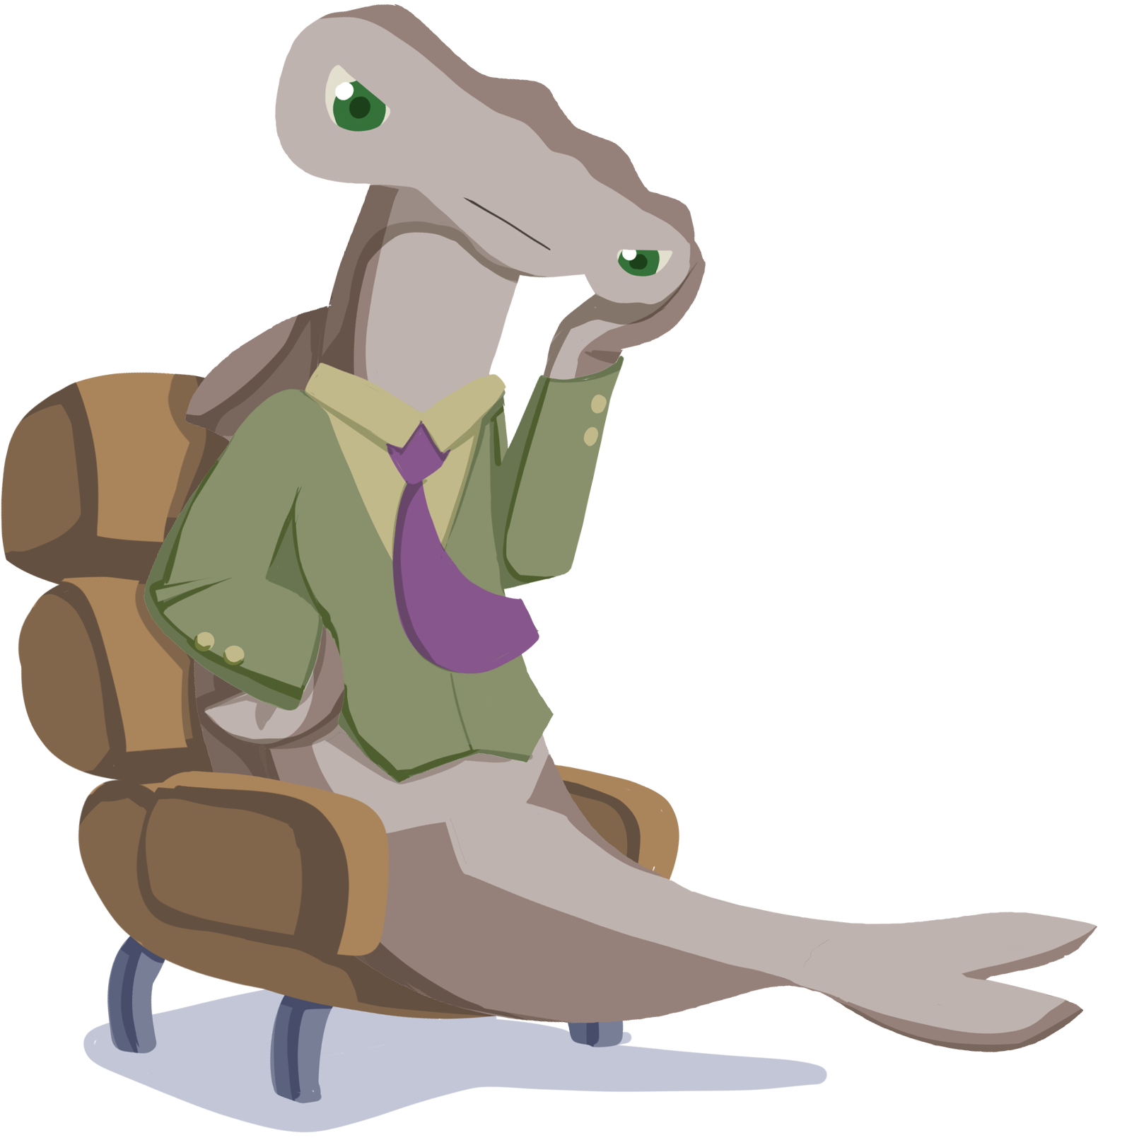
Financial Plan
If you want a business to be successful, then you need to understand the financial side.
Are you going to make or lose money?
How many items do you need to sell to cover all of your expenses?

Slide 37
Profit and Revenue
Profit is the difference between your revenue and your expenses.
Your revenue is the amount of money your company brings in from selling n items, where n is the number of items.

Slide 38
Profit and Expenses
Your expenses are the sum of your fixed costs and variable costs.

Slide 39
Profit and Math Modeling

Slide 40
Profit and Breaking Even
The break-even point is the number of items you need to sell to cover all of your expenses.
What do you think that means for our profit equation?

Slide 41
Business Plan Outline: Finishing
Now that you have a better understanding of what a business plan is, work together to complete your Business Plan Outline handout.
Using your new information, make changes as needed.

Slide 42
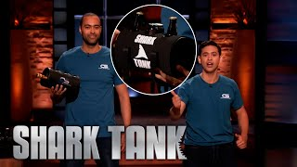
Pitch Rubric: Evaluating Shark Tank
Chill Systems Pitch
Notes:
Shark Tank Global. (2022, January 25). “It Only Holds Three ans?” The Sharks Question Chill Systems | Shark Tank US | Shark Tank Global [Video]. YouTube. https://youtu.be/ULws5gyPTHY?si=bJsxHwnCeCS4RYP1

Slide 43
Pitch Rubric: Evaluating Shark Tank
Chill Systems: Chiller
What score should this pitch receive?
What went well?
What could be improved?

Slide 44
Creating Your Business Pitch
Create a slide deck that is visually appealing and contains:
Business and Product/Service Description
Marketing Strategy
Operations Plan (list of all your expenses)
What are all of your expenses?
Financial Plan
You must show your calculations for your break-even point.
Investment Request (1 year of expenses)
Show your calculations of how much it will cost to run your business for 1 year without profit.

Slide 45
Mathematics Behind a Business Plan
ICAP Video Coming Soon

