Slide 2
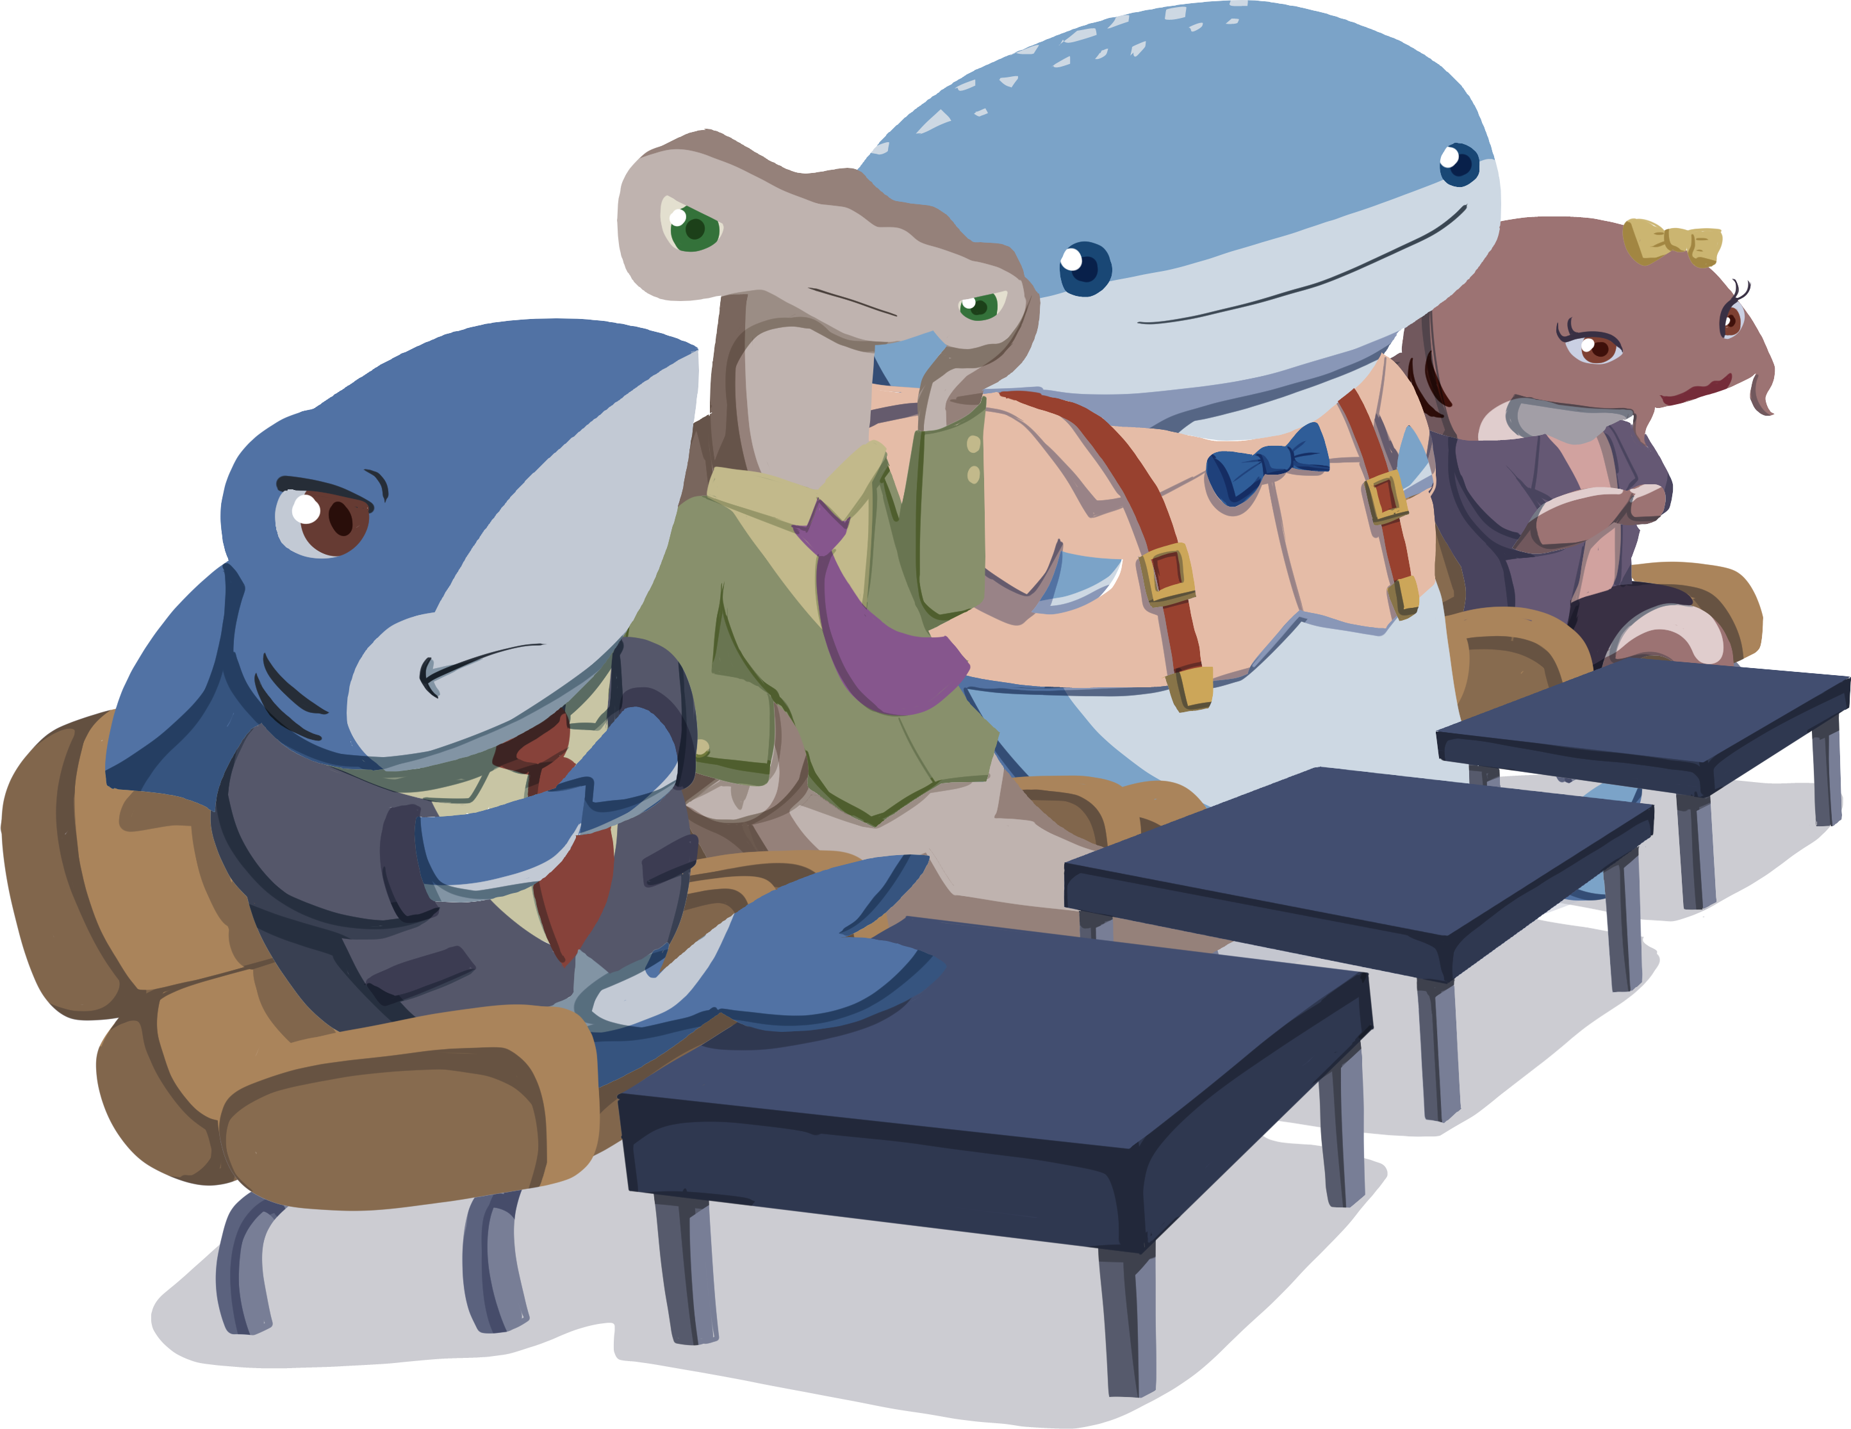
Brunch Box
Brunch in a Box

Slide 3
Business Description: Brunch Box
We are Raymond, Rose, and Rustam. We have all worked in restaurants that serve breakfast.
In Norman, our food truck will be serving food at:
Schools
Offices
Local food-truck events
Sporting events
Catering (private) events
There are not enough food truck options for brunch foods.
This should solve that problem and make a lot of money.

Slide 4
Product Description: Brunch in a Box
3 Boxes Available Each Day ($12 each):
Hearty Option
Healthy Option
Vegan/GF Option
Each box will include a main dish, side, and beverage.
We’ll be the first food truck selling brunch.

Slide 5
Marketing Strategy: Spread the Word
Target Audience:
Young people
Families
We are going to spend $6,000 = $500(12) to have ads on YouTube.
We’re also going to spend $19,200 = $1,600(12) on social media like Facebook and Instagram.

Slide 6
Operations Plan: Annual Expenses
Marketing Costs: $25,200
Property Costs: $50,000
Salary: $50,000 (x3 employees) = $150,000
Employee Health Insurance: $500 (x3 employees) = $1,500
Commercial Property Insurance: $50,000 (1%) = $500
Liability Insurance: $50(12) = $600
Cost per item: $6 per box

Slide 7
Financial Plan: Show Me the Money
Revenue
Expenses
Selling Price: $12.00 / box
Total Fixed Expenses: $227,800
Variable Expenses: $6 / box

Slide 8
Financial Plan: Is It Profitable?
Profit = (Selling Price)(# of items) – (Fixed + Variable Expenses)
P = (12.00)(n) – (227,800 + 6.00n)
0 = 6n – 227,800
n = 37,966.67
I would need to sell 37,967 items to break even.

Slide 9
Is It Worth It?
To operate for 1 year, it is going to cost $227,800 plus $6 for every brunch box we sell.
Since we need to sell 37,967 to break even. Our minimum expense would be $455,602 for the first year. Then we start making profit.
We’re asking for a $455,602 investment for 50% of the profit (after breaking even).

