Slide 2
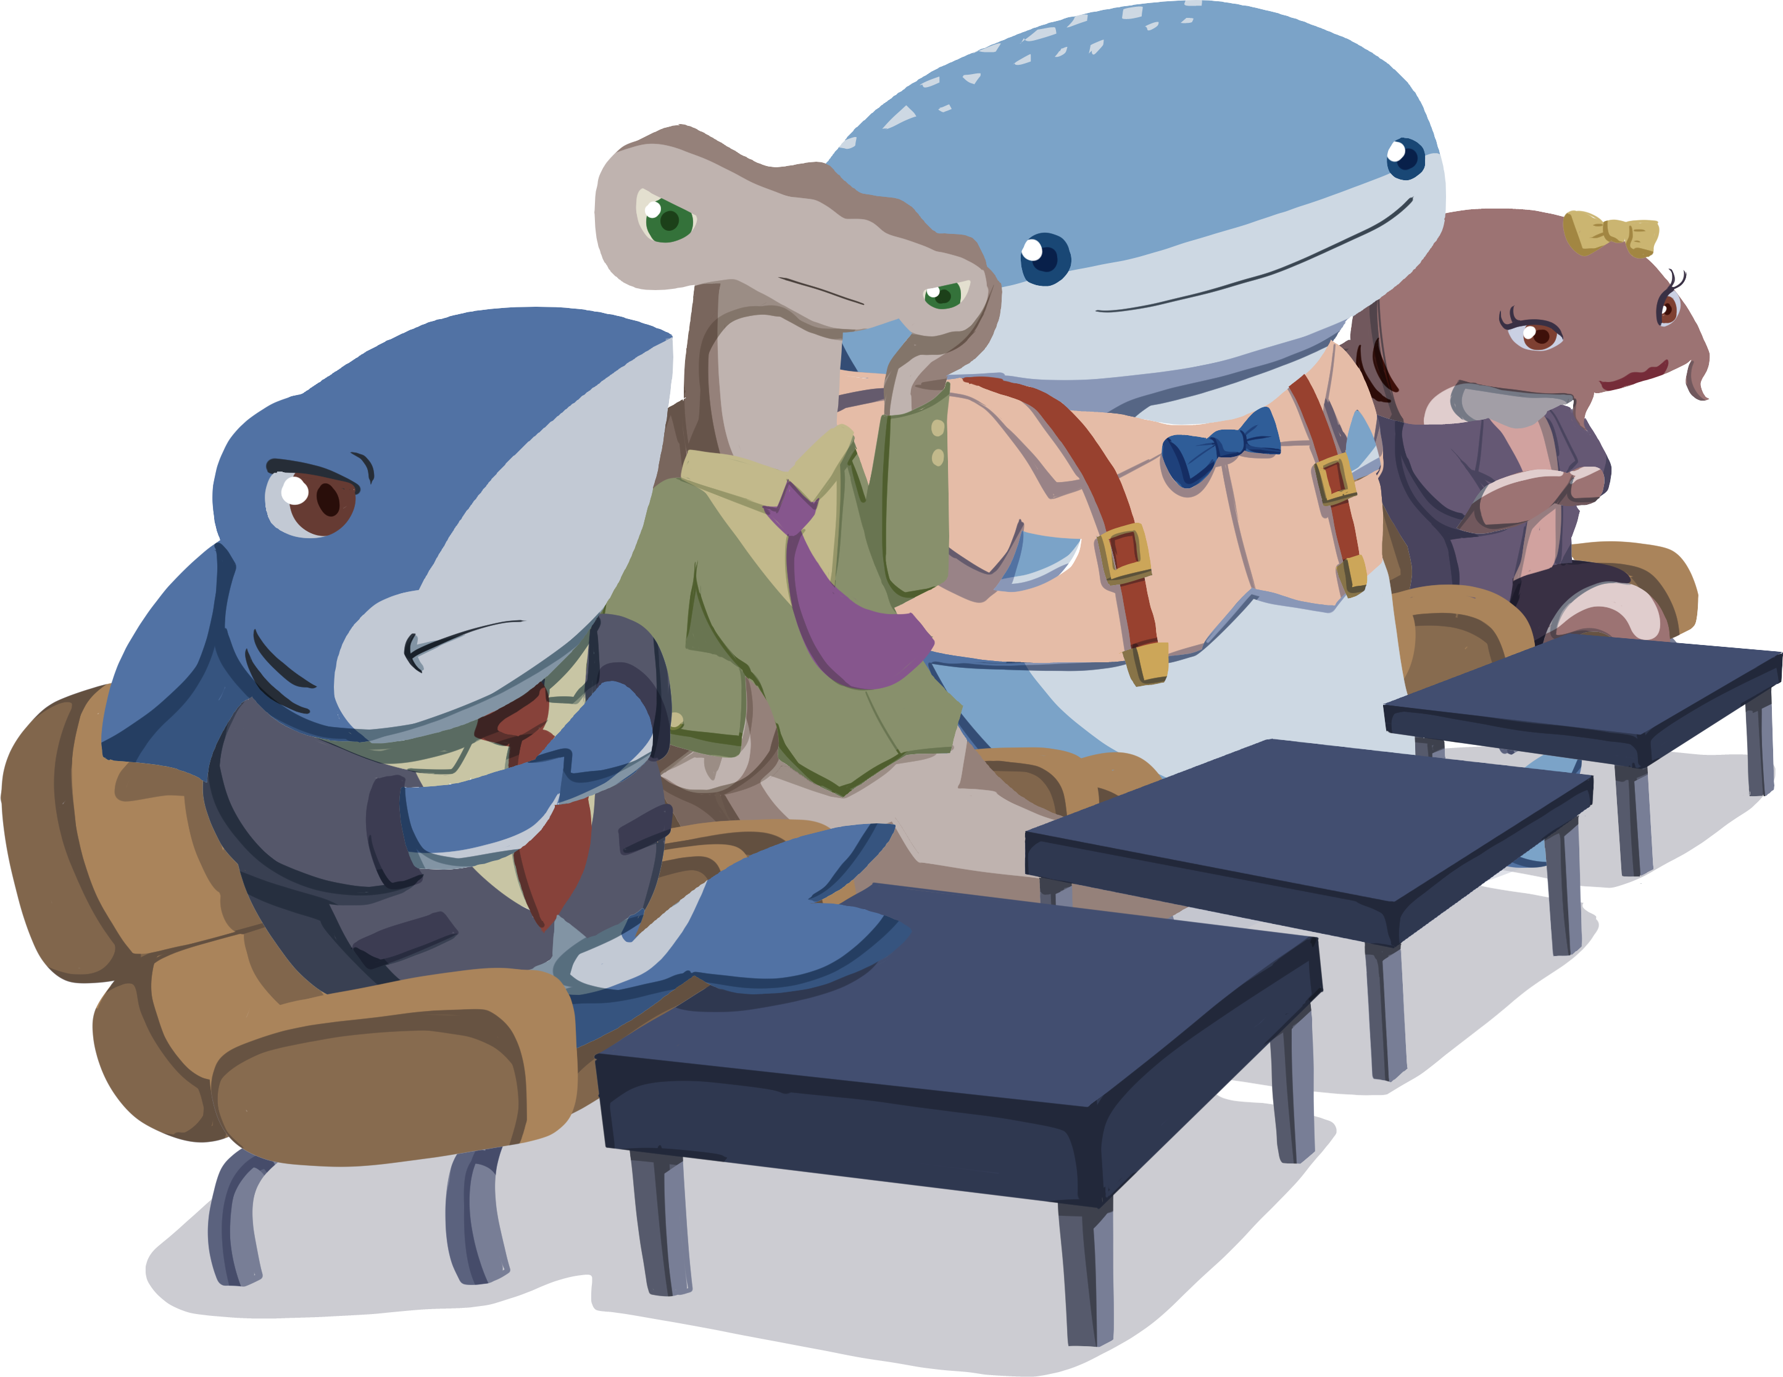
{Company Name}
{Product Name}

Slide 3
Business Description: [Company Name]
Introduce yourselves and your company.
Share where your business will be located.
What problem are you trying to solve?
How many employees will you have?

Slide 4
Product/Service Description: [Item Name]
What is your product?
How is it different from your competitors?
What is the selling price of your product/service?

Slide 5
Marketing Strategy: Spread the Word
Who is your target audience?
How do you plan to promote or advertise your company and product?
How much do you expect this type of advertising to cost?

Slide 6
Operations Plan: Annual Expenses
Marketing Costs: $
Property Costs: $
Salary: $
Employee Health Insurance: $
Commercial Property Insurance: $
Liability Insurance: $
Cost per item: $
How much does it cost you to make the product/service?

Slide 7
Financial Plan: Show Me the Money
Revenue
Expenses
Selling Price: $___ per item
Total Fixed Expenses: $___
Variable Expenses: $___ per item

Slide 8
Financial Plan: Is It Profitable?
What is your break-even point?
Show your calculations.

Slide 9
Is It Worth It?
What investment are you asking for?
Show your calculations.
To operate for 1 year, it is going to cost _____ to break even.
We’re asking for ___ for 50% of the profit (after breaking even).

