Slide 2
Deal with the Devil
Faustian Bargains

Slide 3
Essential Questions
What convinces someone to sacrifice something dear to them?
What role do deals (Faustian bargains) play in literature and pop culture?

Slide 4
Learning Objectives
Students connect the idea of a Faustian bargain with pop culture and literature.
Students craft an argumentative essay persuading someone to or not to take a Faustian bargain.

Slide 5

Four Corners
Make the difficult choice and explain your reasoning.
Read the “Outcome” and all “Deals” you could make to get it.
Move to the corner (A,B,C, or D) which represents the “Deal” you are willing to make the most.
Debate with another group about how you justify your choice.
Notes:
K20 Center. (n.d.). Four corners. Strategies. https://learn.k20center.ou.edu/strategy/138

Slide 6

“If I could… never have to do English homework again…”
“I’m willing to…”
A. Eat only kale for the next 5 years. | B. Give up TikTok forever.
C. Do extra math homework. | D. Listen only to Phil Collins until I reach the age of 30.
Notes:
Could changer “outcome” to “what I want” and “deal” to “what I’m willing to do”

Slide 7
“If I could… be an Influencer and make millions…”
“I’m willing to…”
A. Go completely bald. | B. Have horrendous, non-maskable BO.
C. Never get to see my family again. | D. Be unable to taste ANY food or drink.
Notes:
Could changer “outcome” to “what I want” and “deal” to “what I’m willing to do” If I could…

Slide 8

“If I could… always have enough money at my favorite store to buy whatever I want…”
“I’m willing to…”
A. Take only public transportation. | B. Be chased by aggressive squirrels wherever I go.
C. Drink only Mountain Dew. | D. Switch ages with my oldest grandparent.
Notes:
Could changer “outcome” to “what I want” and “deal” to “what I’m willing to do” I always have enough money at a specific store

Slide 9

CUS and Discuss
Complete the “Crossroads Lyrics” handout comparing Robert Johnson and Cream’s different perspectives using the same lyrics. Annotate using the following guide:
  Circle - Differences
  Underline - Similarities
  Star - Emotions
Use the middle column labeled “Annotations” to write notes about what you noticed for each.
Notes:
K20 Center. (n.d.). CUS and discuss. Strategies. Retrieved from https://learn.k20center.ou.edu/strategy/162

Slide 10
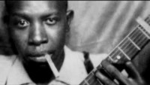
“Crossroads”- Robert Johnson
Notes:
Music Making Manifesto. (2012, Mar. 7). Robert Johnson CrossRoads - Cross Road Blues Song and Lyrics [Video]. YouTube. https://youtu.be/GsB_cGdgPTo

Slide 11

“Crossroads”- Cream
Notes:
1951Fidel. (2012, Oct. 16). Cream Crossroads [Video]. YouTube. https://youtu.be/PE9HvSdcaL4

Slide 12

Snapchat Annotation
Read and compare Robert Johnson and Cream’s different perspectives with the same lyrics using Snapchat.
Open the Snapchat app.
Take a picture of part of the lyrics that illustrates one of the categories below.
Circle, Underline, or Highlight the part and include the abbreviation for the category next to the quote:
  Similarities - #Sim
  Differences - #Diff
  Emotional language/images - #Emo
Include 1-2 emojis or bitmojis to show your reaction to the text.
Write 1-2 sentences of commentary using the text feature.
Save these images to your camera roll and then add them to our class google doc to turn in.
Notes:
K20 Center. (n.d.). Snapchat Annotation. Strategies. https://learn.k20center.ou.edu/strategy/181

Slide 13

Jigsaw - “Faustian Bargains” & “Robert Johnson”
With a partner, complete your H-Chart handout.
Assign each person one of the texts to read and become an expert on.
Fill your “leg” of the H with notes from the article you read.
Share your findings and teach your partner about your article.
After both of you have taught your partner about the other reading, synthesize what you’ve learned.
  In the middle section of the chart, create a real-world scenario of when you may see a Faustian Bargain. What kind of bargain would your parents make? Or principal? Or teacher?
Notes:
K20 Center. (n.d.). Jigsaw. Strategies. https://learn.k20center.ou.edu/strategy/179
K20 Center. (n.d.). Paired texts h-chart. Strategies. https://learn.k20center.ou.edu/strategy/132

Slide 14
Faustian Bargain Defined
A pact where a person trades something of supreme moral or spiritual importance for some worldly or material benefit, such as knowledge, power, or riches.
“Must-have” characteristics:
A Faustian bargain entails a person giving up their morals for something worldly.
They make this bargain with a knowingly “evil” power.
What you surrender is more valuable than what you obtain.

Slide 15
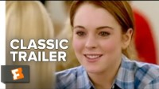
Example: Mean Girls
Notes:
Rotten Tomatoes Classic Trailers. (2017, November 15). Mean girls (2004) trailer #1: Movieclips Classic Trailers. YouTube.
https://youtu.be/oDU84nmSDZY

Slide 16
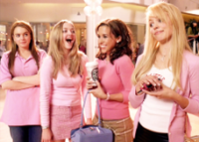
“Mean Girls” Character Break Down
Why would Cady take the deal to join the “plastics?
Notes:
Possible responses:
Cady’s motivations: 1) since she’s new to school she took the deal to make friends; with the plastics but also to appease her other friends Damian and Janice. 2) she continues with the bargain for revenge when Regina takes back the guy Cady likes. 3) since she was homeschooled all her life (and lived in Africa) she may not have known exactly what she was getting into.
Nolfi,J., & CBS VIA GETTY. (n.d.). Rachel McAdams can’t “see a way to shoehorn” “mean girls” stars into new movie. EW.com. https://ew.com/movies/rachel-mcadams-original-mean-girls-cast-new-musical-movie/
Regina’s motivations: 1) “keep enemies closer” she may view Cady as a potential threat to her “queendom” 2) assert her power to make the deal in the first place 3) she may just like manipulating people for her own pleasure.

Slide 17
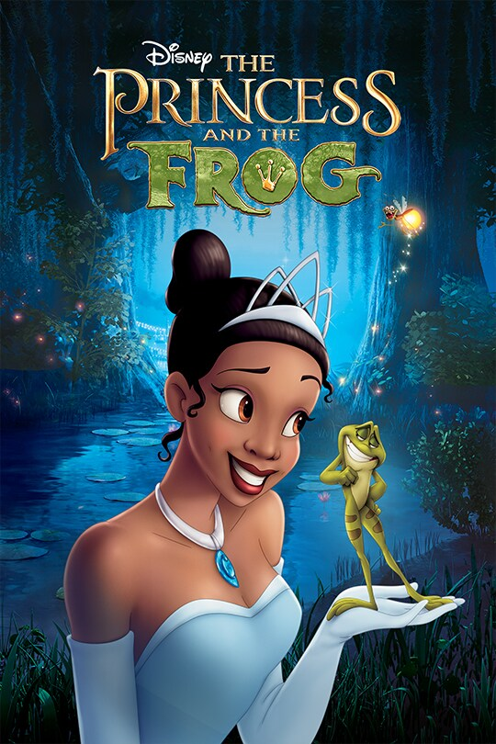

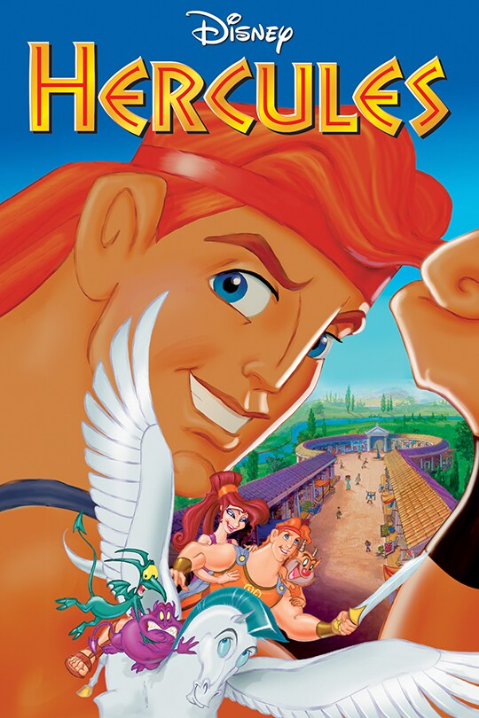
Review
What examples of a Faustian Bargain have you come up with? Can you guess the ones below?
Notes:
Hercules. Disney Movies. (1997, June 27). https://movies.disney.com/hercules
The little mermaid. Disney Movies. (2023, May 26). https://movies.disney.com/the-little-mermaid-2023
The princess and the frog. Disney Movies. (2009, December 11). https://movies.disney.com/the-princess-and-the-frog

Slide 18

Elbow Partner Brainstorm
Get with a partner seated next to you and brainstorm other pop culture references to Faustian Bargains.
Talk about your ideas.
Write down 3 examples.
Next, stand up and read your ideas one at a time for the class. Once all of your ideas are added to the class list, sit down.
Notes:
K20 Center. (n.d.). Elbow partners. Strategies. https://learn.k20center.ou.edu/strategy/116

Slide 19
Examples of Faustian Bargains in Pop Culture
Television Shows
Supernatural
Futurama
The Simpsons
Once Upon a Time
Witcher
Fullmetal Alchemist
Music
Bohemian Rhapsody
Devil Went Down to Georgia
Phantom of the Opera
Movies
Pirates of the Caribbean: Flying Dutchman
The Devil’s Advocate
The Mummy Returns
Doctor Strange
Death Note
Ghost Rider
Heartless
Sleepy Hollow
Star Wars: Episode 3 - Revenge of the Sith
Tenacious D in the Pick of Destiny
The Witch
Harry Potter
Dracula
Pinocchio
Shrek 2; Shrek Forever After
Anastasia
Notes:
https://en.wikipedia.org/wiki/Deals_with_the_Devil_in_popular_culture#:~:text=Faust%3A%20Love%20of%20the%20Damned,to%20cure%20his%20father%27s%20cancer

Slide 20
Persuasion Graphic Organizer
Use Part 1 of the organizer to think about the character you are trying to convince not to take the deal.
Fill in each labeled part with ideas, evidence, images, ect. Be creative!
What are their thoughts? What’s going on in their heads right now?
What actions have they taken that reveal why they would want to take the deal? What actions have they not taken?
Why do they want to make the deal? What will improve for them if they are successful?
What is the setting? How is the location, time, and/or place relevant in making the deal?

Slide 21
Persuasion Graphic Organizer
Now that you know who the character is and what motivates them, use Part 2 to craft your own argument based on what you already brainstormed in Part 1.
Complete each section of the organizer.
Be as specific or vague as needed.
Use this information to write your Persuasive Argument essay.

Slide 22

How am I feeling? / What am I thinking?
Reflect on either of the two questions:
What would convince someone to sacrifice something dear to them?
What role do deals (Faustian bargains) play in literature and pop culture?
Use the following instructions:
  Draw a line (vertically, horizontally, or diagonally) to divide your sticky note in half.
  On one half, draw how you feel about Faustian Bargains.
  On the other half, write a sentence explaining what you understand or think now about the role of Faustian Bargains.
  Place your sticky note on the designated area.
Notes:
K20 Center. (n.d.). How am I feeling? What am I thinking?. Strategies. https://learn.k20center.ou.edu/strategy/187

