Slide 2
Science in the Wild
The Nature of Science

Slide 3
Essential Question
How do scientists do their work?

Slide 4
Lesson Objectives
Describe how science is done in the real world.
Reflect on how your understanding of science has changed.

Slide 5
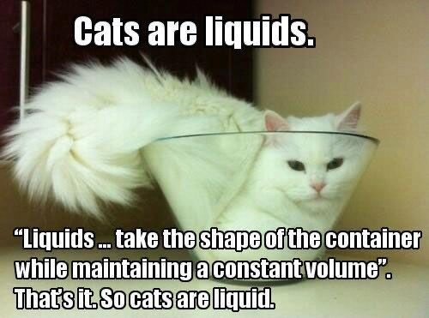
Is this really science?

Slide 6
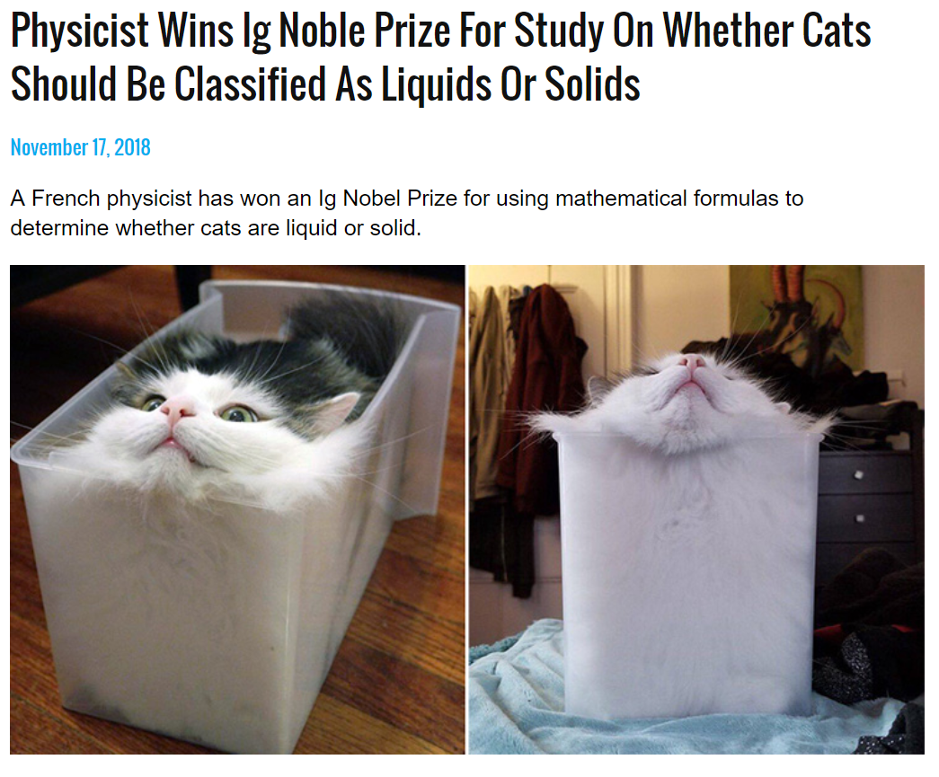
Is this really science?
Notes:
https://www.shiningscience.com/2022/08/physicist-wins-ig-noble-prize-for-study.html

Slide 7
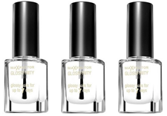
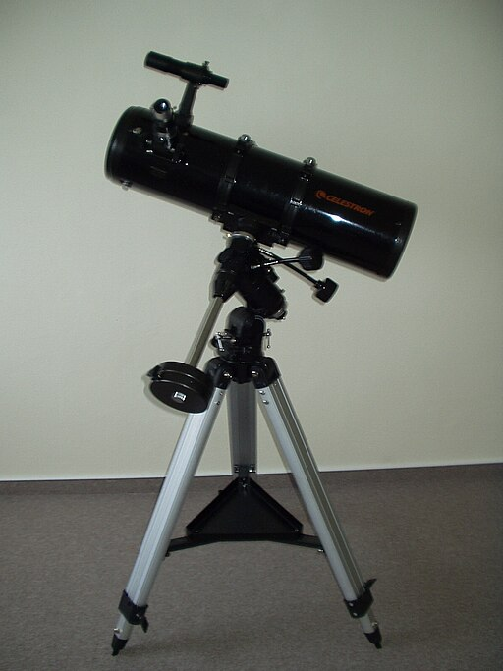
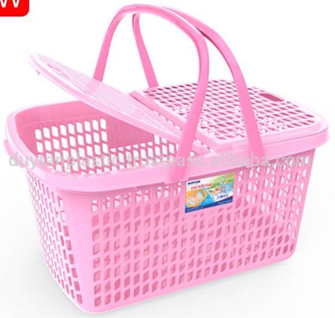
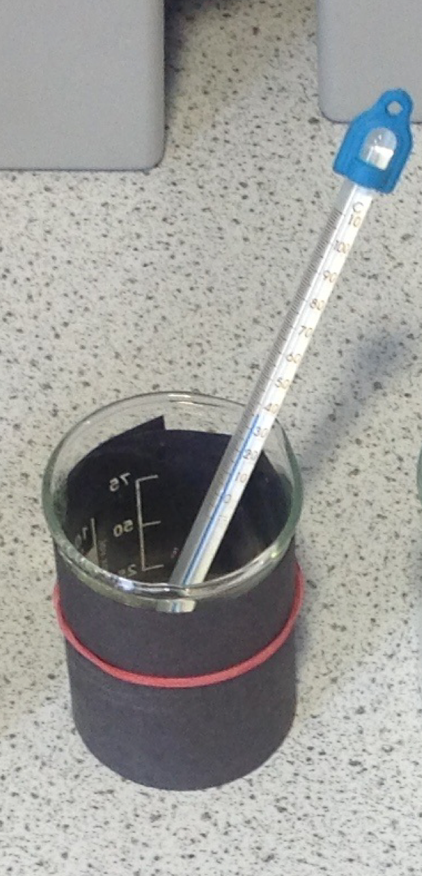
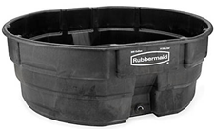
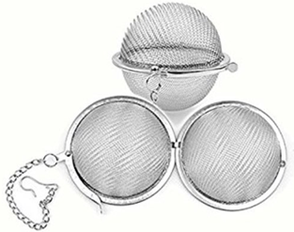
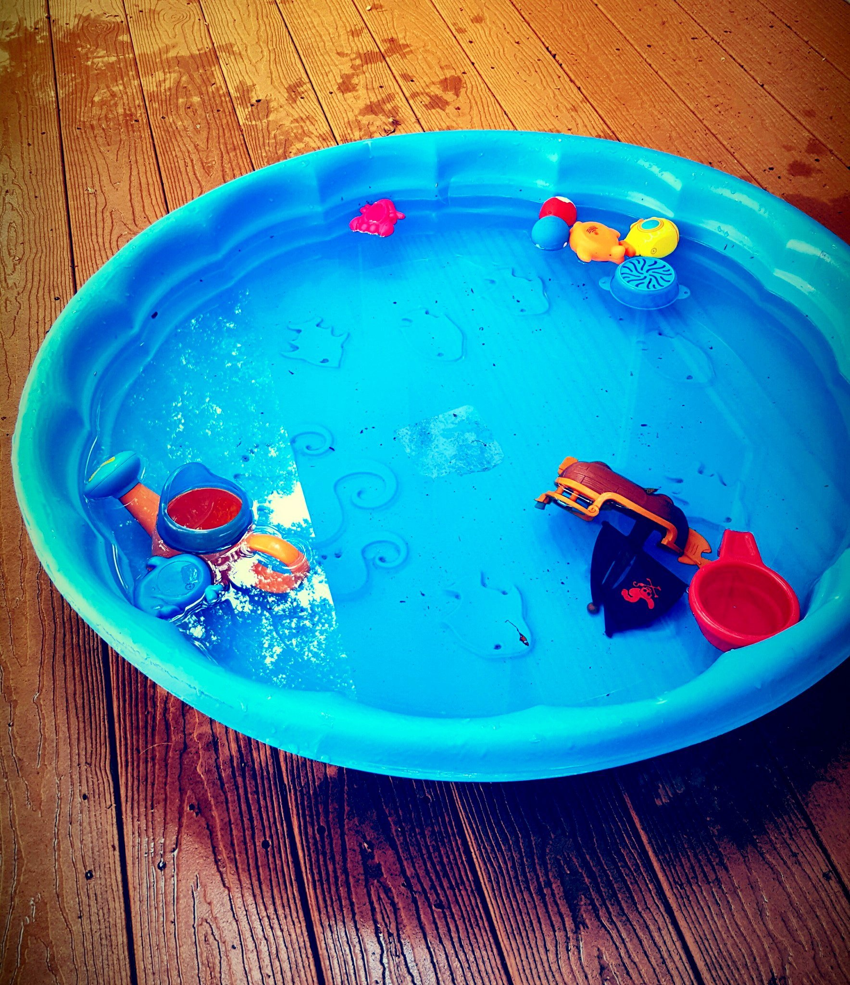
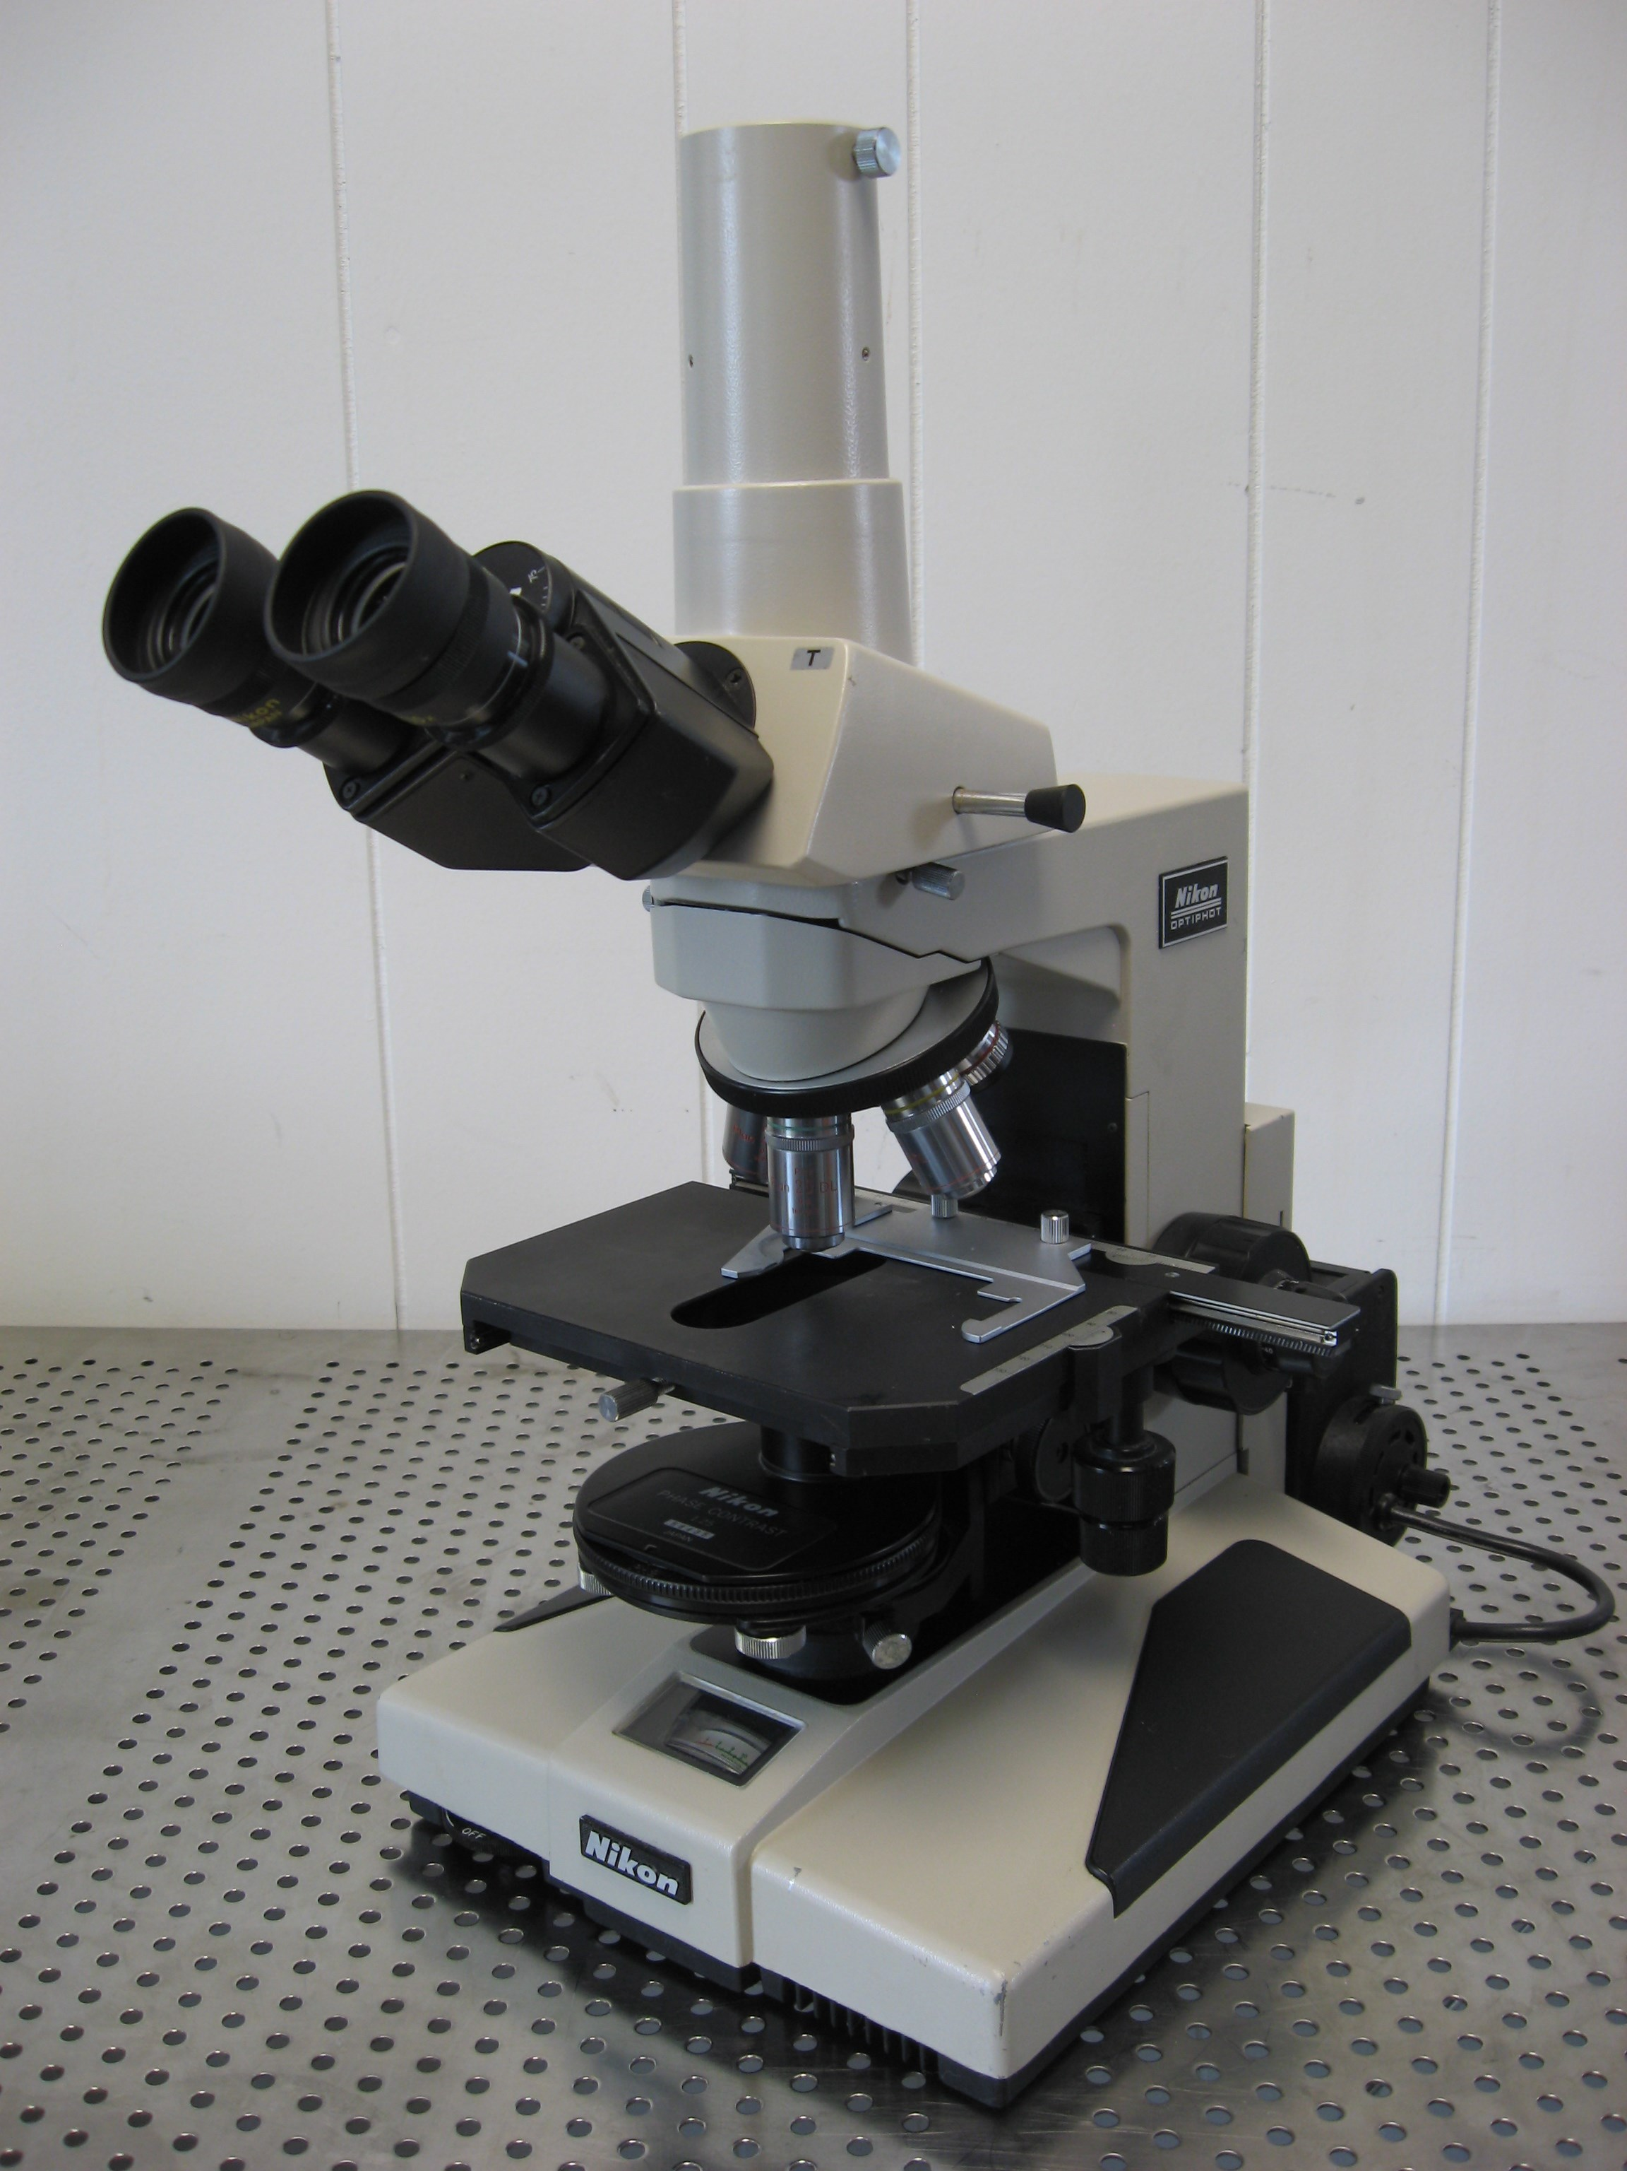
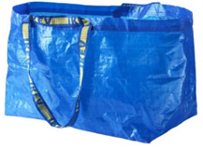
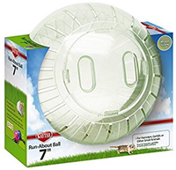
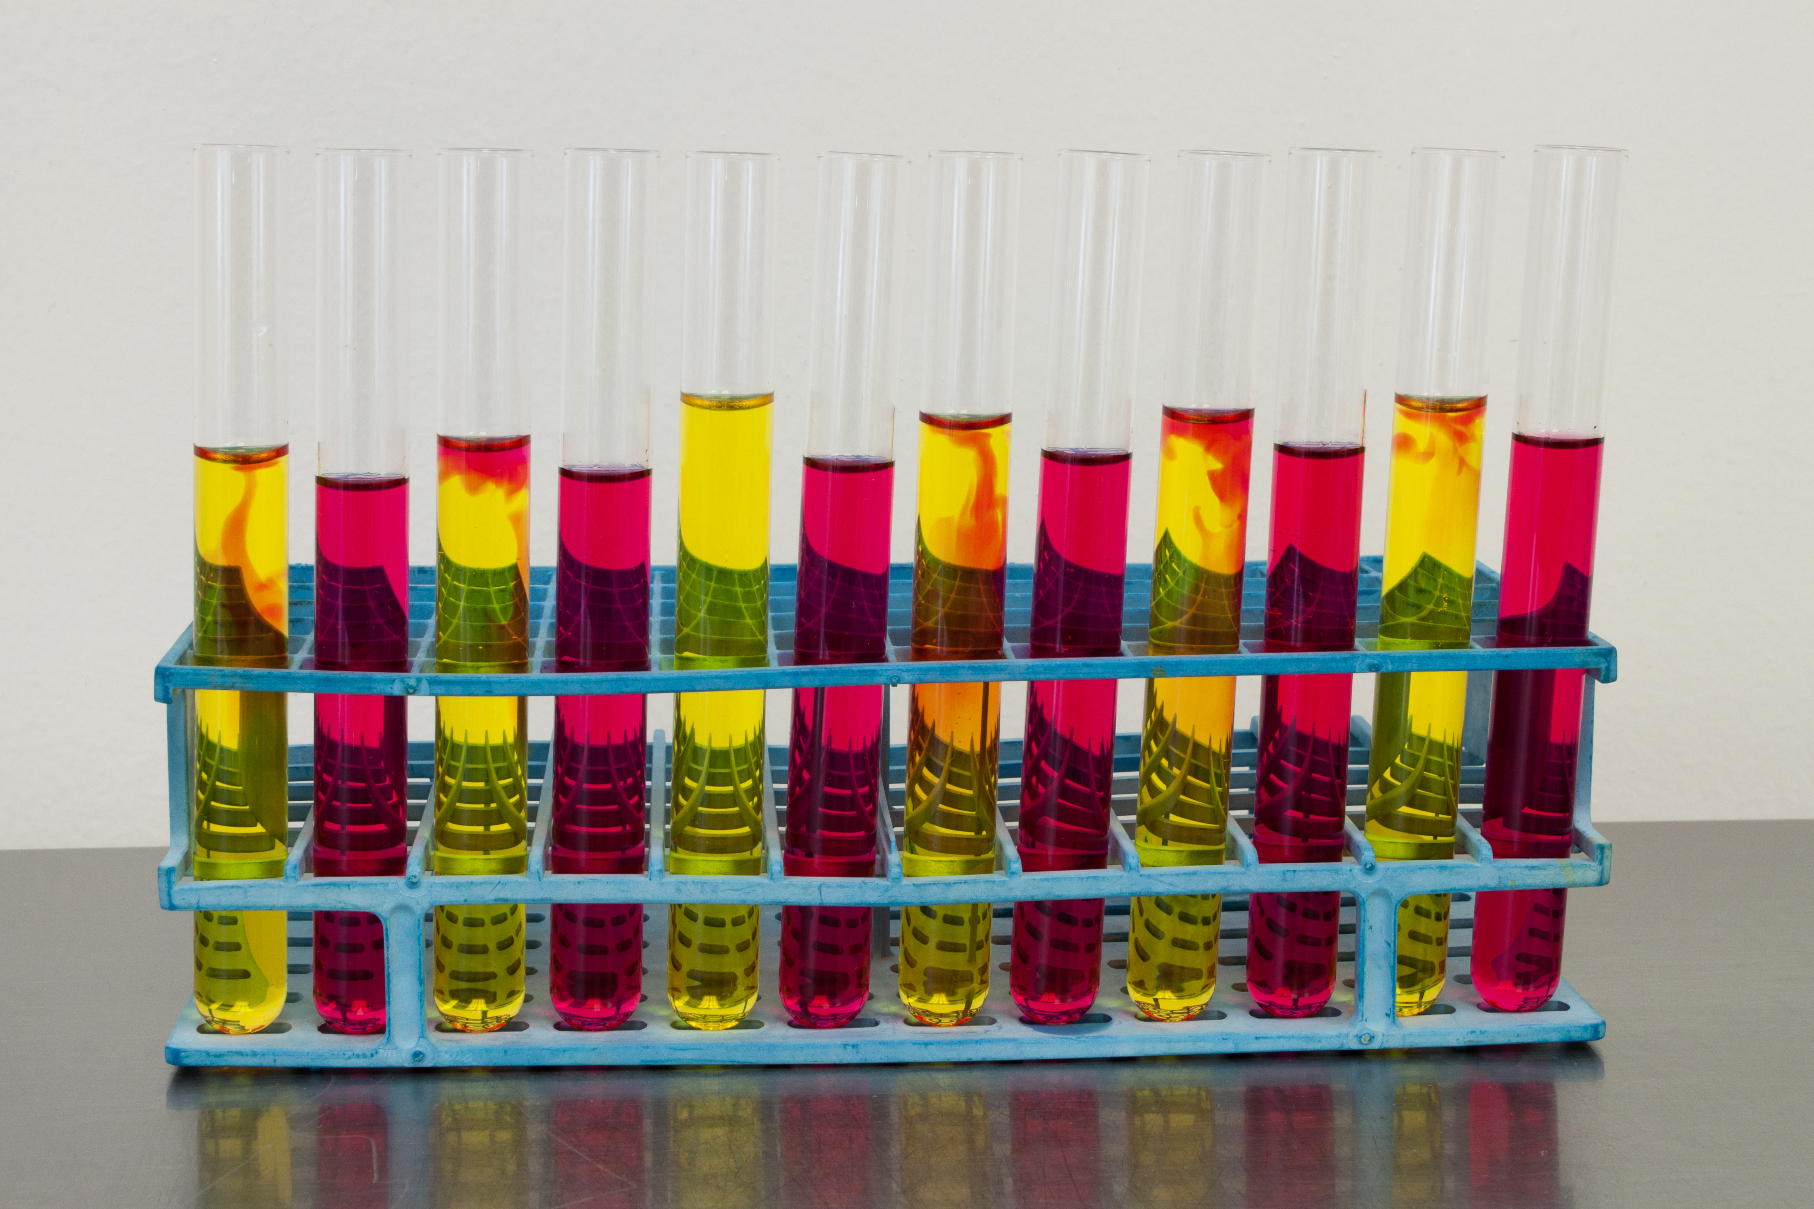
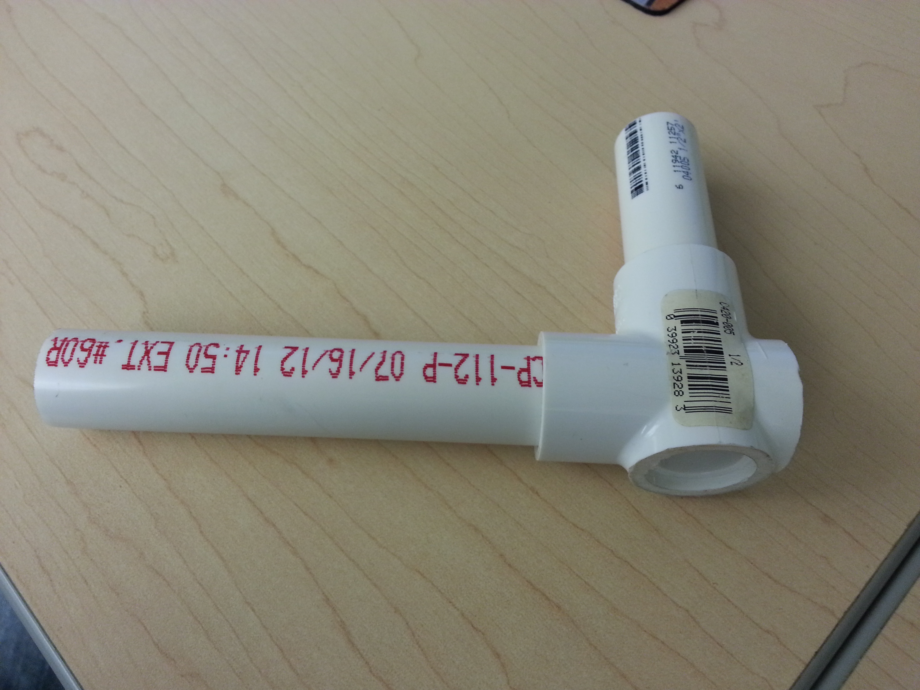
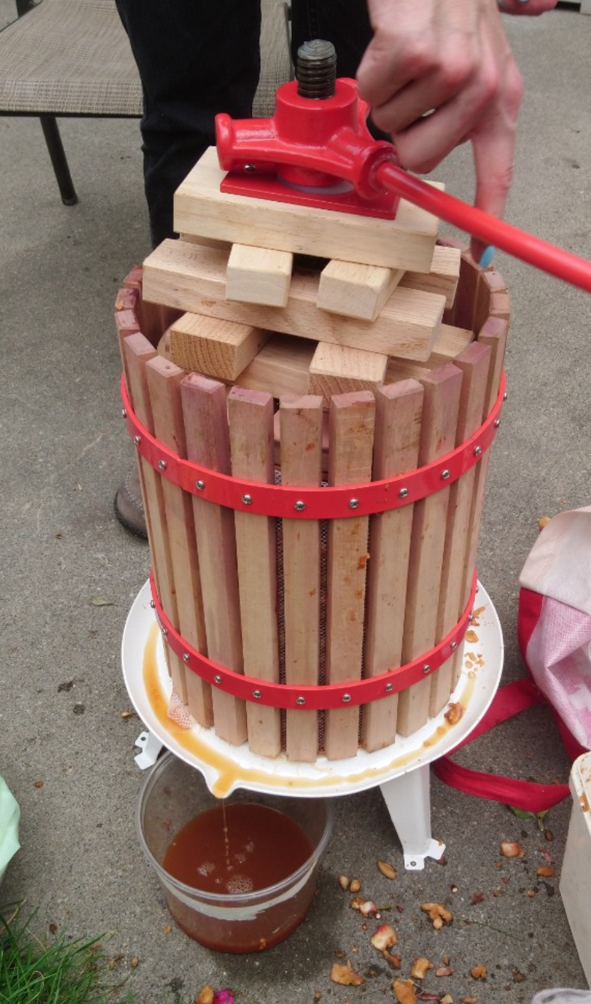
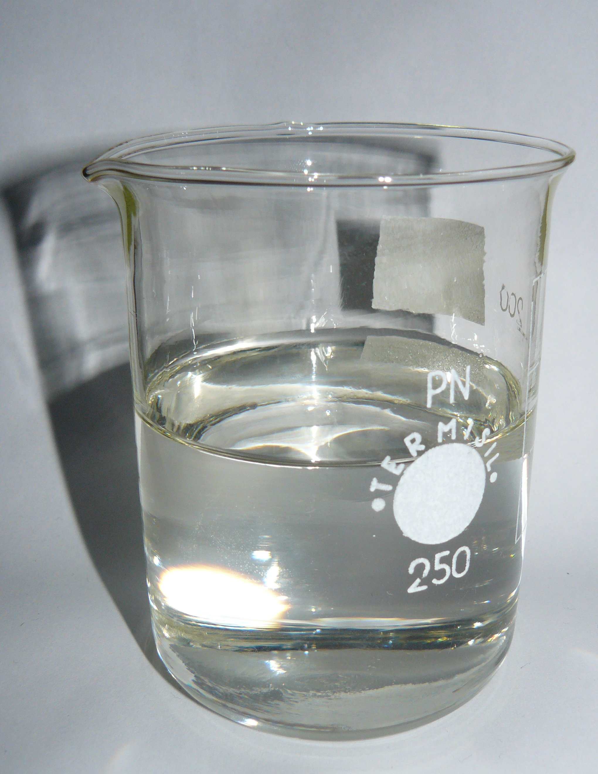
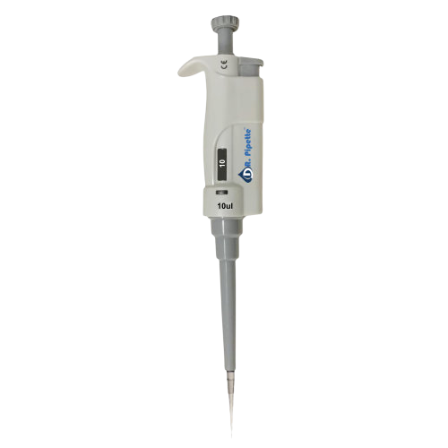
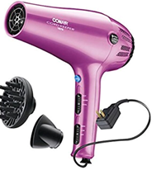
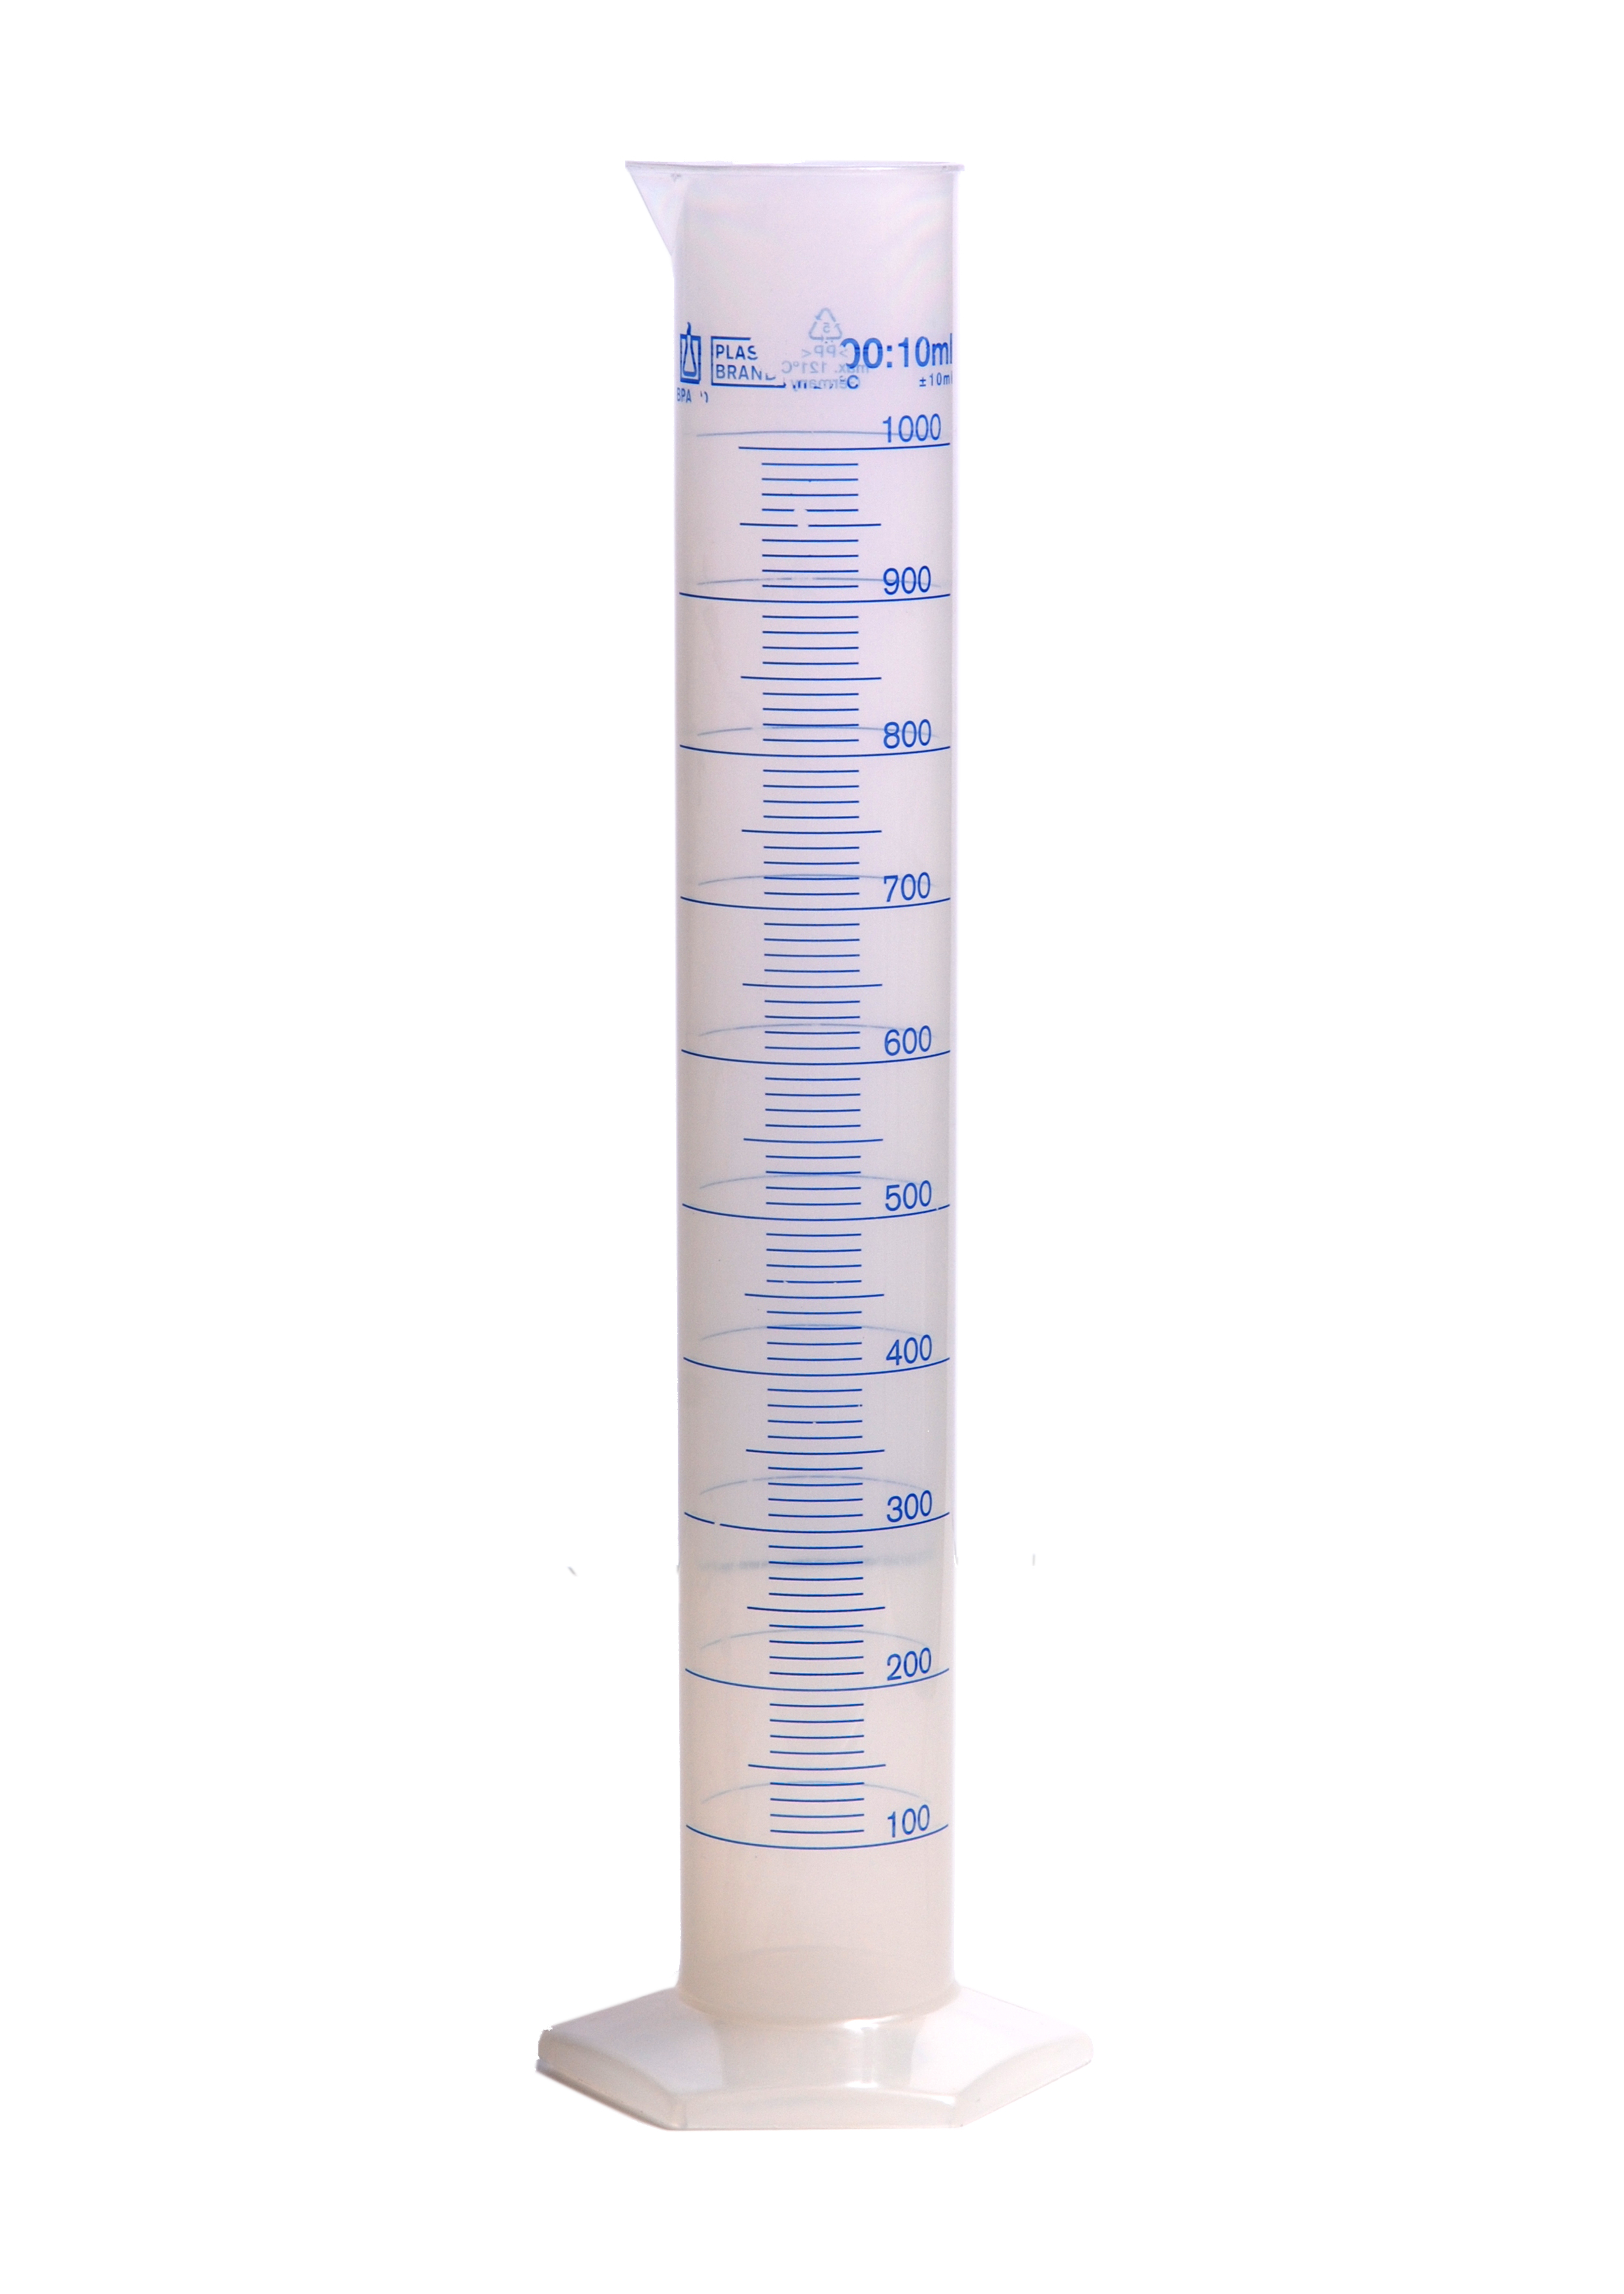
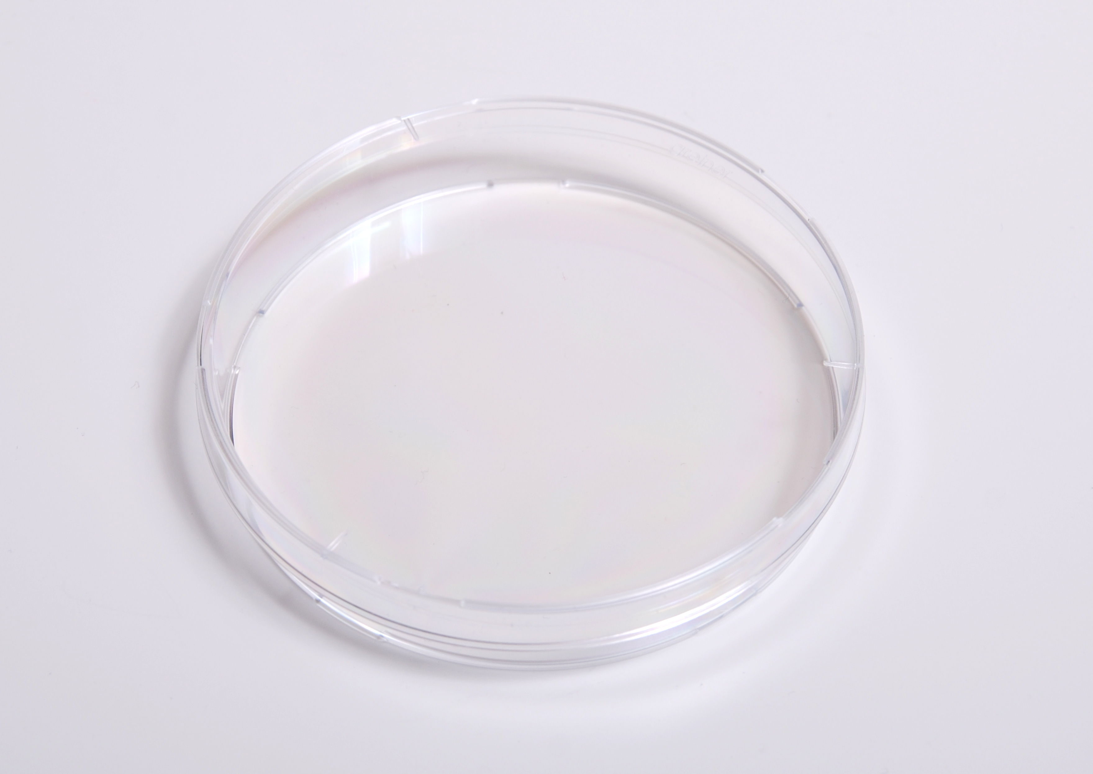
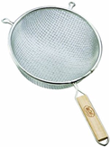
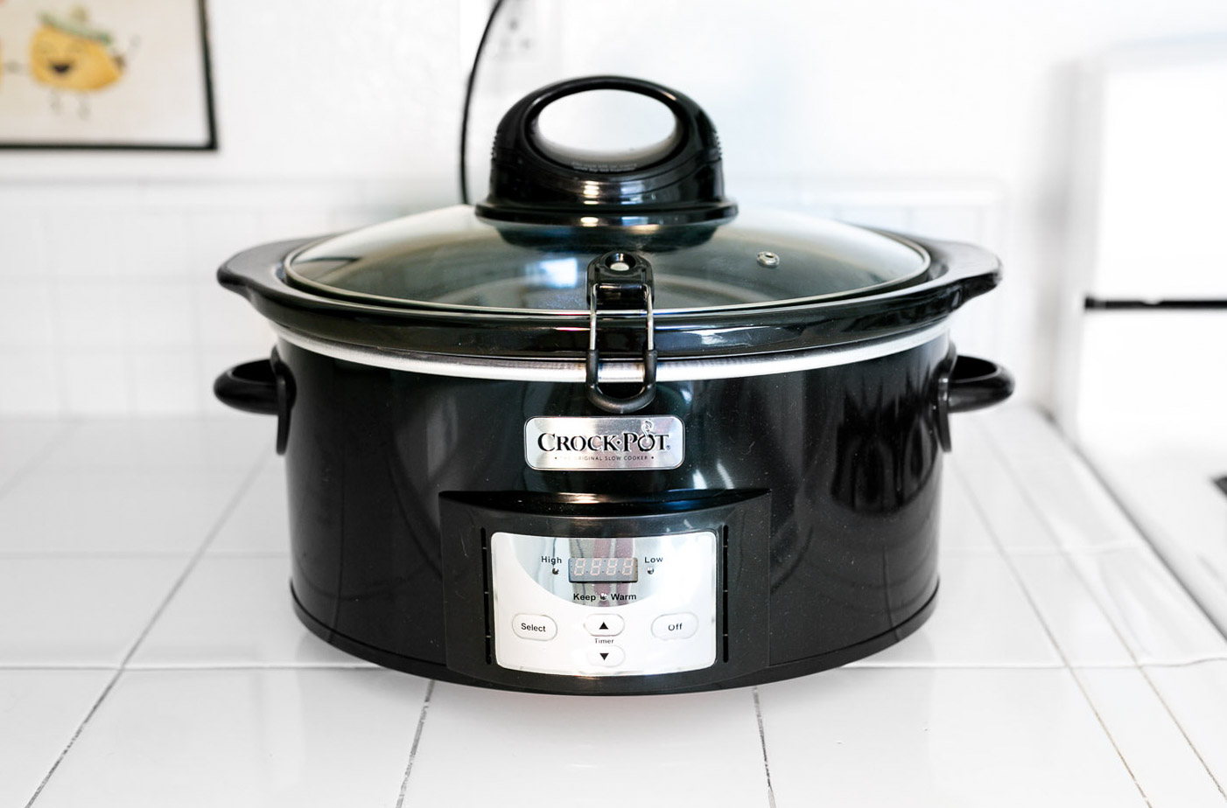
Which items are scientific equipment?
Notes:
Bailey bridge construction manual - Wikimedia Commons. (n.d.-a). https://upload.wikimedia.org/wikipedia/commons/2/2d/Bailey_Bridge_Construction_Manual.pdf
Category:newtonian telescopes. Wikimedia Commons. (n.d.). https://commons.wikimedia.org/wiki/Category:Newtonian_telescopes
CC0-Photographers. (2017, February 8). Free images : Measure, room, Beaker, product, science, laboratory, control, physics, thermometer, insulation, scientist, degree, stop clock 2592X1936 - - 651822 - free stock photos. PxHere. https://pxhere.com/en/photo/651822
Collins, M. (2018, January 30). Eeezy-access shopping baskets, perfect for holding and weighing angry chickens during field sampling in remote areas. come in a pleasing array of pastel shades.⭐️ ⭐️ ⭐️ ⭐️ #reviewforscience pic.twitter.com/ij5kqqemkk. Twitter. https://twitter.com/Echinovet/status/958479802327093248?s=20
Commons:upload. Wikimedia Commons. (n.d.-b). https://commons.wikimedia.org/wiki/Commons:Upload
Commons:upload. Wikimedia Commons. (n.d.-b). https://commons.wikimedia.org/wiki/Commons:Upload
Commons:upload. Wikimedia Commons. (n.d.-b). https://commons.wikimedia.org/wiki/Commons:Upload
Cooke, M. (2018, February 2). 1 mm by 1 mm glitter is perfect for tracking particle displacements in scaled physical experiments of fault evolution. A little goes a long way! (base photo is inverted B&W) #reviewsforscience pic.twitter.com/rhaenply8H. Twitter. https://twitter.com/geomechCooke/status/959567125391269889?s=20
File:nikon OPTIPHOT phase contrast trinocular laboratory microscope 2 ... (n.d.). https://commons.wikimedia.org/wiki/File:Nikon_Optiphot_Phase_Contrast_Trinocular_Laboratory_Microscope_2_(15981516061).jpg
Fisher, S. (2024, January 11). Test tubes. Flickr. https://www.flickr.com/photos/87007001@N04/15126712086/in/photolist-p3GmuN-8Uuy3E-fF2fq7-2UXyAt-57fv5t-Wy3FhE-6zf2Ec-57fu5t-2miQutB-j2GoUn-7WiAjU-2kYoj42-bscyH3-7n8Lg8-5Pak3p-9fSnrR-x2HAJ-9qXhst-6zj9Lf-D8hMu-6fmTic-gJJrsc-oRBhwA-2jztNyj-2oo4YAj-6jTxY8-baRo1r-nDNuWz-HYkWdS-4RHF7U-2jooCps-q9ag3T-8MKYdt-27L7NHw-6eXHEk-C1f3gw-fM75Er-4tj9qw-MHWxUo-pFG2jT-fM7ac6-tCfyb-4ei1rg-ob49FR-a2qaWp-Rcodxz-fbLL4G-9nYJzZ-acnaQE-7wgsZn
Jacob, A. (2018, January 30). Must-have in any tropical rainforest first aid kit! apply topically over entrance to bot fly pupae until maggot dies, then extract. coloured Polish helps track infestation over course of field season. also festive.⭐️⭐️⭐️⭐️⭐️ #reviewforscience pic.twitter.com/bdwasryvma. Twitter. https://twitter.com/Aerin_J/status/958233756011081729
Long, R. (2018, January 30). Great for powderizing dried bear scat prior to stress hormone analysis. can be repurposed and used for pasta (make sure to remove larger chunks first!)⭐️⭐️⭐️⭐️⭐️ #reviewforscience #reviewsforscience pic.twitter.com/nxvbnewcjx. Twitter. https://twitter.com/RLongEco/status/958397335288954881?s=20
Robyn Womack 🐦⏰ on Twitter. Twitter. (n.d.). https://web.archive.org/web/20181101104436/https:/twitter.com/robynjwomack/status/957713365052346368
SurFeRGiRL30. (2024, January 11). Kiddie Pool. Flickr. https://www.flickr.com/photos/surfergirl30/28646479446
Tara Chestnut, P. (2018, February 1). I was interested in understanding ecological processes in aquatic systems. wetlands were too complex but lab settings too simple. I was stuck until I found I could simulate my system & answer
my questions using mesocosms aka Cattle Tanks! #reviewsforscience #reviewforscience PIC.TWITTER.COM/SF5TJWG9EG. Twitter. https://twitter.com/TCastanea/status/958883854340669440?s=20
Wikimedia Foundation. (2023a, August 27). Petri dish. Wikipedia. https://en.wikipedia.org/wiki/Petri_dish
Wikimedia Foundation. (2023, November 12). Slow cooker. Wikipedia. https://en.wikipedia.org/wiki/Slow_cooker
Wikimedia Foundation. (2024, January 3). Graduated cylinder. Wikipedia. https://en.wikipedia.org/wiki/Graduated_cylinder

Slide 8
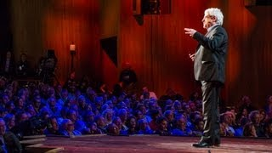
The Pursuit of Ignorance
Notes:
0:10 - 1:12, 4:05-11:25
https://youtu.be/nq0_zGzSc8g?t=10
https://www.ted.com/talks/stuart_firestein_the_pursuit_of_ignorance?language=en

Slide 9
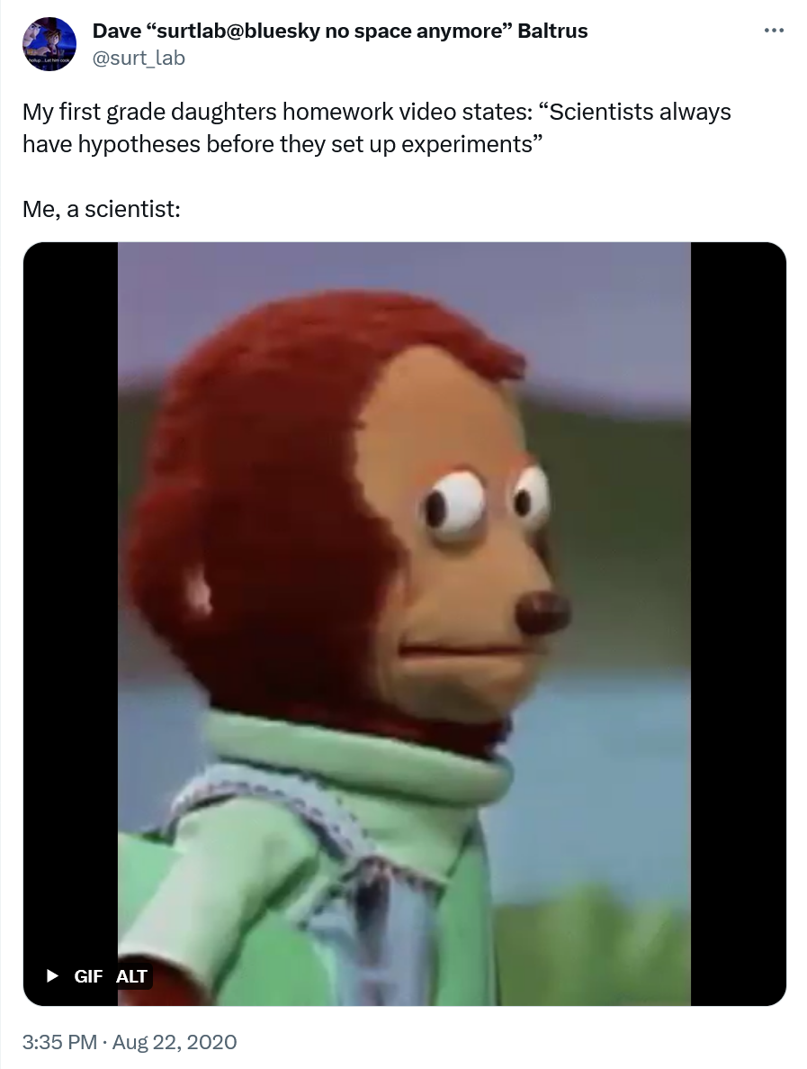
Science in the Wild
You will have 2 minutes at each station.
As a group, decide what the tweets at your station tell you about how science is done.
Write down your answers.
Notes:
https://twitter.com/surt_lab/status/1297271269960765440

Slide 10
How do scientists do their work?
I Used to Think… But Now I Know

