Slide 2
Quantum Mechanics
Lesson 2: Particle Properties of Light

Slide 3
Lesson Objectives
Examine the concept of quantization of energy.
Interpret and implement the photoelectric effect.
Examine experiments that demonstrate the particle properties of light.

Slide 4
Essential Question
Is light a wave or a particle?

Slide 5
Thought Question
Imagine you are given the following materials:
Empty 100 ml graduated cylinder
100 ml of water in a beaker
A dropper that releases 0.01 ml per drop
Ten 10 ml ice cubes
Determine how many different volumes of water you could add to the cylinder using the ice cubes.
Determine how many different volumes of water you could add to the cylinder using the dropper and beaker of water.

Slide 6
Thought Question
Classical Physics Thinking
Water can be added in any amount to the cylinder.
Quantum Physics Thinking
Water may only be added by multiples of 1 ice cube at a time.
Added water = n x ice cube, where n represents the number of ice cubes. Since the amount of water cannot be less than one ice cube, n must be a positive integer.
There is limited amount of water that may be added to the cylinder, and they are multiples of one ice cube.

Slide 7
Thought Question
Imagine you are given:
An empty 100 ml graduated cylinder
100 ml of water in a beaker
A dropper that releases one water molecule at a time
Determine how many different volumes (molecules) of water you could add to the cylinder using the dropper and beaker of water.
Additional information:
Molar mass of water 18.02 g/mol
Density of water is 1 g/ml
1 mole of water contains. 6.022x10^23 molecules of water

Slide 8
Thought Question
Can you add less than one molecule of water to the cylinder at a time?
Why or why not?

Slide 9
Thought Question
Classical Physics Thinking
Imagine that water was made up of particles that are infinitesimally smaller than water molecules so that the amounts of water added to the cylinder become infinite. There is no fundamental unit, or minimum amount, of water that can be added.
Quantum Physics Thinking
Water is made up of molecules, and water may only be added by multiples of one molecule. You can add one molecule of water or two molecules or three molecules.
Added water = n x water molecule, where n is a positive integer representing the number of water molecules.
The molecule is the fundamental unit, or minimum amount, of water.

Slide 10
Cornell Notes
In your Science Notebook, create a diagram to match the one on the right.
For the next few slides, focus on the right-hand side section of your notes.
Record any Big Ideas you learn.
Key Concepts
Big Ideas
Summarize
Notes:
K20 Center. (n.d.). Cornell notes system. Strategies. Retrieved from https://learn.k20center.ou.edu/strategy/56

Slide 11
Max Planck
Max Planck won the Nobel Prize in 1918 for his quantum theory.
At the end of the 19th century, Planck studied the light emitted by objects known as blackbodies.
A blackbody is an object that absorbs all of the incident light it receives when it is at a lower temperature than its surroundings and will emit radiation of all types when its temperature is greater than its surroundings.
An iron rod is an example of a blackbody. As iron is heated, the intensity of light it emits increases.

Slide 12
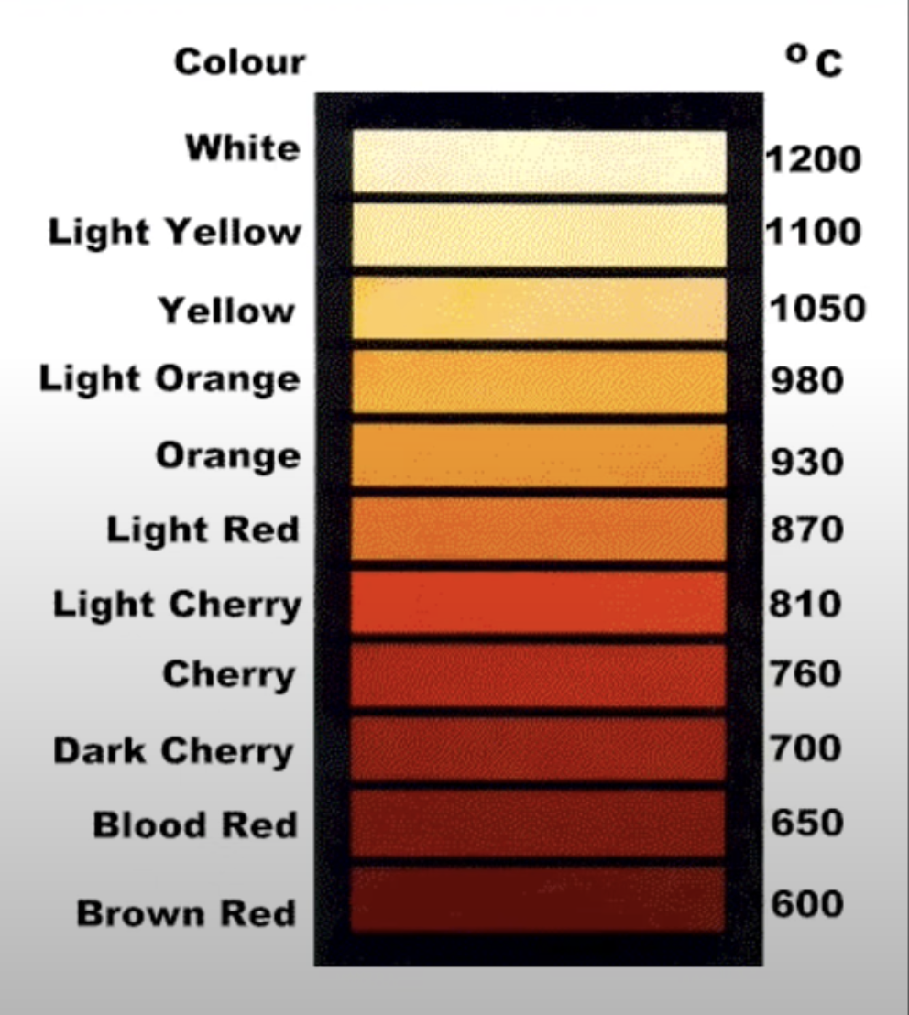
Light Emitted from Iron as the Temperature is Increased
Notes:
Physics Explained. (2020, August 22). What is the ultraviolet catastrophe?. Video. YouTube. https://www.youtube.com/watch?v=rCfPQLVzus4

Slide 13
Heating a Nail White Hot
https://www.youtube.com/watch?v=1wMoR2y01Nw
Notes:
Walding, Richard. (2019a, June 26). Heating a nail white hot (NCPQ). Video. YouTube. https://www.youtube.com/watch?v=1wMoR2y01Nw

Slide 14
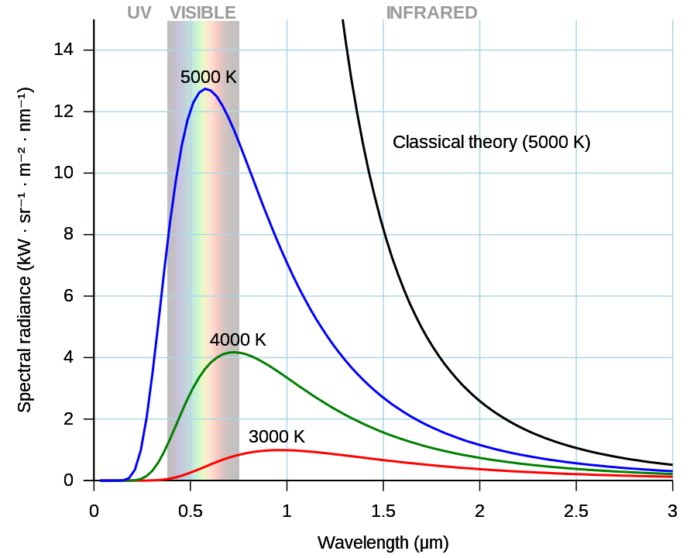
The Ultraviolet Catastrophe
Classical physics or wave theory predicts that the light intensity emitted from blackbodies increases infinitely as the wavelengths or the emitted radiation decreased (shown by the black curve).
The actual measurements are shown by the colored curves.
As the radiation gets into the ultraviolet spectrum, the intensity decreases to zero.
The unexpected result was termed the ultraviolet catastrophe because the measurements could not be explained by classical physics.
The problem was due to the thinking that energy could be emitted in any amount and there was no fundamental unit of energy.
Notes:
Wikimedia Foundation. (n.d.). File:black body.svg. Wikipedia. https://en.wikipedia.org/wiki/File:Black_body.svg

Slide 15
Max Planck Solves the Ultraviolet Catastrophe
Planck assumed that the emitted energy in blackbodies was transferred in discrete packets or fundamental units. He stated that energy is quantized instead of continuous (classical wave theory).
The smallest quantity of energy of the emitted radiation was termed a quantum.
A quantum is dependent on the frequency of the radiation.
Mathematically, the relationship is: E=hf where E is energy, h is Planck’s Constant, and f is frequency. Planck’s Constant has a value of 6.626x10^-34 J-s.
Energy can only be absorbed or emitted in multiples of a quantum.
Energy emitted = nhf, where n represents the number of quanta. A quantum is the fundamental quantity of energy; therefore, n must be a positive integer. It is impossible to have a fraction of a quantum of energy.
When this principle is applied to light intensity emitted by blackbodies, the mathematical predictions match the measured results.
Notes:
In physics, quantization is the systematic transition procedures from a classical understanding of physical phenomena to a newer understanding known as quantum mechanics.

Slide 16
Planck’s Constant and the Origin of Quantum Mechanics
https://www.youtube.com/watch?v=tQSbms5MDvY
Notes:
PBS Space Time. (2016b, June 22). Planck’s constant and the origin of quantum mechanics. PBS Digital Studios. Video. YouTube. https://www.youtube.com/watch?v=tQSbms5MDvY

Slide 17
Cornell Notes
Look at the information you have recorded on the right-hand side of your notes (The Big Ideas).
Find the key concepts and record them on the left side of the notes under “Key Concepts.”
At the bottom of your notes, summarize what you have learned in a few sentences.
Notes:
K20 Center. (n.d.). Cornell notes system. Strategies. Retrieved from https://learn.k20center.ou.edu/strategy/56

Slide 18
Electroscope Investigation
With a partner, investigate electroscopes and how they work. Collect the following materials:
Static tube
An electroscope
An ebony (or pvc) rod
Acrylic rod
Wool cloth
Silk cloth
Electroscope Investigation handout
You have 15-20 minutes to complete the procedures and answer the questions on the handout.

Slide 19
Conductors (Record on paper)
Conductors are materials composed of substances that readily share valence electrons. Electricity (electrons) flows through these materials with relatively low resistance.
Metallic elements are good examples of conductors.

Slide 20
Insulators (Record on paper)
Insulators are materials composed of substances that resist sharing valence electrons. These materials have relatively high resistance to the movement of electricity.
Compounds like plastic, air, and rubber are examples of insulators.

Slide 21
Sketch a Diagram of the Electroscope
Label each part of the electroscope. Include the following:
Top plate or ball
Stationary stem
Mobile rod
Plastic/rubber stopper
Identify each part you labeled as a conductor or insulator based on its material.

Slide 22
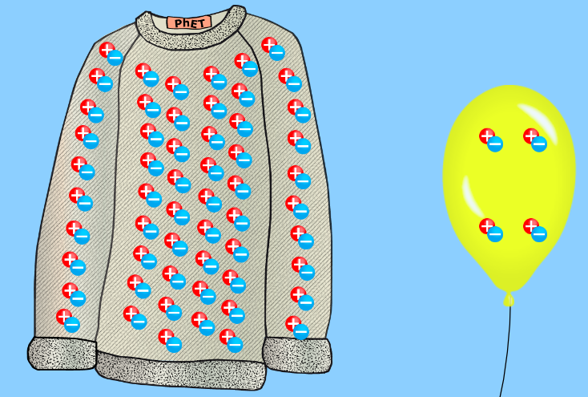
PhET ‘Balloon and Static Electricity’
Before rubbing balloon on sweater
Notes:
University of Colorado-Boulder. (n.d.). Balloons and static electricity. PHET Interactive Simulations. https://phet.colorado.edu/en/simulations/balloons-and-static-electricity/about

Slide 23
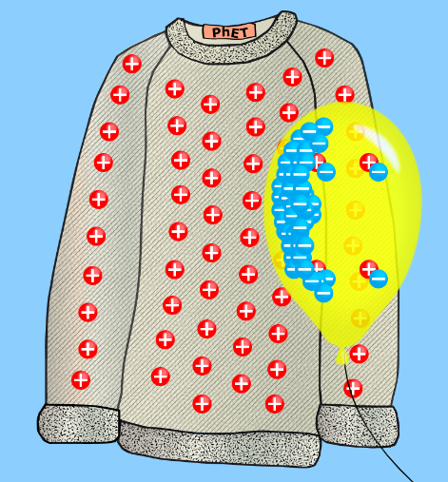
PhET ‘Balloon and Static Electricity’
After rubbing balloon on sweater
Notes:
University of Colorado-Boulder. (n.d.). Balloons and static electricity. PHET Interactive Simulations. https://phet.colorado.edu/en/simulations/balloons-and-static-electricity/about

Slide 24
Teacher Demonstration
This is a demonstration of charging and discharging an electroscope.
In your Science Notebook, record your observations, predictions, and explanations given during the demonstration.

Slide 25
Electrostatic Induction
https://www.youtube.com/watch?v=dwJ-MM7yu4E
Notes:
Bozeman Science. (2015). Electrostatic induction. Video. YouTube. https://www.youtube.com/watch?v=dwJ-MM7yu4E

Slide 26
Knocking Electrons with Light
https://www.youtube.com/watch?v=oYnp0WZDhYQ
Notes:
University of California, Berkeley. (2012, August 15). Photoelectric effect. Video. YouTube. https://www.youtube.com/watch?v=kcSYV8bJox8

Slide 27
PhET Simulation: The Photoelectric Effect
Navigate to http://k20.ou.edu/photoelectric for the simulation.
Follow the instructions on the handout to set up the simulation.
As you complete the simulation, answer the questions in your Science Notebook.
We will work through this step-by-step as a class.
Notes:
University of Colorado-Boulder. (n.d.). Photoelectric effect. PHET Interactive Simulations. https://phet.colorado.edu/en/simulations/photoelectric

Slide 28
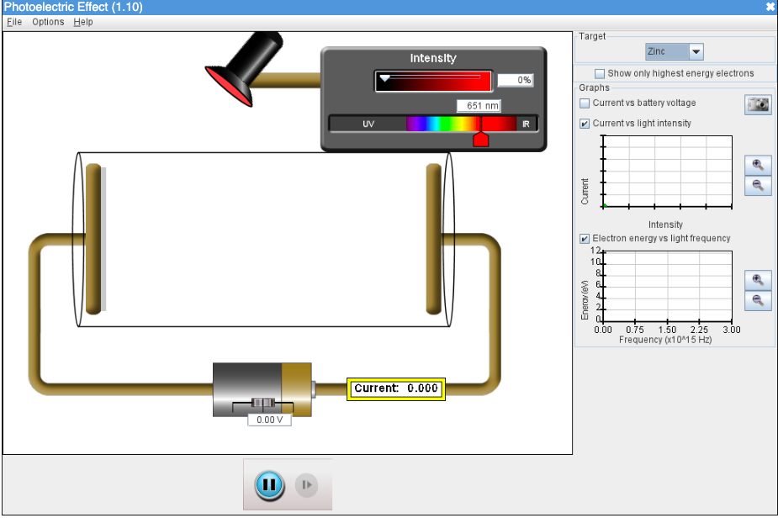
Initial Settings:
Set Up: Complete Steps 1-4.
Begin by completing Steps 1-3.
Notes:
University of Colorado-Boulder. (n.d.). Photoelectric effect. PHET Interactive Simulations. https://phet.colorado.edu/en/simulations/photoelectric

Slide 29
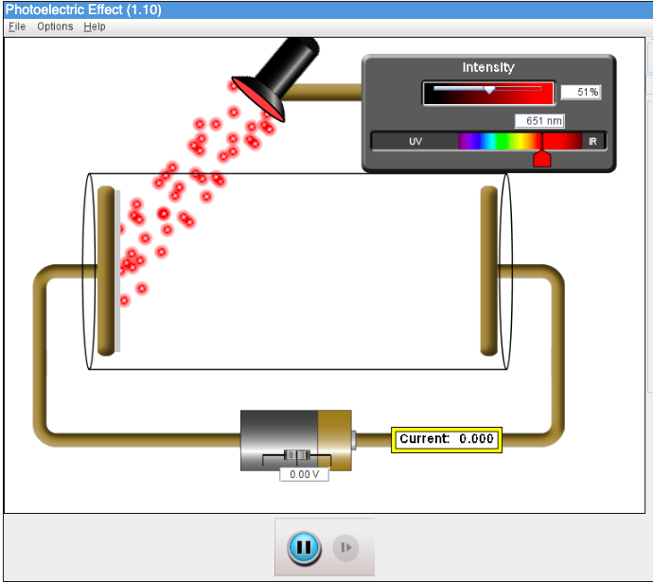
Experiment Step 3: Red photons at 50% intensity.
Notes:
University of Colorado-Boulder. (n.d.). Photoelectric effect. PHET Interactive Simulations. https://phet.colorado.edu/en/simulations/photoelectric

Slide 30
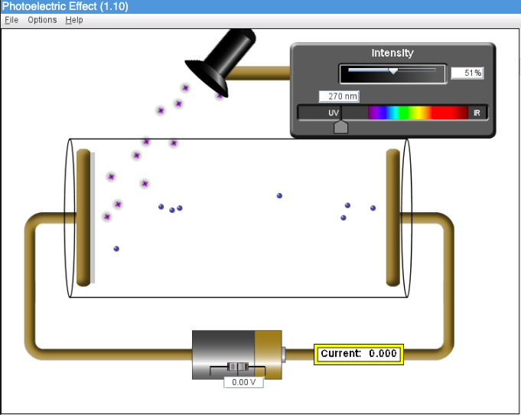
Experiment Step 4:
270 nm photons at 50% intensity.
Photoelectrons are produced.
Notes:
University of Colorado-Boulder. (n.d.). Photoelectric effect. PHET Interactive Simulations. https://phet.colorado.edu/en/simulations/photoelectric

Slide 31
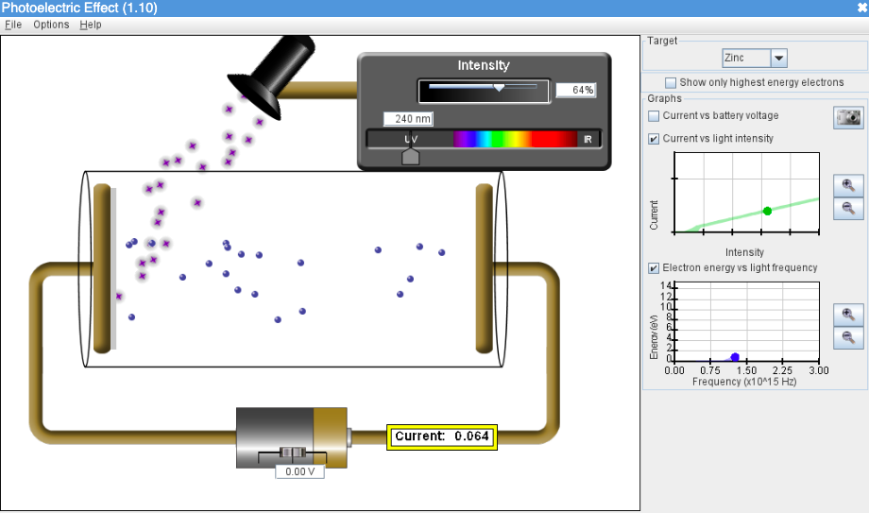
Experiment Step 5:
As the intensity is varied, the current increases as shown in top graph.
Notes:
University of Colorado-Boulder. (n.d.). Photoelectric effect. PHET Interactive Simulations. https://phet.colorado.edu/en/simulations/photoelectric

Slide 32
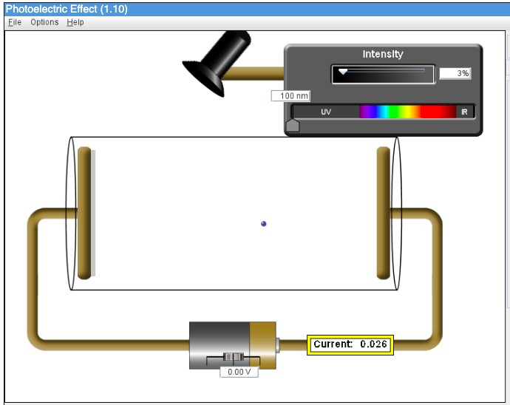
Experiment Step 6:
Photoelectrons produced by single photons. Electrons exist in different energy levels. Electrons ejected from lower energy levels will require higher energy photons.
Notes:
University of Colorado-Boulder. (n.d.). Photoelectric effect. PHET Interactive Simulations. https://phet.colorado.edu/en/simulations/photoelectric

Slide 33
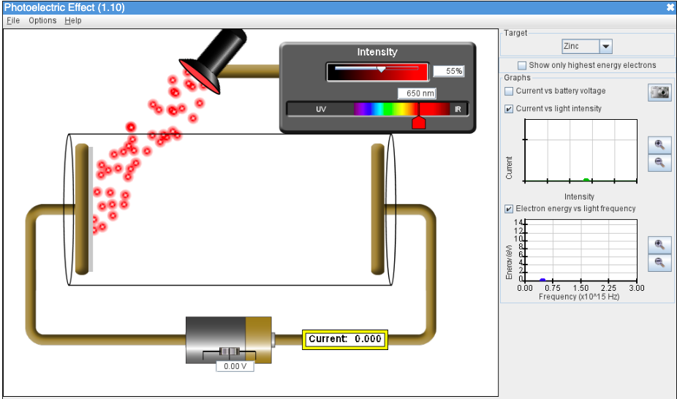
Experiment Step 7:
Red photons do not produce photoelectrons because they do not possess the minimum energy required to eject electrons. Even over time at high intensities, the energy does not build up and eject electrons.
Notes:
University of Colorado-Boulder. (n.d.). Photoelectric effect. PHET Interactive Simulations. https://phet.colorado.edu/en/simulations/photoelectric

Slide 34
Experiment Step 8:
Kinetic energy is directly proportional to the frequency of the photons as shown in the lower graph.
Notes:
University of Colorado-Boulder. (n.d.). Photoelectric effect. PHET Interactive Simulations. https://phet.colorado.edu/en/simulations/photoelectric

Slide 35
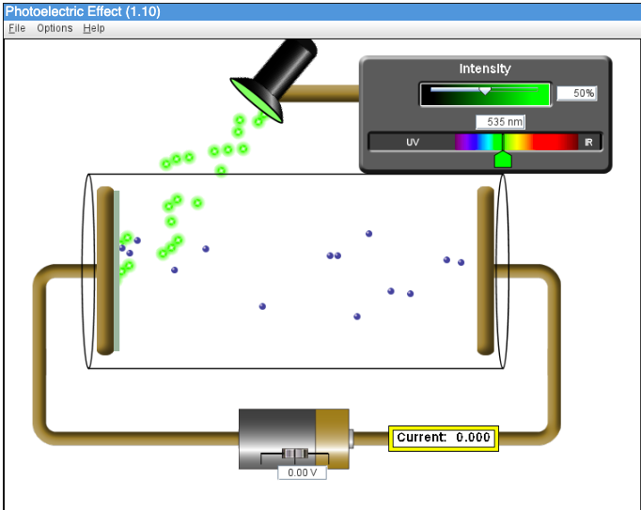
Sodium
Experiment Step 9:
Photoelectrons produced at approximately 535 nm.
It requires less energy to produced photoelectrons in sodium compared to zinc.
Sodium has a smaller work function compared to zinc.
Notes:
University of Colorado-Boulder. (n.d.). Photoelectric effect. PHET Interactive Simulations. https://phet.colorado.edu/en/simulations/photoelectric

Slide 36
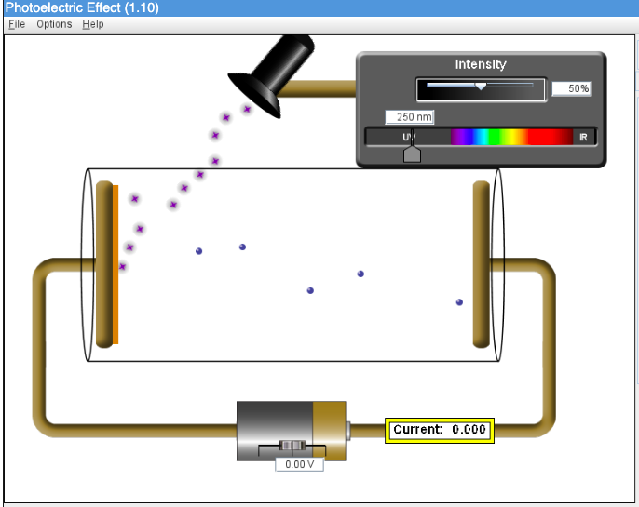
Copper
Experiment Step 10
Photoelectrons produced at approximately 250 nm.
It requires more energy to produced photoelectrons in copper compared to zinc.
Copper has a larger work function than zinc.
Notes:
University of Colorado-Boulder. (n.d.). Photoelectric effect. PHET Interactive Simulations. https://phet.colorado.edu/en/simulations/photoelectric

Slide 37
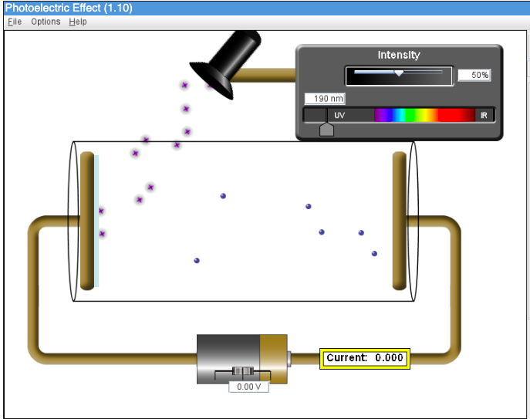
Platinum
Experiment Step 10
Photoelectrons produced at approximately 190 nm.
It requires more energy to produced photoelectrons in platinum compared to zinc.
Platinum has a larger work function compared to zinc.
Notes:
University of Colorado-Boulder. (n.d.). Photoelectric effect. PHET Interactive Simulations. https://phet.colorado.edu/en/simulations/photoelectric

Slide 38
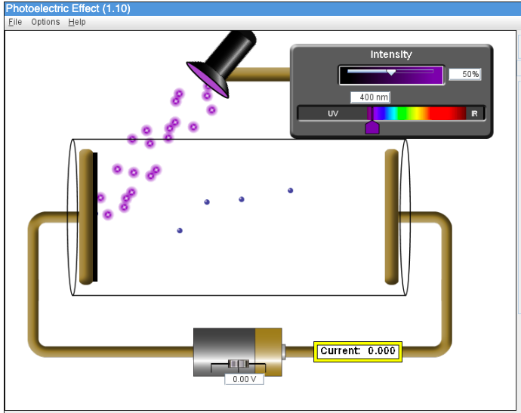
Calcium
Experiment Step 10
Photoelectrons produced at approximately 400 nm.
It requires less energy to produced photoelectrons in calcium compared to zinc.
Calcium has a smaller work function compared to zinc.
Notes:
University of Colorado-Boulder. (n.d.). Photoelectric effect. PHET Interactive Simulations. https://phet.colorado.edu/en/simulations/photoelectric

Slide 39
Unknown Metal
Experiment Step 10
Notes:
University of Colorado-Boulder. (n.d.). Photoelectric effect. PHET Interactive Simulations. https://phet.colorado.edu/en/simulations/photoelectric

Slide 40
Photoelectric Effect Demonstration
https://www.youtube.com/watch?v=kcSYV8bJox8
Notes:
The Action Lab. (2021a, July 8). Knocking electrons with light. The photoelectric effect. Video. YouTube. https://www.youtube.com/watch?v=kcSYV8bJox8

Slide 41
Cornell Notes
In your Science Notebook, create a diagram to match the one on the right.
For the next few slides, focus on the right-hand side section of your notes.
Record any big ideas you learn.
Key Concepts
Big Ideas
Summarize
Notes:
K20 Center. (n.d.). Cornell notes system. Strategies. Retrieved from https://learn.k20center.ou.edu/strategy/56

Slide 42
Albert Einstein
Albert Einstein won the Nobel Prize in 1922 for his work on the photoelectric effect.
Using Planck’s ideas of quantized energy, Einstein was able to explain that light is quantized into fundamental particles he called photons.
The energy of a single photon can be calculated by E=hf.
Each photon delivers its energy to electrons instantaneously, demonstrating that photons are behaving as particles in this situation.

Slide 43
Points of Emphasis
The photoelectric effect demonstrates that light is made of photon particles.
Each photon possesses a quantum of energy, which is the smallest amount of energy that can be absorbed by the electrons.
The energy of the photon is delivered instantaneously.
Increasing the intensity of the light does not increase the maximum kinetic energy of the electrons as predicted by classical wave theory.

Slide 44
Wilhelm Roentgen X-Ray Experiment
Roentgen won the first Nobel Prize in 1901 for his discovery of x-rays.
Roentgen performed an experiment that is somewhat like the reverse process of the photoelectric effect.
He used a cathode tube to accelerate electrons towards metal atoms.
As the electrons near the nuclei of the metal atoms, some or all of their kinetic energy is converted to x-ray photons.
This process is known as bremsstrahlung electron braking because the electrons slow down.
The emitted energy occurs in packets of energy or photon particles.
The emitted photons demonstrate quantized energy and provide more evidence of the particle properties of electromagnetic radiation.

Slide 45
How does an X-Ray Tube Work?
https://www.youtube.com/watch?v=Bc0eOjWkxpU
Notes:
Ionactive Consulting Limited. (2009, November 4). How does an X-ray tube work (radiation protection)? Video. YouTube. https://www.youtube.com/watch?v=Bc0eOjWkxpU

Slide 46
Arthur Compton
Compton won the Nobel Prize in 1927 for his discovery of what became known as Compton scattering.
During this process, high energy x-ray photons are directed at carbon atoms.
After colliding with electrons in the atoms, the scattered photons have longer wavelengths than the incident photons.
This demonstrates that the incident photons transfer some of their energy to the electrons during the collision like particles.
Classical wave theory predicts that the scattered photons will have the same wavelength as the incident photons.
This experiment provides further evidence that light and other electromagnetic radiation behave like particles.

Slide 47
Compton Experiment Animation
https://www.youtube.com/watch?v=zTzJJ9lGP0U
Notes:
Si Rebiaz, Catalan. (2021c, December 6). Compton Experiment Animation | 12th class physics. Video YouTube. https://www.youtube.com/watch?v=zTzJJ9lGP0U

Slide 48
Cornell Notes
Look at the information you have recorded on the right side of your notes (The Big Ideas).
Find the key concepts and record them on the left side of the notes under “Key Concepts.”
At the bottom of your notes, summarize what you have learned in a few sentences.
Notes:
K20 Center. (n.d.). Cornell notes system. Strategies. Retrieved from https://learn.k20center.ou.edu/strategy/56

Slide 49
3-2-1 Strategy Evaluation
In your Science Notebook, write the following responses:
3 statements showing what you learned about light having properties of particles.
2 questions you have about light’s having properties of particles.
1 thing you found most interesting about light’s having properties of particles.
Notes:
K20 Center. (n.d.). 3-2-1. Strategies. https://learn.k20center.ou.edu/strategy/117

