Slide 2
Quantum Mechanics
Lesson 4: Wave Properties of Particles

Slide 3
Lesson Objective
Investigate standing waves and wave functions in atoms.

Slide 4
Essential Questions
Is light a wave or a particle?
Are particles waves?

Slide 5
What is a Standing Wave?
https://www.youtube.com/watch?v=aTaT1orpHg8
Notes:
The Physics Classroom. (2023 January 5). What is a standing wave? Video. YouTube. https://www.youtube.com/watch?v=aTaT1orpHg8

Slide 6
I Think/We Think
Create a T-Chart in your Science Notebook.
Label the left side “I Think.” Label the right side “We Think.”
On your own, “I Think” page, complete the following prompt: Describe a standing wave.
Use the terms node and antinode in your description.
With a partner, share your descriptions and create a new description under “We Think.”
Notes:
K20 Center. (n.d.). I think / We think. Strategies. https://learn.k20center.ou.edu/strategy/141

Slide 7
Modes on a String
https://www.youtube.com/watch?v=cnH2ltfW48U
Notes:
Martin, Geoff. (2015 August 28). Modes on a string. Video. YouTube. https://www.youtube.com/watch?v=cnH2ltfW48U

Slide 8
I Think/We Think
Create a second T-Chart in your Science Notebook.
As you have done previously, label the left side “I Think” and the right side “We Think.”
On your second T-Chart under “I Think,” complete the prompt: How are standing waves dependent on frequency? Why do only certain frequencies produce standing waves?
With a partner, share your descriptions and create a new description under “We Think.”
Notes:
K20 Center. (n.d.). I think/We think. Strategies. https://learn.k20center.ou.edu/strategy/141

Slide 9
Flexural and Longitudinal Waves
https://www.youtube.com/watch?v=sIw0Fh-fXIM
Notes:
NPS Physics. (2016 June 9). Flexural and longitudinal waves - Singing rods demonstration. Video. YouTube. https://www.youtube.com/watch?v=sIw0Fh-fXIM

Slide 10
Demonstration: Singing Rods
Pay attention to the demonstration.
Be prepared to answer the following question:
Why did the rod stops ‘singing’ when held away from the node?

Slide 11
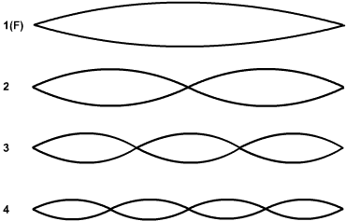
Standing Waves in Rods
wavelength is 2 lengths of rod (L) or 2L
wavelength=1L
wavelength= 2/3L
wavelength=?
Notes:
Projects, C. to W. (2023, February 17). Files. Wikimedia Commons. https://commons.wikimedia.org/wiki/Files

Slide 12
Singing Rod Video
https://www.youtube.com/watch?v=3zrtu6c71Xk
Notes:
New Zealand Institute of Physics. (2022 May 30). Physics demonstration: Singing rods and tubes. Video. YouTube. https://www.youtube.com/watch?v=3zrtu6c71Xk

Slide 13
Whirly Tube Demonstration
During the demonstration think about the answer to the following questions:
Why can only four tones be heard?
Why do the tones instantly jump up instead of continuously increasing?
Where are the missing tones that the tube can’t produce?

Slide 14
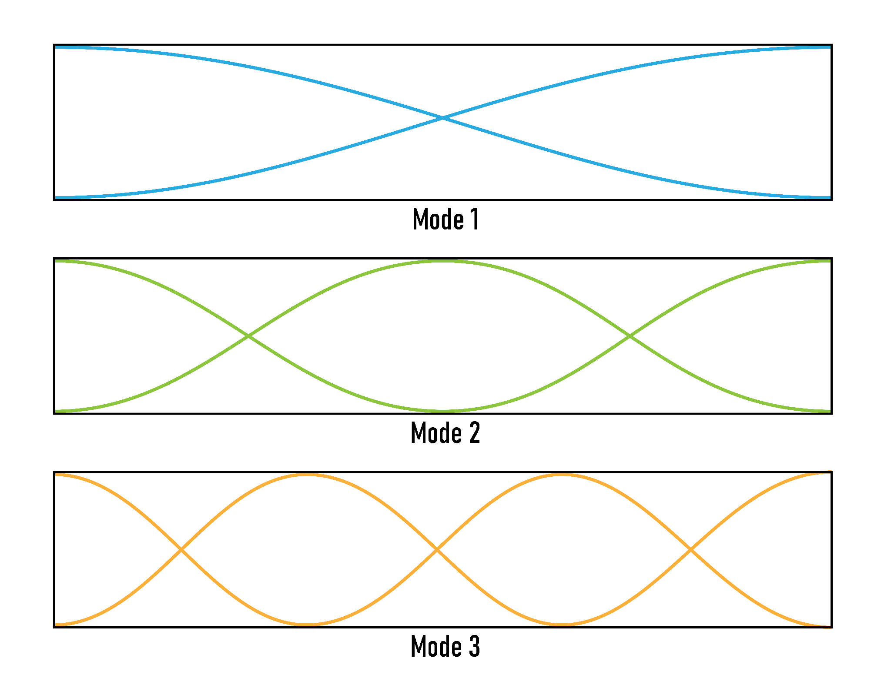
Whirly Tube Wavelengths That Fit in Tube
First pitch wavelength=2L
Second pitch wavelength=L
Third pitch
wavelength=⅔ L

Slide 15
Sound Tube Demonstration
https://www.youtube.com/watch?v=LCEvzU9sh4Y
Notes:
Steve Spangler Science. (2017 January 25). Singing pipes - The Spangler effect. Video. YouTube. https://www.youtube.com/watch?v=LCEvzU9sh4Y

Slide 16
‘Stringin’ It’ Toy Demonstration
https://www.youtube.com/watch?v=vraQIQSW-Rc
Notes:
3D Modeling & STEM. (2019 November 19). Amazing 3D standing wave motion. Video. YouTube. https://www.youtube.com/watch?v=vraQIQSW-Rc .

Slide 17
Stringin’ It Demonstration Question
Sketch a picture of each standing wave.
On your pictures, label all the nodes and antinodes.

Slide 18
Wave Functions
In the last lesson, you learned that electrons and other small particles have wave properties.
The wave properties of these particles can be described by math equations known as wave functions.
Wave functions enable us to predict probable locations of electrons in atoms.
While the mathematics of wave functions are beyond the scope of this course, we can investigate some of the standing waves and the probability densities they produce.

Slide 19
The Schrodinger Equation Describes the Wave Function

Slide 20
What is the Schrodinger Equation, Exactly?
https://www.youtube.com/watch?v=QeUMFo8sODk
Notes:
YUp and Atom. (2018 July 6). What is the Schrödinger equation, exactly? Video. YouTube. https://www.youtube.com/watch?v=QeUMFo8sODk

Slide 21
Some Weird Things About Wave Functions
Even within quantum mechanics, it is debatable whether or not wave functions are real.
There is no derivation for Schrodinger’s Equation. It simply came out of his mind.
The significance of Schrodinger’s Equation is its ability to accurately describe nature.
It is a mathematical tool that is addressed in college courses.

Slide 22
Particle in a Box
A particle is an electron that is completely isolated in an inescapable box so that its quantum state can be measured.
Designed for a particle to be in the box, its wave function must have nodes at the edges of the box.
Therefore, only certain wave functions are allowed. In other words, the state of the electron is quantized.

Slide 23
Particle in a Box Simulation
Use your computer to investigate some of the basic data for some quantum states.
Explore some of the wave functions you recognize from the standing waves you have studied.
When wave functions are squared, they produce plots of probable densities for electron positions.
While we don’t know the exact position of electrons, we can predict the probability of electrons occupying different positions.

Slide 24
Particle in a Box Activity
You and a partner will now explore the particle in a box problems by completing the Student Handout.
Navigate to: http://k20.ou.edu/quantum
During the Quantum Bound States simulation, use the Particle in a Box Student Handout to guide you.
Record the answers to the questions from the handout in your Science Notebook.
Notes:
University of Colorado at Boulder. (n.d.). Quantum bound states. Quantum Bound States - Quantum Particles | Potential Wells | Waves - PhET Interactive Simulations (colorado.edu)

Slide 25
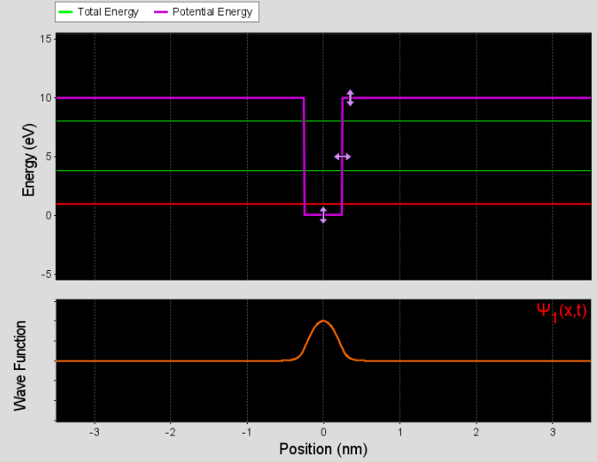
State 1
Notes:
University of Colorado-Boulder. (n.d.). Quantum bound states. PhET Simulaitons. https://phet.colorado.edu/en/simulations/bound-states

Slide 26
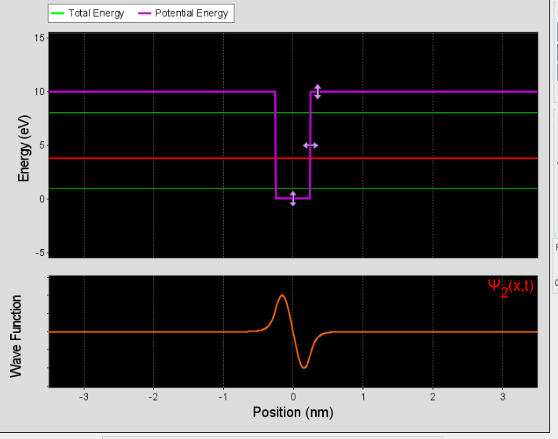
State 2
Notes:
University of Colorado-Boulder. (n.d.). Quantum bound states. PhET Simulaitons. https://phet.colorado.edu/en/simulations/bound-states

Slide 27
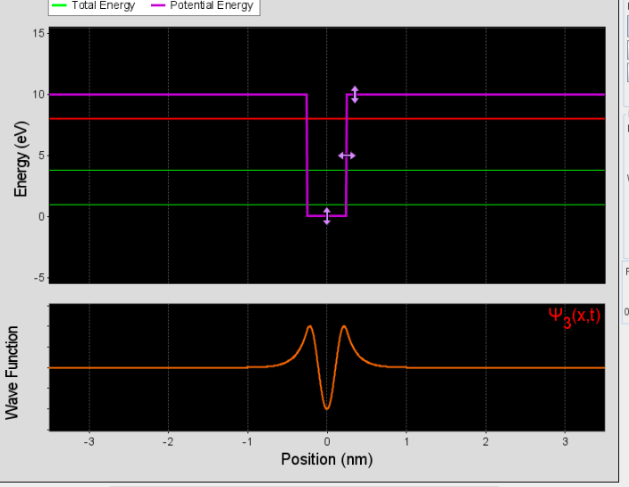
State 3
Notes:
University of Colorado-Boulder. (n.d.). Quantum bound states. PhET Simulaitons. https://phet.colorado.edu/en/simulations/bound-states

Slide 28
Probability Densities for States 1, 2 and 3 (top to bottom) Which Result from Squaring the Wave Functions
Notes:
University of Colorado-Boulder. (n.d.). Quantum bound states. PhET Simulaitons. https://phet.colorado.edu/en/simulations/bound-states

Slide 29
Wave Functions Handout
Find a new partner.
With your partner, read over the Wave Functions in Atoms Student Handout, stopping after you read about Figure 2.

Slide 30
Standing Wave in Vibrating Hoop
https://www.youtube.com/watch?v=df3oJPi9_mg
Notes:
Physics Demos. (2016 August 20). Standing wave demo: Vibrating hoop. Video. YouTube. https://www.youtube.com/watch?v=df3oJPi9_mg

Slide 31
Atomic Orbitals 3D
https://www.youtube.com/watch?v=Nr40fnfHccQ
Notes:
Sci Pills. (2020 February 26). Atomic orbitals 3D. Video YouTube. https://www.youtube.com/watch?v=Nr40fnfHccQ

Slide 32
Hydrogen Emission Lines
Get a diffraction gradient.
View the light that is emitted by hydrogen atoms with a spectroscope.
View the light that is emitted from helium atoms with a spectroscope.
Safety: Do NOT stare directly at the lamp. View the light by looking to either side of the lamp.

Slide 33
Hydrogen Spectral Lines
https://www.youtube.com/watch?v=JiKb9jcD0Xs
Notes:
Koon Physics. (2020 December 24). Hydrogen discharge lamp. Video. YouTube. https://www.youtube.com/watch?v=JiKb9jcD0Xs

Slide 34
Hydrogen Emission Lines Handout
With your partner, read through the handout.
Work with your partner to answer the questions on the handout.
Record all your answers in your Science Notebook.

Slide 35
Discussion Questions
Describe what you saw when you looked at the light coming from the hydrogen atoms. You may want to draw a picture and label it.
The lamp socket provided electricity to the hydrogen lamp. What part of the atoms could the electricity be energizing?
Based on your previous activities, what could happen to an electron in an atom if it gained sufficient energy?
Do we know whether electrons are ionized by the lamp?

Slide 36
3-2-1
Answer the following:
3- Statements showing what you have learned about electrons having properties of waves.
2 - Questions you have about electrons having properties of waves.
1 - Thing you found most interesting about electrons having properties of waves.
Notes:
K20 Center. (n.d.). 3-2-1. Strategies. https://learn.k20center.ou.edu/strategy/117

