Slide 2
Balancing Act 1: Stoichiometry
Moles to Moles

Slide 3
Essential Question
How can the balanced chemical equation be used to determine the mole-to-mole ratio between reactants and products?

Slide 4
Lesson Objectives
Define the proportional relationship between the number of moles of one substance and the number of moles of another substance in a chemical reaction.
Convert moles of one substance to moles of another substance in stoichiometric calculations.

Slide 5
I Notice, I Wonder
As you observe the three types of lotions, record the following on your handout.
What do you notice about each of the lotions?
What do you wonder about each of the lotions?
Be prepared to share with class what you record.
Notes:
K20 Center. (n.d.). I notice, I wonder. strategies. Retrieved from https://learn.k20center.ou.edu/strategy/180

Slide 6
Lotion Observation
Complete the following for each lotion.
Rub a small amount of lotion on your arm or hand. (Make sure to apply each lotion in a different location so they don’t mix.)
Record your I Notice, I Wonder reflections for each of the 3 solutions.

Slide 7
Mole-y Chalk Art
With your group, complete the pre-work questions on your handout.
Once your group has completed Steps 1 and 2, wait for the class to review the answers.
As you wait, discuss as a group what you are going to draw using your 3 different colors of chalk. (Drawings need to be school appropriate).

Slide 8
Mole-y Art
As you work with your group, use the cups to show where you are in the process of completing each task.
Put the correct color cup on top of the stack to show the following:
Green - We are finished.
Yellow - We are still working.
Red - We need assistance.

Slide 9
Mole-y Chalk Art
With your group, you will have 15 minutes to complete an illustration. All group members must make a contribution to the work of art.
Notes:
YouTube. (2021d, September 21). K20 Center 15 minute timer. YouTube. https://www.youtube.com/watch?v=m3zT2IxZQaw

Slide 10
Mole to Mole Notes
Stoichiometry - Greek,"stoiechion" meaning "element" and "metron" meaning "to measure. The is the process of calculating substance quantities in a reaction using the balanced equation.

Slide 11
Mole to Mole Notes
Balance the following equation:
___Al + ___HCl -> __AlCl₃ + __H₂

Slide 12
Mole to Mole Notes
Label the Reactants, Products & Coefficients:
___Al + ___HCl -> __AlCl₃ + __H₂

Slide 13
Mole to Mole Notes
2 Al + 6HCl -> 2 AlCl₃ + 3H₂
Coefficients
Reactants
Products

Slide 14
Vocabulary
Conversion factor: A numeric ratio of equal measurements used to convert quantities between different units.
Moles(mol): The quantity of an element or compound containing 6.02 x 10²³(Avagadro’s number) particles (ex. atoms, ions, etc.) of that element/compound.
Molar(Molecular) Mass: The weight(in grams) of a single mole of particles (atoms, ions, or molecules) of an element/compound.

Slide 15
Steps
Balance the equation.
Determine the mole-to-mole ratio between A and B.
Multiply across. Divide bottom.
General Form for mole-to-mole conversions:
# mol A | Ratio from coefficient mol B | = moles of B
 | Ratio from coefficient mol A

Slide 16
https://www.youtube.com/watch?v=Gle1bPAZsgg
Notes:
YouTube. (2016b, December 14). Stoichiometry made easy: Stoichiometry tutorial part 1. YouTube. https://www.youtube.com/watch?v=Gle1bPAZsgg

Slide 17
Moles to Moles Conversion
In your groups, assign each element a designated color and use the colors to help balance the equations.
Once you have balanced the equation, use your coefficients to help convert moles in the provided problem.

Slide 18
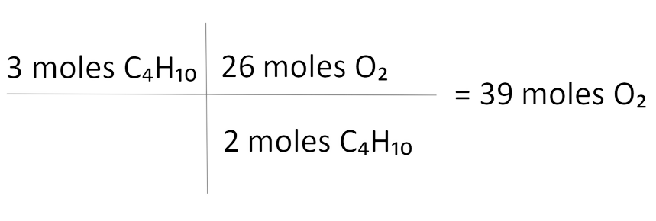
My Favorite Mistake
I have selected my favorite mistake below:
Problem: How many moles of O₂ do you need
to burn 3 moles of C₄H₁₀?
Given equation: __C₄H₁₀ + __O₂ → __CO₂ + __H₂O
Balance the equation: 2C₄H₁₀ + 13O₂ → 8CO₂ + 10H₂O
Mole-to-mole ratio: 2 moles C₄H₁₀ require 26 moles O₂
Using the given information, solve the problem:
Notes:
K20 Center. (n.d.). My Favorite Mistake. Strategies. Retrieved from https://learn.k20center.ou.edu/strategy/115

Slide 19
My Favorite Mistake
I have selected my favorite mistake below:
Problem: How many moles of O₂ do you need
to burn 3 moles of C₄H₁₀?
Given equation: __C₄H₁₀ + __O₂ → __CO₂ + __H₂O
Balance the equation: 2C₄H₁₀ + 13O₂ → 8CO₂ + 10H₂O
Mole-to-mole ratio: 2 moles C₄H₁₀ require 26 moles O₂
Using the given information, solve the problem:
Notes:
K20 Center. (n.d.). My Favorite Mistake. Strategies. Retrieved from https://learn.k20center.ou.edu/strategy/115

Slide 20
My Favorite Mistake
I have selected my favorite mistake below:
Problem: How many moles of O₂ do you need
to burn 3 moles of C₄H₁₀?
Given equation: __C₄H₁₀ + __O₂ → __CO₂ + __H₂O
Balance the equation: 2C₄H₁₀ + 13O₂ → 8CO₂ + 10H₂O
Mole-to-mole ratio: 2 moles C₄H₁₀ require 13 moles O₂
Using the given information, solve the problem:
Notes:
K20 Center. (n.d.). My Favorite Mistake. Strategies. Retrieved from https://learn.k20center.ou.edu/strategy/115

