Slide 2
Making Magento

Slide 3
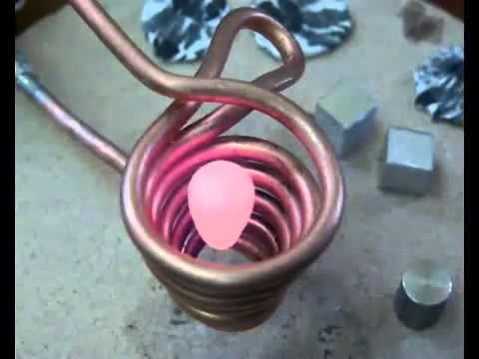
Exclaim and Question
Take all the notes you can. The more notes the better.
https://www.youtube.com/watch?v=qUiCh1OTLts

Slide 4



Task
Supplies are at the front
WARNING: the exposed wire gets HOT. The rubber bands and electrical tape are for securing so your fingers don’t have to.

Slide 5
Fiction in the Facts
Read the claims.
Sort the claims into two stacks:
  Claims you can prove/disprove based on observations from your Exclaim/Question sheet.
  Claims you can't prove yet.
Of the claims that you can prove/disprove, write the claim on your Exclaim/Question sheet where you have the evidence to support/refute the claim. If you decide a claim is false, note that when you write it down.
Read through the claims that you have left to prove and make predictions of whether you think they will be true or false.

Slide 6
Test Something Out!
Pick a claim that you haven’t yet proven.
In your lab group, figure out how you are going to test the claim to figure out if it is true or false.
Don’t forget to write EVERYTHING down in your lab notebook!

Slide 7
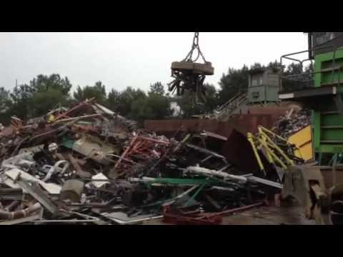
CER: Claim, Evidence, Reasoning
https://www.youtube.com/watch?v=rP2C6M7tDhM

Slide 8
CER: Claim, Evidence, Reasoning
Based upon your observations, write a CER analysis.
C = Claim. What statement do you think is true?
E = Evidence. What data did you collect to support your claim?
R = Reasoning. How do you know that your evidence is accurate and related to your claim?

