Slide 2
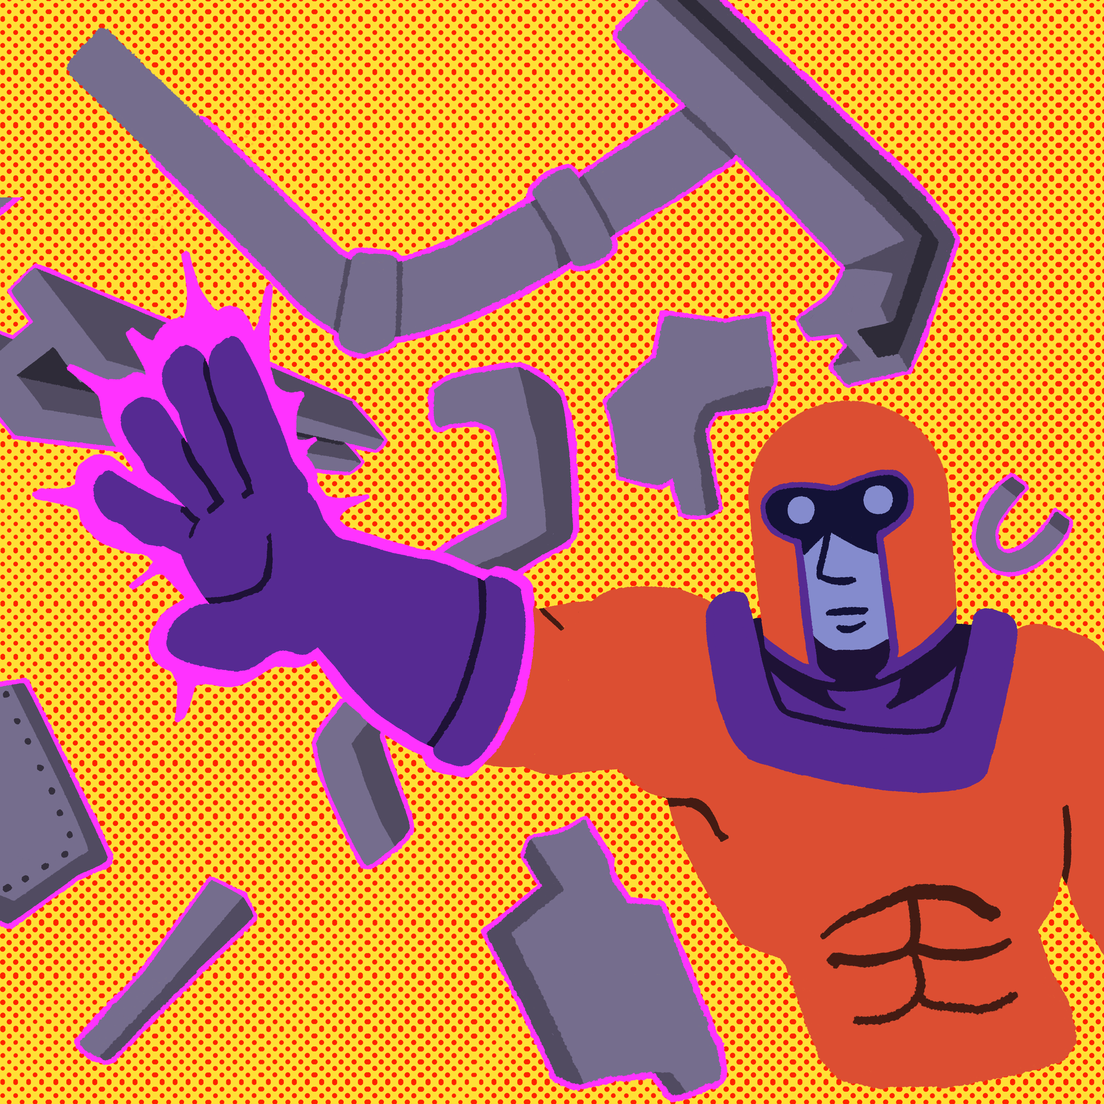
Making Magento

Slide 3
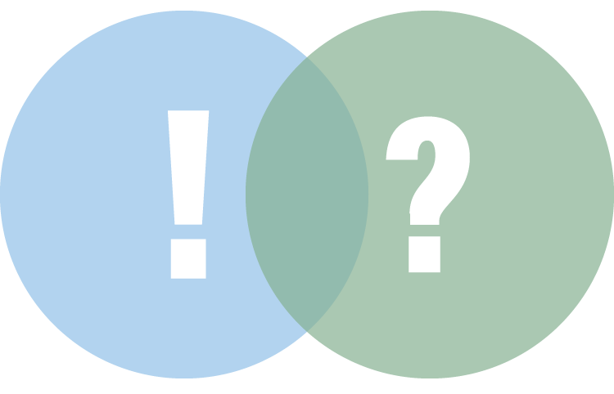
Exclaim and Question
As you watch the video, write down observations you notice.
In the “Exclaim” column write down things you find surprising.
In the “Question” column write down what you don’t understand.
Notes:
bosswaw (boss8O8). HQ melting aluminum w/ electromagnetic cylinder HQ (video file). https://www.youtube.com/watch?v=qUiCh1OTLts
K20 Center. (n.d.). Exclaim and Question. Strategies. https://learn.k20center.ou.edu/strategy/94

Slide 4
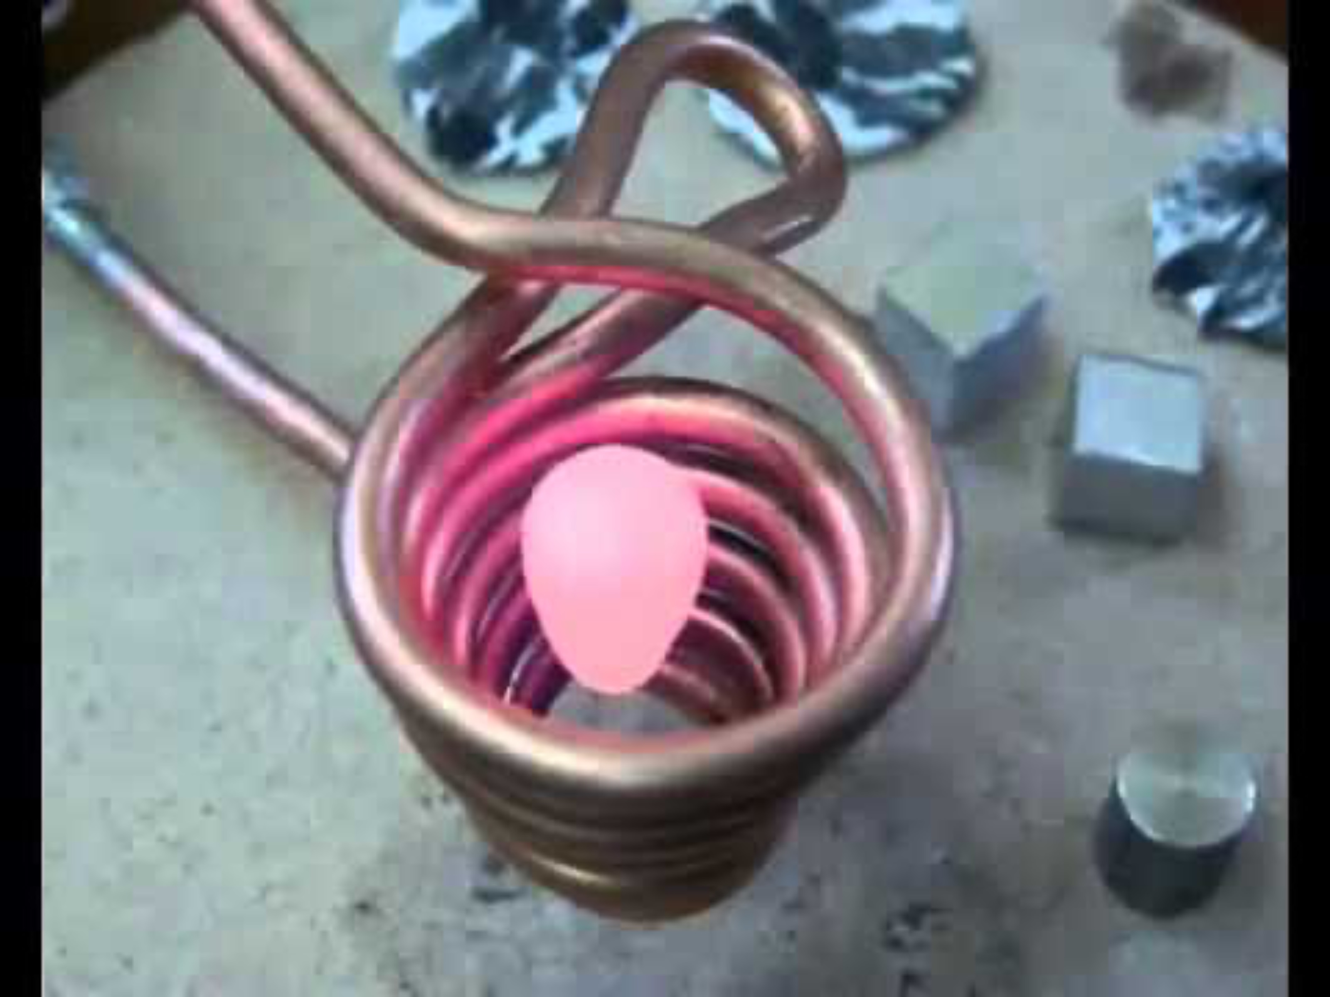
https://www.youtube.com/watch?v=qUiCh1OTLts

Slide 5
Essential Question
How can unseen forces affect us?

Slide 6
Learning Objectives
Construct a functional simple electromagnet using batteries, wire, and a nail, demonstrating understanding of how electric current produces magnetic fields.
Analyze experimental observations to distinguish between factual and fictional claims about electromagnet strength and behavior.
Create a CER explanation that supports conclusions about the relationship between electrical input and magnetic output based on collected data.

Slide 7
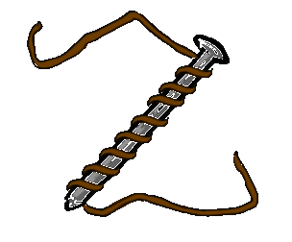

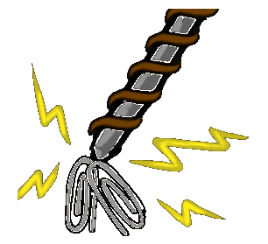
Task
Supplies are at the front
WARNING: the exposed wire gets HOT. The rubber bands and electrical tape are for securing so your fingers don’t have to.

Slide 8

Fiction in the Facts
Read the claims.
Make two stacks of cards:
  Claims you have evidence for and can prove.
  Claims you don’t have evidence for and cannot prove.
Notes:
K20 Center. (n.d.). Fiction in the Facts. Strategies. https://learn.k20center.ou.edu/strategy/60

Slide 9
Fiction in the Facts
Write the claims on your handout next to the evidence in your “Exclaim” column.
For the cards you don’t have evidence for, make predictions about whether or not you will be able to prove the claim.
Notes:
K20 Center. (n.d.). Fiction in the Facts. Strategies. https://learn.k20center.ou.edu/strategy/60

Slide 10
Test Something Out!
Pick a claim that you don’t have evidence for.
In your lab group, design an experiment to test the claim.
Write down all your observations in your notebook.
Notes:
K20 Center. (n.d.). Fiction in the Facts. Strategies. https://learn.k20center.ou.edu/strategy/60

Slide 11
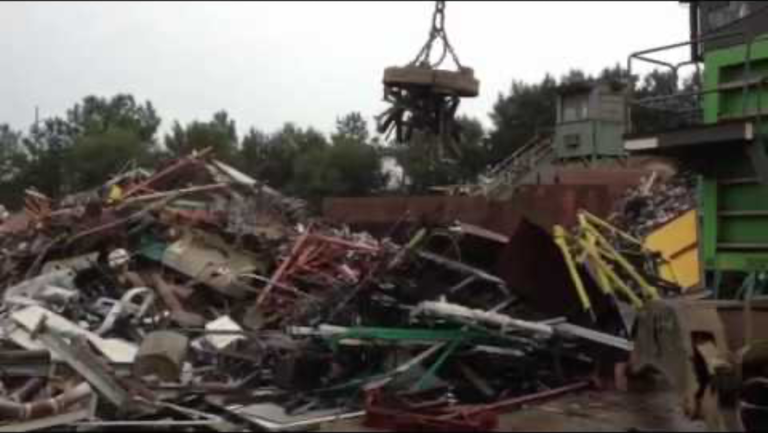
https://www.youtube.com/watch?v=rP2C6M7tDhM
Notes:
gmonkey3. Scrap metal unloaded by magnet (video file). https://www.youtube.com/watch?v=rP2C6M7tDhM
K20 Center. (n.d.). Claim, Evidence, Reasoning (CER). Strategies. https://learn.k20center.ou.edu/strategy/156

Slide 12

CER: Claim, Evidence, Reasoning
Based upon your observations, write a CER analysis:
C = Claim. What statement do you think is true?
E = Evidence. What data did you collect to support your claim?
R = Reasoning. How do you know that your evidence is accurate and related to your claim?
Notes:
K20 Center. (n.d.). Claim, Evidence, Reasoning (CER). Strategies. https://learn.k20center.ou.edu/strategy/156

