Slide 2
Welcome to the Mead Hall
Introduction to Beowulf

Slide 3
Essential Question
How does culture and religion affect literature and the way it is understood?

Slide 4
Lesson Objectives
Students will research context topics.
Students will present research with anchor charts.

Slide 5
ABC Graffiti: Overview
Round 1
Round 2
Round 3
Generate words or phrases related to the topic for each letter of the alphabet.
Rotate to the next group.
Read through their list.
Add words and phrases to the letters the have not already been used.
Rotate again
Repeat the steps from Round 2, except feel free to add to letters that have already been used.
Notes:
K20 Center. (n.d.). ABC Graffiti. Strategies. https://learn.k20center.ou.edu/strategy/96

Slide 6
ABC Graffiti: Round 1
Work in small groups to brainstorm words or phrases that connect to the following question:
What do you know about Norse people and the Vikings?
Be prepared to move after time is called.
Notes:
K20 Center. (n.d.). ABC Graffiti. Strategies. https://learn.k20center.ou.edu/strategy/96
K20 Center. (2021, September 21). K20 Center 3 minute timer. [Video]. YouTube. https://youtu.be/iISP02KPau0?si=oew-VIocHqA5Tn8z

Slide 7
ABC Graffiti: Round 2
Rotate to the next group.
Read through their list.
Add words and phrases to the letters that have not already been used in their alphabet.
Be prepared to move after time is called.
Notes:
K20 Center. (n.d.). ABC Graffiti. Strategies. https://learn.k20center.ou.edu/strategy/96
K20 Center. (2021, September 21). K20 Center 3 minute timer. [Video]. YouTube. https://youtu.be/iISP02KPau0?si=oew-VIocHqA5Tn8z

Slide 8
ABC Graffiti: Round 3
Once again, rotate to the next group.
Read through their list.
Add words and phrases to the letters that have not already been used in their alphabet.
Feel free to add to letters that have already been used.
Notes:
K20 Center. (n.d.). ABC Graffiti. Strategies. https://learn.k20center.ou.edu/strategy/96
K20 Center. (2021, September 21). K20 Center 3 minute timer. [Video]. YouTube. https://youtu.be/iISP02KPau0?si=oew-VIocHqA5Tn8z

Slide 9
Always, Sometimes, or Never True
Read each statement and determine if it is:
Always True,
Sometimes True, or
Never True
Do not yet fill out the Justification column.
Notes:
K20 Center. (n.d.). Always, Sometimes, or Never True. Strategies. https://learn.k20center.ou.edu/strategy/145

Slide 10
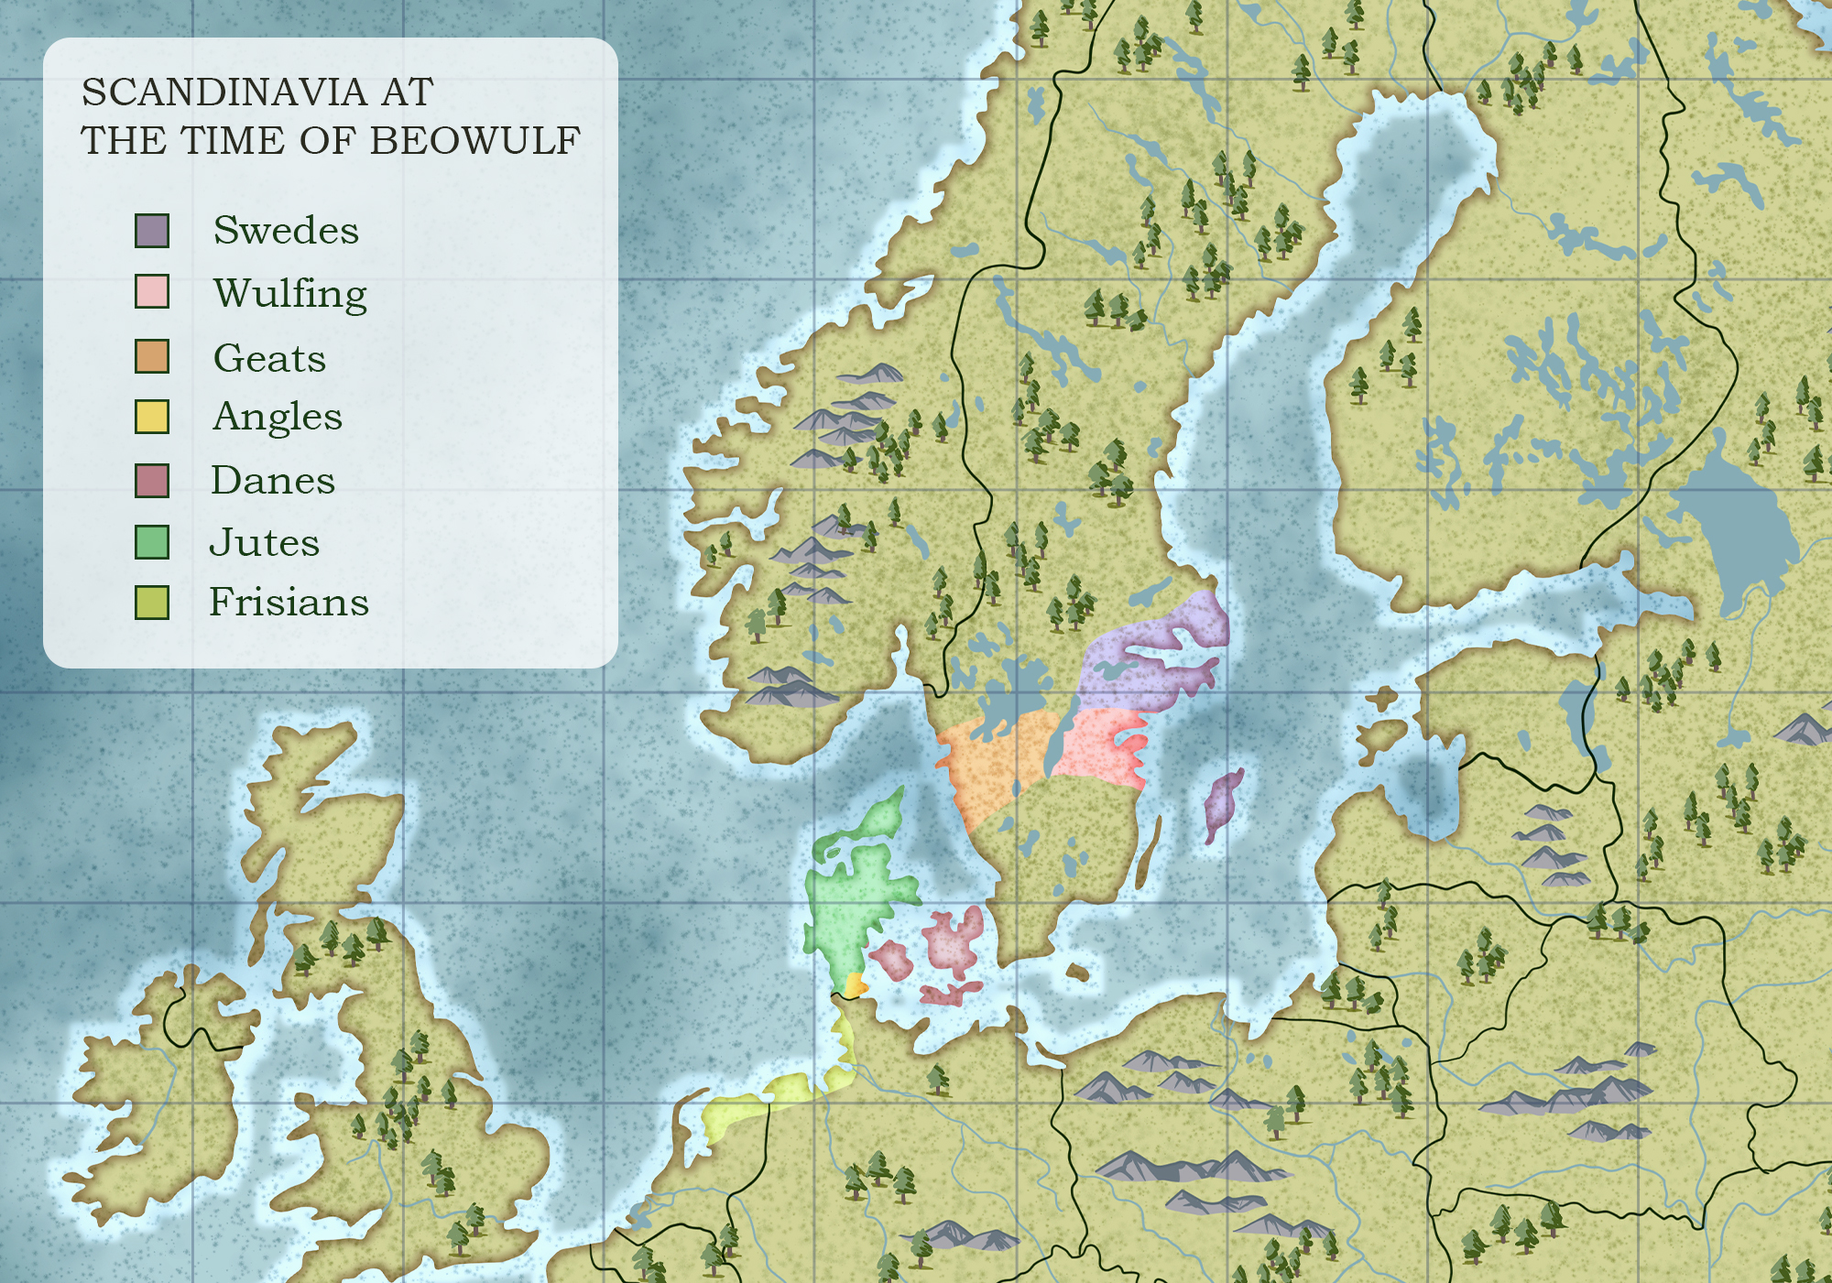

Slide 11
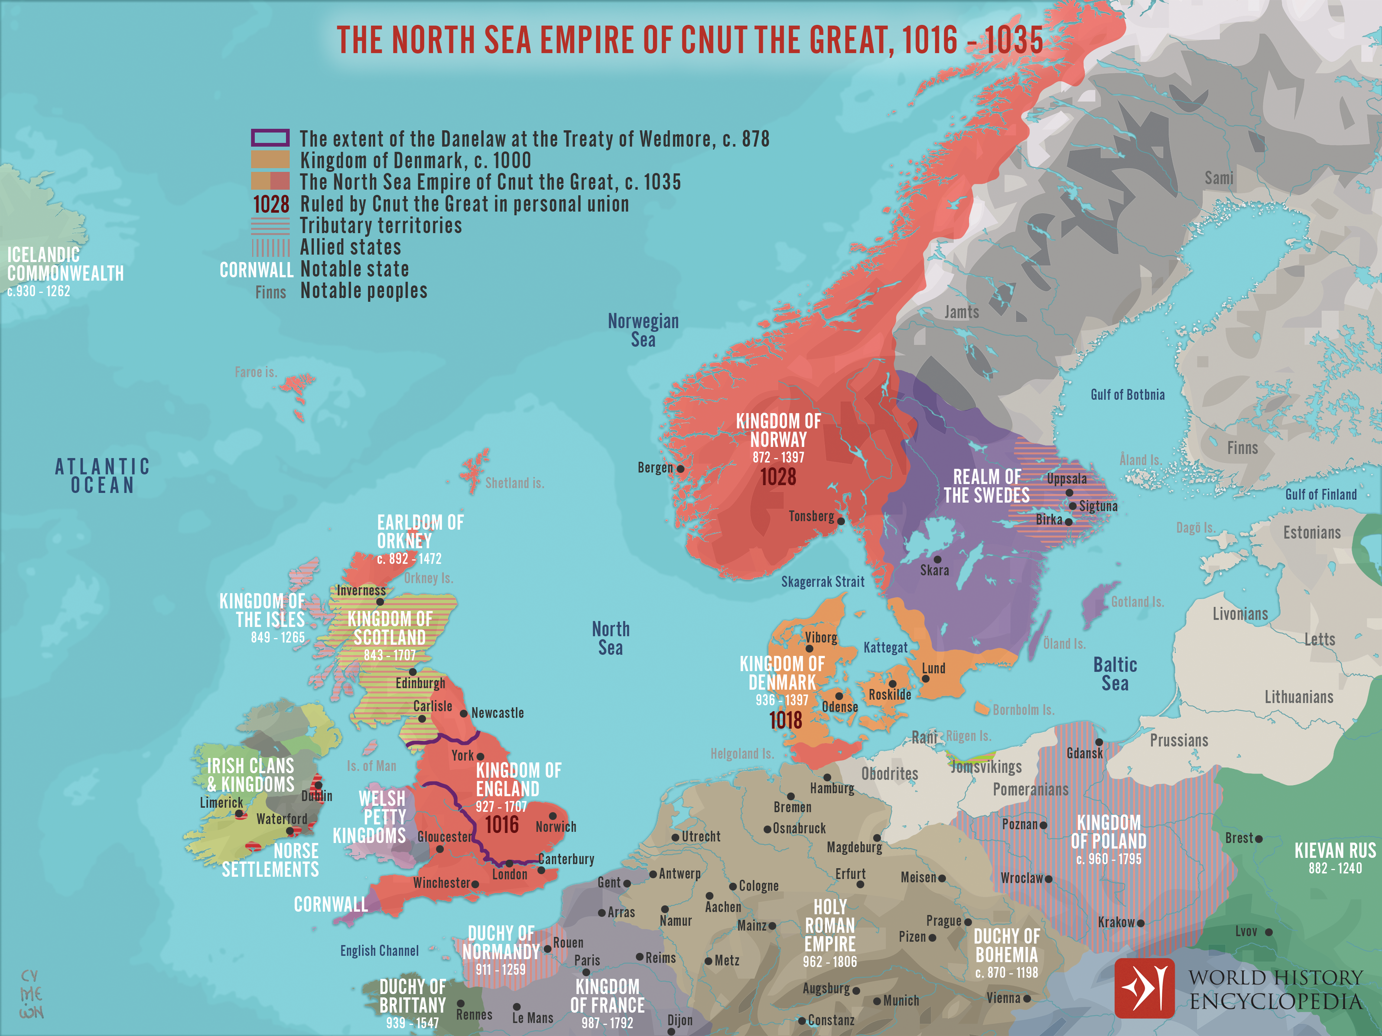
Notes:
Netchev, S. (2023). Illustration. The North Sea Empire of Cnut the Great, 1016 - 1035. https://www.worldhistory.org/image/17441/the-north-sea-empire-of-cnut-the-great-1016---1035/

Slide 12
Wakelet Research
Groups 1-3, go to bit.ly/Beowulf-1.
Groups 4-6, go to bit.ly/Beowulf-4.
On a piece of notebook paper, take notes as you read through your sources.
Make notes:
• Who? • When? • Why?
• What? • Where?
Gather enough information to create a poster.
Notes:
K20 Center. (n.d.). Wakelet. Tech tools. https://learn.k20center.ou.edu/tech-tool/2180

Slide 13
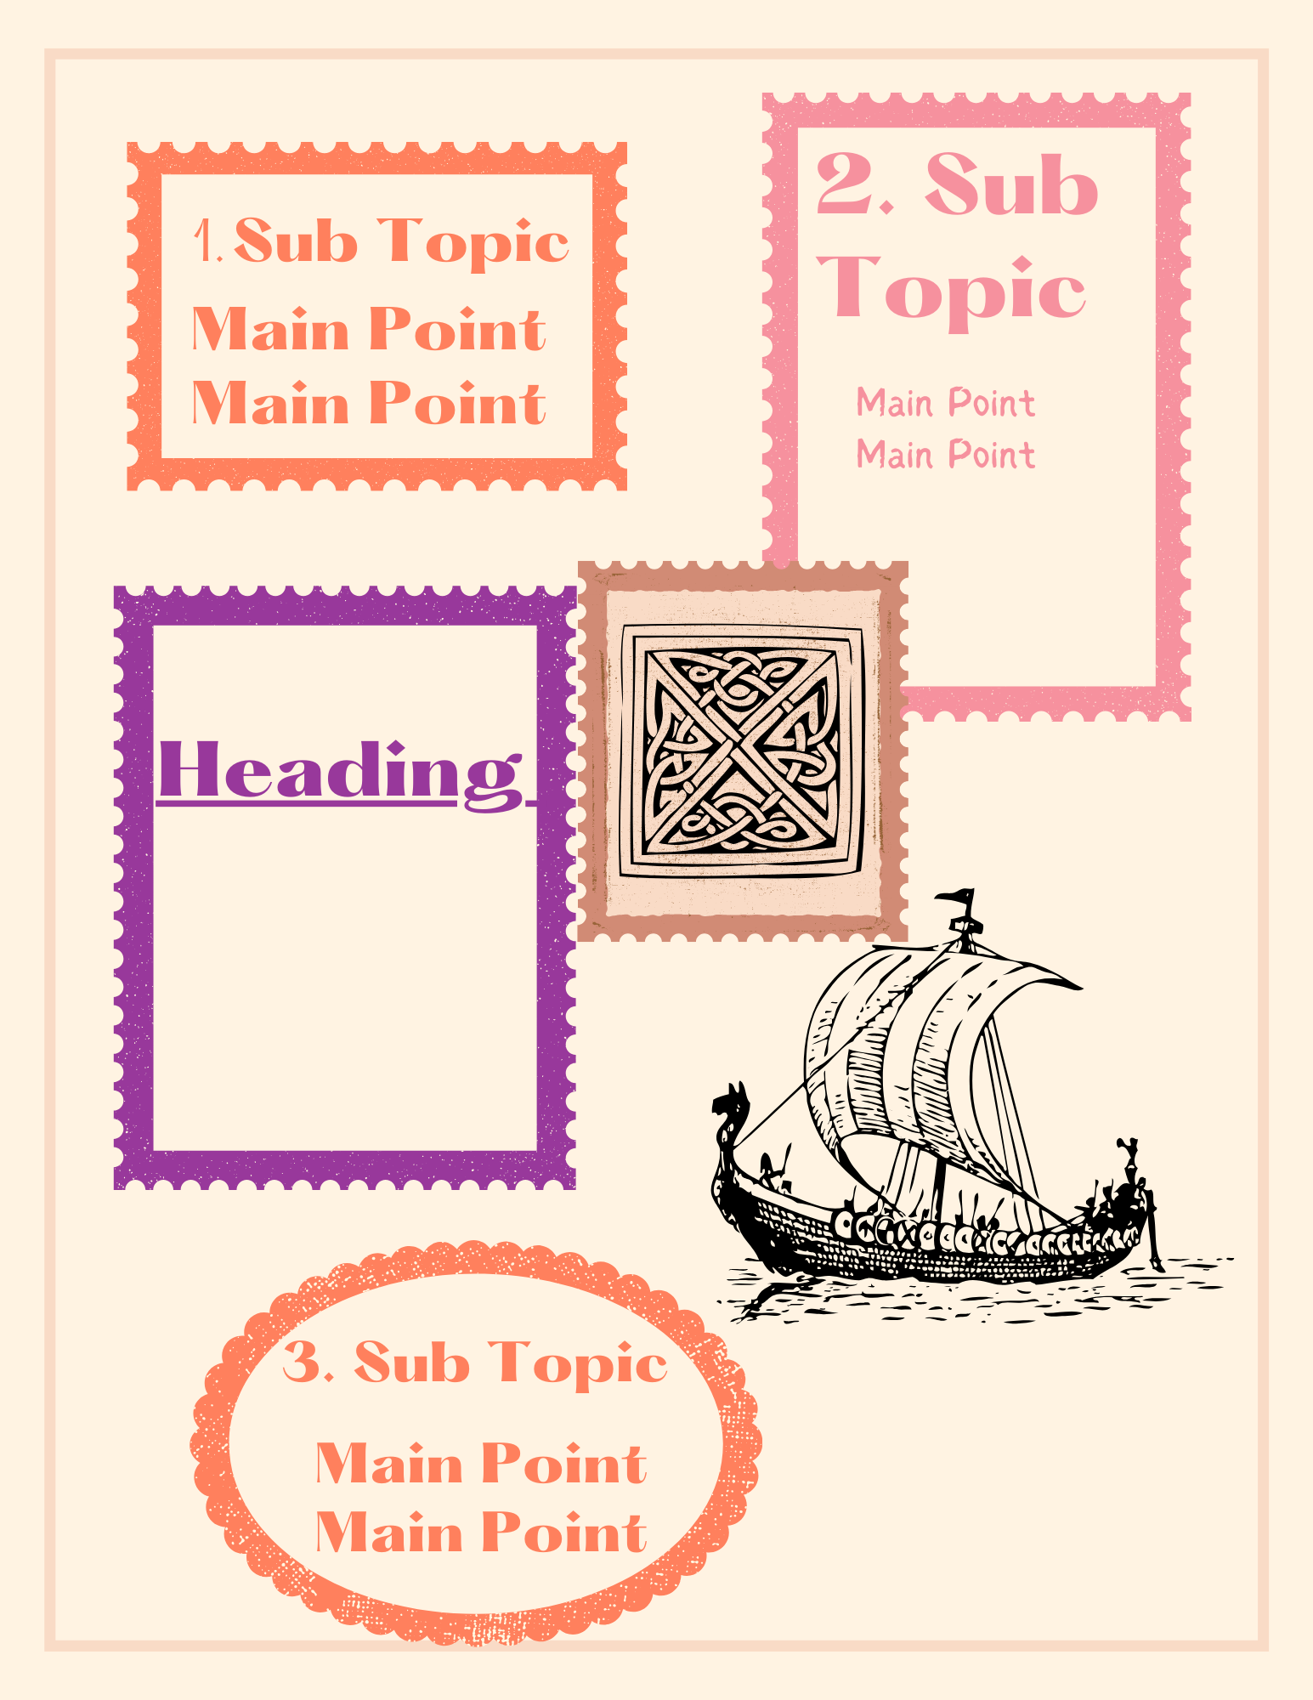
Anchor Charts: Overview
Work with your group to create an anchor chart on your assigned topic.

Slide 14
Anchor Charts: Expectations
Information:
Heading
Subtopic(s)
Main Points
Visually Appealing:
Graphics/Diagrams/Illustrations
Legible, Large Enough to Read
Be creative! Make something interesting!

Slide 15
Gallery Walk
Read peers’ anchor charts.
Add a sticky note with one of the following:
A question
A comment
An additional fact

Slide 16
Revisit: Always, Sometimes, or Never True
Reflect on what you have learned, then reread each statement and determine if it is:
Always True,
Sometimes True, or
Never True
Now explain your reasoning in the Justification column.
Notes:
K20 Center. (n.d.). Always, Sometimes, or Never True. Strategies. https://learn.k20center.ou.edu/strategy/145

Slide 17
Always, Sometimes, or Never True?
The Norse expected people to be quiet and humble.
Notes:
The Norse never expected people to be quiet and humble. Especially in Beowulf, he does a lot of “bragging”.

Slide 18
Always, Sometimes, or Never True?
Odin is the only god the Norse worshiped.
Notes:
Odin was not the only god the Norse worshiped. The Norse had a multitude of gods as well as pagan practices they followed.

Slide 19
Always, Sometimes, or Never True?
All Viking raiders were bloodthirsty berserkers.
Notes:
Sometimes Viking raiders were bloodthirsty berserkers. Some Vikings were categorized as “berserkers,” but not all Vikings were.

Slide 20
Always, Sometimes, or Never True?
The Norse set people on fire as part of their funeral practices.
Notes:
Sometimes the Norse set people on fire as part of their funeral practices. Not all Norse funerals involved a pyre, but many were celebrated in that way.

Slide 21
Always, Sometimes, or Never True?
Vikings wear helmets with horns.
Notes:
Vikings never wore helmets with horns. This is a funny myth that has not been proven.

Slide 22
Always, Sometimes, or Never True?
Norse people survived only by raiding.
Notes:
Sometimes Norse people survived by raiding. “Only” is the word that makes this sentence tricky. While some Norse were Vikings, many others farmed, fished, and hunted. And raiding was often seasonal work.

