Slide 2
Dust Bowl Chat
U.S. History

Slide 3
Essential Questions
What factors contributed to the Dust Bowl?
How effectively did the FDR administration respond to the crisis?
What impact did this event have on contemporary resource management?

Slide 4
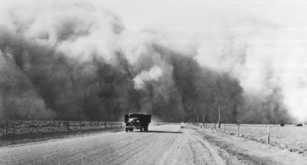
Fireside Chat
Mmakki, (2003). The Dust Bowl.gif [image file]. Retrieved from https://commons.wikimedia.org/wiki/File:The_Dust_Bowl.gif

Slide 5
Document Analysis
Examine and evaluate your document.
Come up with three pieces of information that your document reveals about the Dust Bowl and record them in the document analysis organizer.
Share what you learned about your document with your group.
Fill out the rest of the document analysis organizer with information presented by other group members.
Share out.

Slide 6
FDR Fireside Chat
Read the FDR Fireside chat text.
While you read, stop after every major paragraph and jot down main ideas for that paragraph in the margin.
Share what you found as the main ideas with your partner. Together, come up with the main ideas for the entire text.
Share out.

Slide 7
New Deal Response
Read the Woolner text.
While reading, stop after each main paragraph and jot down main ideas for that paragraph in the margin.
Share what you found as the main ideas with your partner. Together, come up with the main ideas for the entire text.
Share out.

Slide 8
Third Text
On the left side of the H-Chart, write down the main ideas from the FDR Fireside Chat text.
On the right side of the H-Chart, write down the main ideas from the Woolner text.
In the middle of the chart, write the “third text,” which includes your ideas and thoughts about how the two texts compare and contrast, what they’re both saying about the New Deal response, and how, as a pair, they shine light on the essential questions.
Share out.

