Slide 2
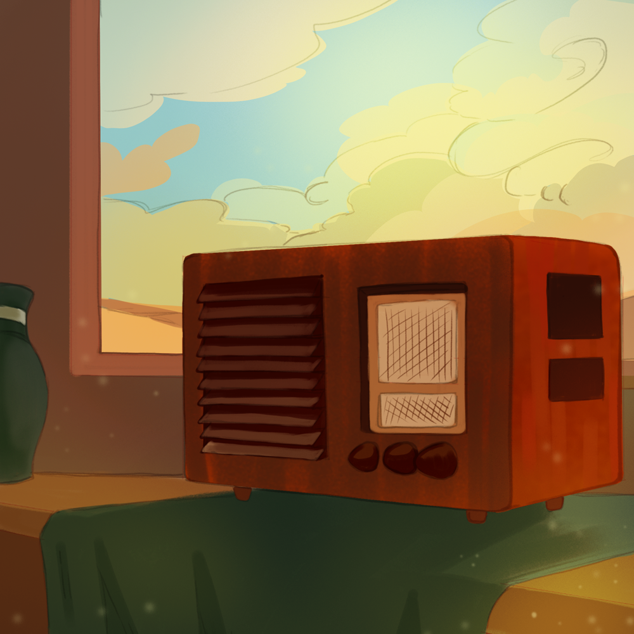
Dust Bowl Chat
Dust Bowl

Slide 3

Tip of the Iceberg
Think about what you already know about the following question:
  What impact did the Dust Bowl have on Oklahomans?
Write your response above the water line.
Notes:
K20 Center. (n.d.). Tip of the iceberg. Strategies. https://learn.k20center.ou.edu/strategy/67

Slide 4
Essential Question
What impact did the Dust Bowl have on Oklahomans?

Slide 5
Learning Objective
Describe the impact of the Dust Bowl on Oklahomans.

Slide 6
FDR’s Fireside Chat
Listen to the excerpt of a Fireside Chat with President Franklin Delano Roosevelt (FDR) in which he describes the conditions of the Dust Bowl.

Slide 7
FDR’s Fireside Chat
On the Dust Bowl Notes handout, write what you have learned about the Dust Bowl from the excerpt.

Slide 8
Dust Bowl Images
Analyze each image.
Respond to the questions under the images.

Slide 9

Dust Bowl Captions
Create a caption for your assigned image.
Notes:
K20 Center. (n.d.). Caption this. Strategies. https://learn.k20center.ou.edu/strategy/82

Slide 10
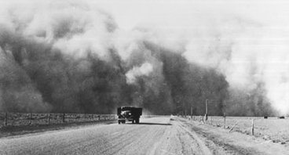
Notes:
Dust cloud [Photograph]. (1936, May). Getty Images. https://www.gettyimages.com/detail/news-photo/south-of-lamar-colorado-a-large-dust-cloud-appears-behind-a-news-photo/108802891?adppopup=true

Slide 11
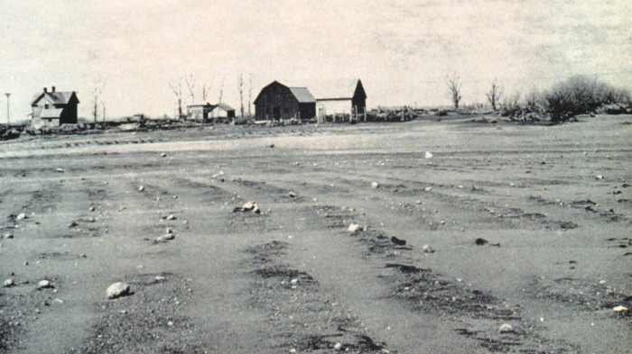
Notes:
Lord, R. (1935). A blown-out field in South Dakota [Photograph]. American Institute of Physics. https://history.aip.org/climate/xDust.htm

Slide 12
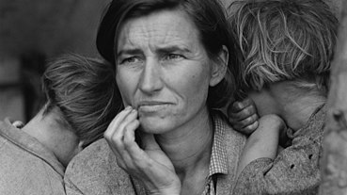
Notes:
Lange, D. (1936). Migrant mother [Photograph]. Wikimedia Commons. https://commons.wikimedia.org/w/index.php?curid=52734

Slide 13
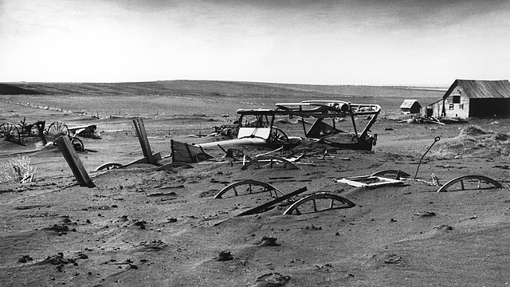
Notes:
Dust bowl – Dallas, South Dakota [Photograph]. (1936). Wikimedia Commons. https://en.wikipedia.org/wiki/File:Dust_Bowl_-_Dallas,_South_Dakota_1936.jpg

Slide 14
Dust Bowl Images
On the Dust Bowl Notes handout, write what you have learned about the Dust Bowl from the images.

Slide 15
Dust Bowl Blues
Listen to the song Dust Bowl Blues by Woody Guthrie.
On the Dust Bowl Notes handout, write what you have learned about the Dust Bowl from the song.

Slide 16
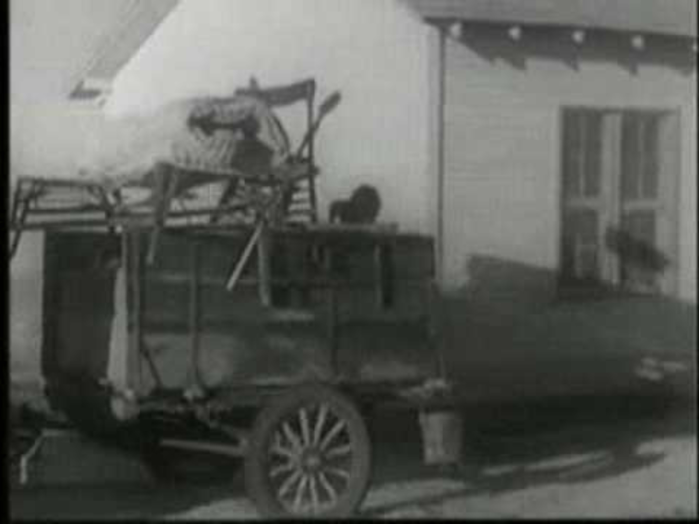
Dust Bowl Blues
Notes:
Adelfred. (2010, January 16). Woody Guthrie – Dust Bowl Blues [Video]. YouTube. https://www.youtube.com/watch?v=jQYKJaWuj0Y&t=1s

Slide 17
Tip of the Iceberg
Think about what you learned in response to the following question:
  What impact did the Dust Bowl have on Oklahomans?
Write your response below the water line.
Notes:
K20 Center. (n.d.). Tip of the iceberg. Strategies. https://learn.k20center.ou.edu/strategy/67

