Slide 2
Balancing Act 2
Stoicheometry--Grams to Grams

Slide 3
Essential Question
How can stoichiometry calculations help us understand the relationship between reactants and products in a chemical reaction?

Slide 4
Lesson Objectives
Understand how different substances interact and the amount of each substance required or produced in the reaction.
Establish the quantitative relationship between reactants and products in a chemical reaction.

Slide 5

I Notice, I Wonder
After viewing and holding the ball, respond to the following prompts:
What do you notice about the bouncy ball?
What do you wonder about the bouncy ball?
Notes:
K20 Center. (n.d.). I notice, I wonder. strategies. Retrieved from https://learn.k20center.ou.edu/strategy/180

Slide 6
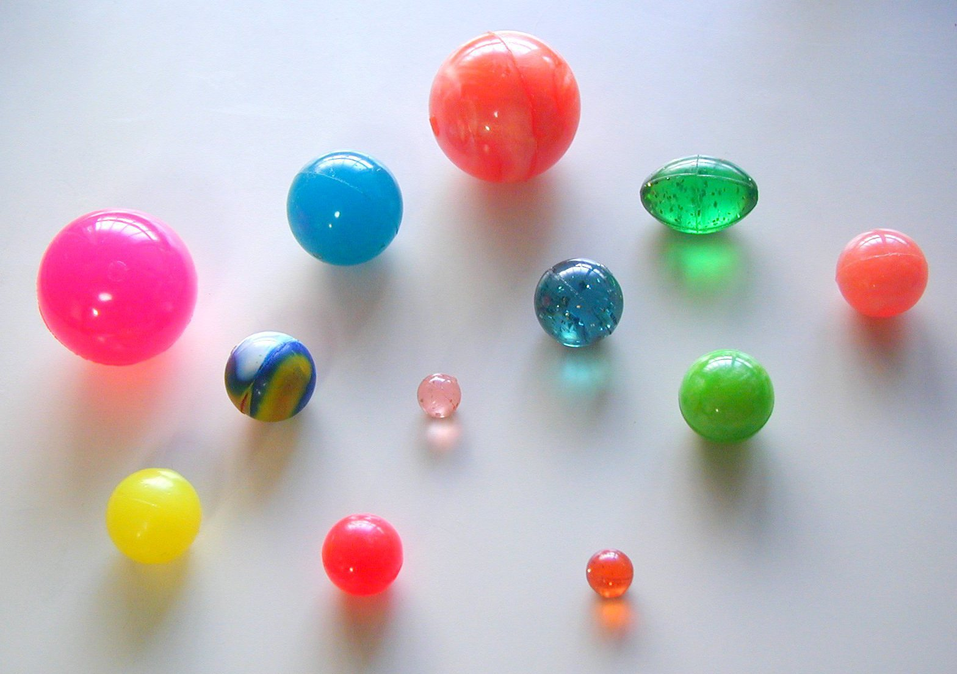
Your Turn!
Now you get to make your own bouncy ball!
Each ingredient is listed below, but you will decide how much glue is needed.
Borax
Warm water
Liquid glue
Corn starch
Food coloring
Measuring cups
Measuring spoons
Craft stick
Bowls
**Note: If the ball is left sitting, it will become flat on one side. Just reroll it between your hands to reshape. Remember to measure the bounce from the bottom of the ball!
Notes:
File:colorful super ball.jpg - wikimedia commons. (n.d.-a). https://commons.wikimedia.org/wiki/File:Colorful_Super_ball.jpg

Slide 7
Science Behind it
When the reactant of the glue was added to the borax water, the glue became firm and bouncy. That’s because the borax reacted with the glue, causing the polymers, or long chains of molecules in the glue to stick together and form the product of an elastomer (being elastic, rubbery, and stretchable).
Notes:
File:colorful super ball.jpg - wikimedia commons. (n.d.-a). https://commons.wikimedia.org/wiki/File:Colorful_Super_ball.jpg

Slide 8
Grams to Grams Notes
Stoichiometry: Greek,"stoiechion" meaning "element," and "metron" meaning "to measure. The process of calculating substance quantities in a reaction using the balanced equation.

Slide 9
Moles to Moles Notes
Balance the following equation:
___Al + ___HCl -> __AlCl₃ + __H₂

Slide 10
Grams to Grams Notes
Label the Reactants, Products & Coefficients:
___Al + ___HCl -> __AlCl₃ + __H₂

Slide 11
Grams to Grams Notes
2 Al + 6HCl -> 2 AlCl₃ + 3H₂
Coefficients
Reactants
Products

Slide 12
Vocabulary
Conversion factor: A numeric ratio of equal measurements used to convert quantities between different units.
Moles(mol):The quantity of an element or compound containing 6.02 x 10²³(Avagadro’s number) particles (ex. atoms, ions, etc.) of that element/compound.
Molar(Molecular) Mass: The weight(in grams) of a single mole of particles (atoms, ions, or molecules) of an element/compound.

Slide 13
Steps:
Balance the equation.
Convert grams A given in the problem to moles of A by dividing by the molar (molecular) mass of A from the periodic table.
Determine the mole-to-mole ratio between A and B.
Convert moles of B to the mass of B by multiplying the molecular mass of B.
Multiply across. Divide bottom.

Slide 14
General Form for Grams-to-Grams Conversions
Ratio from coefficient mol B
Molar mass from periodic table g B
# g A
# mol A
Molar mass from periodic table g A
Ratio from coefficient mol A
1 mol B

Slide 15
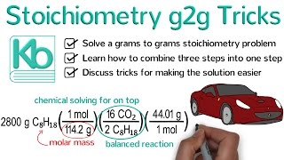
https://www.youtube.com/watch?v=-1xfnq8yGk8
Notes:
YouTube. (2017a, March 26). Stoichiometry tricks. YouTube. https://www.youtube.com/watch?v=-1xfnq8yGk8

Slide 16
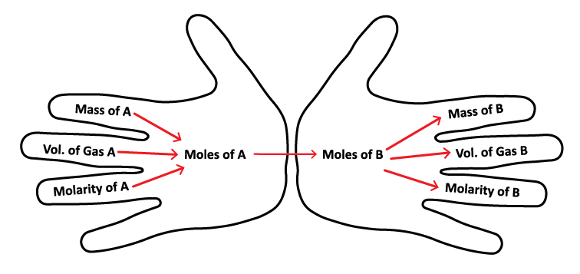
Need a Hand?

Slide 17
Let’s Try It
If 14 grams of H₂ and excess O₂ react to produce water, how many grams of H₂O are produced?

Slide 18
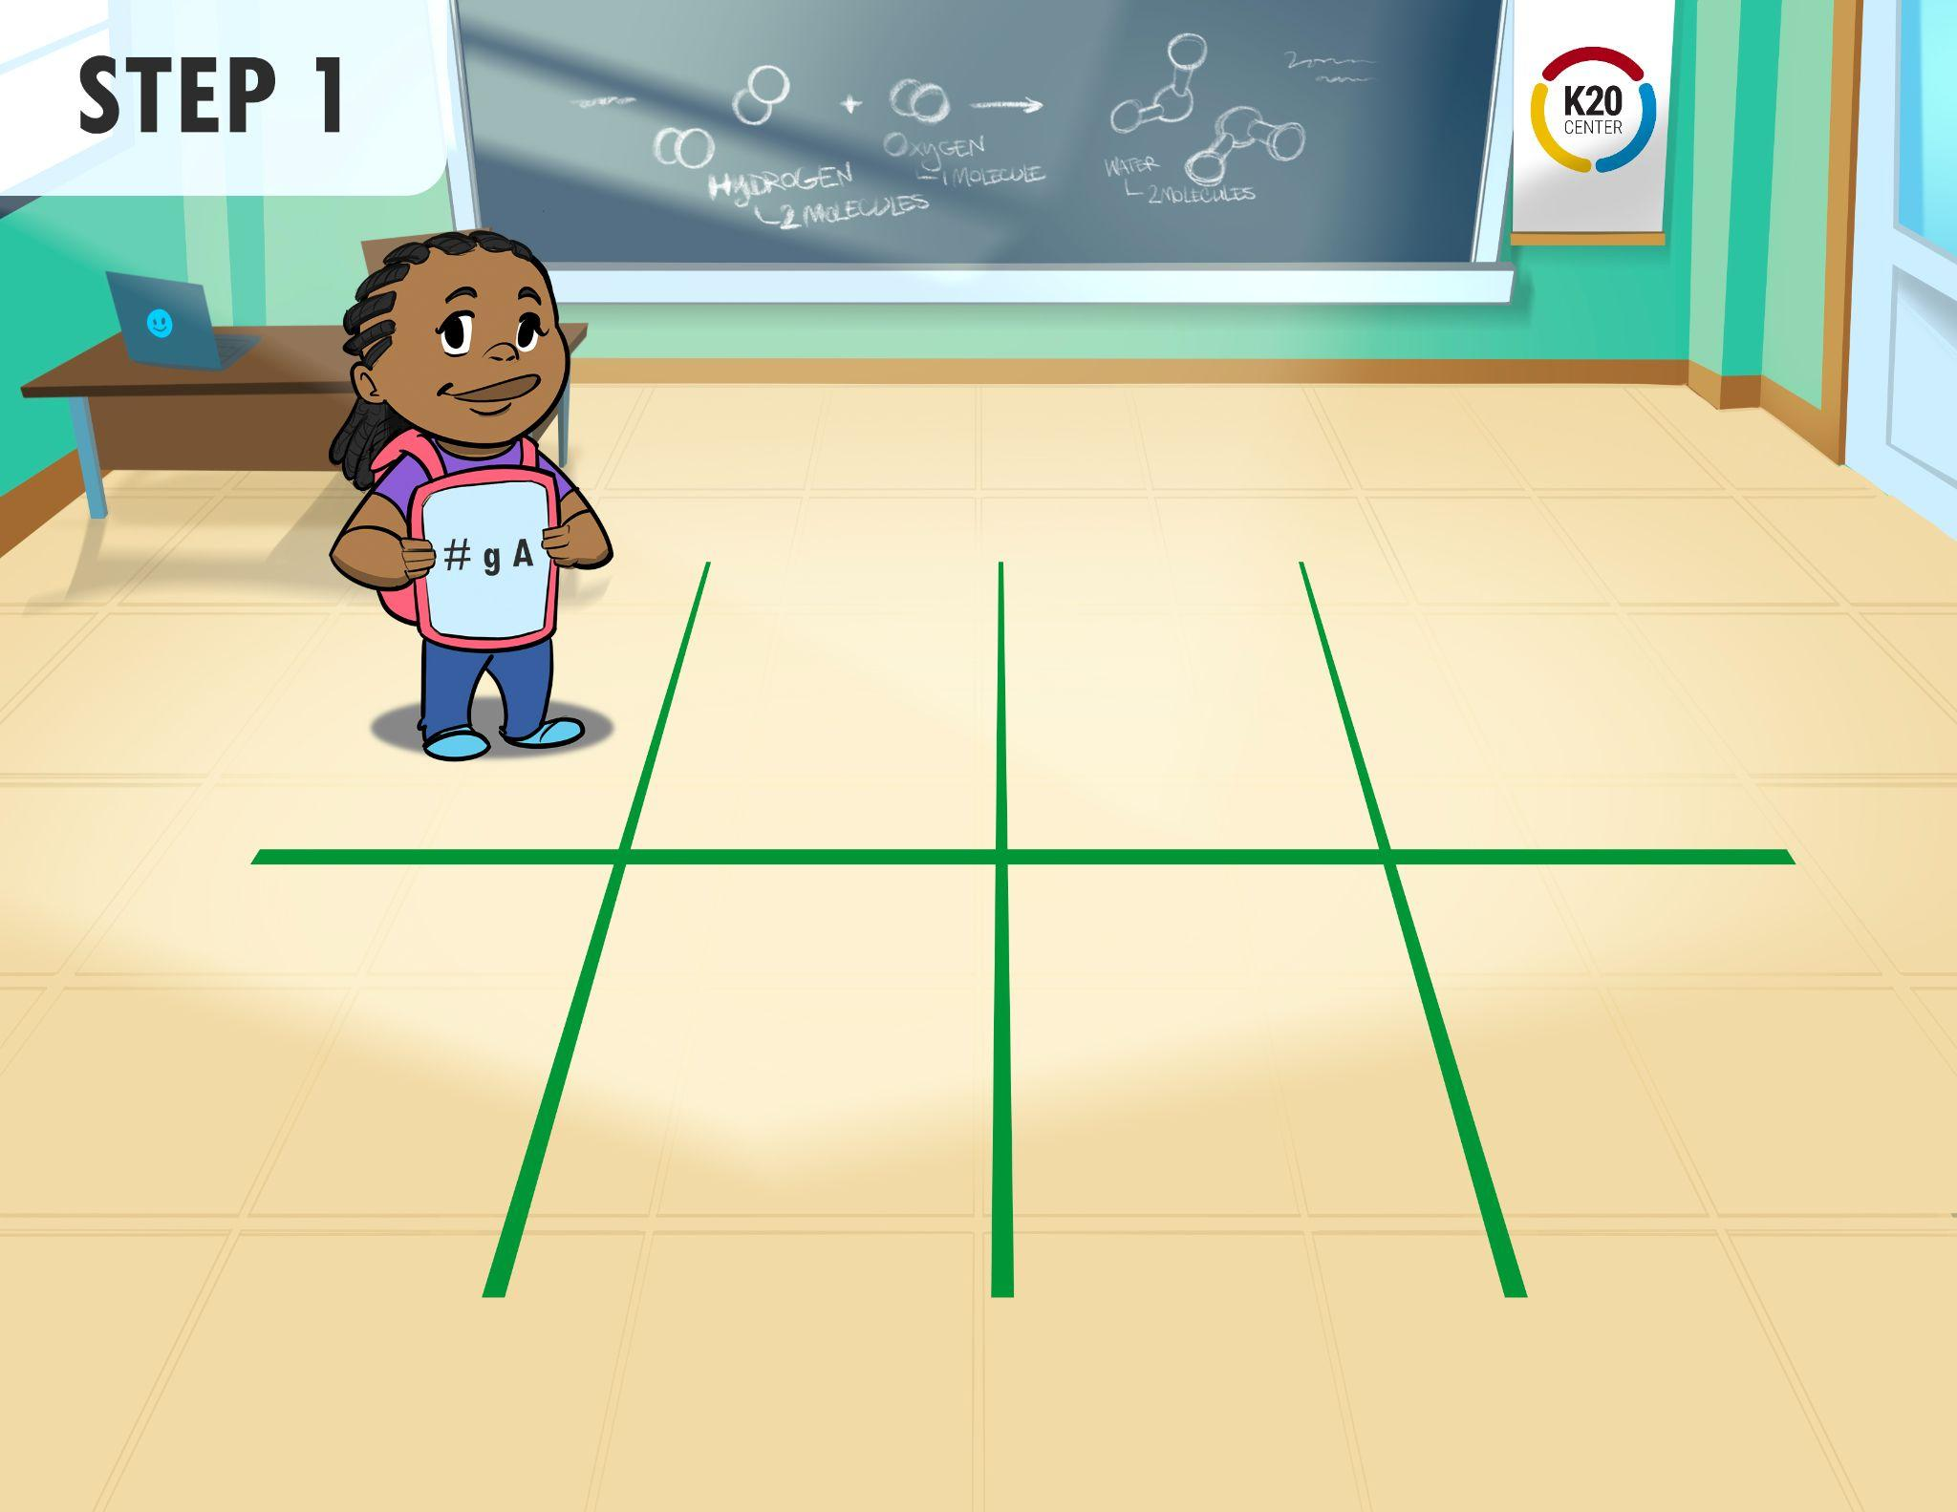
Let’s Try It

Slide 19
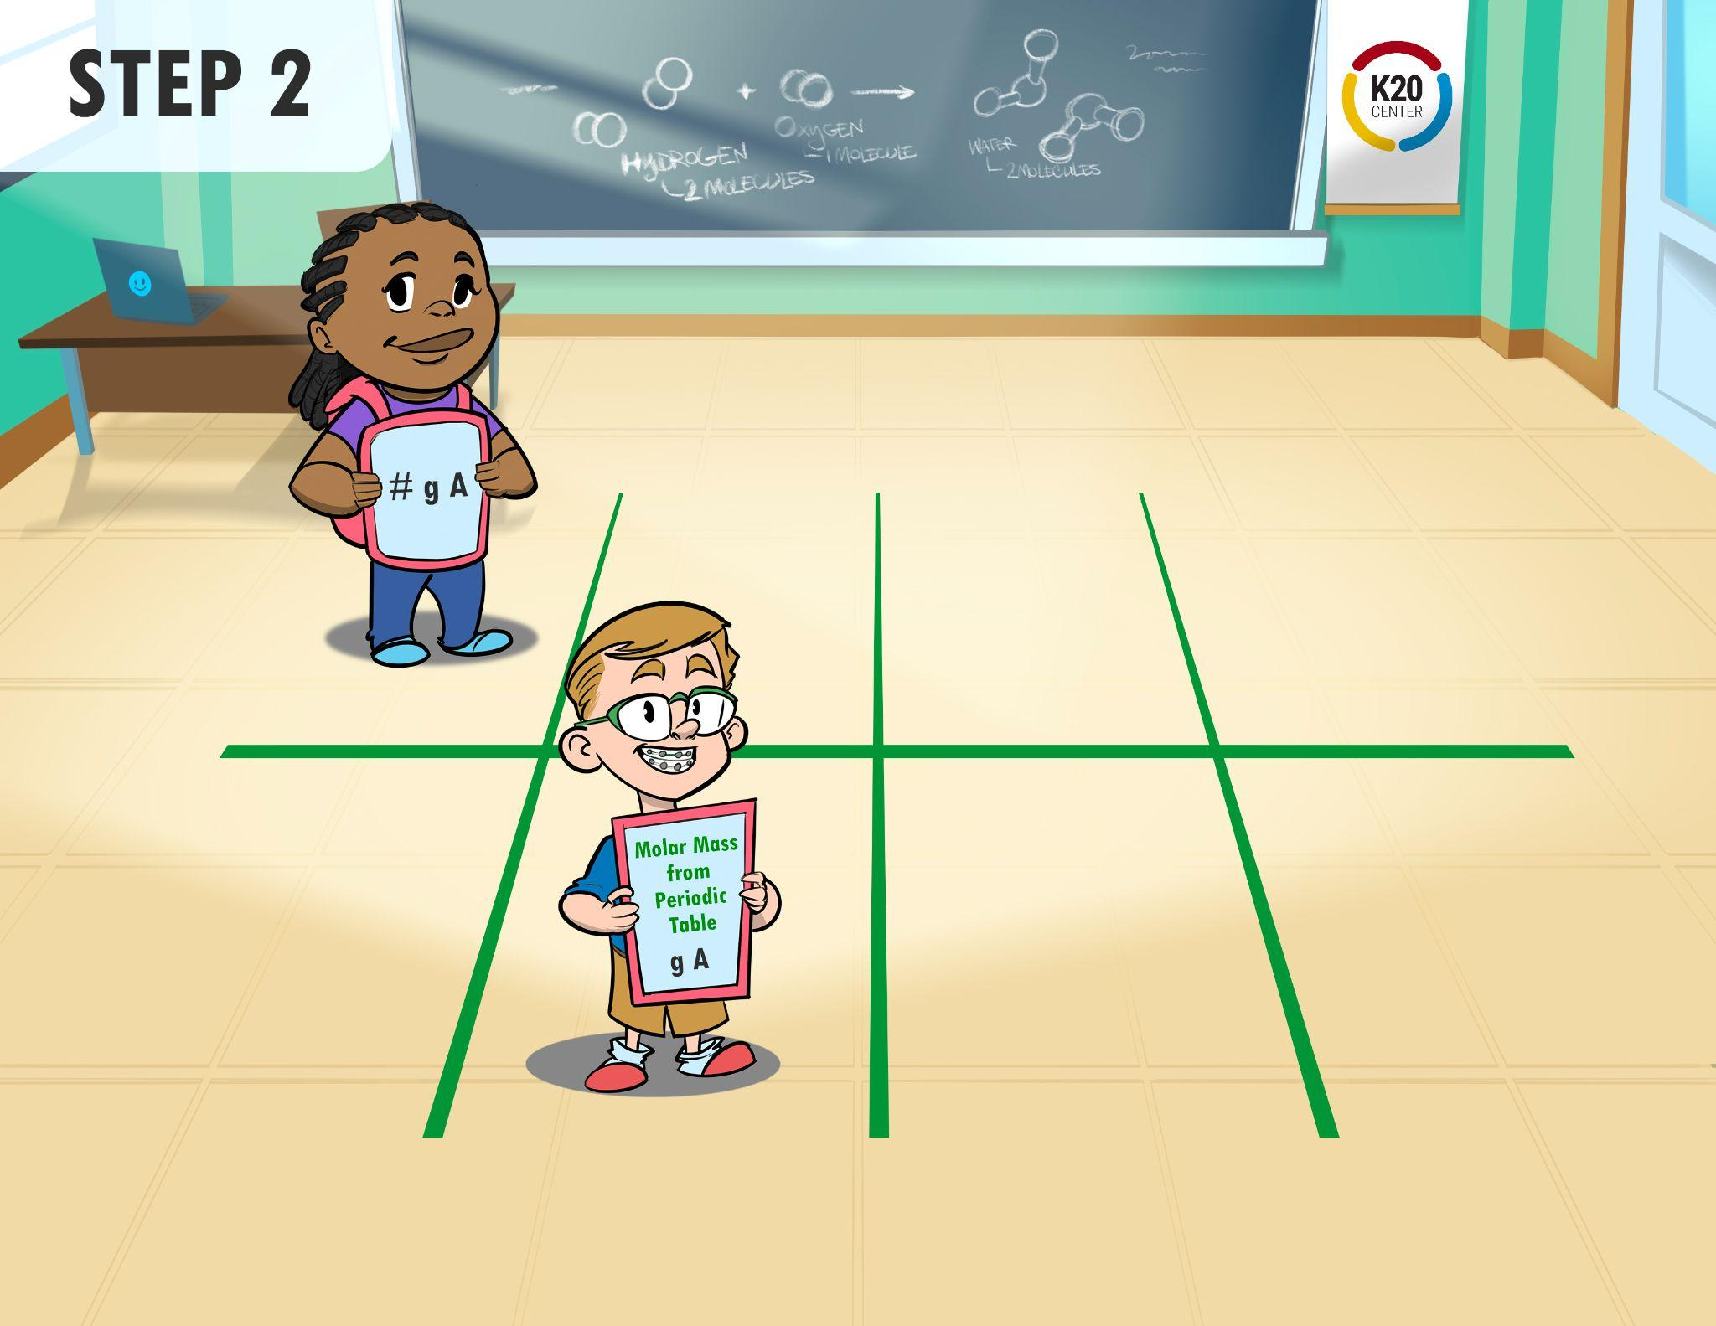
Let’s Try It

Slide 20
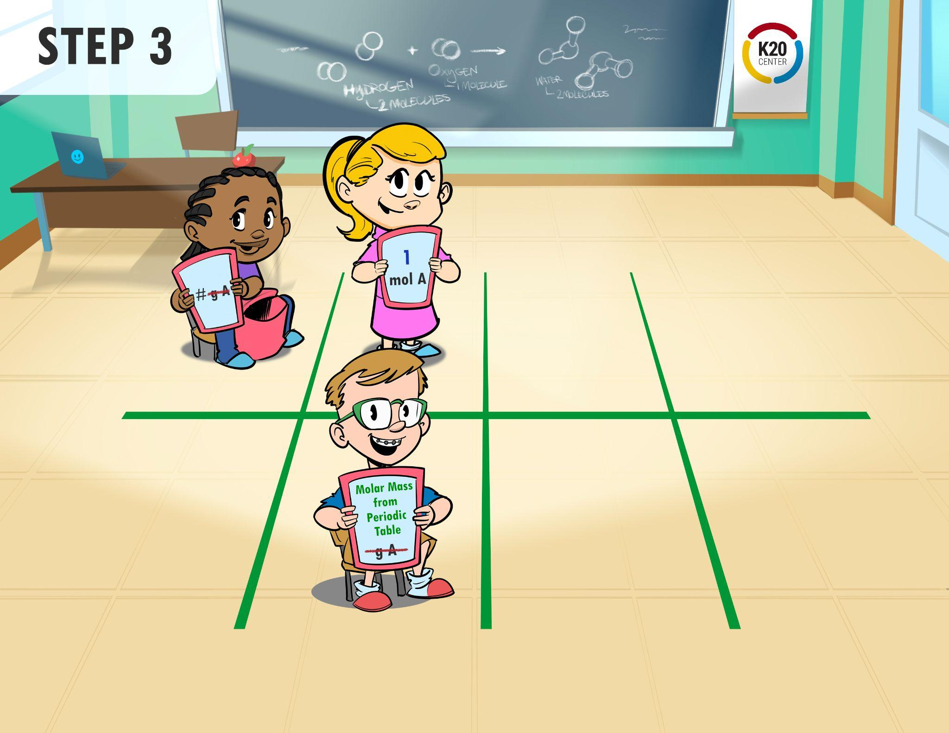
Let’s Try It

Slide 21
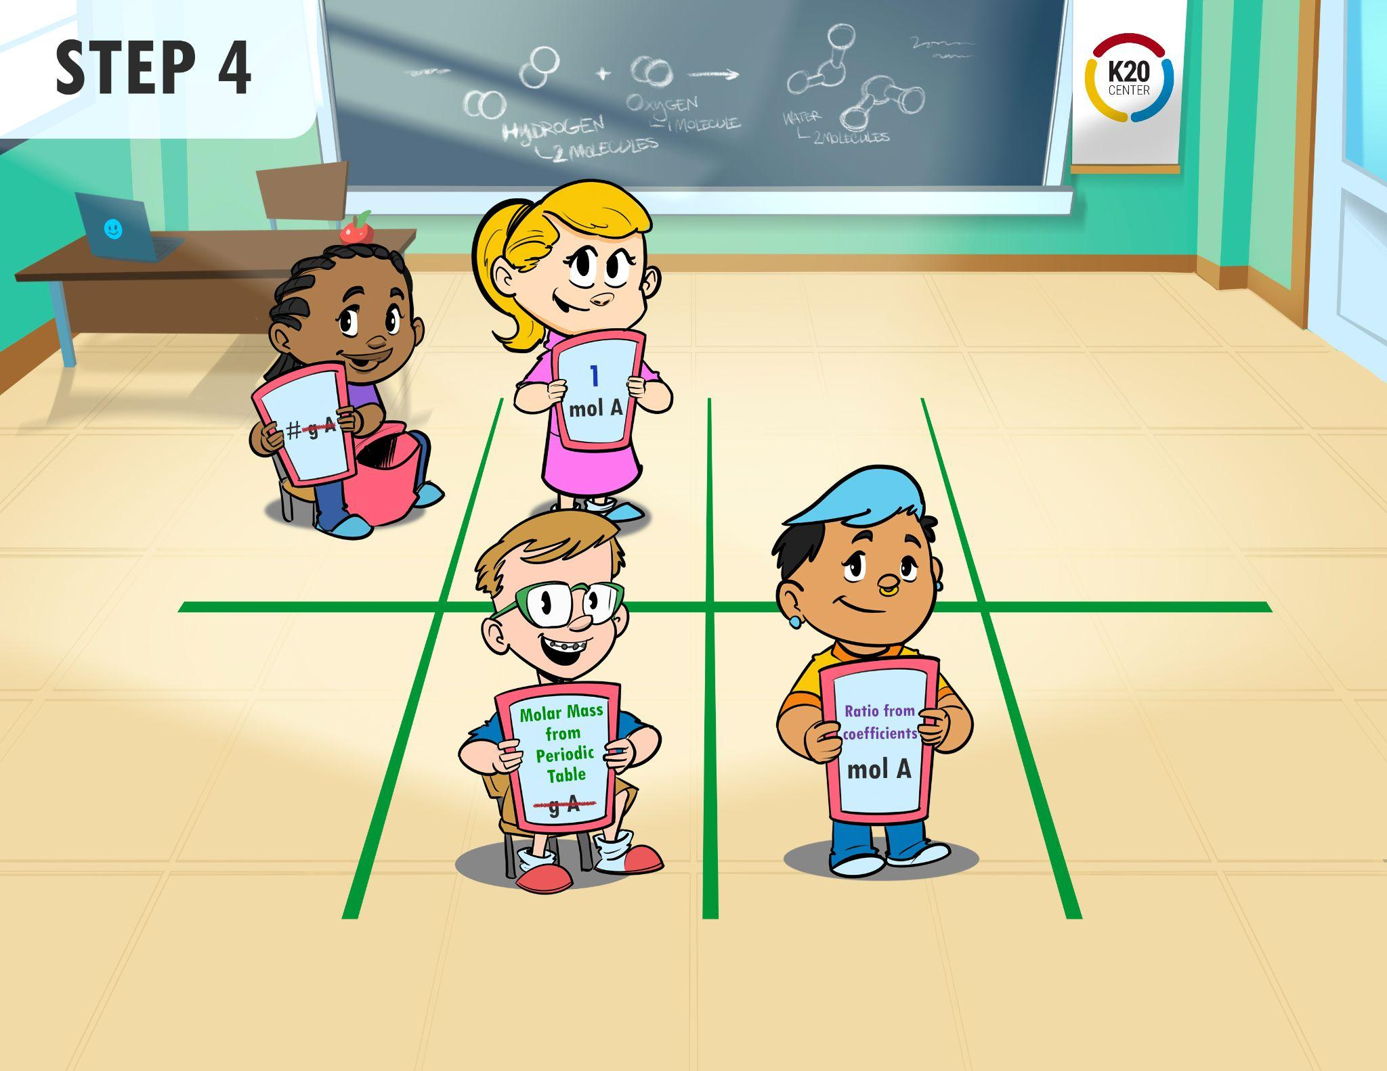
Let’s Try It

Slide 22
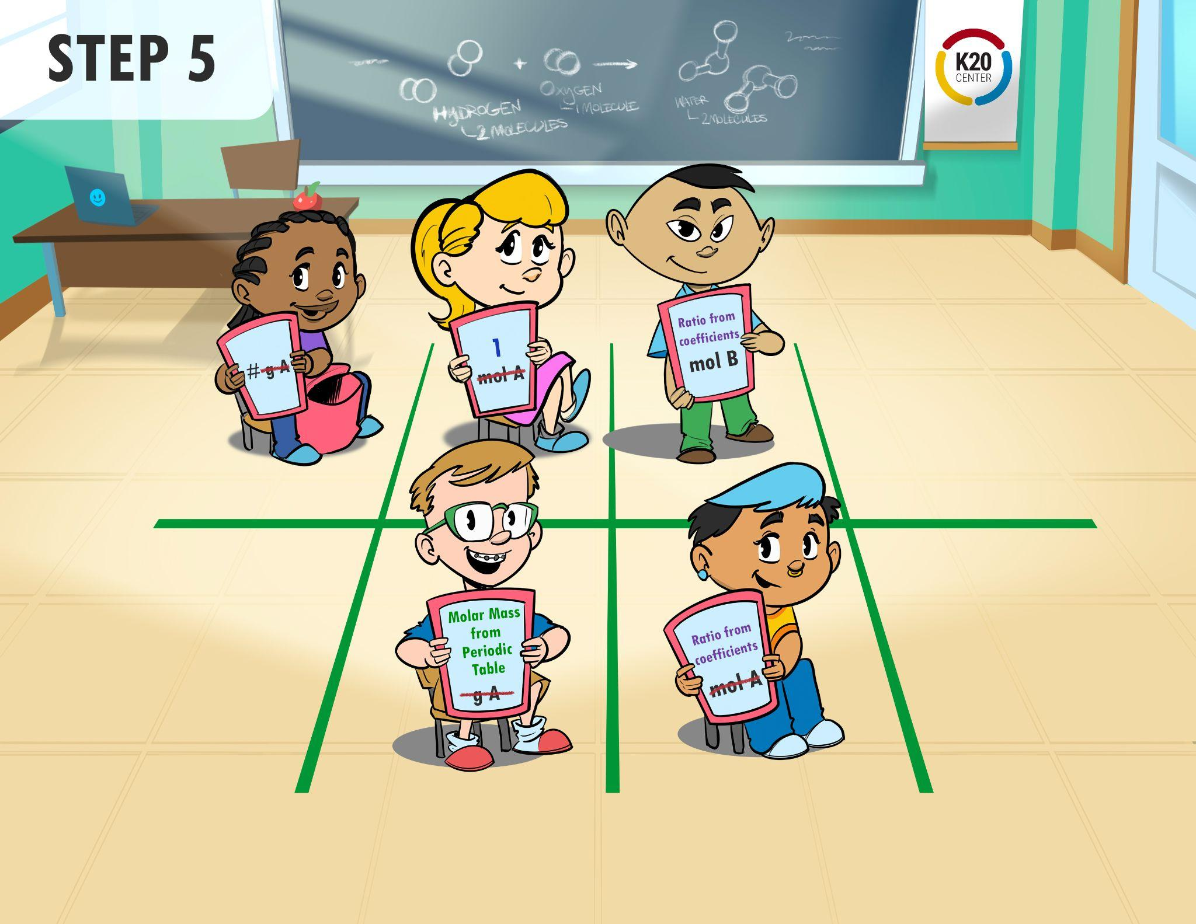
Let’s Try It

Slide 23
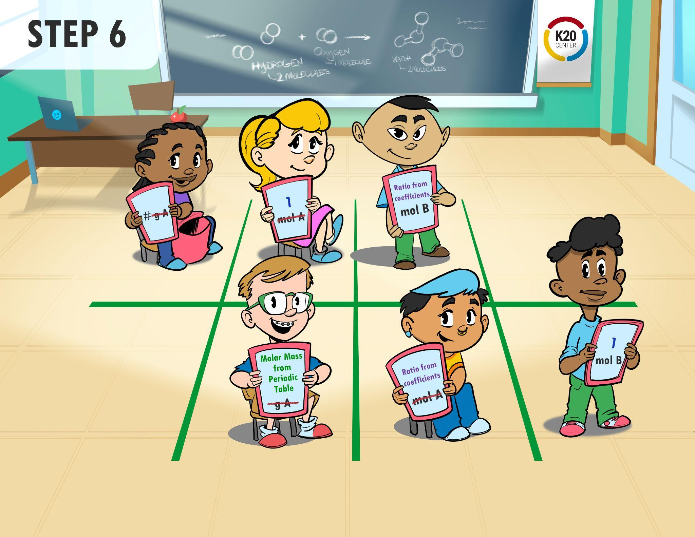
Let’s Try It

Slide 24
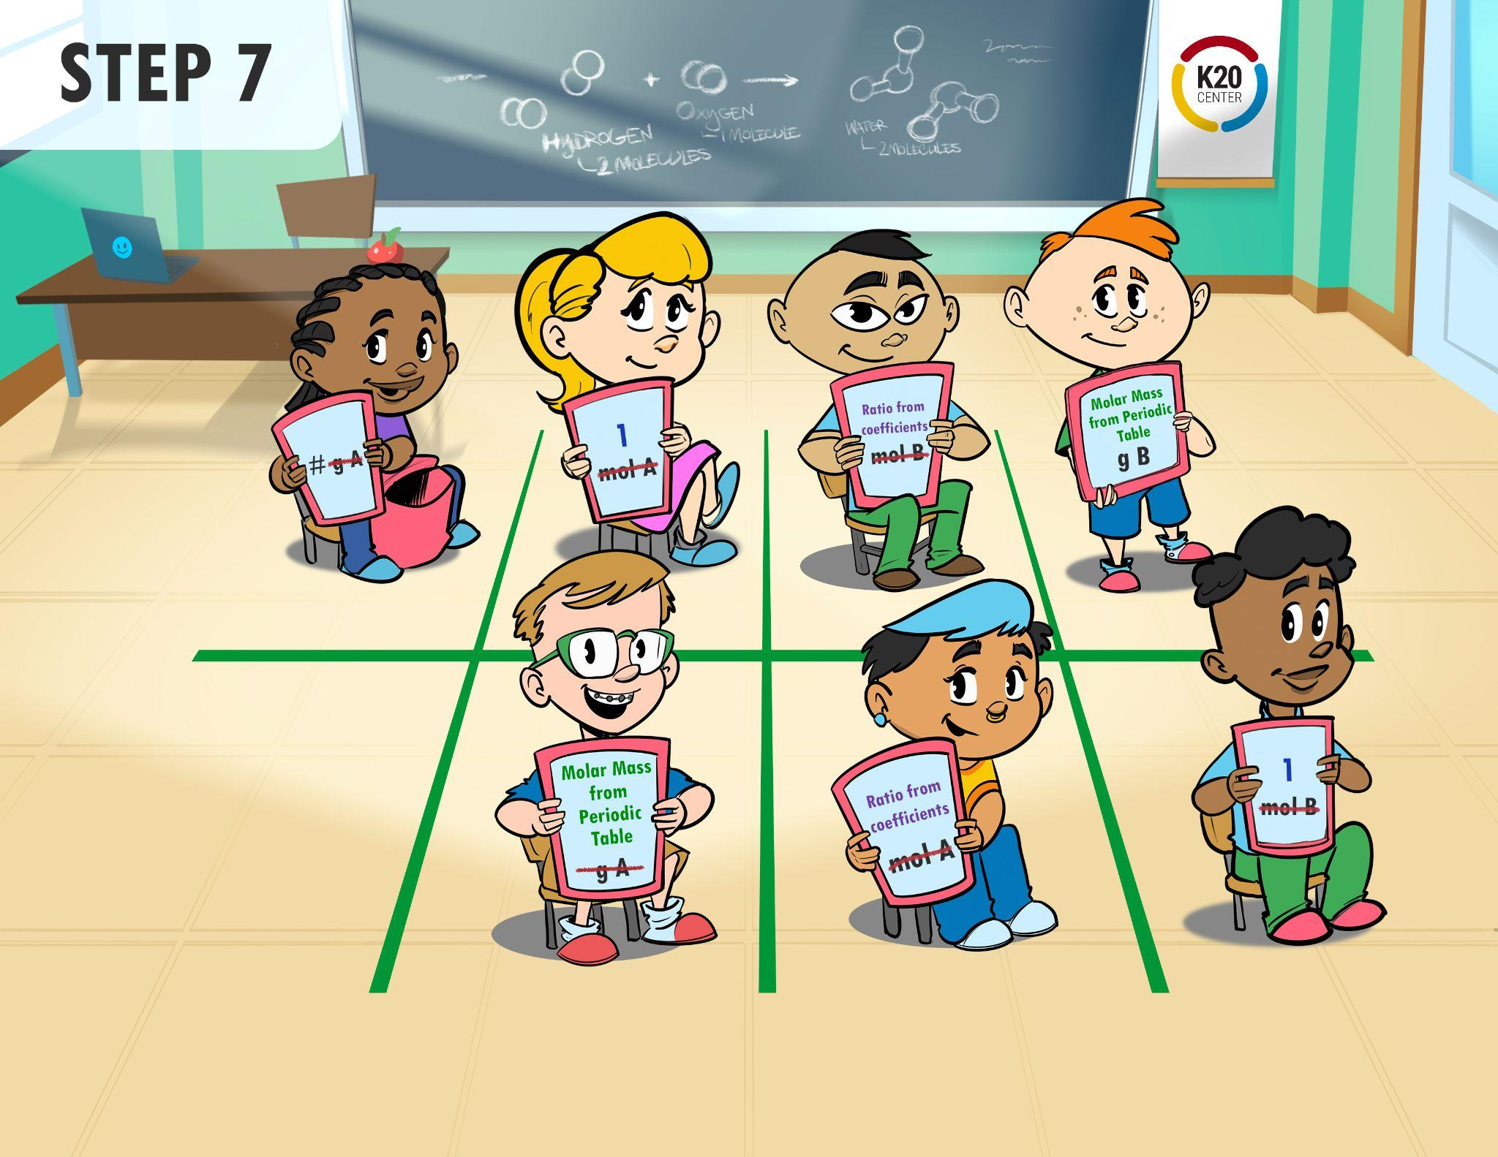
Let’s Try It

Slide 25
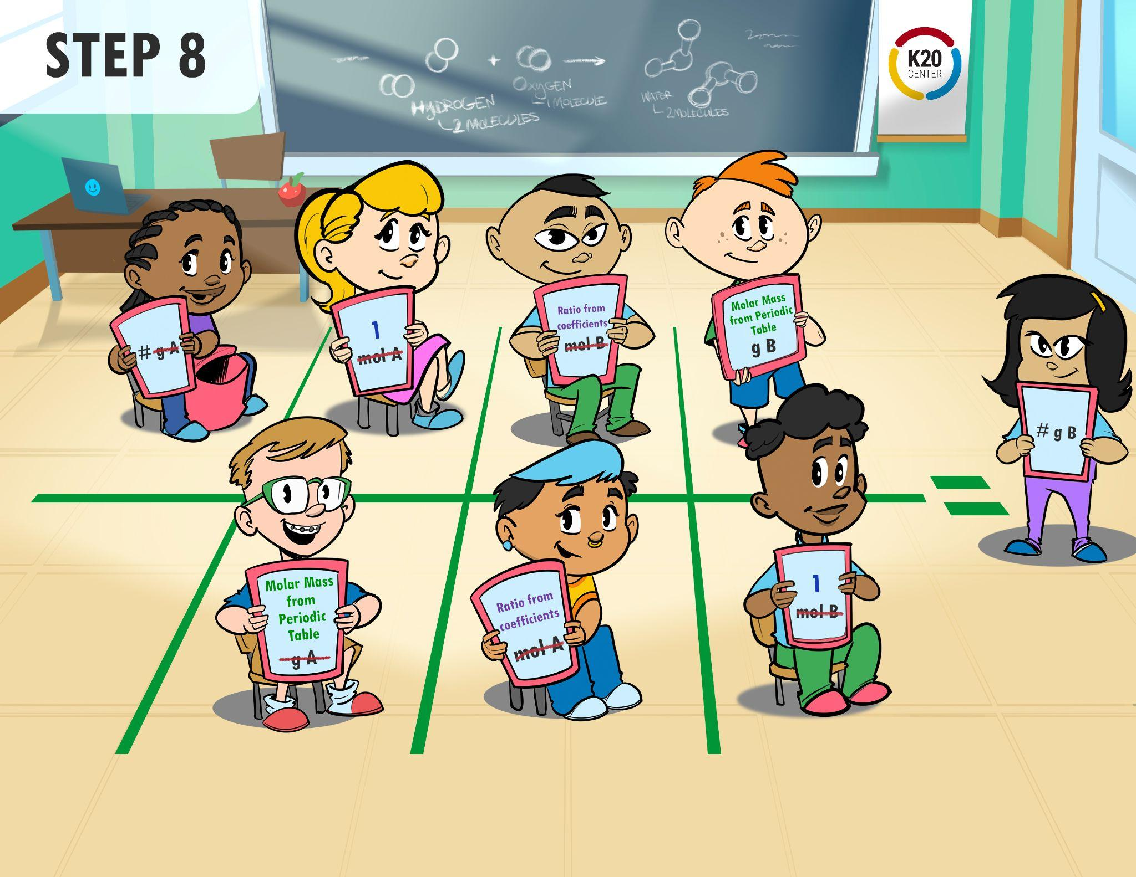
Let’s Try It

Slide 26
Stoichiometry Race
With your group, collect the following materials:
  Dry erase boards and markers (one for each member of your group)
  Periodic Table
  Calculator
  Red, Yellow, and Green cups
Create a 2x4 table on the floor with the tape.

Slide 27
Now You Try
Have each team member represent an element/compound in the table.
You may use the poster to help remind you of the steps for grams to grams.
Solve the problem as a team.
Turn your cup to green when your group is done.

Slide 28

Stoichiometry Race
As you work with your group use the cups to show where you are in the process of completing each task.
Put the correct color cup on top of the stack to show the following:
Green - We are finished.
Yellow - We are still working.
Red - We need assistance.

Slide 29


My Favorite Mistake
What mistake did your group make?
Why did you guys make it?
What can you do differently in the future to keep from making that mistake?
Notes:
K20 Center. (n.d.). My Favorite Mistake. Strategies. Retrieved from https://learn.k20center.ou.edu/strategy/115
YouTube. (2021, September 21). K20 Center 2 minute timer. YouTube. https://www.youtube.com/watch?v=HcEEAnwOt2c

