Slide 2
Whoopsies, Graphing Edition
Math

Slide 3
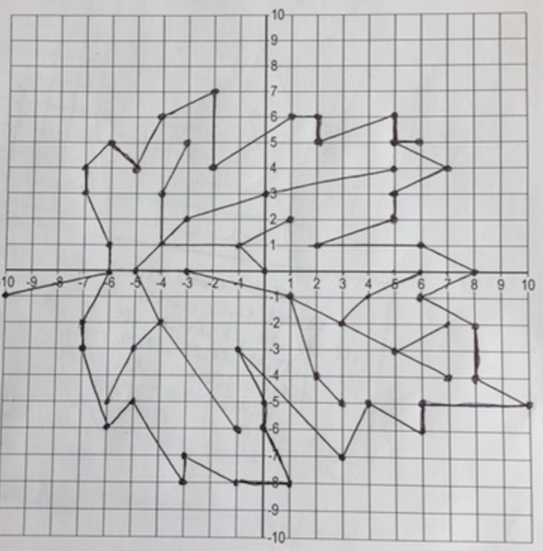
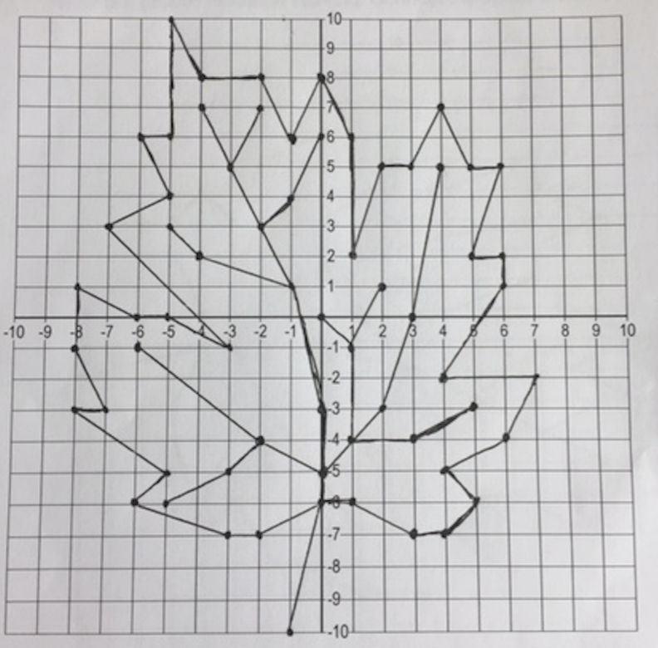
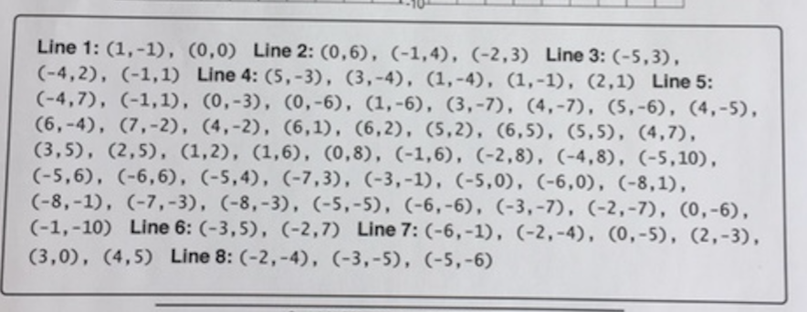
Which is right and which is wrong? Why?

