Slide 2
You Have the Right…
Gideon v. Wainwright & Miranda v. Arizona

Slide 3
I Notice, I Wonder
Draw a vertical line down the middle of a piece of paper.
Title the left side “I Notice,” and write things you notice about the film as you watch it.
Title the right side “I Wonder,” and after the film ends, write on that side anything you might be wondering about the film.
Notes:
K20 Center. (n.d.). I notice, I wonder. Strategies. https://learn.k20center.ou.edu/strategy/180

Slide 4
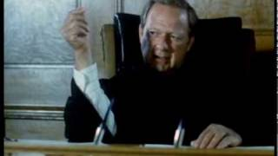
Gideon’s Trumpet
Notes:
SlickSwiftProduction. (2010, June 8). Gideon’s trumpet part 1/11 [Video]. YouTube. ​​https://www.youtube.com/watch?v=rOnsB2S5nJc&list=PL0B9A647C97DC48AA&index=2

Slide 5
Essential Question
How did Gideon v. Wainwright and Miranda v. Arizona extend the rights of Americans?

Slide 6
Lesson Objectives
Examine the effect of the decisions in both cases on the criminal justice system, including the impact on defendants’ rights, law enforcement practices, and trial procedures.
Identify and explain the constitutional rights protected by each case, along with the amendments in which those rights were established.
Reflect on current challenges to these cases and the role that these cases have played in preserving the Due Process Clause.

Slide 7
Tea Party
You will receive a card with an excerpt from the 5th, 6th, or 14th amendment.
Walk up to several different classmates and discuss with each what you think your excerpt means. Try to think about the “big picture” as you discuss.
Afterwards, discuss in your small group what you learned during the Tea Party.
Notes:
K20 Center. (n.d.). Tea party. Strategies. https://learn.k20center.ou.edu/strategy/105
K20 Center. (n.d.). Jigsaw. Strategies. https://learn.k20center.ou.edu/strategy/179

Slide 8
I Notice, I Wonder
Draw a vertical line down the middle of another piece of paper.
Title the left side “I Notice,” and write things you notice about each clip as you watch it.
Title the right side “I Wonder,” and after each clip ends, write on that side anything you might be wondering about the case described in the video.
Notes:
K20 Center. (n.d.). I notice, I wonder. Strategies. https://learn.k20center.ou.edu/strategy/180

Slide 9
The Supreme Court: A Nation of Liberties
Clip #1: https://oeta.pbslearningmedia.org/resource/bf09.socst.us.const.gideon/gideon-v-wainwright/
Clip #2:
https://oeta.pbslearningmedia.org/resource/bf09.socst.us.const.miranda/miranda-v-arizona/
Notes:
THIRTEEN. (2007). The Supreme Court: A nation of liberties [Video]. PBS LearningMedia. https://oeta.pbslearningmedia.org/resource/bf09.socst.us.const.gideon/gideon-v-wainwright/
THIRTEEN. (2007). The Supreme Court: A nation of liberties [Video]. PBS LearningMedia. https://oeta.pbslearningmedia.org/resource/bf09.socst.us.const.miranda/miranda-v-arizona/

Slide 10
Gideon and Miranda Briefs
Read the brief for whichever case you’ve been assigned. Identify the following in the graphic organizer:
Defendant
Plaintiff
Question of the court
Ruling
Rationale

Slide 11
T-Chart
With your partner, fill out the T-Chart handout about your cases.
Answer the reflection questions in order to compare and contrast the cases you read about.
Be prepared to share with the class.
Notes:
K20 Center. (n.d.). T-chart. Strategies. https://learn.k20center.ou.edu/strategy/86
Follow the reading and graphic organizer with a brief discussion of due process. Make sure to emphasize the following points (which might reflect some of the themes that you wrote on the board during the Explore activity. :
Due process guarantees that individuals are treated fairly, given notice of any legal actions against them, and have the opportunity to be heard before any life, liberty, or property is taken from them.
It refers to the procedural rights upheld by the government when taking legal action against an individual. This includes the right to a fair and impartial hearing, the right to be represented by an attorney, the right to present evidence and witnesses, and the right to appeal a decision.
Due process acts as a safeguard against abuse of power by the government and ensures that individuals are not subjected to unjust actions or unfair treatment.

Slide 12
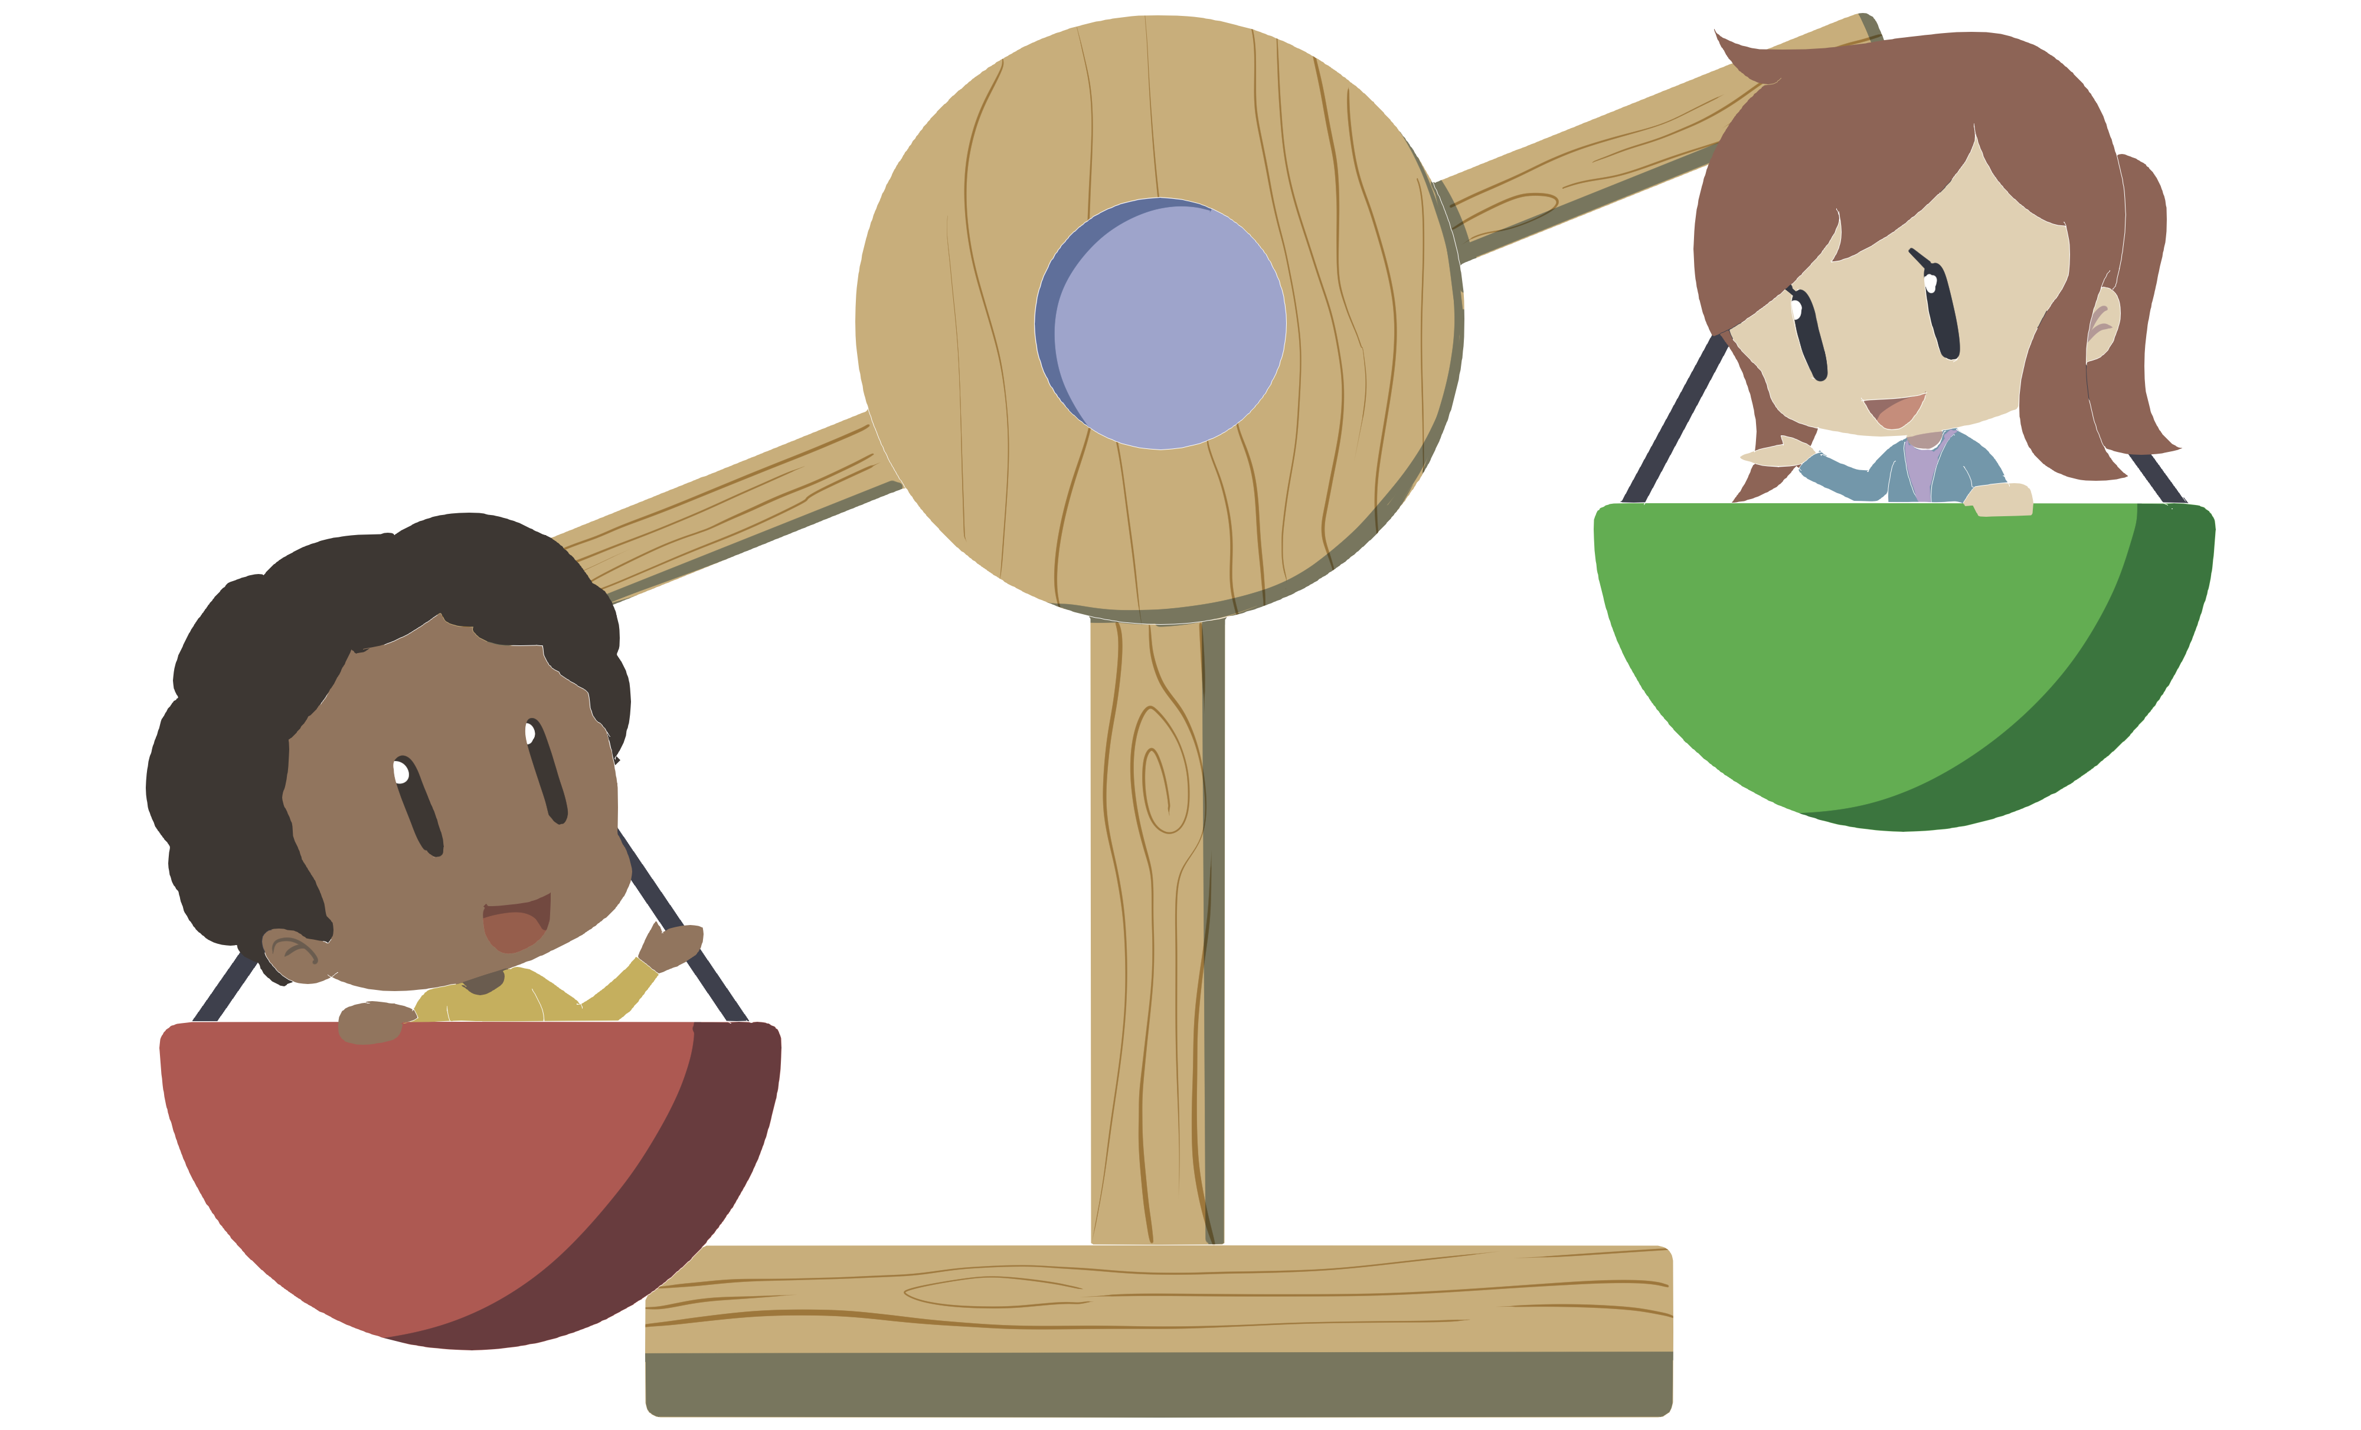
Constructive Controversy, Round 1
On your own, reflect and write a response in boxes 1 and 2 of the Gideon or Miranda graphic organizer.
Why might you argue that the practice described in the prompt is fair or not fair?
Be prepared to share your reasoning with a small group.
Notes:
K20 Center. (n.d.). Constructive Controversy. Strategies. https://learn.k20center.ou.edu/strategy/3136

Slide 13
Constructive Controversy, Round 2
With your small group, discuss the reasonings you each gave in boxes 1 and 2 of your Gideon or Miranda graphic organizer.
Prepared to share a summary of your group’s discussion with the class.
Notes:
K20 Center. (n.d.). Constructive Controversy. Strategies. https://learn.k20center.ou.edu/strategy/3136

Slide 14
Constructive Controversy, Round 3
With your group, look at box 3 of the Gideon or Miranda graphic organizer.
Write a statement of advice that creates a balanced approach to applying the principles of the ruling to the current issue.
Be prepared to share your statement with the class.
Notes:
K20 Center. (n.d.). Constructive Controversy. Strategies. https://learn.k20center.ou.edu/strategy/3136

Slide 15
Quick Write
Take out a sheet of paper, and answer the following question:
How did Gideon v. Wainwright and Miranda v. Arizona extend the rights of Americans?
Notes:
K20 Center. (n.d.). Quick write. Strategies. https://learn.k20center.ou.edu/strategy/1127

