Slide 2
The Way I See It
Point of View

Slide 3
Essential Question
How does one’s perspective affect the telling of an event or story?

Slide 4
Lesson Objectives
Understand point of view and its effect on how a story is told and understood.
Rewrite a story from an alternative point of view.

Slide 5
The House
Follow along on your handout as the article is read aloud.
Highlight details about the house that are important to your group.
Try to remember as many important details as you can.

Slide 6
Important Details
Work with your group to write down as many important details as you can remember from the reading.
Do not look back at the reading. Only write down the details you remember.
Choose a spokesperson to share your group’s observations.

Slide 7
Important Details
Share your group’s observations.
As each group shares, make note of details that are similar and different.

Slide 8
Robbers and Real Estate Agents
On the “I Think” side of your paper, answer the following questions:
To which details did the robbers pay attention?
To which details did the real estate agents pay attention?
Why do you think their focuses were so different?
Why is it important to be able to see other people’s points of view?
Notes:
K20 Center. (n.d.). I think / we think. Strategies. https://learn.k20center.ou.edu/strategy/141

Slide 9
Robbers and Real Estate Agents
Discuss your answers with your group members.
On the “We Think” side of your paper, answer the following questions as a group:
Which details did the robbers pay attention to?
Which details did the real estate agents pay attention to?
Why do you think their focuses were so different?
Why is it important to be able to see other people’s points of view?
Notes:
K20 Center. (n.d.). I think / we think. Strategies. https://learn.k20center.ou.edu/strategy/141

Slide 10
Think-Pair-Share
Read your assigned story and answer the following questions on the bottom of your handout:
Who is the narrator?
What do you know about him/her/it?
Which pronouns are used in the story?
Notes:
K20 Center. (n.d.). Think-Pair-Share. Strategies. https://learn.k20center.ou.edu/strategy/139

Slide 11
Think-Pair-Share
Find a partner who read the same story.
Share your responses to the questions.
Work together to choose the best response or create a new response to each question.
Notes:
K20 Center. (n.d.). Think-Pair-Share. Strategies. https://learn.k20center.ou.edu/strategy/139

Slide 12
Think-Pair-Share
Find a partner who read a different story.
Share your responses to the questions with your new partner.
Notes:
K20 Center. (n.d.). Think-Pair-Share. Strategies. https://learn.k20center.ou.edu/strategy/139

Slide 13
Think-Pair-Share
How did your ideas change when you worked with a partner who read the same story?
How did your ideas change when you worked with a partner who read a different story?
What did you notice about each story?
Notes:
K20 Center. (n.d.). Think-Pair-Share. Strategies. https://learn.k20center.ou.edu/strategy/139

Slide 14
Notes:
Ted-Ed. (2020, June 25). First person vs. second person vs. third person - Rebekah Bergman [Video]. YouTube. https://www.youtube.com/watch?v=B5vEfuLS2Qc

Slide 15
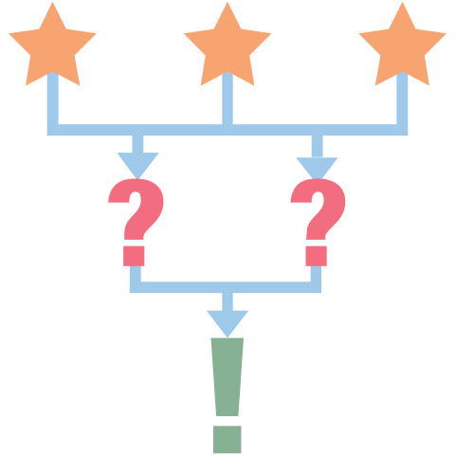
3-2-1
On your paper, record the following:
3 things you learned
2 questions you have
1 thing you found interesting
Notes:
K20 Center. (n.d.). 3-2-1. Strategies. https://learn.k20center.ou.edu/strategy/117

Slide 16
Point of View
Point of view is the perspective from which a story or poem is told.
Point of view is extremely important when analyzing literature.
To understand a piece of literature, you must determine the point of view and understand why the author chose that perspective.

Slide 17
Point of View: Third-Person
Third-person limited point of view is commonly used in traditional storytelling including fairy tales and fables.
In a third-person limited narrative, the storyteller is not one of the characters in the story.
Pronouns used in this type of storytelling include he, she, it, and they.
For example: “After breakfast, they all went to take a nap.”
In a third-person limited narrative, the reader only gets a limited amount of information. The reader does not experience a character’s thoughts, emotions, or motives.

Slide 18
Point of View: First-Person
In a first-person narrative, the storyteller (narrator) is a character in the story.
The narrator was there when the story happened.
Pronouns used in this type of storytelling include I, me, my, and we.
For example: “After breakfast, I went upstairs to take a nap.”
In a first-person narrative, the reader can better understand the character’s thoughts, emotions, and motives.

Slide 19
Fairy Tales: Third-Person
Navigate to https://sooperbooks.com/fairy-tales/.
Choose a fairy tale you like or have never read before.
Read the fairy tale.
Write a 4-5 sentence summary of the fairy tale using third-person point of view.
Notes:
Souper Books. (n.d.). Fairy tales. https://sooperbooks.com/fairy-tales/

Slide 20
Fairy Tales: First-Person
On the back of your paper, retell the story using first-person point of view from a character’s perspective.
Consider choosing a character other than the protagonist, or the “good guy.”

