Slide 2
Carrot or Stick?
Operant Conditioning Learning Theory

Slide 3

Four Corners
Read each statement on the following slides.
Move to the poster that aligns to your level of agreement.
Notes:
K20 Center. (n.d.). Four corners. Strategies. https://learn.k20center.ou.edu/strategy/138

Slide 4
Four Corners
Receiving $10 for every A that I earn would motivate me to make all A’s.
Notes:
K20 Center. (n.d.). Four corners. Strategies. https://learn.k20center.ou.edu/strategy/138

Slide 5
Four Corners
Getting my phone taken away for failing a class would motivate me to have passing grades.
Notes:
K20 Center. (n.d.). Four corners. Strategies. https://learn.k20center.ou.edu/strategy/138

Slide 6
Four Corners
Receiving a late fee for returning a library book past the due date would motivate me to stop returning books late.
Notes:
K20 Center. (n.d.). Four corners. Strategies. https://learn.k20center.ou.edu/strategy/138

Slide 7
Four Corners
Attending summer school due to excessive absences would motivate me to stop missing classes.
Notes:
K20 Center. (n.d.). Four corners. Strategies. https://learn.k20center.ou.edu/strategy/138

Slide 8
Essential Question
How is behavior influenced?

Slide 9
Lesson Objective
Explain the operant conditioning theory of learning.

Slide 10
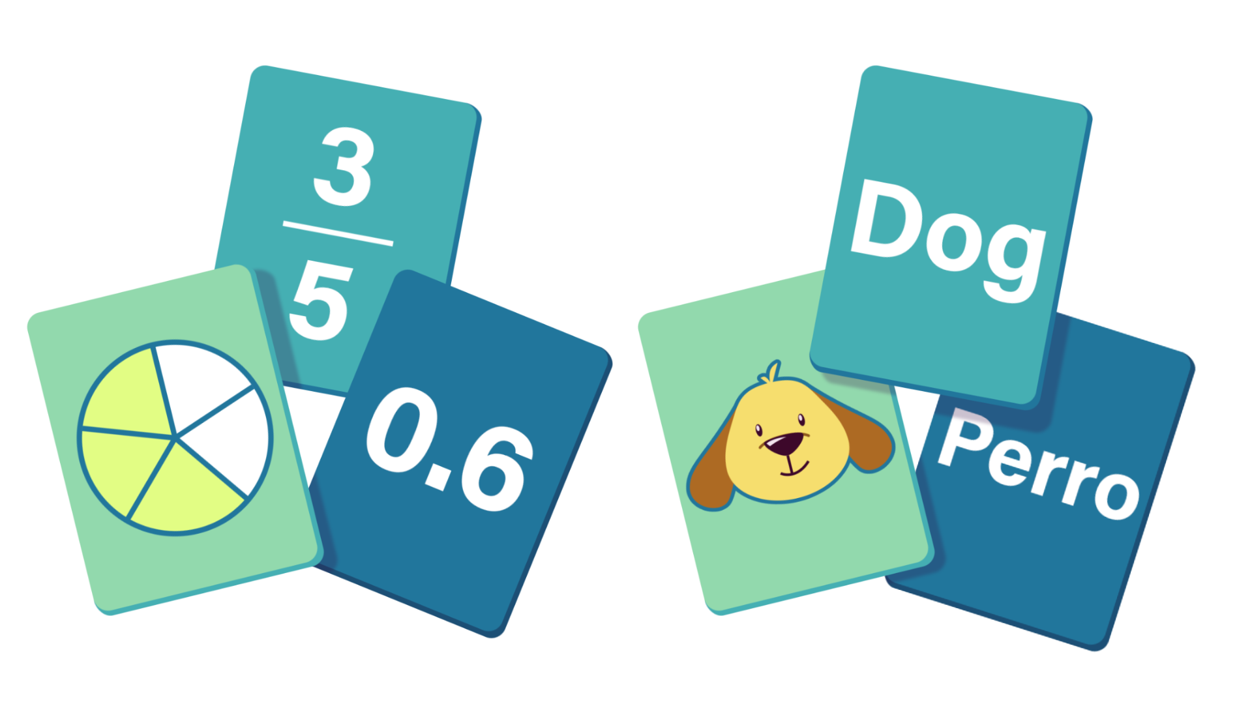
Card Matching
Arrange the cards with the four types of operant conditioning as a row:
  Positive Reinforcement
  Negative Reinforcement
  Positive Punishment
  Negative Punishment
The remaining cards are to be sorted under the four types of operant conditioning.
Notes:
K20 Center. (n.d.). Card matching. Strategies. https://learn.k20center.ou.edu/strategy/1837
K20 Center. (n.d.). Desmos Classroom. Tech tools. https://learn.k20center.ou.edu/tech-tool/1081

Slide 11
Four Techniques of Operant Conditioning
Positive Reinforcement | Adding something to increase behavior.
Negative Reinforcement | Subtracting something to increase behavior.
Positive Punishment | Adding something to decrease behavior.
Negative Punishment | Subtracting something to decrease behavior.

Slide 12

Operant Conditioning Theory of Learning
Read the handout.
After reading, summarize the main points on the left side of the H-Chart.
Notes:
K20 Center. (n.d.). Paired Texts H-Chart. Strategies. https://learn.k20center.ou.edu/strategy/132

Slide 13
Operant Conditioning Theory of Learning
Watch the video.
After viewing, summarize the main points on the right side of the H-Chart.
Notes:
K20 Center. (n.d.). Paired Texts H-Chart. Strategies. https://learn.k20center.ou.edu/strategy/132

Slide 14
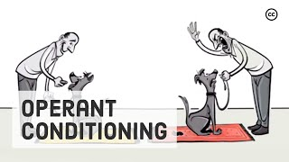
https://www.youtube.com/watch?v=ne6o-uPJarA
Notes:
Sprouts. (2020, June 30). Skinner’s operant conditioning: Rewards & punishments [Video]. YouTube. https://www.youtube.com/watch?v=ne6o-uPJarA

Slide 15
Operant Conditioning Theory of Learning
In the middle of the H-Chart, respond to the following question:
  According to operant conditioning, how can behavior be influenced?
Notes:
K20 Center. (n.d.). Paired Texts H-Chart. Strategies. https://learn.k20center.ou.edu/strategy/132

Slide 16
Operant Conditioning Scenario
Develop an operant conditioning scenario.
Identify the behavior that should be increased or decreased.
Determine if a punishment or reinforcement should be used.
  Create the punishment or reinforcement to modify desired behavior.
  Determine if the punishment or reinforcement should be positive or negative.
Be ready to share your scenario.

Slide 17

Six-Word Memoir
Write a Six-Word Memoir that summarizes the learning theory of operant conditioning.
An example of a six-word memoir about B.F. Skinner is:
  Father of operant conditioning, researched behavior.
Notes:
K20 Center. (n.d.) Six-word memoirs. Strategies. https://learn.k20center.ou.edu/strategy/75

