Slide 1
Analyzing Historical Figures in Psychology
Analyzing Historical Figures

Slide 2

Tell Me Everything
What do you know about the field of Psychology and those who study this field?
Who are the key foundational researchers in psychology?
Share out

Slide 3
Tell Me More
Look at the list we have developed.
Do you notice any trends? What stands out to you?
Any omissions from the list?
Share out

Slide 4
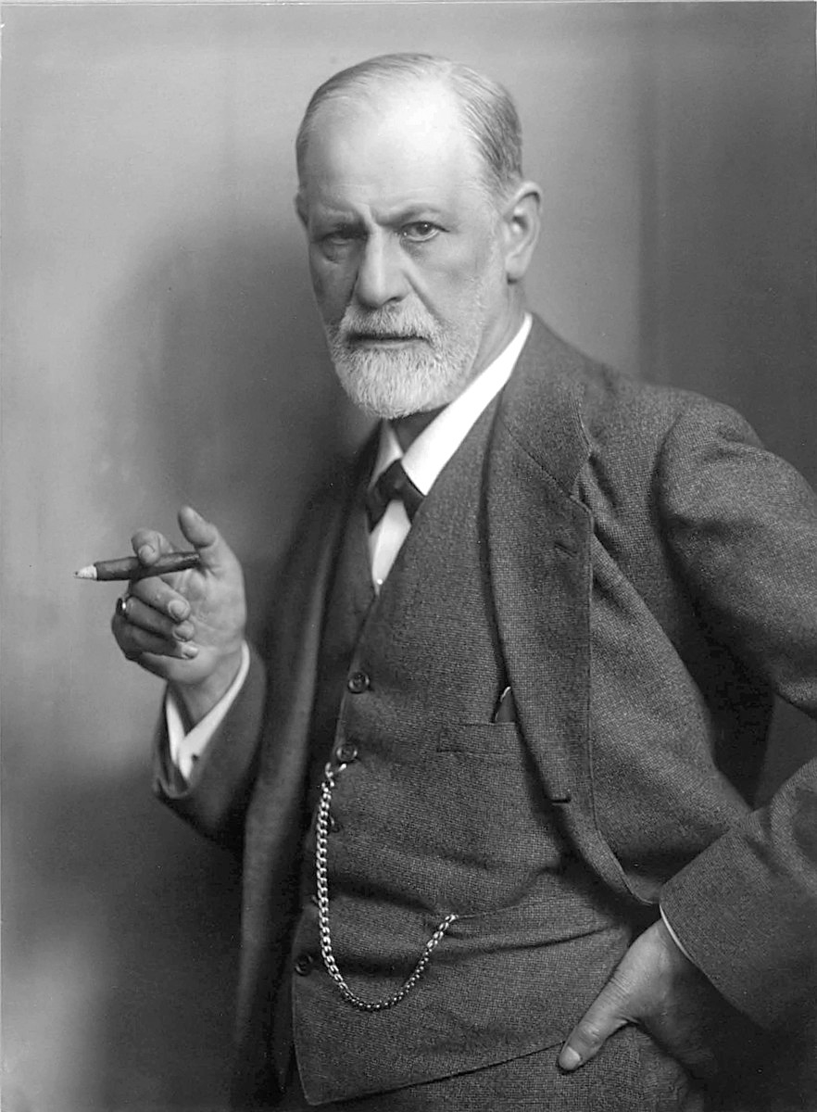
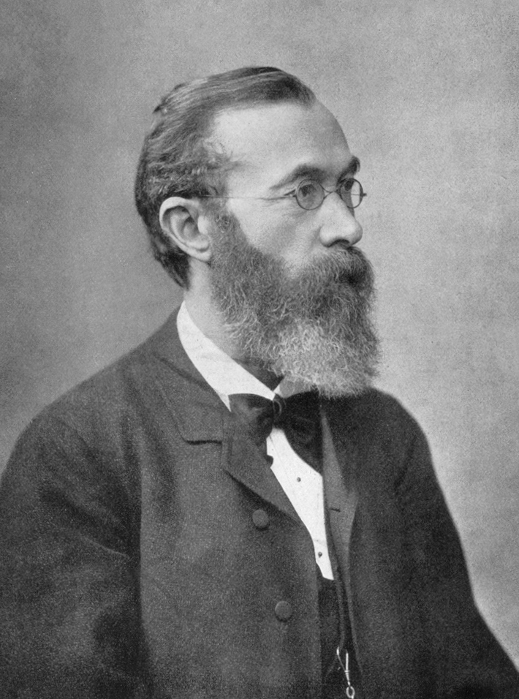
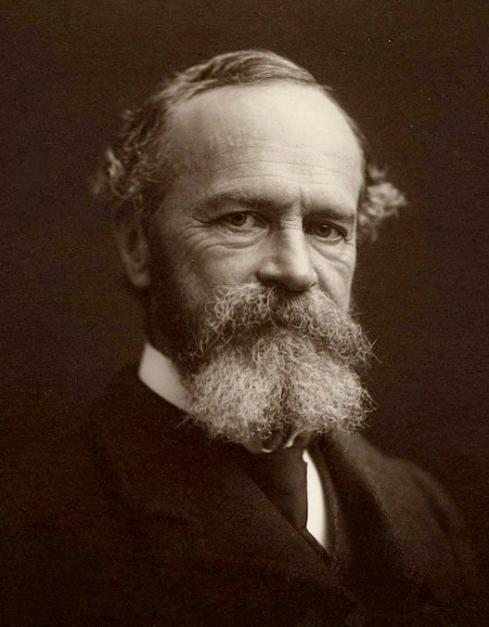
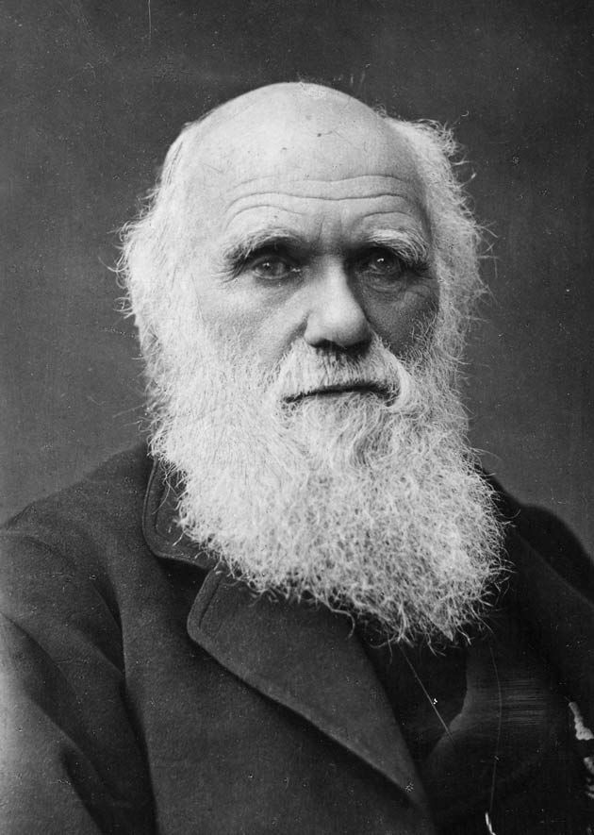
Key Psychologists
Sigmund Freud
Wilhelm Wundt
William James
Charles Darwin
Notes:
First image:
Halberstadt , M. (n.d.). Sigmund Freud. Wikimedia Commons. https://commons.wikimedia.org/wiki/File:Sigmund_Freud,_by_Max_Halberstadt_(cropped).jpg
Second image:
Wilhelm Wundt. Wikimedia Commons. (n.d.). https://commons.wikimedia.org/wiki/File:Wilhelm_Wundt.jpg
Third image:
Notman Studios. (n.d.). William James. Wikimedia Commons. https://commons.wikimedia.org/wiki/File:William_James_b1842c.jpg
Fourth image:
Barraud, H. R. (n.d.). Charles Darwin portrait. Wikimedia Commons. https://commons.wikimedia.org/wiki/File:Charles_Darwin_portrait.jpg

Slide 5
Essential Question
What impact do researchers and their discoveries have on a field of study?

Slide 6
Objectives
Analyze and summarize the impact of key historical figures in the field of Psychology.

Slide 7
Your Task
Draw a slip of paper.
The name on the paper will be the name of the person you will research for the project.

Slide 8

KWHL Chart
Write the name of your historical figure at the top of your KWHL Chart.
In the “K” column, fill in everything that you know about your figure.In the “W” column, write down everything you want to know about your figure.
If you are unfamiliar with your figure, combine the “K/W” and come up with research questions.
Notes:
K20 Center. (n.d.). KWHL Graphic Organizer. Strategies. https://learn.k20center.ou.edu/strategy/127

Slide 9
KWHL Chart: K/W
Need help? Think about:
What do I want to know?
What would others want to know?
For what is this person famous?

Slide 10
KWHL Chart
In the “H” column, write down ways you can find the information you listed in the “W” column.
What resources could you use to learn
more about your figure?

Slide 11
KWHL: Research
Lastly, using the questions on “W” and the resources listed on the “H” fill in the “L” column.
Some things to consider as you research:
  Notable accomplishments
  Education
  Connections to other historical figures
  Interests or hobbies
  Contributions to their field
  Interesting facts

Slide 12
Historical Figures Project
Using the template, create a project about your figure that includes each of the following:
Quote
Five fast facts
Historical importance
Six-word memoir
Four symbols
Image

Slide 13
Historical Figure Rubric
Required Items | Points Possible
Name and Picture | 5
Quote | 5
Fast Facts (5 total) | 30
Historical Importance | 30
Symbols (4 total) | 20
Six-Word Memoir | 10
Total | 100

Slide 14

Gallery Walk
Using your Gallery Walk Graphic Organizer, go around the room visiting each profile and complete the handout.
Include the following:
  Name of the historical figure
  What stands out to you about the individual?
  Why are they important in their field of study?
By the end of the Gallery Walk, your organizer should have visited every figure’s profile.
Notes:
K20 Center. (n.d.). Gallery Walk/Carousel. Strategies. https://learn.k20center.ou.edu/strategy/d9908066f654727934df7bf4f505a54d

Slide 15
Essential Question
What impact do researchers and their discoveries have on a field of study?

