Slide 2
Are We Golden?
Exploring the golden ratio to uncover common mathematical patterns expressed in nature.

Slide 4
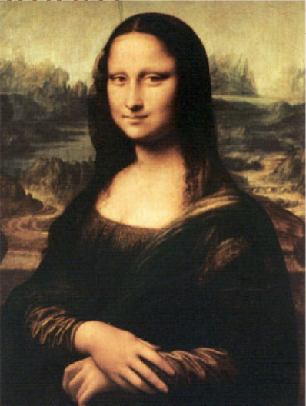
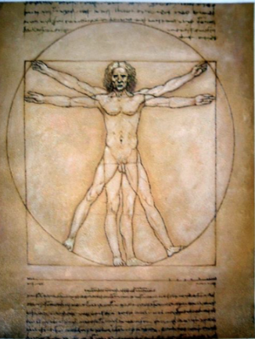
What do each of these have in common?

Slide 5
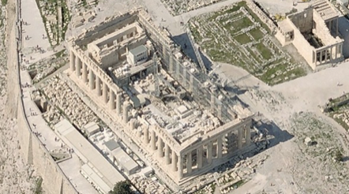
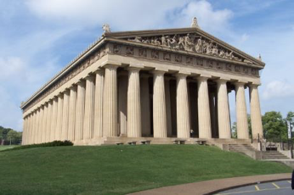
What do each of these have in common?

Slide 6
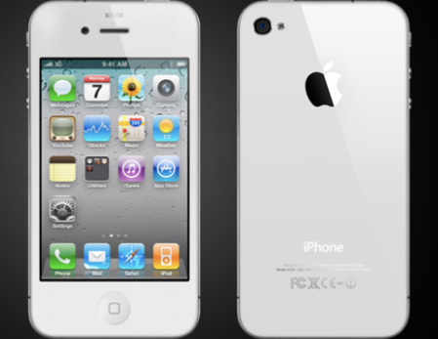
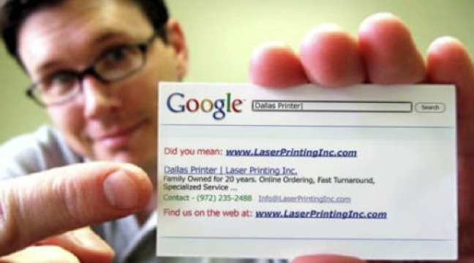
What do each of these have in common?

Slide 7
Rectangle Pageant
Pick which rectangle you like best.
A
B
C
D

Slide 8
Here she is…”Ms. Rectangle!”
Rectangle | Tally Marks
A
B
C
D

Slide 9
The Golden Ratio
What is it?
A proportion between components of an item that people tend to find visually pleasing.
The golden ratio can be expressed as a fraction or as a decimal.
$$\frac{1+\sqrt{5}}{2} or approximately 1.618$$

Slide 10
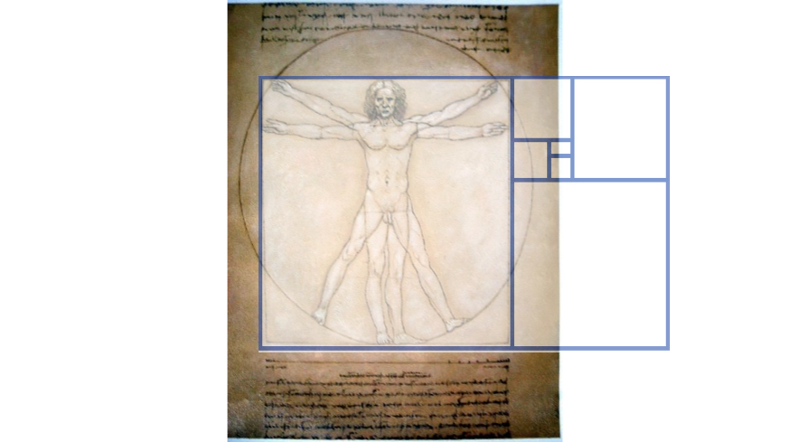
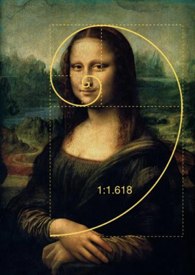

Slide 11
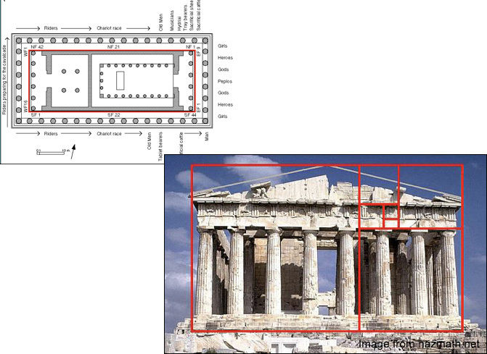

Slide 12
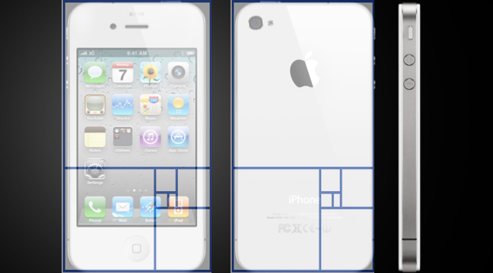
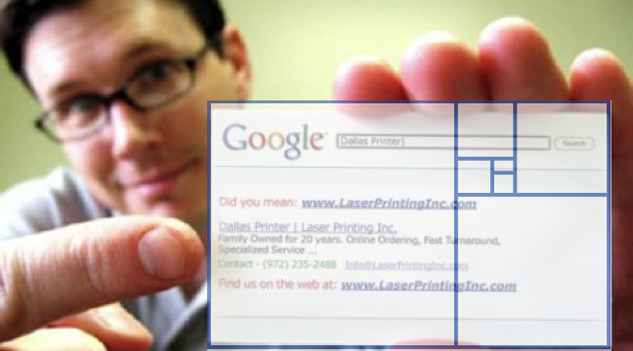

Slide 13
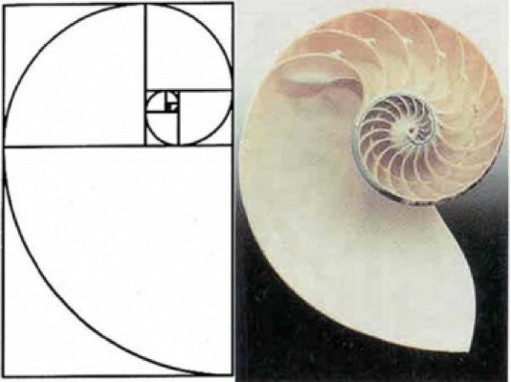
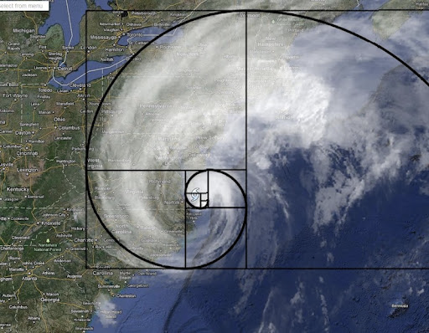
Gold Ratio in Nature

Slide 15
Leonardo DaVinci’s The Vitruvian Man
What do you notice about this sketch, mathematically?
Circle
Square
Arm span = height

Slide 16
Are you a “golden” child?
Materials needed per group:
Calculator
Measuring tool(s)
Activity sheet (digital)

Slide 17
Exploration: Completed on Data Collection Sheet
Step One: Measure the needed body dimensions and record in the space provided.
Step Two: Use the spreadsheet to create ratios with the measurements to determine if you are a “golden child.” Find your group average for each category.
Step Three: One group member provides teacher with group averages.

Slide 19
Are You “Golden”?
Based on your ratios, are you a “golden” child?
Are we, as a class, a “golden” class?
How do you know?
Standard
7.A.2 Recognize proportional relationships in real-world and mathematical situations; represent these and other relationships with tables, verbal descriptions, symbols, and graphs; solve problems involving proportional relationships and interpret results in the original context.

Slide 21
Locating the Golden Ratio
Find your original partner.
Work with your partner to locate three rectangular objects in the room that exhibit the golden ratio.
Record the following in your notebooks:
What you measured
The actual measurements
Explanation of whether or not the object exhibits the golden ratio

Slide 23
Golden Ratio at Home
Locate three objects that you believe exhibit the Golden Ratio at home.
Photograph or sketch them.
Measure each item to confirm the golden ratio.

Slide 24
Two Minute Paper
In two minutes, respond to the following:
Explain to a friend who is not in our class what the golden ratio is and share a few examples of where it
can be found in nature and/or in man-made objects.

