Slide 2
Are We Golden?
Investigating the Golden Ratio

Slide 3
Essential Question
Are there common mathematical patterns around us?

Slide 4
Lesson Objectives
Divide whole numbers and/or decimals.
Compare quotients with the golden ratio.

Slide 5
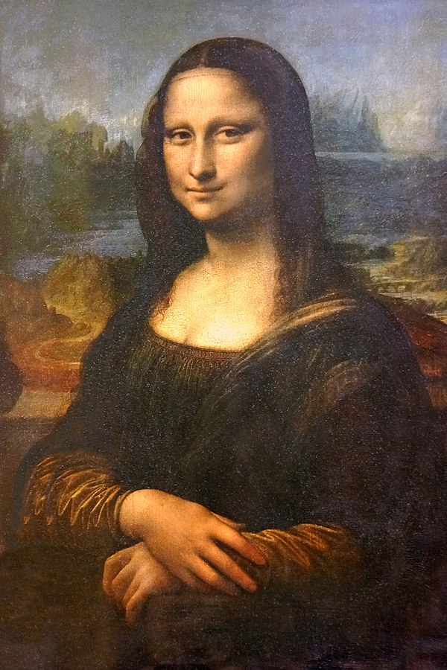
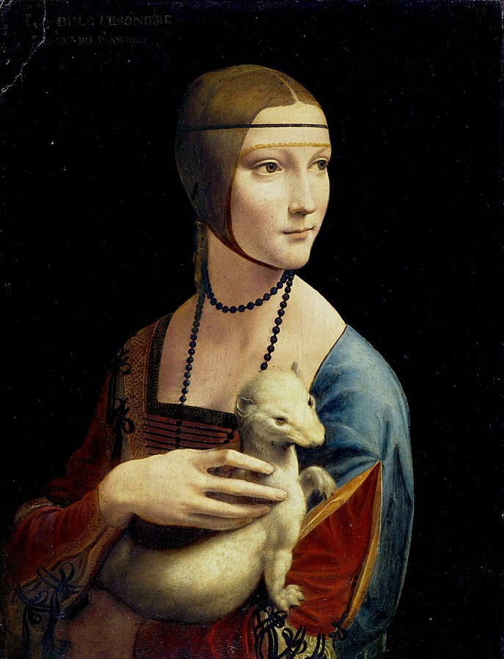
What Do These Have in Common?
Notes:
Da Vinci, L. (1506). Mona Lisa [Painting]. Musée du Louvre, Paris, France. https://commons.wikimedia.org/wiki/File:France-003324_-_Mona_Lisa_(16236519171).jpg
Da Vinci, L. (1490). Lady with an ermine [Painting]. Czartoryski Museum, Kraków, Poland. https://commons.wikimedia.org/wiki/File:The_Lady_with_an_Ermine.jpg

Slide 6
Rectangle Pageant
D
Which rectangle do you like best?
B
A
C

Slide 7
The Golden Ratio
Two numbers (a and b) have a golden ratio if dividing the bigger number (b) by the smaller number (a) equals the sum of the two numbers (a + b) divided by the bigger number (b).

Slide 8
The Golden Ratio

Slide 9
The Golden Ratio
If the ratio of the longer side to the shorter side of a rectangle equals the golden ratio, that rectangle is called a golden rectangle.

Slide 10
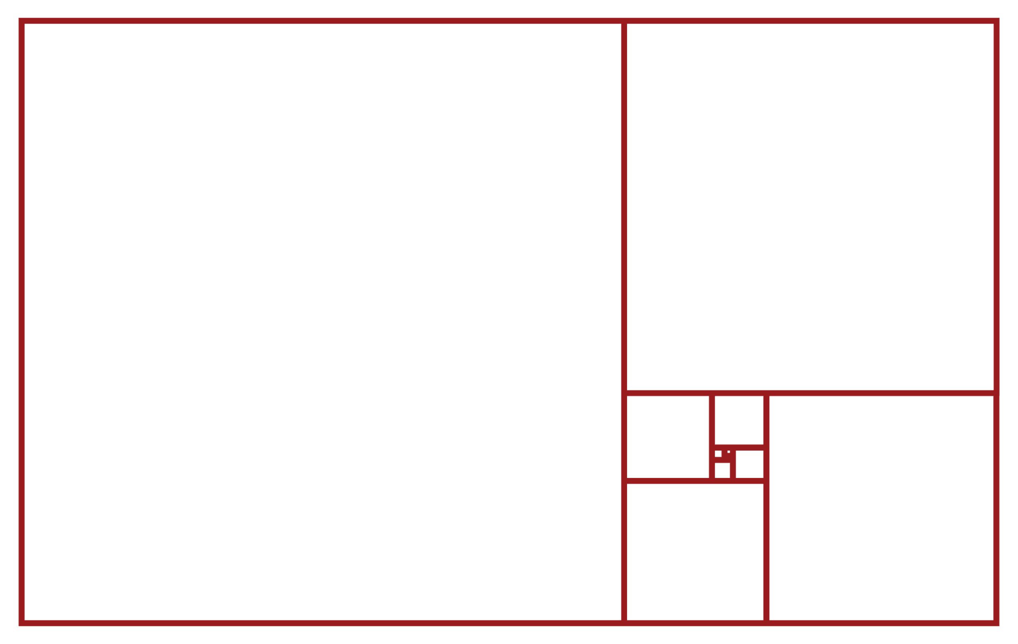
The Golden Ratio
If you construct a golden rectangle within a golden rectangle, you can have an infinite number of golden rectangles.

Slide 11
Works by DaVinci
Notes:
Da Vinci, L. (1506). Mona Lisa [Painting]. Musée du Louvre, Paris, France. https://commons.wikimedia.org/wiki/File:France-003324_-_Mona_Lisa_(16236519171).jpg
Da Vinci, L. (1490). Lady with an ermine [Painting]. Czartoryski Museum, Kraków, Poland. https://commons.wikimedia.org/wiki/File:The_Lady_with_an_Ermine.jpg

Slide 12
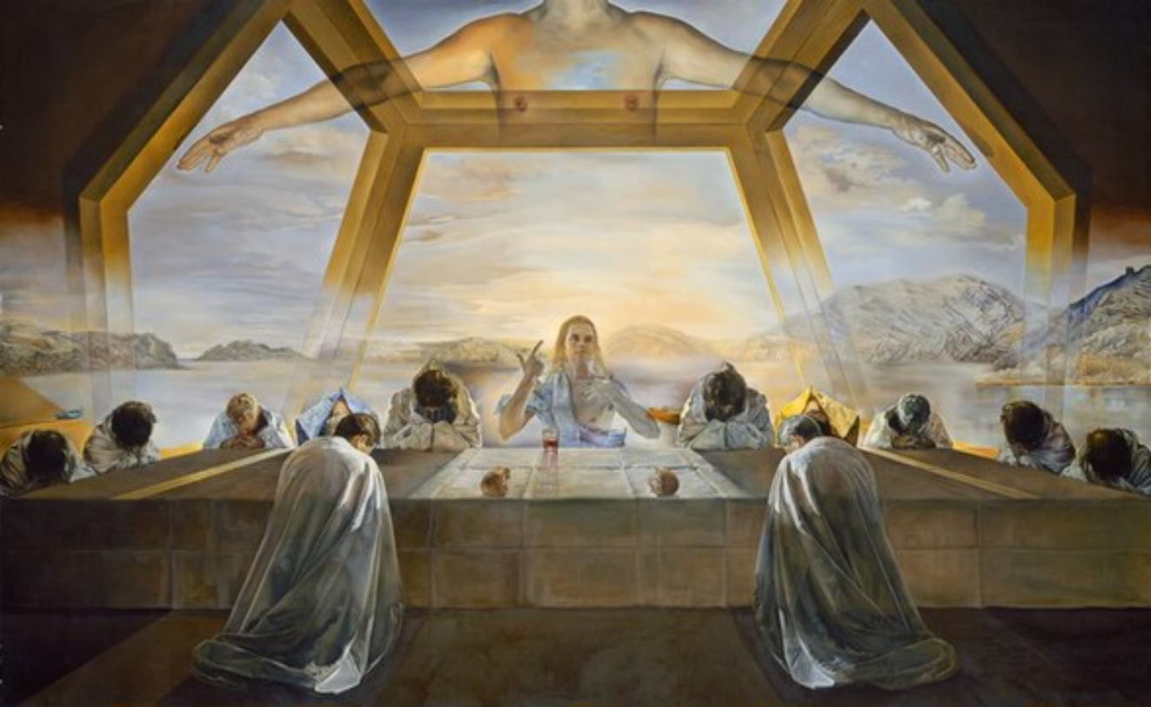
The Sacrament of the Last Supper
by Salvador Dalí
Notes:
Dalí, S. (1955). The sacrament of the Last Supper [Painting]. National Gallery of Art, Washington D.C., United States. https://www.nga.gov/collection/art-object-page.46590.html

Slide 13
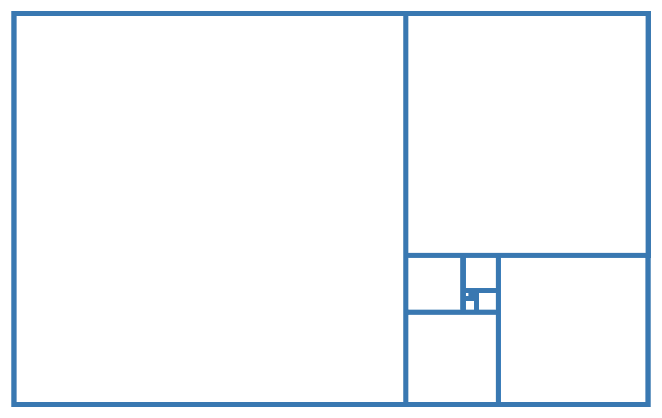
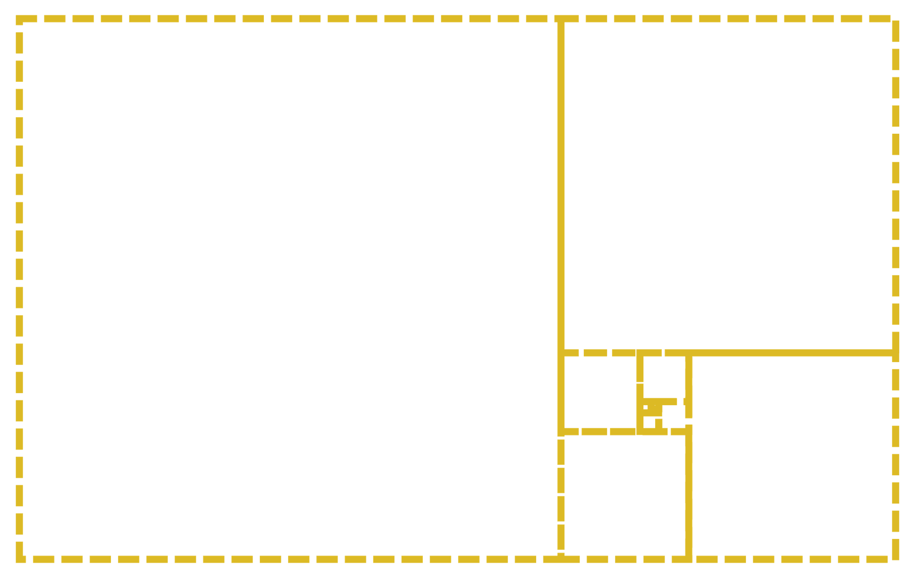
The Sacrament of the Last Supper
by Salvador Dalí
Notes:
Dalí, S. (1955). The sacrament of the Last Supper [Painting]. National Gallery of Art, Washington D.C., United States. https://www.nga.gov/collection/art-object-page.46590.html

Slide 14
Did You Know?
The length of your foot is relatively the same length as your forearm.
Do you know of any other comparisons like this?

Slide 15
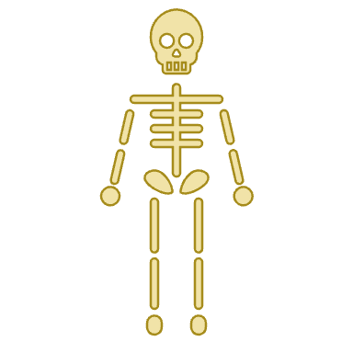
Are You a “Golden Genius”?
Each pair needs the following:
Measuring tool(s)
Data Collection handout

Slide 16
Are You a “Golden Genius”?
Work with your partner and use the measuring tool(s) to measure each other’s body dimensions.
Record your measurements in the table.

Slide 17
Estimation and Number Sense
Calculators only do what you ask them to do.
Have you ever accidentally typed the wrong thing into a calculator?
How do you know if your answers are correct?

Slide 18
Strategy Harvest
A newborn baby is 20 inches long. Her legs are each 6 inches long. How could you estimate the ratio of the baby’s body length to leg length?
Write how you would estimate this ratio in the “My Strategy” box.
Show all your work.
Notes:
K20 Center. (n.d.). Strategy harvest. Strategies. https://learn.k20center.ou.edu/strategy/135

Slide 19
Strategy Harvest
Find a partner.
Take turns sharing your estimation strategies. While your partner is sharing, listen and record their strategy on your handout.
Record your partner’s name.
Discuss your strategies.
Ask questions.
Give feedback.
Notes:
K20 Center. (n.d.). Strategy harvest. Strategies. https://learn.k20center.ou.edu/strategy/135

Slide 20
Calculating Ratios
Use the measurements from your Data Collection handout to complete the table.
Write each pair of measurements as a fraction then as a decimal. Round to 3 decimal places.
Example:

Slide 21
Calculating Ratios
Once each ratio is written as a decimal, find the average of each column.
Who is the “Golden Genius”?

Slide 22
Calculating Ratios
Have one person from your group share your averages with your teacher.
Who is the “Golden Genius”?

Slide 23
Seeking the Golden Ratio
Which rectangles around you are golden rectangles?
On a piece of paper, sketch and label 3 rectangles.
Measure each rectangle.
Calculate the long side over the short side.
Was your prediction correct? Are those golden rectangles?

Slide 24
Two-Minute Paper
On a piece of paper, respond to the following prompt:
Explain to a friend who is not in our class what the golden ratio is. Share at least one example of where someone could see the golden ratio.
2-Minute Timer
Notes:
K20 Center. (n.d.). Two-minute paper. Strategies. https://learn.k20center.ou.edu/strategy/152
K20 Center. (2021, September 21). K20 Center 2 minute timer [Video]. YouTube. https://youtu.be/HcEEAnwOt2c?si=IjQ0Z14eT1CEtWwS

