Slide 2
Estereotipos sobre la comida hispana
Examining stereotypes in Hispanic cuisine

Slide 3
Essential Question
What are stereotypes, and how does learning about other cultures affect our perception of others?
Notes:
Teacher Note: In this lesson, we’ll answer that question by exploring some culinary aspects of Spanish cultures.

Slide 4
Lesson Objectives
Students will investigate common stereotypes around Hispanic food
Students will explore food from six different Spanish speaking countries/territories
Students will examine culinary aspects of Hispanic culture and design their own food menu

Slide 5


Collective Brain Dump with Mentimeter
Scan the QR code or follow the link below and answer the following question: “What are stereotypes?”
insert link and QR here
Notes:
K20 Center. (n.d.). Collective Brain Dump. Strategies. https://learn.k20center.ou.edu/strategy/111
K20 Center. (n.d.).Mentimeter. Tech Tool. https://learn.k20center.ou.edu/tech-tool/645

Slide 6


I Think, We Think T-Chart
Using your handout, answer both questions on the “I think” side:
What are some characteristics of Hispanic food?
What kinds of foods do you think Hispanic people like to eat?
Find a small group and discuss your answers. Write the group responses on the “We think” side of the page.
Notes:
K20 Center. (n.d.).I Think / We Think. Strategies. https://learn.k20center.ou.edu/strategy/141
K20 Center. (n.d.). T-chart. Strategies. Retrieved from https://learn.k20center.ou.edu/strategy/86

Slide 7


Sticky Bars | Part 1
Write your answer to the following question on your sticky note: What is one stereotype you have about the food of your assigned country?
Place your sticky note on the board above the name of your assigned country.
Notes:
K20 Center. (n.d.). Sticky bars. Strategies. Retrieved from https://learn.k20center.ou.edu/strategy/129
K20 Center. (n.d.). Elbow partners. Strategies. Retrieved from https://learn.k20center.ou.edu/strategy/116

Slide 8
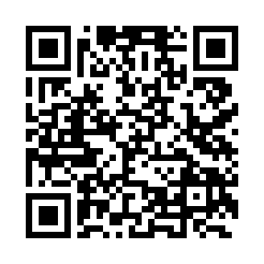
Discover Your Country!
Scan the QR code provided OR
  Use the following link to access the “World Food Collections” Wakelet: https://bit.ly/47P8GjR
Watch the video resource on your country/territory
Take notes on their different foods and customs
Notes:
K20 Center. (n.d.). Wakelet. Tech Tool. Retrieved from https://learn.k20center.ou.edu/tech-tool/2180

Slide 9
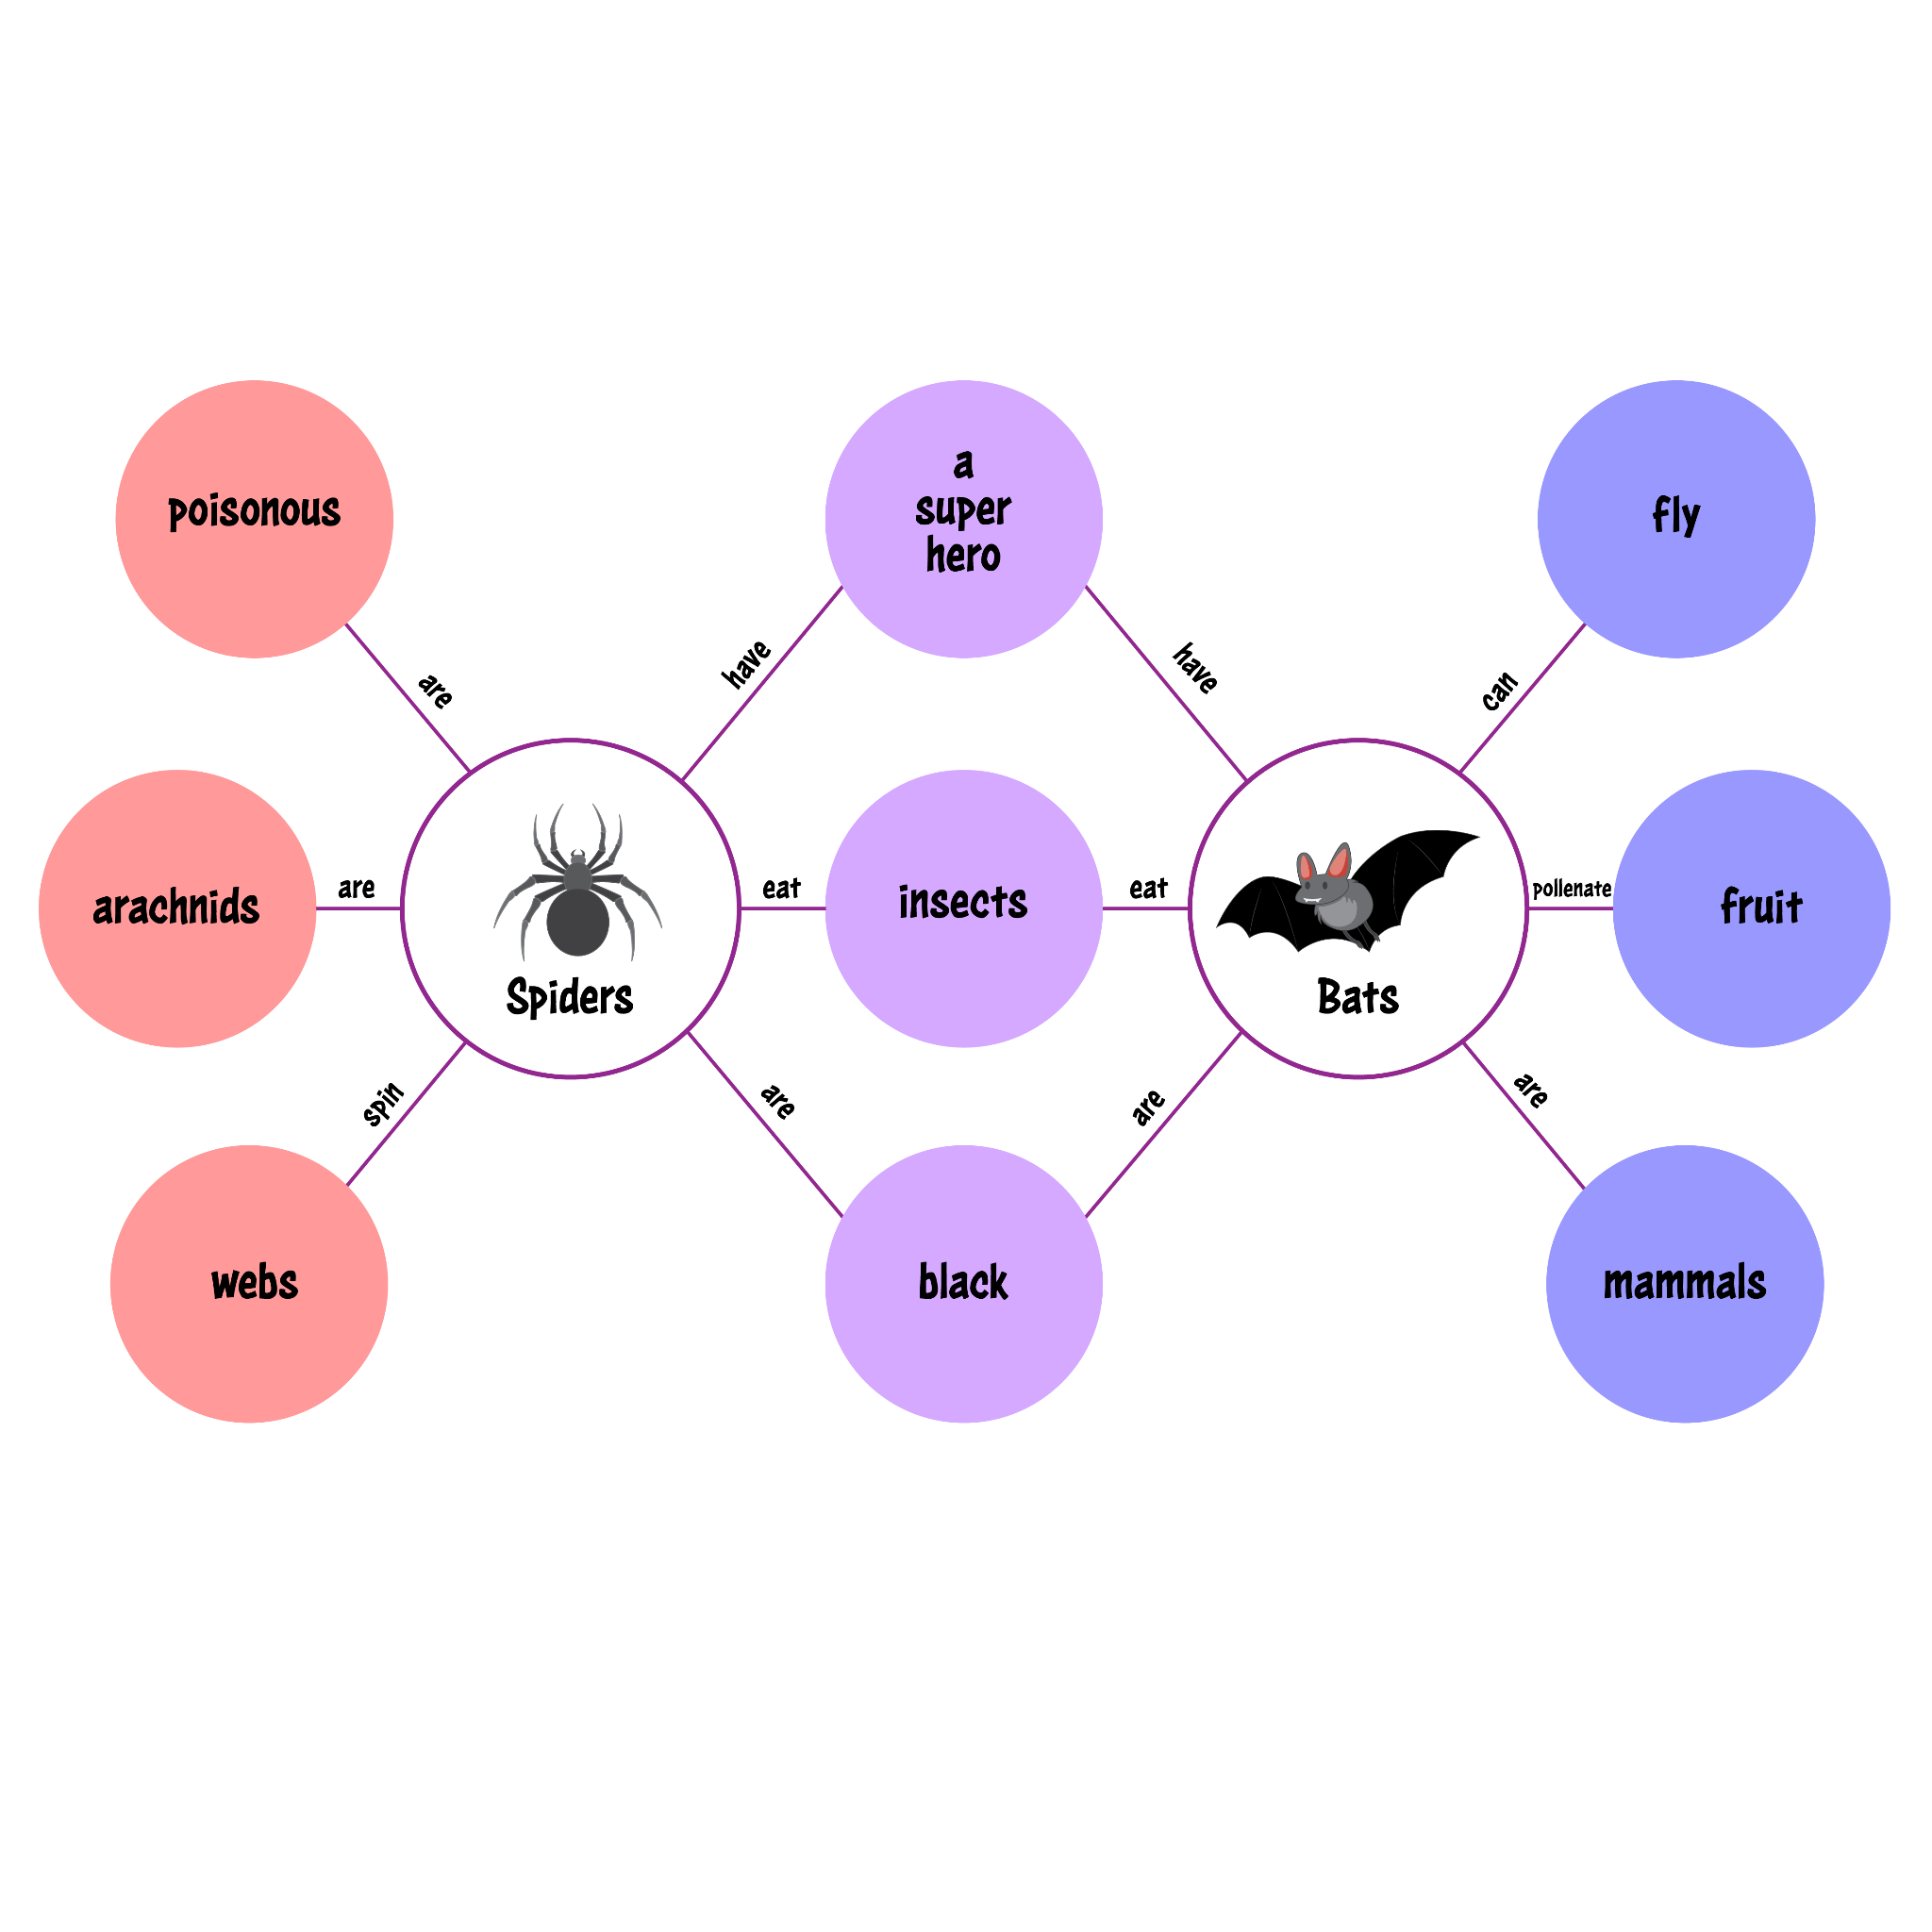
Double Bubble Map
Visually compare/contrast your countries/territories:
On the poster paper provided, draw a Double Bubble map (see image).
You fill in one side with information about your country that is different from your partner’s; they fill in the other side.
In the middle bubbles, write foods/customs that are similar between the two countries.
Notes:
K20 Center. (n.d.). Double Bubble. Strategies. Retrieved from https://learn.k20center.ou.edu/strategy/3035

Slide 10
Sticky Bars | Part 2
Reflect on what we discussed about the different stereotypes for each of your countries/territories.
Write your answer to the following question on your note: What was one stereotype about Hispanic food that wasn’t true?
Place your answer next to any sticky note that you’re responding to.
Notes:
K20 Center. (n.d.). Sticky bars. Strategies. Retrieved from https://learn.k20center.ou.edu/strategy/129

Slide 11
Sticky Bars | Part 3
Reflect on what you learned from your research.
Write your answer to the following question on your note: What is the most unique thing you saw in your video/research?
Place your answer in the column of your country/territory.
Notes:
K20 Center. (n.d.). Sticky bars. Strategies. Retrieved from https://learn.k20center.ou.edu/strategy/129

Slide 12
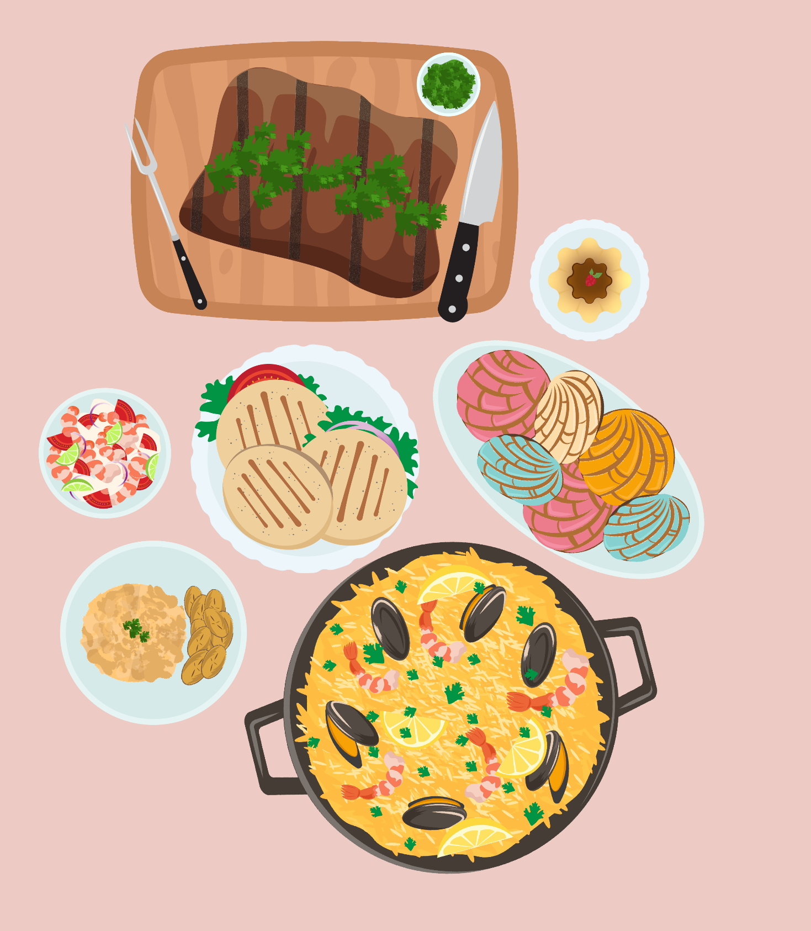
Hispanic Menu Handout
Follow the instructions on your handout.
Plan a traditional Hispanic meal for your friends based on what you learned about your country/territory.

