Slide 2
The Sound of Polynomials
Adding and Subtracting Polynomials

Slide 3
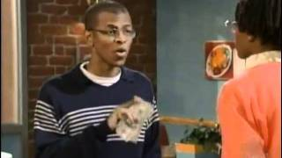
Fast Food Ordering
Fast Food Ordering (Shortened)
Notes:
My-Junk Shared. (2011, March 11). MADtv fast food ordering [Video]. YouTube. https://www.youtube.com/watch?v=M2T7Z8PwESY

Slide 4
The Order
Is there an easier way he could have communicated his order?

Slide 5
Essential Question
How can you use addition and subtraction to simplify polynomial expressions?

Slide 6
Lesson Objective
Apply addition and subtraction to simplify
polynomial expressions.

Slide 7
Mathsbot
Navigate to http://k20.ou.edu/algebratiles
Use the online math manipulative to help you answer the questions about the given expressions on your handout.
Notes:
K20 Center. (n.d.). Mathsbot. Tech Tool. https://learn.k20center.ou.edu/tech-tool/2793

Slide 8
Adding Polynomials
Use the online math manipulative to answer the questions on the handout.
First, try the problem on your own.
Then, discuss with a partner.
Choose a color to represent your confidence in efficiently summarizing how many blocks of each kind you have all together.
The cup colors represent the following:
Green - “I can summarize my thought process.”
Yellow - “I am a bit uncertain about how to summarize my thought process.”
Red - “I need help summarizing my thought process.”
Notes:
K20 Center. (n.d.). Try it, talk it, color it, check it. Strategies. https://learn.k20center.ou.edu/strategy/2329

Slide 9
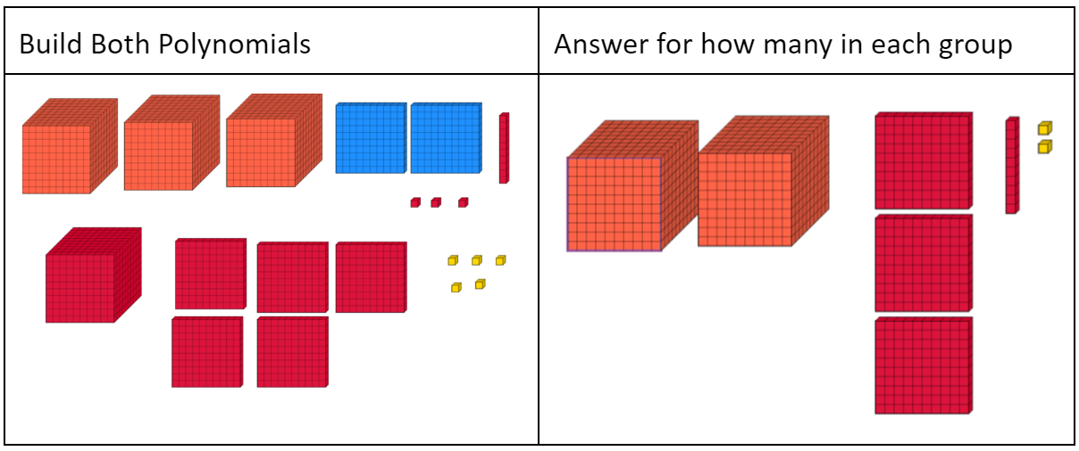
How many blocks of each kind do you have altogether?

Slide 10
Subtracting Polynomials
Use the online math manipulative to answer the questions on the handout.
First, try the problem on your own.
Then, discuss with a partner.
Lastly, choose a color to represent your confidence in efficiently summarizing how many blocks you have left.
The cup colors represent the following:
Green - “I can summarize my thought process.”
Yellow - “I am a bit uncertain about how to summarize my thought process.”
Red - “I need help summarizing my thought process.”
Notes:
K20 Center. (n.d.). Try it, talk it, color it, check it. Strategies. https://learn.k20center.ou.edu/strategy/2329

Slide 11
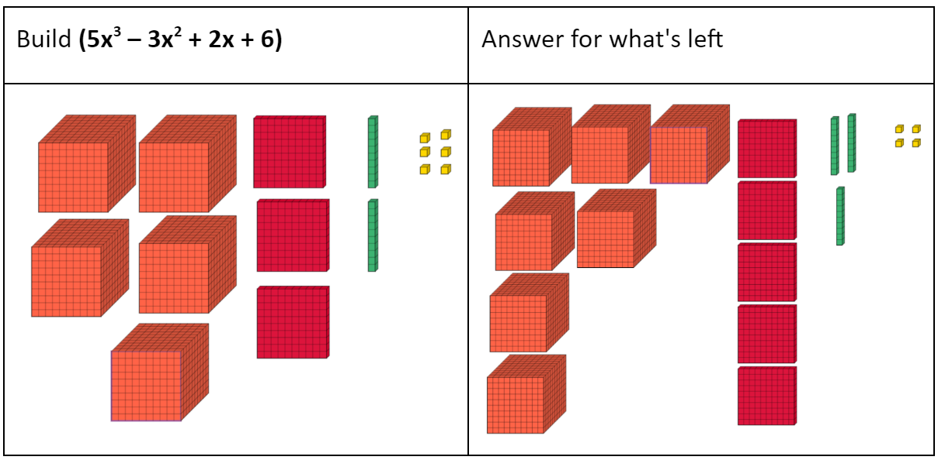
How many blocks do you have left?

Slide 12
Scavenger Hunt
Complete the Frayer Model handout for adding/subtracting polynomials. The “answers” are hung around the classroom.
Start anywhere you like; spread out
Use the answers and QR codes on the wall to complete each box on your Frayer Models notes.
We will review the answers together.
Notes:
K20 Center. (n.d.). Scavenger hunt notes. Strategies. https://learn.k20center.ou.edu/strategy/3113

Slide 13
What is a polynomial expression?
What is a polynomial?
What is a term?
What is an expression?
2x³ + 5x – 7

Slide 14
What is a polynomial expression?
terms
variables
constants
Many ________ that have __________ or ____________ that are separated by a _______ or ________ symbol.
2x³ + 5x – 7
plus
minus
Coefficient
Exponent
Constant
Variables

Slide 15
How do we simplify polynomials?
Remove parentheses
Why do we remove parentheses?
Identify like terms
What are some strategies we can use to identify like terms?
What characteristics do you look for?
Combine like terms
What does it mean to combine like terms?
Write in standard form
How do we put a polynomial in standard form?

Slide 16
What is the most important thing to remember about subtracting polynomials?
Remember to distribute the negative one to each term in the second polynomial
How are adding and subtracting polynomials similar? How are they different?

Slide 17
Addition (Horizontal)

Slide 18
Addition (Vertical)

Slide 19
Subtraction (Vertical)

Slide 20
Subtraction (Horizontal)

Slide 21
Chebyshev Polynomials
Did you know that so much math goes into instrument design, sound mixing, music production, and more?
One special kind of math used are the Chebyshev polynomials.
A musician or sound engineer may use the Chebyshev polynomials to distort or shift the shape of the soundwave that is heard, resulting in a change of the sound.
To get a specific sound or effect, one may add or subtract Chebyshev polynomials together to get the desired sound.

Slide 22
Math and Music
Education Specialist for Ableton
Notes:
K20 Center. (2024, March 12). K20 ICAP - Education specialist for Ableton - the sound of polynomials [Video]. YouTube. https://youtu.be/H4vF2556Sig

Slide 23
Polynomials and Sound
Work together to simplify the expressions on your handout using the given Chebyshev polynomials.
Show your work on a separate piece of paper.

Slide 24
Polynomials and Sound (Key)

Slide 25
Polynomials and Sound (Key)

Slide 26
Polynomials and Sound: Web Tool
Go to: k20center.ou.edu/e-learning/polynomials-sound/
Turn down the Effect volume.
Turn up the Noeffect volume.
Select “Sample 2.”
Press the “Start” button.

Slide 27
Polynomials and Sound: Web Tool
Change the current polynomial to the T₈(x) Chebyshev polynomial.
Click on each coefficient and exponent to edit its value.
How should we enter a negative coefficient?
How do we enter a constant?

Slide 28
Polynomials and Sound: Web Tool
Turn down the Noeffect volume.
Turn up the Effect volume.

Slide 29
Changes in Sound
What happens to a sound when we add or subtract the Chebyshev polynomials?
How are the sounds different?
What descriptive words would you use for each sound?
Example: nasal, cold, scary, happy, etc.

Slide 30
Polynomials and Sound: Web Tool
Change the current polynomial to the T₅(x) Chebyshev polynomial.
Turn down the Effect volume.
Turn up the Noeffect volume.
Select a “Sample #.”
Press the “Start” button.
Enter the new polynomial.
Click each number to edit.
Turn down the Noeffect volume.
Turn up the Effect volume.

Slide 31
Polynomials and Sound: Web Tool
Enter your simplified polynomial from question 1 on your handout.
As you work, keep in mind:
How are the sounds different?
What descriptive words would you use for each sound?
Example: nasal, cold, scary, happy, etc.
Repeat this for each of your simplified polynomials.

Slide 32
Changes in Sound
What happens to a sound when we add or subtract the Chebyshev polynomials?
How are the sounds different?
What descriptive words would you use for each sound?
Example: nasal, cold, scary, happy, etc.

Slide 33
Math and Music
Sound Designer and Film Composer
Notes:
K20 Center. (2024, March 19). K20 ICAP - Sound designer and film composer - math, music, career [Video]. YouTube. https://youtu.be/pwC2gWQEnFw

Slide 34
Exit Ticket
Simplify the problems on the handout and turn in when you’re done.
Notes:
K20 Center. (n.d.). Bell ringers and exit tickets. Strategies. https://learn.k20center.ou.edu/strategy/125

