Slide 2
The Sound of Polynomials
Adding and Subtracting Polynomials

Slide 3
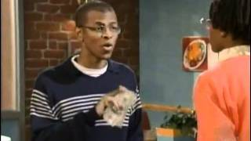
Fast Food Ordering
https://www.youtube.com/embed/M2T7Z8PwESY?start=001&end=241
Notes:
YouTube. (2011, March 11). MADtv fast food ordering. YouTube. https://www.youtube.com/watch?v=M2T7Z8PwESY

Slide 4
The Order
Is there an easier way he could have communicated his order?

Slide 5
Essential Question
How can you use addition and subtraction to simplify polynomial expressions?

Slide 6
Lesson Objective
Apply addition and subtraction to simplify polynomial expressions.

Slide 7
Mathsbot
Navigate to http://k20.ou.edu/algebratiles
Use the online math manipulative to help you answer the questions about the given expressions on your handout.
Notes:
K20 Center. (n.d.). Mathsbot. Tech Tool. https://learn.k20center.ou.edu/tech-tool/2793

Slide 8
Adding Polynomials
Use the online math manipulative to answer the questions on the handout.
First, try the problem on your own.
Then, discuss with a partner.
Choose a color to represent your confidence in efficiently summarizing how many blocks of each kind you have all together.
The cup colors represent the following:
Green - “I can summarize my thought process.”
Yellow - “I am a bit uncertain about how to summarize my thought process.”
Red - “I need help summarizing my thought process.”
Notes:
K20 Center. (n.d.). Try It, Talk It, Color It, Check It. Strategies. Retrieved from https://learn.k20center.ou.edu/strategy/2329

Slide 9
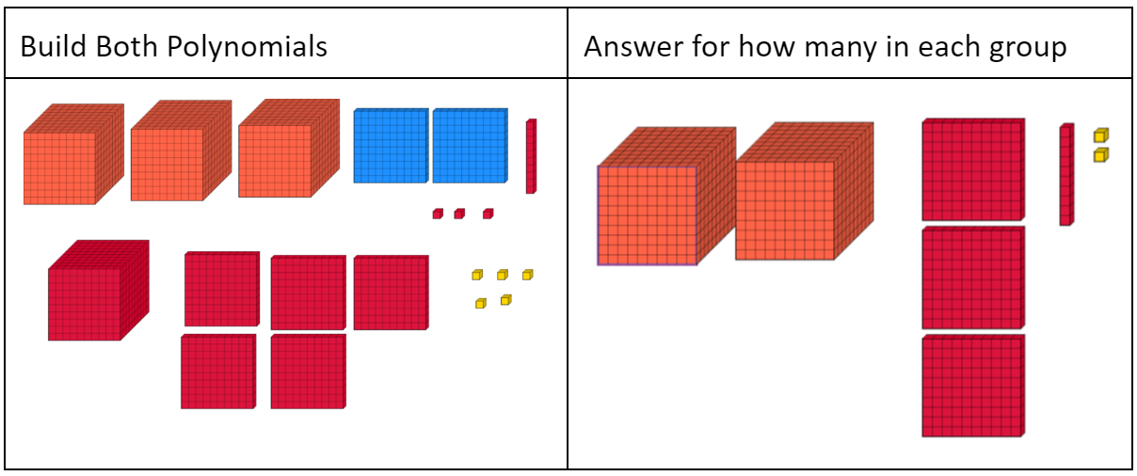
How many blocks of each kind you have altogether?

Slide 10
Subtracting Polynomials
Use the online math manipulative to answer the questions on the handout.
First, try the problem on your own.
Then, discuss with a partner.
Lastly, choose a color to represent your confidence in efficiently summarizing how many blocks you have left.
The cup colors represent the following:
Green - “I can summarize my thought process.”
Yellow - “I am a bit uncertain about how to summarize my thought process.”
Red - “I need help summarizing my thought process.”
Notes:
K20 Center. (n.d.). Try It, Talk It, Color It, Check It. Strategies. Retrieved from https://learn.k20center.ou.edu/strategy/2329

Slide 11
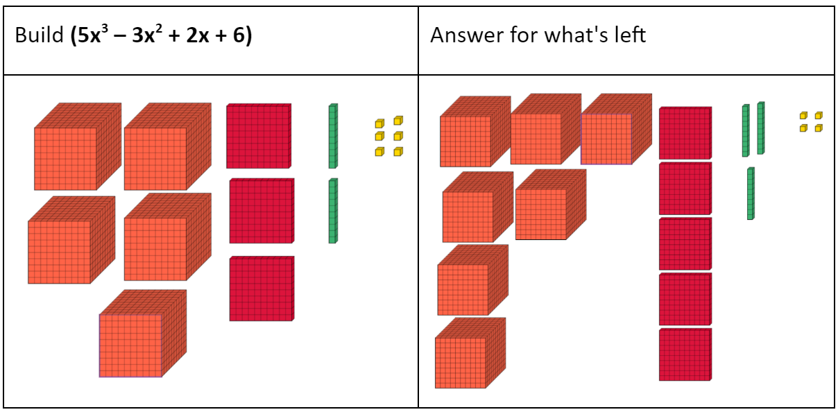
How many blocks do you have left?

Slide 12
Scavenger Hunt
Complete the Frayer Model handout for adding/subtracting polynomials. The “answers” are hung around the classroom.
Start anywhere you like; spread out
Use the answers and QR codes on the wall to complete each box on your Frayer Models notes.
We will review the answers together.
Notes:
K20 Center. (n.d.). Frayer model. Strategies. Retrieved from https://learn.k20center.ou.edu/strategy/126

Slide 13
What is a polynomial expression?
What is a polynomial?
What is a term?
What is an expression?
2x³+ 5x -7
Notes:
K20 Center. (n.d.). Frayer model. Strategies. Retrieved from https://learn.k20center.ou.edu/strategy/126

Slide 14
What is a polynomial expression?
terms
variables
constants
Many ________ that have __________ or ____________ that are separated by a _______ or ________ symbol.
2x³+ 5x -7
plus
minus
Coefficient
Exponent
Constant
Variables
Notes:
K20 Center. (n.d.). Frayer model. Strategies. Retrieved from https://learn.k20center.ou.edu/strategy/126

Slide 15
How do we simplify polynomials?
Remove parenthesis
Why do we remove parenthesis?
Identify like terms
What are some strategies we can use to identify like terms?
What characteristics do you look for?
Combine Like terms
What does it mean to combine like terms?
Write in standard form
How do we put a polynomial in standard form?
Notes:
K20 Center. (n.d.). Frayer model. Strategies. Retrieved from https://learn.k20center.ou.edu/strategy/126

Slide 16
What is the most important thing to remember about subtracting polynomials?
Remember to distribute the negative one to each term in the second polynomial
How are adding/subtracting polynomials Similar? Different?
Notes:
K20 Center. (n.d.). Frayer model. Strategies. Retrieved from https://learn.k20center.ou.edu/strategy/126

Slide 21
Chebyshev Polynomials
Did you know that so much math goes behind instrument design, sound mixing, music production and more?
One special kind of math used are the Chebyshev Polynomials.
A musician or sound engineer may use the Chebyshev Polynomials to distort or shift the shape of the soundwave that is heard resulting in a change of the sound.
To get a specific sound or effect, one may add or subtract Chebyshev Polynomials together to get the desired sound.

Slide 22
https://www.youtube.com/watch?v=KyjsoykuFrY
Notes:
K20 Center. (n.d.). Frayer model. Strategies. Retrieved from https://learn.k20center.ou.edu/strategy/126
YouTube. (2023, August 22). K20 ICAP-the sound of polynomials. YouTube. https://www.youtube.com/watch?v=KyjsoykuFrY

Slide 23
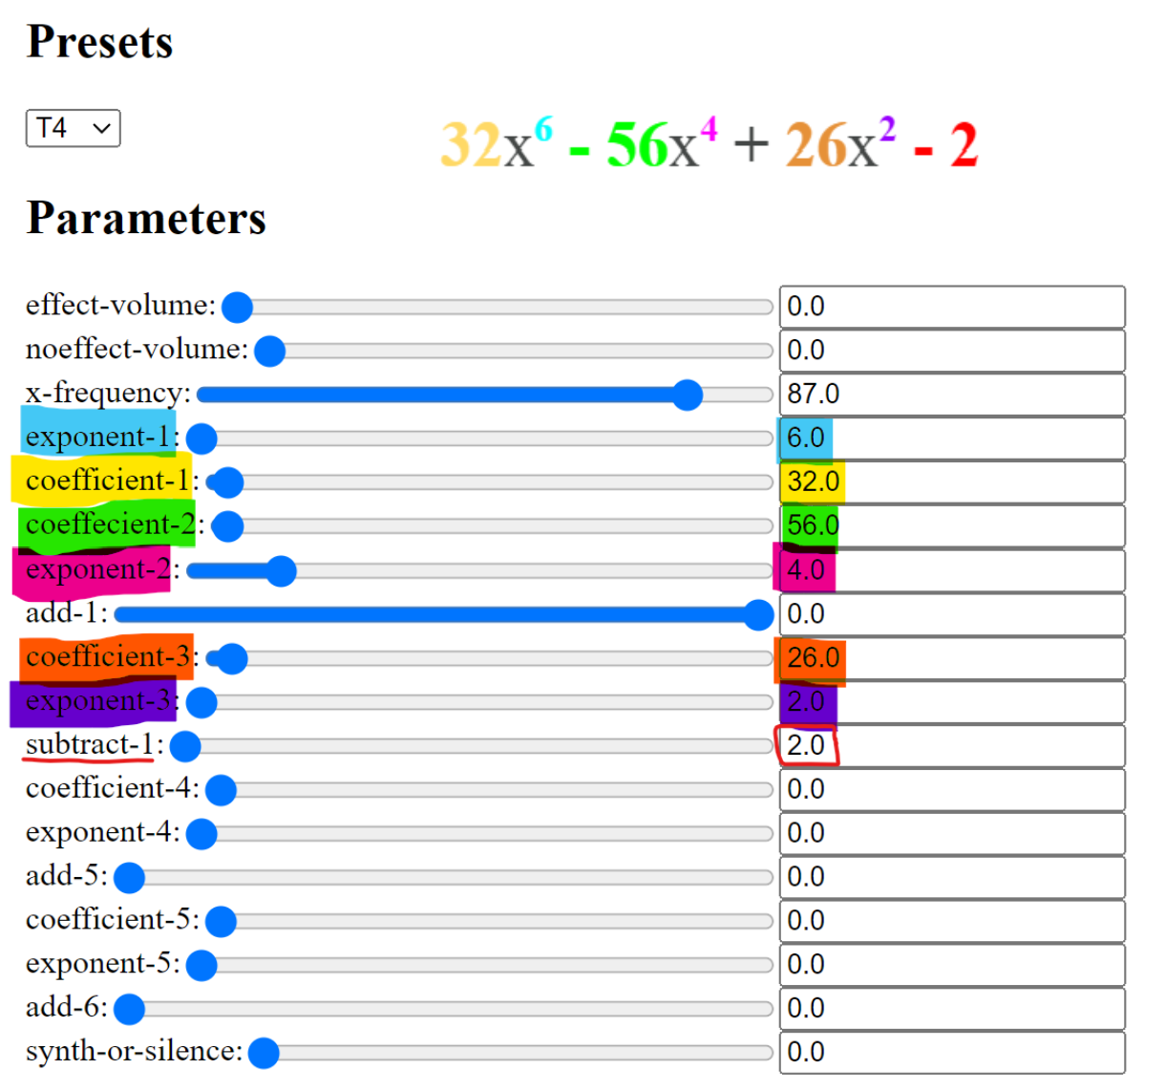
Polynomials and Sounds
Navigate to: https://youngweather.github.io/
Simplify each expression on your Polynomials and Sound handout
Put each solution into the program using the image to the right.
Answer the question: What happens to a sound when we add or subtract Chebyshev Polynomials?

Slide 24
Polynomials and Sounds
Click the number “49” key at the top of the page. (49 is the MIDI number for the note C#3).
Turn the effect volume all the way down and slide the noeffect volume all the way up. This is the unfiltered sound.
Slide the effect volume all the way up. This is the sound being filtered by the T3 Chebyshev polynomial.
Change the preset to T5, then repeat the process clicking on “49,” turning the effect volume all the way down and sliding the noeffect volume all the way up. Then setting the effect volume to “102.” This is the sound being filtered by the T5 Chebyshev polynomial.
You should notice that the noeffect is the same, but the effect sound is different as the T5 sound is more nasally and lower in pitch than the T3 sound.
Go to the worksheet and simplify the first set of polynomials.
After getting the result, leave the sound on while inputting the answers in the boxes. Upon changing the 3rd coefficient, you should hear the sound change.

Slide 25
Polynomials and Sounds (Key)
1)
2)

Slide 26
What happens to a sound when we add or subtract the Chebyshev Polynomials?
Share your answer and describe the change of the sound
How are the sounds different?
What descriptive words would you use for each sound?
Example: nasally, cold, scary, happy, etc

Slide 27
Exit Ticket
Simplify the problems on the handout and turn in when you’re done.
Notes:
K20 Center. (n.d.). Bell Ringers and Exit Ticket. Strategies. Retrieved from https://learn.k20center.ou.edu/strategy/125

