Slide 2
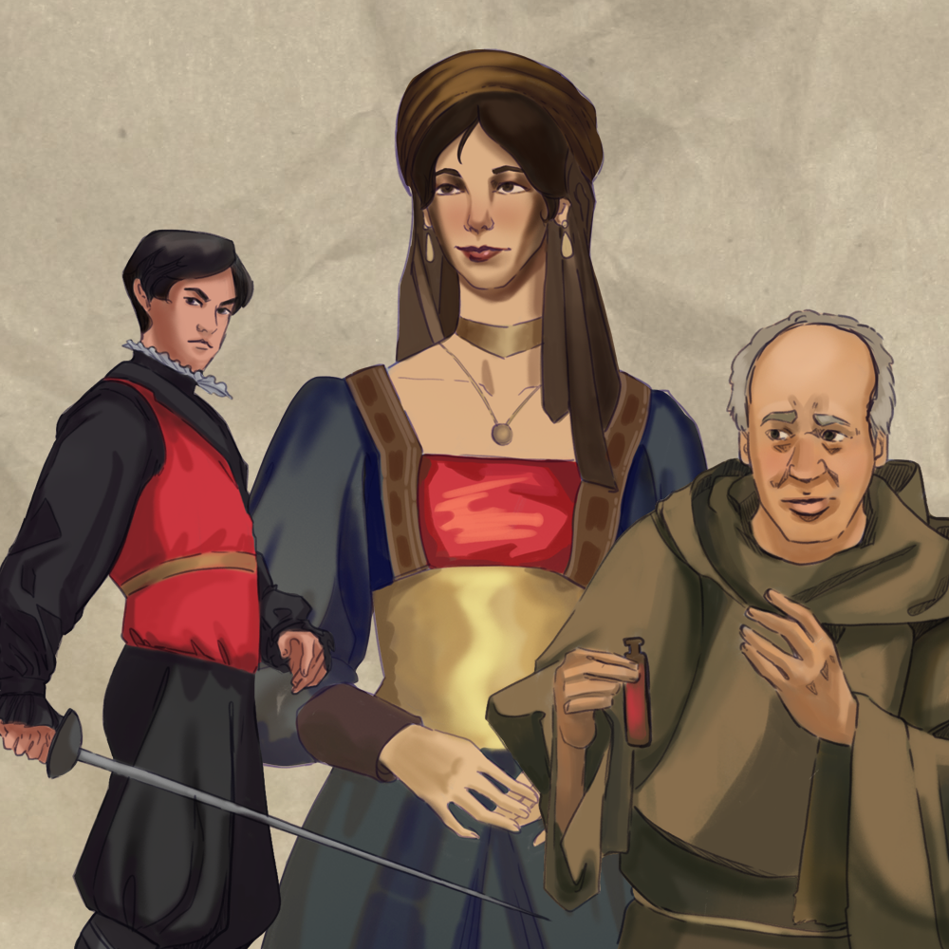
Much Ado With Thoughts, Words, and Deeds
Character Motivation and Theme

Slide 3
Essential Question
How do characters and their motivations influence thematic aspects of a text?

Slide 4
Learning Objectives
Make connections between characters’ motivations and theme topics.
Write theme statements using evidence from the text.

Slide 5

Making Connections
L
H
P
F
Read the quote.
Decide which idea (love, hate, peace, free will)
best connects to the quote.
Move to that sign.
Discuss in your group your reasoning.
  Why do you think the quote connects to that idea?
Elect one spokesperson to share.
  We think the quote best connects to… because…
Notes:
K20 Center. (n.d.). Four corners. Strategies. https://learn.k20center.ou.edu/strategy/138

Slide 6

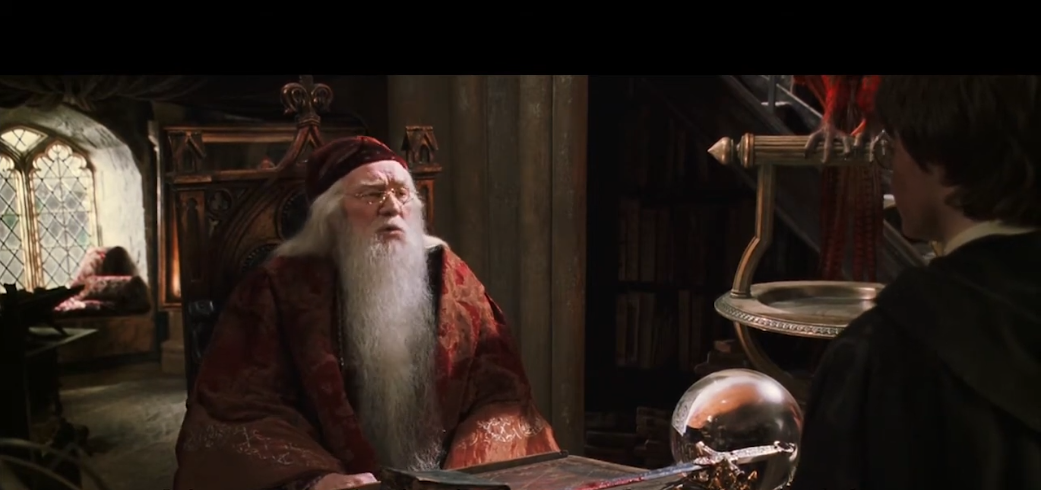
Harry Potter and the Chamber of Secrets
It is our actions that show who we truly are.
Notes:
LoveMovieQuotes. (2021, April 25). Harry Potter Chamber of Secrets-It's not our abilities that show what we truly are. It's our choices [Video]. YouTube. https://www.youtube.com/watch?v=1qHjIrI_fp0

Slide 7
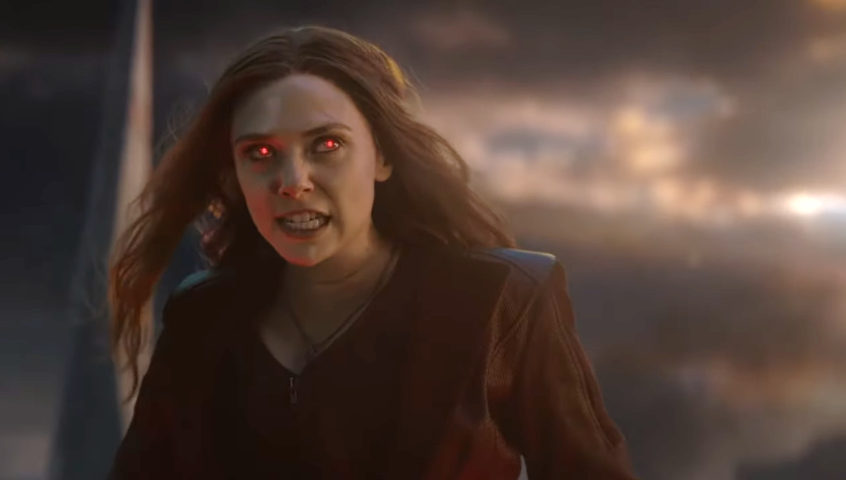
Avengers: Endgame
You took everything from me!
Notes:
Recall. (2020, August 24). You took everything from me. The Final Battle Thanos's bound by Wanda Maximoff's energy. Avengers [Video]. YouTube. https://www.youtube.com/watch?v=U37cChUfHk0

Slide 8
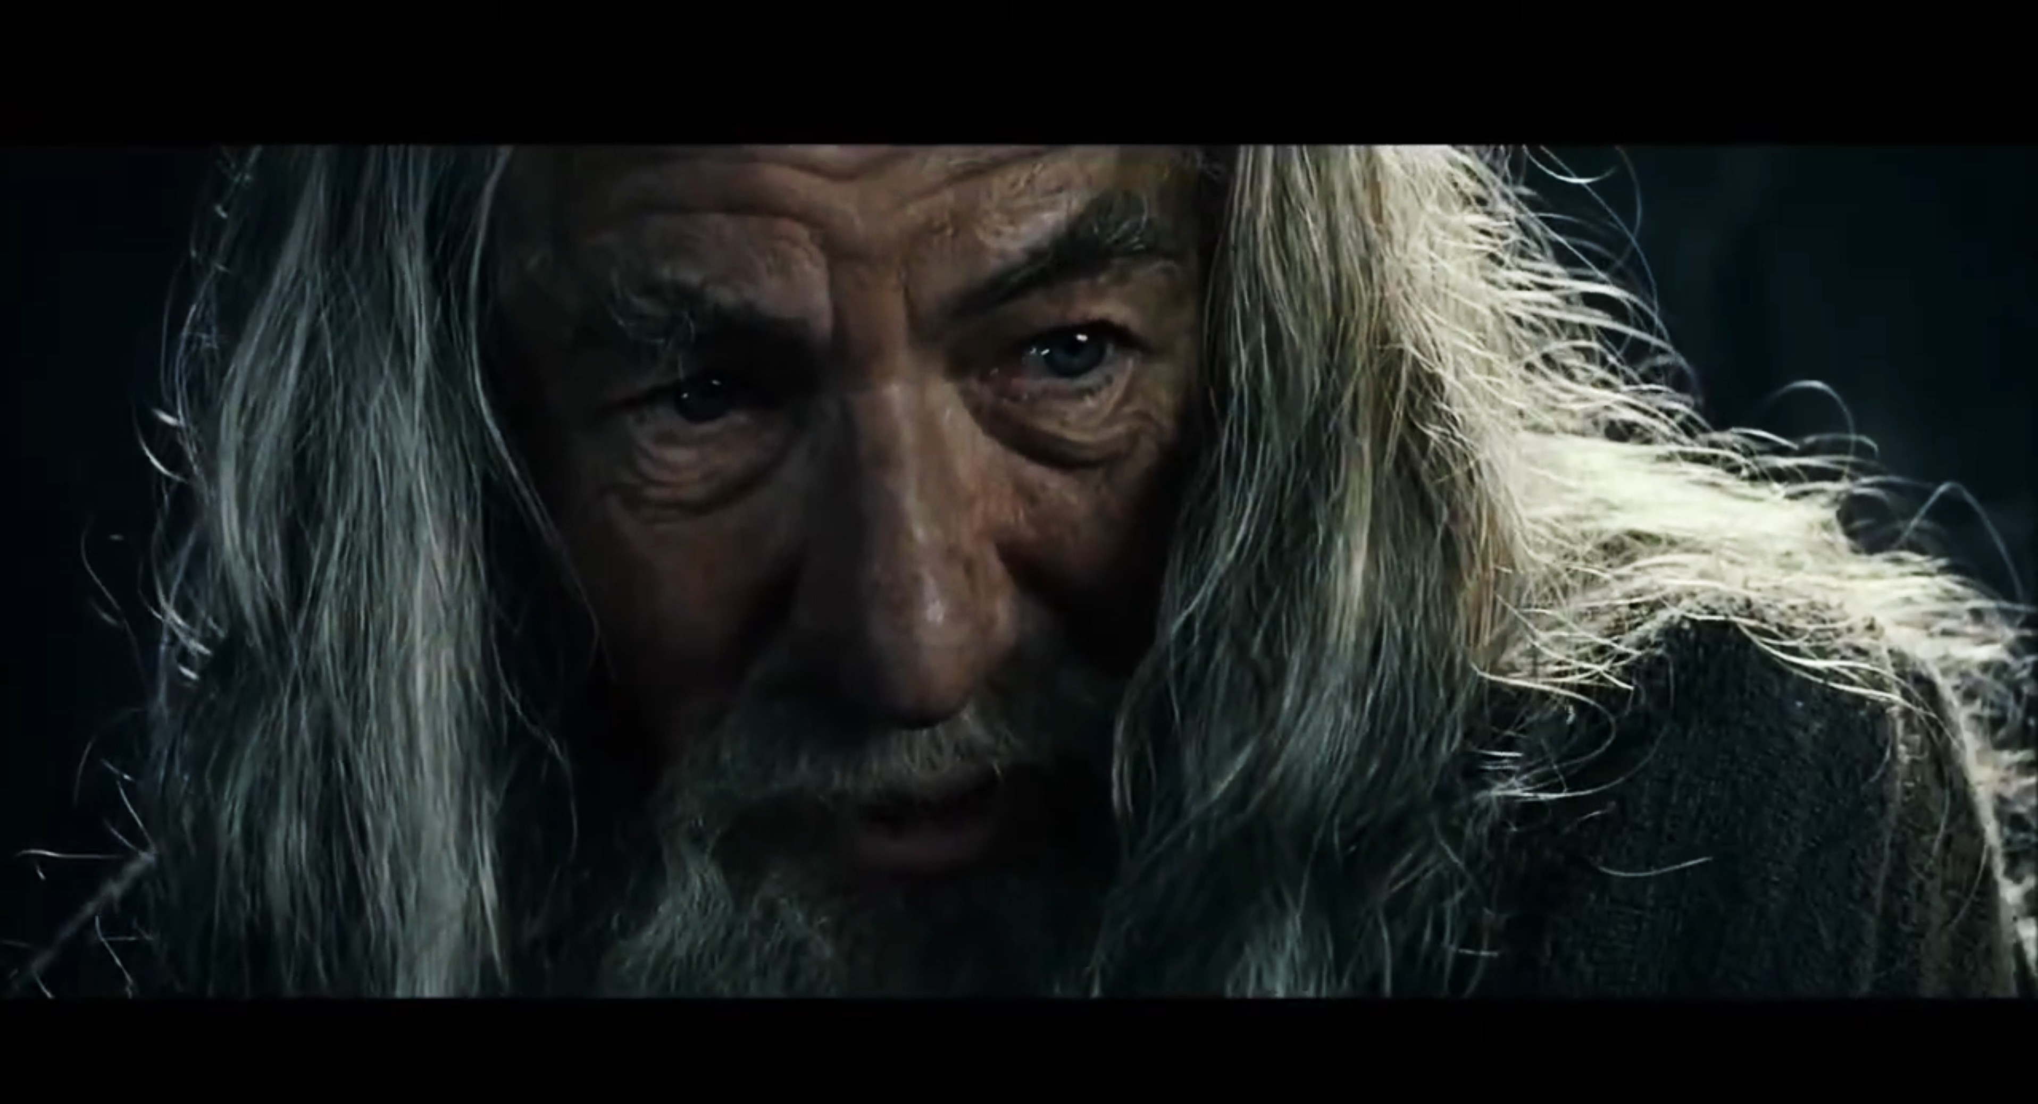
The Fellowship of the Ring
All we have to decide is what to do with the time that is given to us.
Notes:
Everything In Middle Earth. (2016, April 4). The lord of the rings The Fellowship of the Rings-So do all who live to see such times [Video]. YouTube. https://www.youtube.com/watch?v=TDBS6I5DjBg

Slide 9
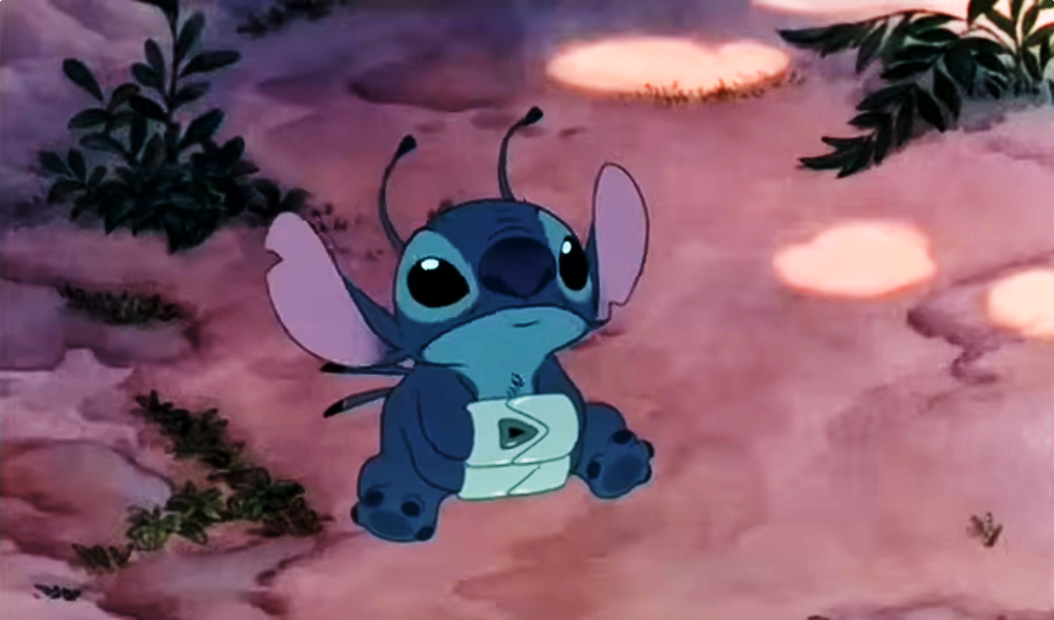
Lilo & Stitch
Ohana means family. Family means nobody gets left behind or forgotten.
Notes:
Santospi1. (2013, October 29). Clip from Lilo and Stitch, Ohana means family… [Video]. YouTube. https://www.youtube.com/watch?v=U37cChUfHk0

Slide 10
Romeo and Juliet
Part, fools, put up your swords;
you know not what you do.
(two people fighting)
Break it up! Put up your swords;
you don’t know how bad this is.

Slide 11
Romeo and Juliet
O Romeo, Romeo! Wherefore art thou Romeo?
Deny thy father and refuse thy name;
Or, if thou wilt not, be but sworn my love,
And I'll no longer be a Capulet.
Romeo, Romeo, why do you have to be named Romeo?
Deny your family and change your name;
Or, if you won’t, tell me you love me and
I will leave my family for you.

Slide 12
Romeo and Juliet
What, drawn and talk of peace! I hate the word,
As I hate hell, all Montagues, and thee.
What, you have your sword drawn and you want peace!?
I hate the word peace,
just like I hate hell, all members of the
Montague family, and you.

Slide 13
Romeo and Juliet
She speaks.
O, speak again, bright angel, for thou art
As glorious to this night, being o'er my head,
As is a wingèd messenger of heaven
(Hearing Juliet)
She speaks.
Oh speak again, bright angel. You look as glorious
above me as an angel in heaven

Slide 14

Chalk Talk
Write your assigned idea in the middle
of your paper.
Idea
Notes:
K20 Center. (n.d.). Chalk talk. Strategies. https://learn.k20center.ou.edu/strategy/197

Slide 15

Chalk Talk
Then answer the following
prompts on your paper:
  What could a character do…?
  What could a character say…?
  What could a character think…?
  …that would show they are motivated by your idea (love, hate, peace, free will)?
3-Minute Timer
Notes:
K20 Center. (2021, September 21). K20 Center 3 minute timer [Video]. YouTube. https://www.youtube.com/watch?v=iISP02KPau0
K20 Center. (n.d.). Chalk talk. Strategies. https://learn.k20center.ou.edu/strategy/197

Slide 16
Chalk Talk
It’s now time to practice
communicating silently using
pencil and paper.
Read what your group members wrote.
Respond to what they wrote.
  Write words
  Draw: arrows, circles, pictures,
  lines connecting ideas, etc.
3-Minute Timer
Notes:
K20 Center. (2021, September 21). K20 Center 3 minute timer [Video]. YouTube. https://www.youtube.com/watch?v=iISP02KPau0
K20 Center. (n.d.). Chalk talk. Strategies. https://learn.k20center.ou.edu/strategy/197

Slide 17
Chalk Talk: Discussion
In your group, choose a spokesperson
who is willing to share what your group wrote.
Be ready to share (and listen).
Notes:
K20 Center. (n.d.). Chalk talk. Strategies. https://learn.k20center.ou.edu/strategy/197

Slide 18

Why-Lighting
Highlight any of your character’s
thoughts, words, or deeds (actions) that connect to love, hate, peace, or free will.
Make a note of which idea the action connects to
(to explain why you highlighted that text).
Highlight at least 5 actions (thoughts, words, or deeds) for your character.
Notes:
K20 Center. (n.d.). Why-Lighting. Strategies. https://learn.k20center.ou.edu/strategy/128

Slide 19

myShakespeare
Go to myShakespeare.com.
Sign in.
Select “my Romeo & Juliet”.
Select “Play Menu” to navigate to your reading.
Use your cursor to highlight the desired text.
Select the note icon that pops up.
Notes:
K20 Center. (n.d.). Why-Lighting. Strategies. https://learn.k20center.ou.edu/strategy/128

Slide 20
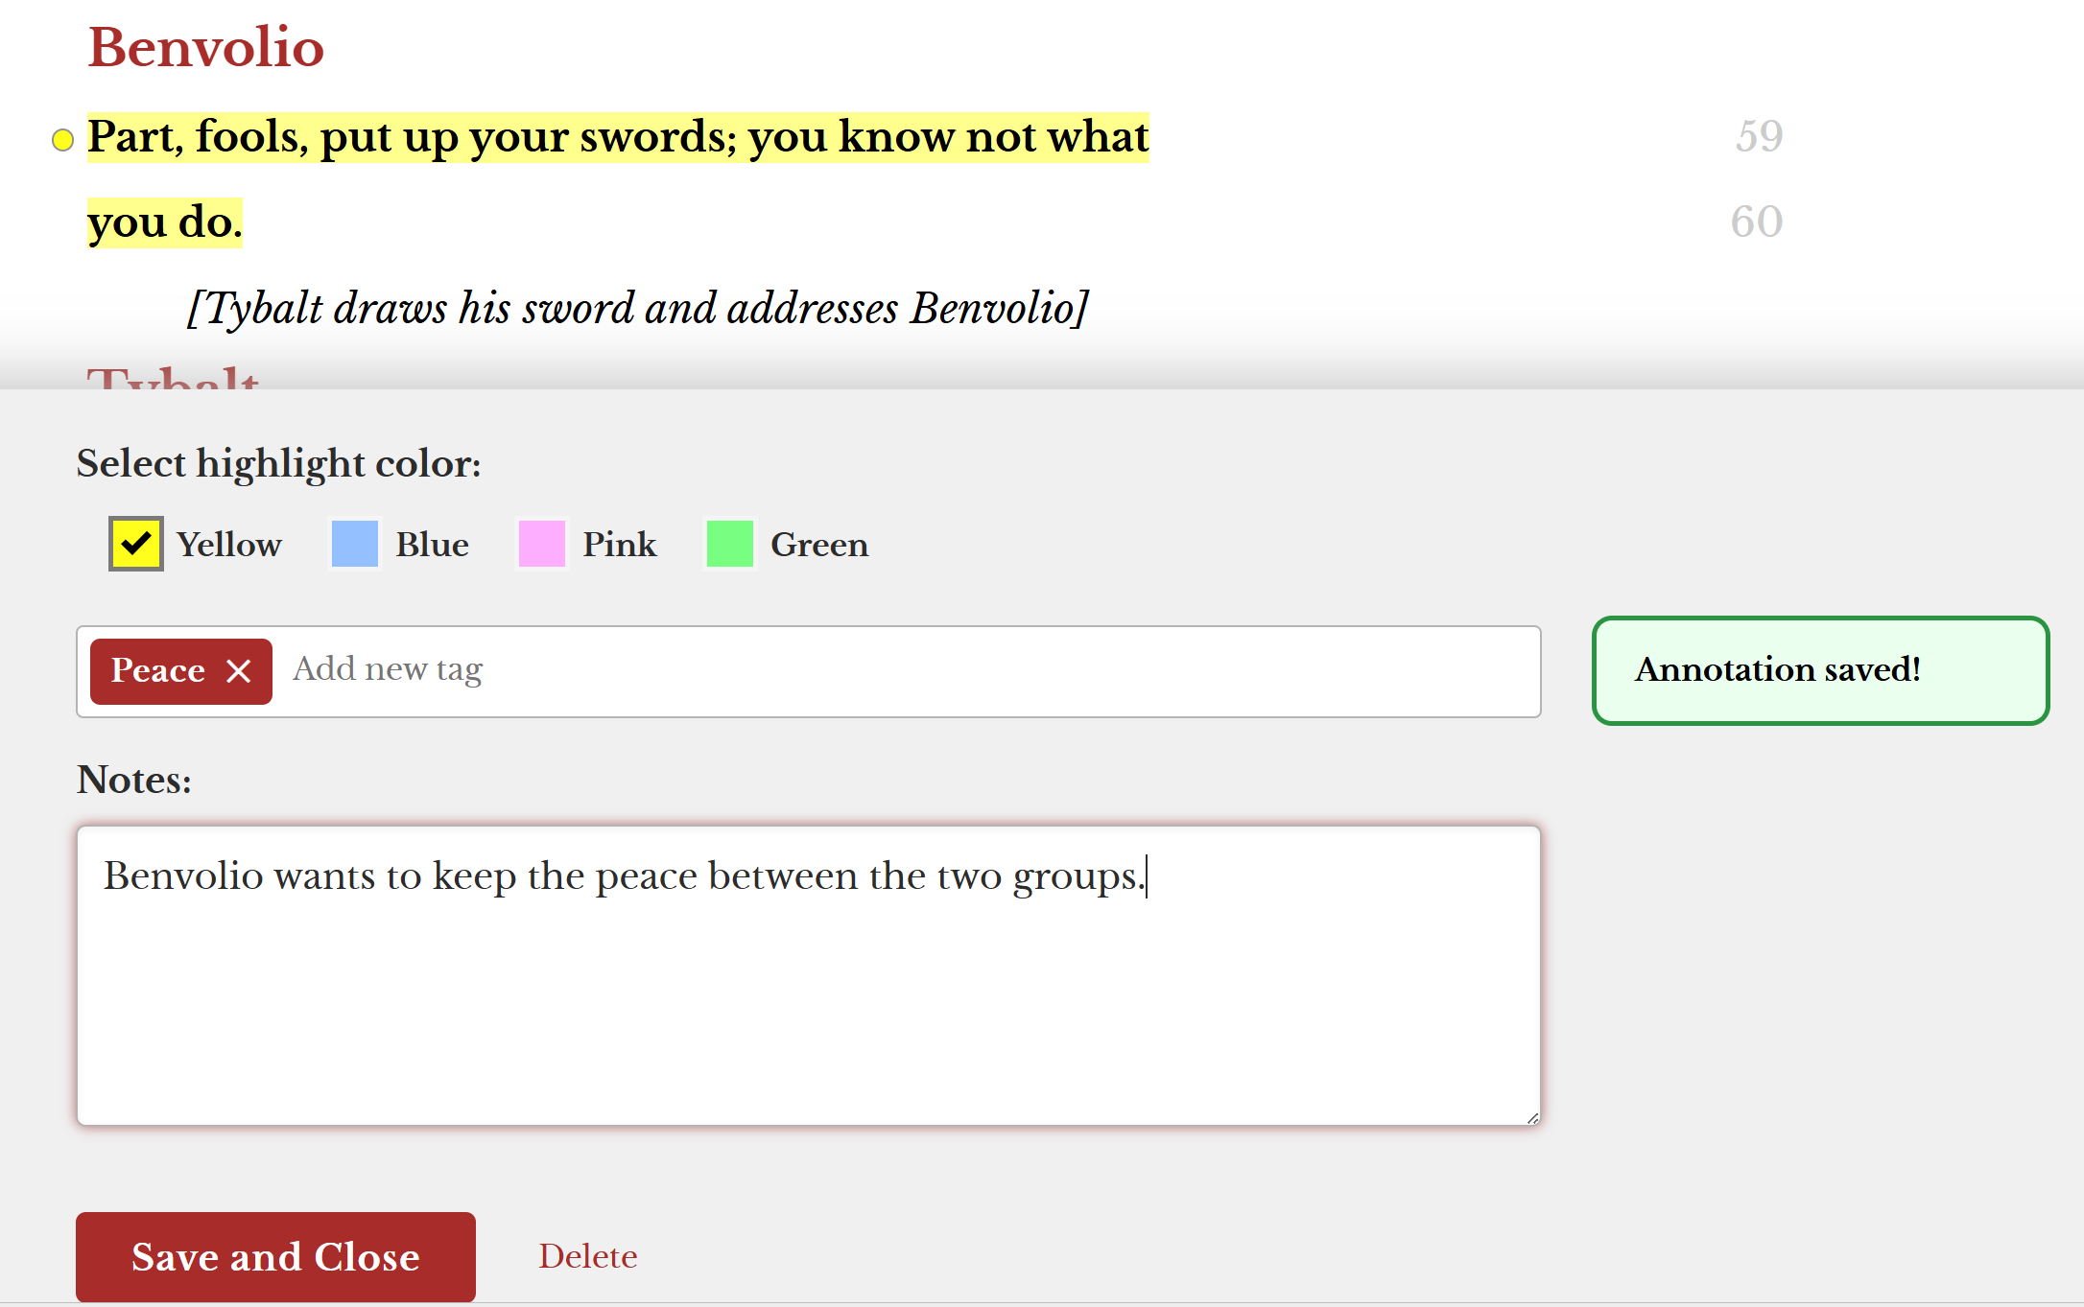

Why-Lighting: Example
Notes:
K20 Center. (n.d.). Why-Lighting. Strategies. https://learn.k20center.ou.edu/strategy/128

Slide 21
Why-Lighting
Highlight any of your character’s
thoughts, words, or deeds (actions) that connect to love, hate, peace, or free will.
Make a note of which idea the action connects to
(to explain why you highlighted that text).
Highlight at least 5 actions (thoughts, words, or deeds) for your character.
Notes:
K20 Center. (n.d.). Why-Lighting. Strategies. https://learn.k20center.ou.edu/strategy/128

Slide 22
Character Reflection
What did you learn from your character’s thoughts, words, and deeds?
What did their actions tell you about…
  …the character?
  …the plot?
  …the meaning?

Slide 23
Theme Topics and Theme Statements
Theme Topic | Theme Statement
An important concept that a work explores or deals with Usually just one word or a short phrase | A message about a concept or topic conveyed through a work A good theme statement needs to be: a complete sentence. universal (applies outside of the story as well).

Slide 24
Theme Topics and Theme Statements
Theme Topic | Theme Statement
Examples: Love Hate Peace Free Will Remember these? | Examples: “War can turn friends into enemies.” “Even people with good intentions can be corrupted by power.”

Slide 25
Character Motivations and Meaning
Consider the theme topics of love, hate,
peace, or free will.
What do your character’s thoughts, words, and deeds reveal about those theme topics?
  Think about which one is most important for your character.
Hint: You will use this to write your theme statement.

Slide 26
Theme
Character: Write the name of your assigned character.
Theme Topic: Circle the theme topic that was most noted in your Why-Lighting.
  Select the “Notebook” tab in myShakespeare to quickly see your Why-Lighting notes.

Slide 27
Theme
Theme Statement: What is the lesson or message you learned (about that theme topic) through your character’s thoughts, words, and deeds?
  Make sure to write a complete sentence that is universal (applies to people in general).
Supporting Quotes: Find 2 quotes you highlighted that reveal your theme statement.

Slide 28

Theme One-Pager
Your creation needs to be visually appealing and contain:
Name & Illustration of your Character
Theme Statement
2 Direct Quotes
Theme Topic
Supporting Illustrations
It needs to fit within and fill one page.
Notes:
K20 Center. (n.d.). Concept one-pager. Strategies. https://learn.k20center.ou.edu/strategy/5374

Slide 29
Supporting Quotes: Reasoning
On the back of your Theme One-Pager, explain why the quotes you selected are “Supporting Quotes.”
  For each quote, write 3 sentences explaining how it supports your theme statement.
  Make it clear in your response which quote you are referring to.

