Slide 2
Thoughts, Words, and Deeds :
Methinks Much Ado with Language, Character Motivation, and Theme in Shakespeare’s Romeo and Juliet

Slide 3
Essential Question
How do language and character motivation
influence thematic aspects of a text?

Slide 5
Quick Write
On a piece of notebook paper,
respond to the following prompt:
To which aspects of your personal character does this quote connect?

Slide 7
Elbow Partner
Share your response to the Rowling quote with an Elbow Partner, the person sitting next to you.

Slide 8
Four Corners
Examine the Four Corners signs (LOVE, HATE, FATE, FREEWILL) posted around the room. Take a minute to decide which of these terms/themes best fits with the Rowling quote. Move to the sign you choose.
Share your reasoning with the group.
Elect a speaker for the group who justifies why the quote best fits with the theme displayed.

Slide 9
Four Corners
Once again, examine the Four Corners signs (LOVE, HATE,FATE, FREEWILL) posted around the room. Take a minute to decide which of these terms/themes best fits with the Romeo & Juliet quote you have been given.
Move to the sign that you choose.
Share your reasoning with the group.
Elect a speaker for the group who justifies why the quote best fits with one of the four themes.

Slide 10
Character Motivation =
The driving force behind why the character does what he/she does, says what he/she says, and thinks what he/she thinks. (Reasons for the character’s actions, words, thoughts, etc.)
What do the characters want more than anything else?
What potential conflicts or struggles might exist between characters?

Slide 11
Language
Compare/Contrast | Sound | Meaning | Others
Metaphor | Onomatopoeia | Allusions | Look for genre features: soliloquies, aside, etc.
Simile | Assonance | Irony | Look for visual language: imagery
Juxtaposition | Alliteration | Puns
 |  | Personification
 |  | Hyperbole

Slide 12
In-Class Reading: Romeo and Juliet, Act 3, Scene 1
As we read, we’ll engage in the Stop and Jot and Why-Lighting strategies.
When we pause, jot down notes in the margins regarding language and character motivation.
Think specifically about your assigned character: Benvolio, Mercutio, Tybalt, or Romeo.
When you see a word, line, or phrase connected to one of the four themes previously discussed, code it accordingly (L, H, F, FW). Highlight these important pieces of text and annotate in the margins.

Slide 13
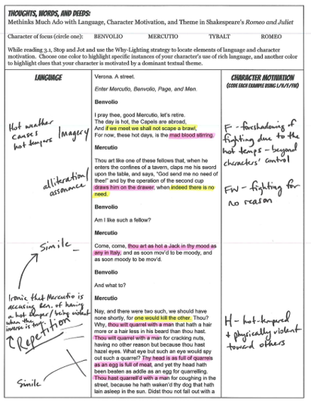
Sample Annotation

Slide 14
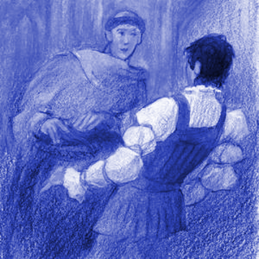
For Homework:
Read Act 3, Scenes 2-4.
Continue annotating the text using the Stop and Jot strategy practiced during class.
Focus on language, character motivation, and theme.

Slide 15
Four Corners

Slide 16
In-Class Reading: Romeo and Juliet Act 3, Scene 5 - Act 4, Scene 3
In your assigned groups, you will read collaboratively, focusing especially on your group’s character (Romeo, Juliet, Friar, Nurse, or Capulets).
As you read together, fill out the annotation template (similar to last night’s homework).
Your goal is to get through Act 4, Scene 3. Whatever reading you don’t complete in class is homework.
Be sure to label your annotations at the top with your name and Act/Scene.
Remember to include citations for direct quotes.

Slide 17
First Turn / Last Turn

Slide 18
In-Class Reading: Romeo and Juliet, Act 4, Scenes 4-5
As we read, we’ll engage in the Stop and Jot and Why-Lighting strategy.
When we pause, jot down notes in the margins regarding language and character motivation.
Think specifically about your assigned character.
When you see a word, line, or phrase connected to one of the four themes previously discussed, code it accordingly (L, H, F, FW). Highlight these important pieces of text and annotate in the margins.

Slide 19
Create a Thematic Character Poster
Answer the following questions to start your project:
How would Friar Laurence sell LOVE?
How might Juliet’s Nurse persuade us to buy a bit of FREEWILL?

Slide 20
Create a Thematic Character Poster: Directions
In groups, you will create an advertisement for one of the textual themes of focus, featuring your character.
The main features of your advertisement will, of course, include:
THEME
LANGUAGE
CHARACTER MOTIVATION

Slide 21
Exit Ticket
On the notecard provided, respond to
the following question:
How do language and character motivation
influence thematic aspects of Romeo and Juliet?

