Slide 2
The Washita Massacre
The Indian Wars in Indian Territory

Slide 3
I Notice, I Wonder
After viewing the image:
Write down at least one thing that you notice or observe in the image.
Write down at least one thing that you wonder about, or a question you have about the image.
Notes:
K20 Center. (n.d.). I notice, I wonder. Strategies. https://learn.k20center.ou.edu/strategy/180

Slide 4
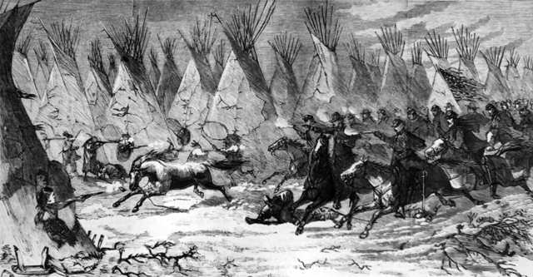
Image 1
Notes:
Unknown artist. (1868, December 19). The Seventh U.S. Cavalry charging into Black Kettle’s village at daylight, Nov. 27, 1868. Harper’s Weekly. https://www.loc.gov/item/96521161/

Slide 5
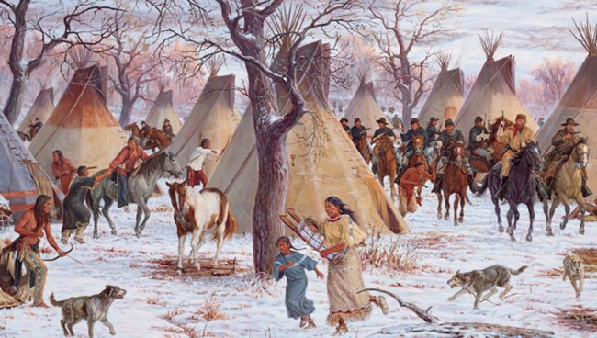
Image 2
Notes:
Lang, S. (2003). The 1868 Battle of the Washita. Commissioned by the National Park Service. https://www.nps.gov/waba/learn/historyculture/index.htm

Slide 6
Class Discussion
With your groups, answer this question and be prepared to share with the whole class:
What do you think is happening in these images?
Using your prior knowledge and evidence from the images, justify your response.
Notes:
K20 Center. (n.d.). Think-pair-share. Strategies. https://learn.k20center.ou.edu/strategy/139

Slide 7
Essential Question
Why was the Washita Massacre significant?

Slide 8
Lesson Objectives
Examine the events that led up to and occurred during the Washita Massacre.
Determine why the Washita Massacre was historically significant.

Slide 9
Washita Massacre - Article Analysis
Use the Point of Most Significance (POMS) strategy to analyze the article.
For each POMS, summarize the most significant information from the previous section of the article.
Notes:
K20 Center. (n.d.). POMS: Point of most significance. Strategies. https://learn.k20center.ou.edu/strategy/101

Slide 10
Washita Massacre - History Frame
Working with your group, use the article and your POMS to complete the Washita Massacre history frame graphic organizer.

Slide 11
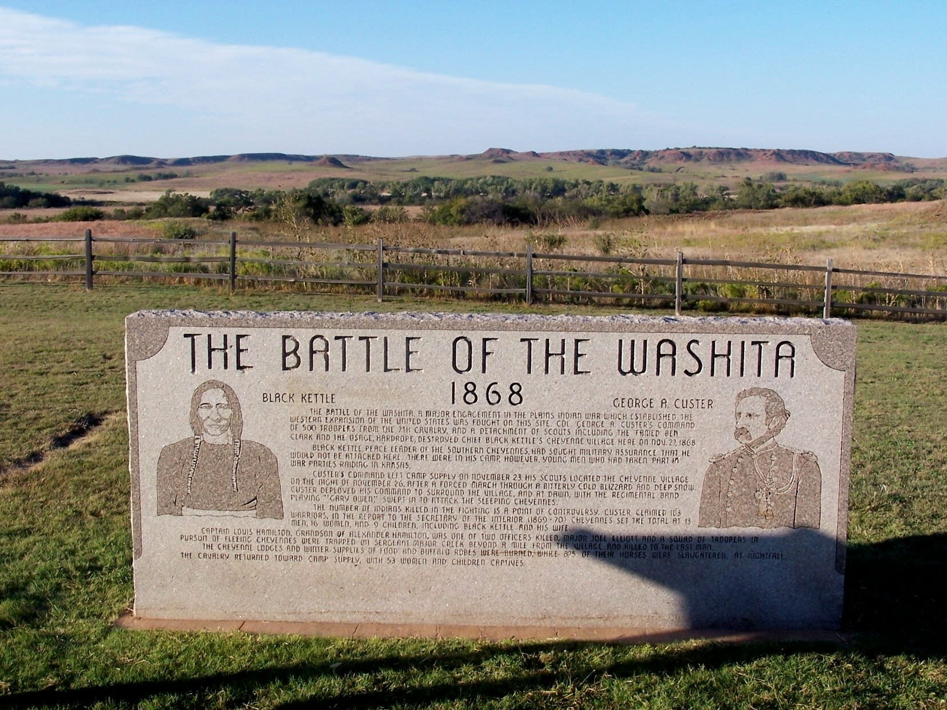
Washita Battlefield NHS Historical Marker
Notes:
Conn, J. S. (2007, October 16). The Battle of the Washita marker. Historical Marker Database. https://www.hmdb.org/PhotoFullSize.asp?PhotoID=35923

Slide 12
Historical Marker Jigsaw
Your group will read the text from the historical marker at the Washita Battlefield NHS.
Using the Jigsaw strategy, make sure that each person in your group reads a different part of the text.
Notes:
K20 Center. (n.d.). Jigsaw. Strategies. https://learn.k20center.ou.edu/strategy/179

Slide 13
Definitions
Battle - a hostile encounter or engagement between two military forces; a fight between armed forces.
Massacre - the unnecessary, indiscriminate killing of a large number of people and/or animals; an act of killing a lot of people.
Notes:
Definitions from dictionary.com and dictionary.cambridge.org.

Slide 14
Caption This
Choose one of the images from the beginning of the lesson.
Based on what you have learned about the Washita Massacre, create a 1-3 sentence caption that explains what is happening in the image.
Notes:
K20 Center. (n.d.). Caption this. Strategies. https://learn.k20center.ou.edu/strategy/82

Slide 15
Image 1
Notes:
Unknown artist. (1868, December 19). The Seventh U.S. Cavalry charging into Black Kettle’s village at daylight, Nov. 27, 1868. Harper’s Weekly. https://www.loc.gov/item/96521161/.

Slide 16
Image 2
Notes:
Lang, S. (2003). The 1868 battle of the Washita. Commissioned by the National Park Service. https://www.nps.gov/waba/learn/historyculture/index.htm.

