Slide 2
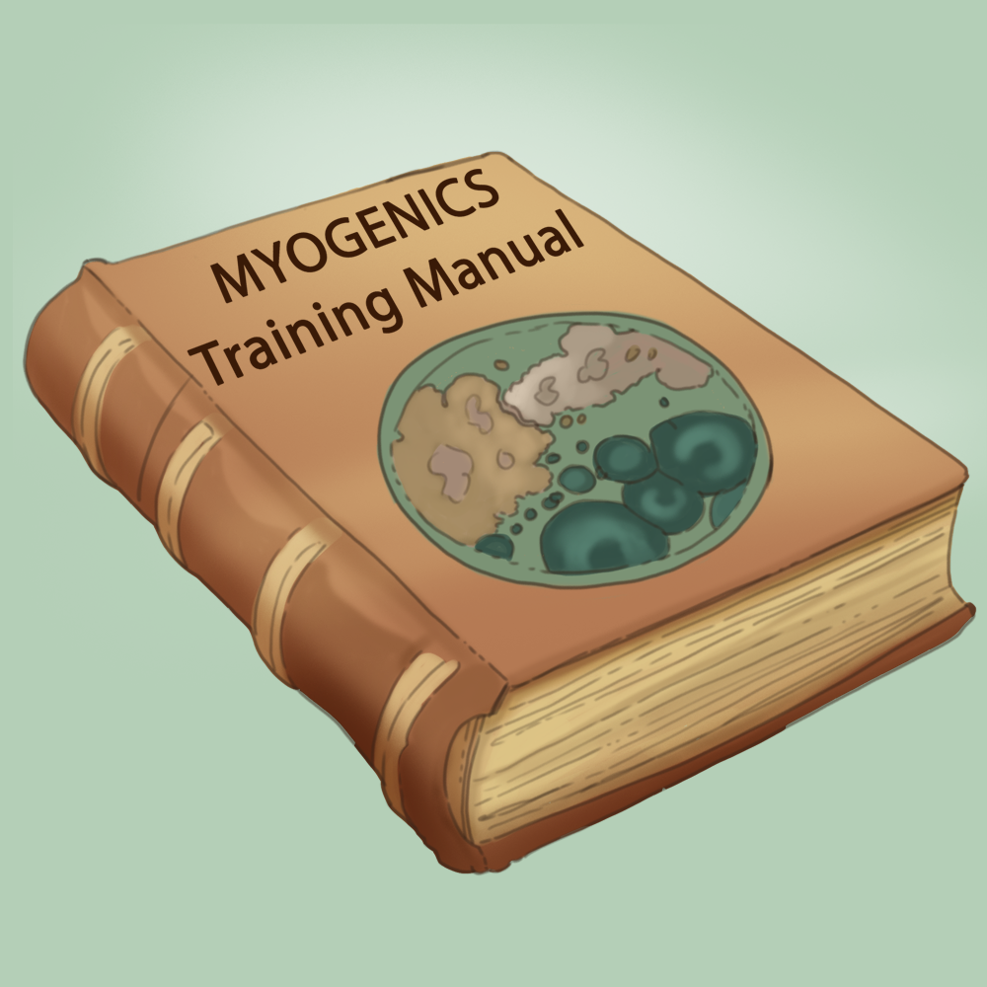
Life in a Petri Dish
Evolution and Natural Selection

Slide 3
Essential Question
How do environmental forces change a species?

Slide 4
Learning Objectives
Analyze how selection pressures affect bacterial populations using outcomes from the Perfect Strain simulation.
Interpret how mutation and adaptation influence survival and reproduction within a population.
Construct a concept map that connects mutation, adaptation, and natural selection using evidence from gameplay.

Slide 5
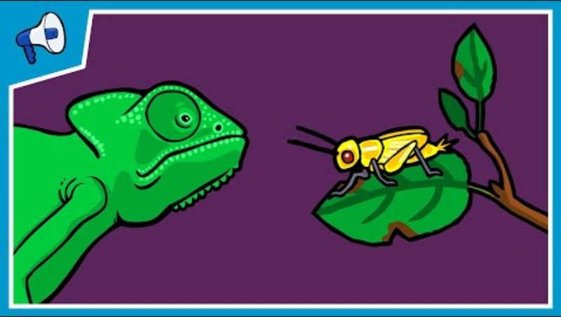
What is Natural Selection?
Notes:
Stated Clearly. (2013). What is natural selection? [Video]. YouTube. https://www.youtube.com/watch?v=0SCjhI86grU

Slide 6
Video Discussion
What were some things you found interesting from the video?
What questions do you have after watching the video?

Slide 7
Perfect Strain
Go to games.k20center.ou.edu/login
Login into the site.
Find the game “Perfect Strain”.
Complete the first two missions.

Slide 8

Concept Card Mapping
Work with your group to sort your cards.
Show connections between your cards using string or lines.
Be prepared to explain your connections.
Notes:
K20 Center. (n.d.). Concept card mapping. Strategies. https://learn.k20center.ou.edu/strategy/123

Slide 9
Perfect Strain, Part 2
Return to the game.
Play through the third mission.

Slide 10
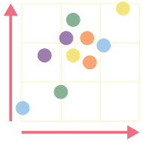
Human Scatterplot
Read the question carefully and determine your answer.
Move to line yourself with the answer choice on y-axis on the wall.
Then align yourself with the level of confidence “low”, “medium”, and “high” on the x-axis.
Notes:
K20 Center. (n.d.). Human scatter graph. Strategies. https://learn.k20center.ou.edu/strategy/172

Slide 11
Human Scatterplot
How does selection pressure differ in artificial selection compared to natural selection?
In artificial selection mutations don’t happen randomly.
Selection pressure is controlled by the breeder in artificial selection.
In artificial selection fitness is not important.

Slide 12
Human Scatterplot
How does selection pressure differ in artificial selection compared to natural selection?
In artificial selection mutations don’t happen randomly.
Selection pressure is controlled by the breeder in artificial selection.
In artificial selection fitness is not important.

Slide 13
Human Scatterplot
A trait becomes common in a population because:
This trait helps an individual live longer and successfully reproduce.
This trait is always beneficial and leads to increased fitness.
This trait always develops in response to environmental changes.

Slide 14
Human Scatterplot
A trait becomes common in a population because:
This trait helps an individual live longer and successfully reproduce.
This trait is always beneficial and leads to increased fitness.
This trait always develops in response to environmental changes.

Slide 15
Human Scatterplot
What is a mutation?
An individual becoming a more advanced form during its life.
The development of a new species.
Any change in an individual that makes it different from its parent.

Slide 16
Human Scatterplot
What is a mutation?
An individual becoming a more advanced form during its life.
The development of a new species.
Any change in an individual that makes it different from its parent.

Slide 17
Human Scatterplot
What are the results of selection pressure?
A population with a different proportion of traits.
A stronger population.
A population with low fitness.

Slide 18
Human Scatterplot
What are the results of selection pressure?
A population with a different proportion of traits.
A stronger population.
A population with low fitness.

Slide 19
Human Scatterplot
How do populations change over time?
Their fitness will drop.
The proportion of traits that lead to survival and reproduction will increase in a population.
All individuals will become identical.

Slide 20
Human Scatterplot
How do populations change over time?
Their fitness will drop.
The proportion of traits that lead to survival and reproduction will increase in a population.
All individuals will become identical.

Slide 21
Human Scatterplot
How do individuals in a population compare with one another?
They are essentially the same.
They always have the same fitness.
They are different from one another.

Slide 22
Human Scatterplot
How do individuals in a population compare with one another?
They are essentially the same.
They always have the same fitness.
They are different from one another.

