Slide 3
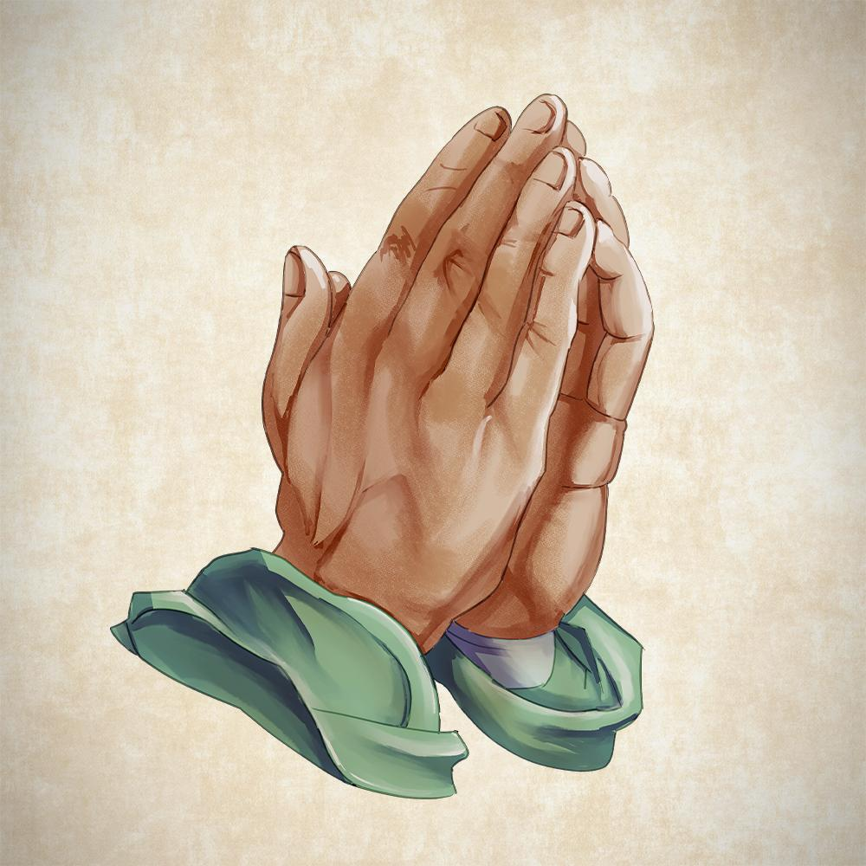
Engel v. Vitale (1962)
Preserving the Separation of Church and State

Slide 4
Essential Question
How did the Supreme Court’s ruling in Engel v. Vitale (1962) shape the interpretation of the First Amendment and impact the role of religion within public schools?

Slide 5
Learning Objectives
Consider the limitations of the First Amendment and freedom of religion.
Explain the significance of the “Establishment Clause” within the First Amendment.
Reflect on the relationship between state and religious institutions within modern society.

Slide 6
Think-Pair-Share
Take a moment to consider the following question.
How far is it possible to extend the principle of separation of church and state without violating other fundamental rights?
Once you have collected your thoughts, find a partner and share your ideas with that person.
Be prepared to discuss the conversation you had with the whole class.

Slide 7
First Amendment
The First Amendment to the U.S. Constitution protects the fundamental rights of every American citizen.
The text of the amendment reads as follows:
Congress shall make no law respecting an establishment of religion, or prohibiting the free exercise thereof; Or abridging the freedom of speech, or of the press; or the right of people peaceably to assemble, and petition the government for a redress of grievances.
How is this amendment related to the question that was discussed on the previous slide?

Slide 8
Painting a Picture
You are about to see several images related to the separation of church and state, as well as the First Amendment.
On your paper, please list any observations and inferences that you make about each image in the appropriate column.

Slide 9
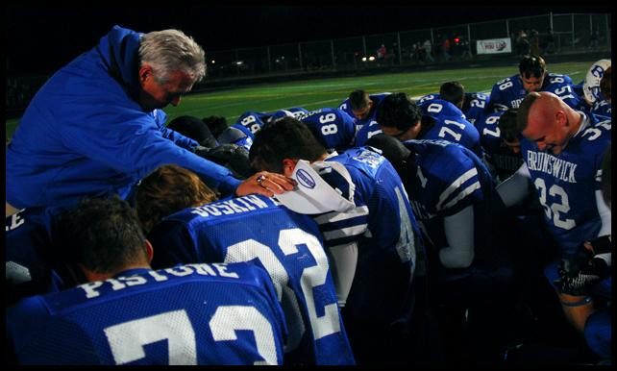
Painting a Picture: Image 1

Slide 10
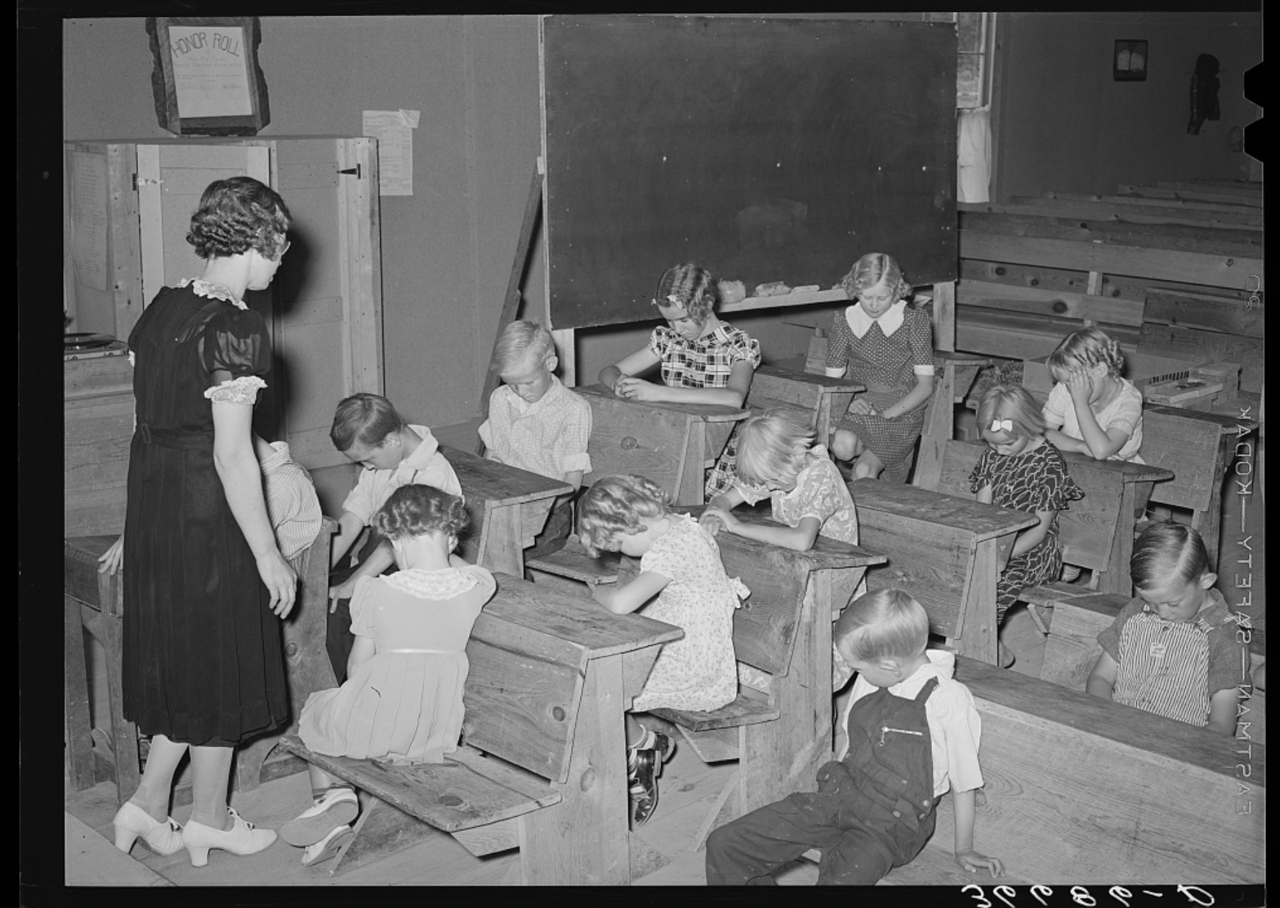
Painting a Picture: Image 2

Slide 11
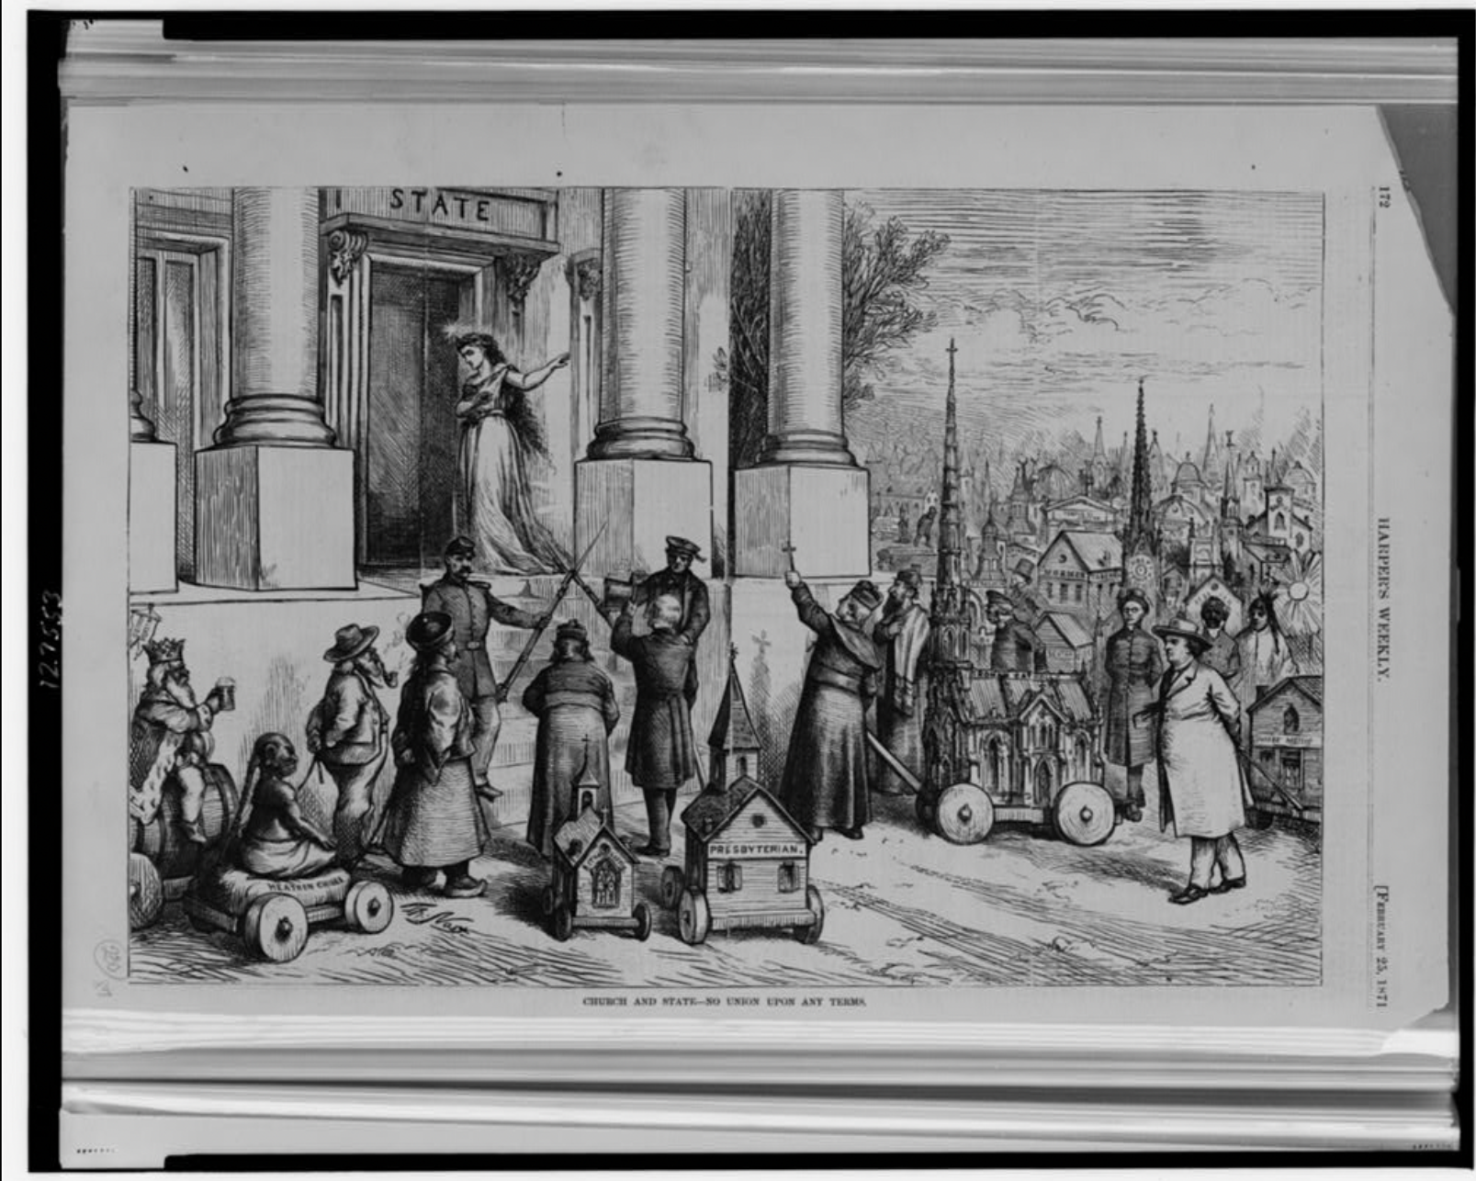
Painting a Picture: Image 3

Slide 12
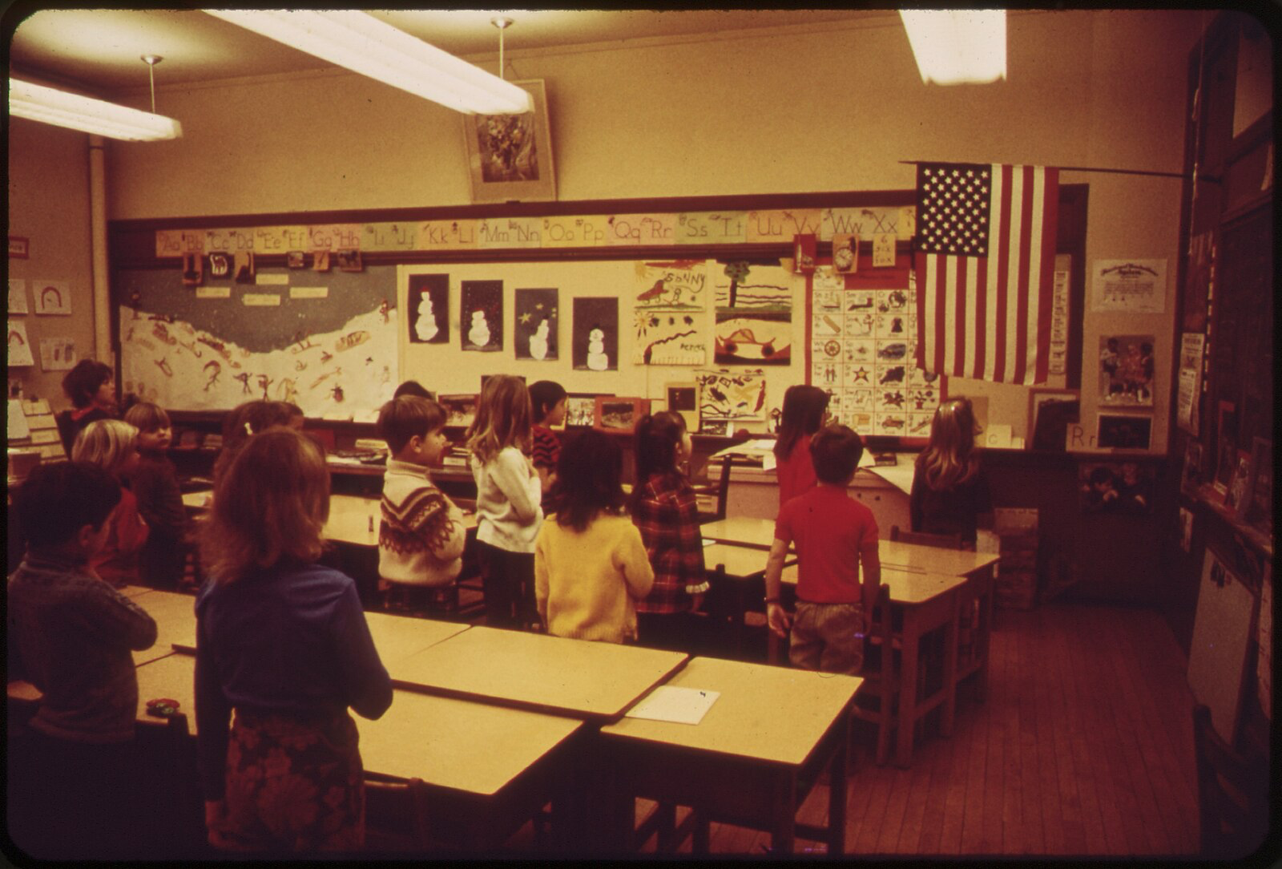
Painting a Picture: Image 4

Slide 13
Painting a Picture Continued
Now that you have viewed the images, consider the following questions:
Who is often leading the prayer in these images?
Did you get the sense that anyone was forced to participate in any of these images?
Do you think students would be worried about being either positively or negatively affected at school if they made the decision not to participate?

Slide 14
Engel v. Vitale (1962)
In a landmark Supreme Court case, Engel v. Vitale (1962), the Court examined the constitutionality of a state-sanctioned prayer that was recited in New York Public schools.
Read the short document about Engel v. Vitale to learn more about the case.
Use the information from the reading to complete the graphic organizer.

Slide 15
Constructive Controversy
For this activity, there will be two to three students in each group.
Reflect on the following prompt and guiding questions.
Under what circumstances might prayer at school events be considered a violation of separation of church and state, and in what circumstances might it not be a violation?
Are students forced to participate?
Is the activity led by students?
Does the activity occur before or after school?
Is the activity graded? Will students be punished for the activity?

Slide 16
Post-Engel v. Vitale
Below we have listed other cases involving prayer at school events:
Abington School District v. Schempp (1963): The Supreme Court ruled that mandatory Bible readings or recitation of the Lord's Prayer in public schools violated the Establishment Clause.
Lee. v. Weisman (1992): The Supreme Court ruled that including clergy-led prayer at public school graduation ceremonies was unconstitutional.
Santa Fe Independent School District v. Doe (2000): The Supreme Court held that student-led and student-initiated prayer over the public address system at high school football games violated the Establishment Clause.
Kennedy v. Bremerton (2022): The Free Exercise and Free Speech Clauses of the First Amendment protect an individual who engages in a personal religious observance from government reprisal.

Slide 17
Reflection
How do the rulings in these cases about school prayer compare to your statement of advice?

Slide 18
It Says, I Say, and So
Take out your It Says, I Say, and So Handout
Complete the graphic organizer using what you have learned in this lesson.
What rights are outlined in the First Amendment?
What do you think it means to have these rights in practice?
How did the Supreme Court’s ruling in Engel v. Vitale (1962) shape the interpretation of the First Amendment and impact the perception of the role of religion in public schools?

