Slide 2
Let the Dirt Fly!
The Construction of the Panama Canal

Slide 3
Preflection
Consider what you already know
about the following topics, and write
down some notes on notebook paper.
Canals
Panama Canal
Panama
Notes:
K20 Center. (n.d.). Preflection. Strategies. https://learn.k20center.ou.edu/strategy/191
Let the Dirt Fly. (n.d.). Wikimedia Commons. (n.d.-b). https://en.m.wikipedia.org/wiki/File:Panam2.JPG

Slide 4
Essential Question
How did the United States expand its role in Panama?

Slide 5
Lesson Objectives
Explain how the Panama Canal developed.
Rate the fairness of the United States’ role in constructing the Panama Canal.

Slide 6
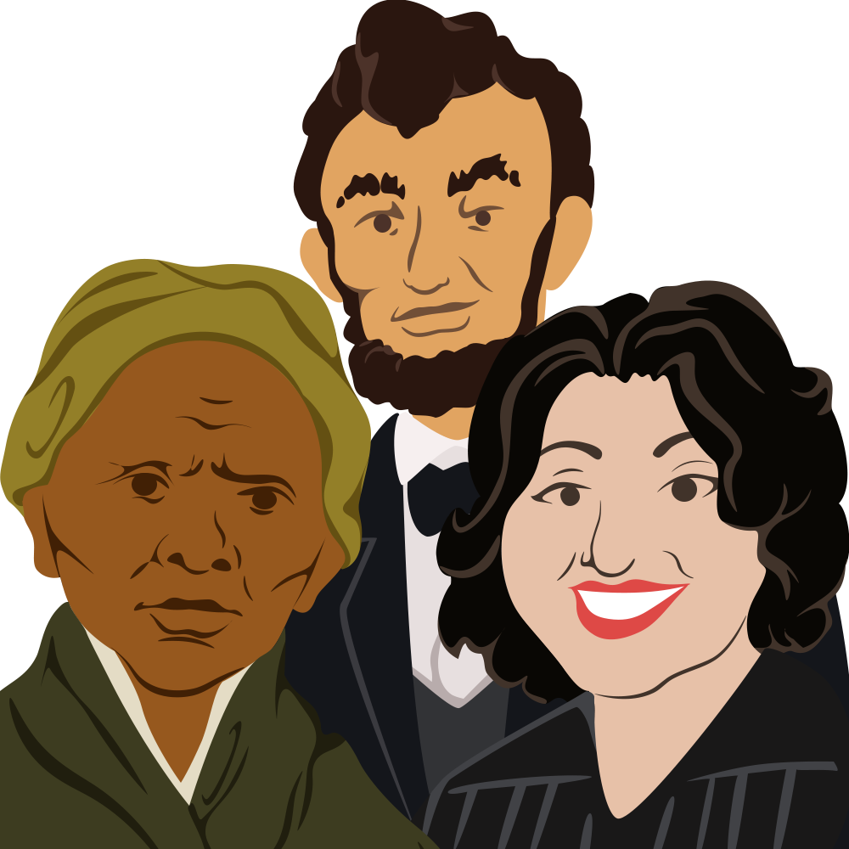
Canal Characters
Read about your historical character. This is the role you will take on.
As you mingle around the room, introduce yourself and assume the point of view of your character.
Use the information on your card to help you answer the question on the next slide.
Notes:
K20 Center. (n.d.). Historical Mingle. Strategies. https://learn.k20center.ou.edu/strategy/184

Slide 7
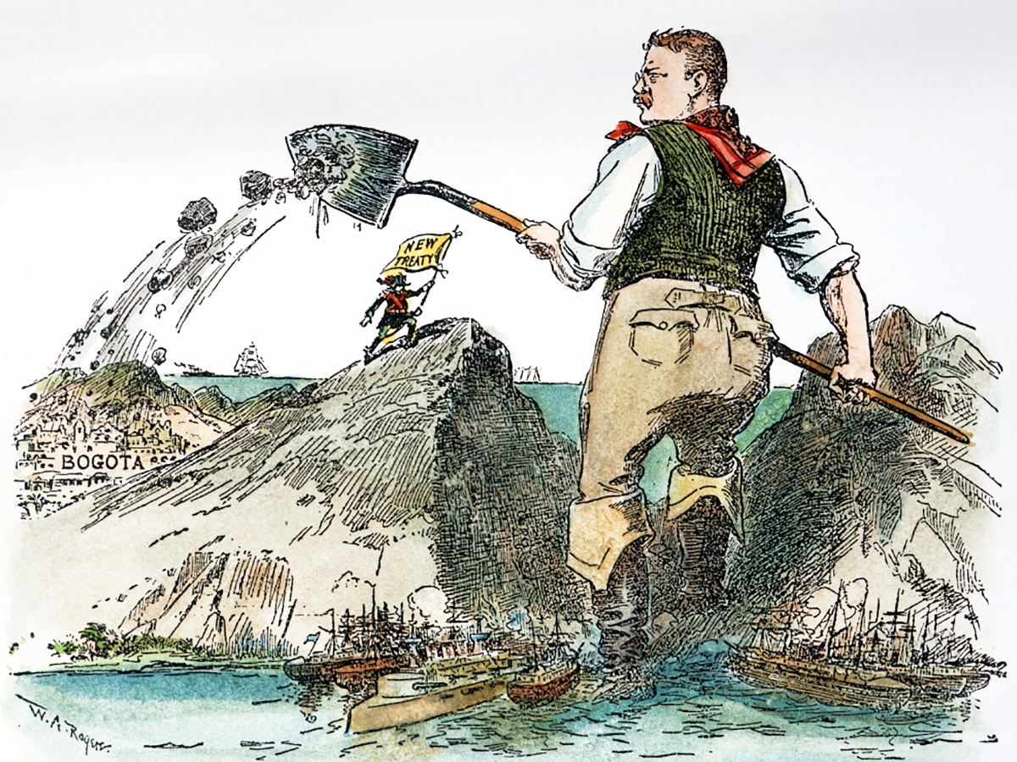
Canal Characters
What role did you play in the
development of the Panama Canal?
K20 10-minute Timer
Notes:
K20 Center. (2021, September 21). K20 Center 10 minute timer. YouTube. https://www.youtube.com/watch?v=9gy-1Z2Sa-c
Let the Dirt Fly. (n.d.). Wikimedia Commons. (n.d.-b). https://en.m.wikipedia.org/wiki/File:Panam2.JPG

Slide 8
Canal Characters
What roles did the characters play in the development of the Panama Canal?
What were some of the struggles in the construction of the canal?
Notes:
Let the Dirt Fly. (n.d.). Wikimedia Commons. (n.d.-b). https://en.m.wikipedia.org/wiki/File:Panam2.JPG

Slide 9
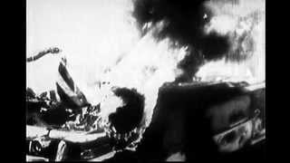
U.S. History of the Panama Canal
U.S. History of the Panama Canal
Notes:
Robert Smalling. (2012). U.S. History of the Panama Canal. YouTube. https://www.youtube.com/watch?v=Tw5NMo_u-oA.

Slide 10
U.S. and the Panama Canal Zone
Was the U.S. justified in obtaining the canal? Consider:
President Roosevelt supported a revolution to gain access to the land for the canal.
After Panama was independent, President Roosevelt convinced Panama to lease the land to the United States.
In 1977, President Carter signed a deal to give Panama the canal back in 20 years.
Panama obtained rights to the canal in 1999.
Notes:
K20 Center. (n.d.). Partner Speaks. Strategies. https://learn.k20center.ou.edu/strategy/62

Slide 11
U.S. and the Panama Canal Zone
Was the U.S. justified in obtaining the canal?
Pair up and discuss.
First, you speak and your partner listens.
Then, your partner re-states what you said.
Swap roles and repeat.
Notes:
K20 Center. (n.d.). Partner Speaks. Strategies. https://learn.k20center.ou.edu/strategy/62

Slide 12
Preflection
Refer back to what you wrote down at the beginning of the lesson.
Add your new knowledge about the Panama Canal.
Notes:
K20 Center. (n.d.). Preflection. Strategies. https://learn.k20center.ou.edu/strategy/191

