Slide 1
The History of Allotment
The Dawes Severalty Act of 1887

Slide 2
Surprising, Interesting, Troubling (S-I-T)
As you watch the video and review the image, think about the following:
S – What do you find Surprising?
I – What do you find Interesting?
T – What do you find Troubling?
Notes:
K20 Center. (2021). S-I-T (Surprising, interesting, troubling). Strategies. https://learn.k20center.ou.edu/strategy/926

Slide 3
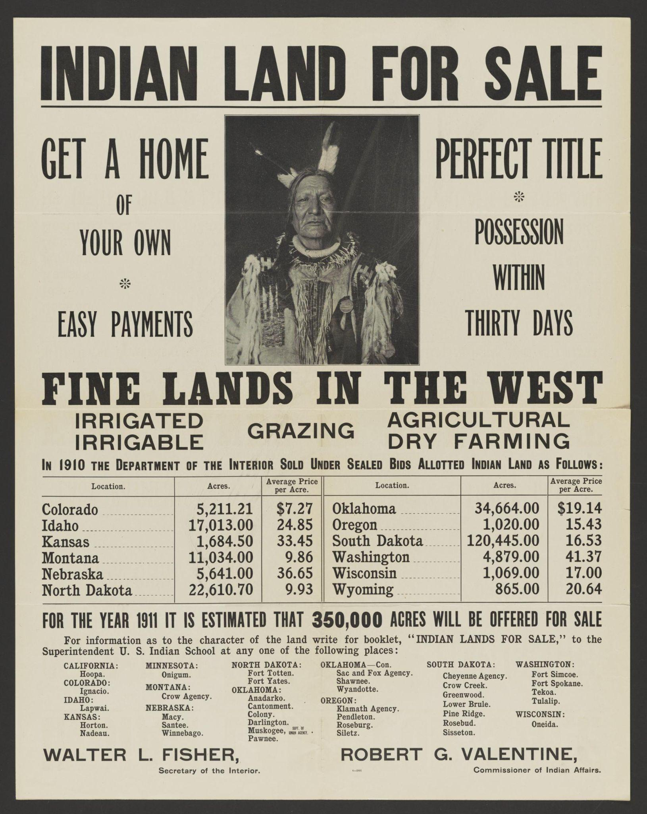
The Invasion of America
Notes:
eHistory.org. (2014, June 2). The invasion of America [Video]. YouTube. https://youtu.be/pJxrTzfG2bo Retrieved from: Fisher, W. L., Valentine, R. G., United States Department Of The Interior, I. B. & Printed Ephemera Collection. (1911) Indian land for sale: get a home of your own, easy payments. Perfect title. Possession within thirty days. Fine lands in the West. [United States Publisher not identified] [Pdf] Retrieved from the Library of Congress, https://www.loc.gov/item/2015657622/.

Slide 4
Surprising, Interesting, Troubling (S-I-T)
Consider the video/image and consider the following:
S – What do you find surprising?
I – What do you find interesting?
T – What do you find troubling?
Notes:
K20 Center. (2021). S-I-T (Surprising, interesting, troubling). Strategies. https://learn.k20center.ou.edu/strategy/926

Slide 5
Lesson Objectives
Students examine the Dawes Severalty Act and its impact on tribal sovereignty and land ownership.

Slide 6
Painting a Picture
Around the room you will find 4 images related to today’s topic.
Using the Painting a Picture Chart, visit each image and record what you observe on the left side and what you can infer on the right side.
Observation: to inspect or take note of something
Inference: a conclusion or opinion that is formed because of known facts or evidence
Notes:
K20 Center. (2021). Painting a picture. Strategies. https://learn.k20center.ou.edu/strategy/1331

Slide 7
Painting a Picture
Notes:
K20 Center 15 minute timer. YouTube. (2021c, September 21). https://youtu.be/m3zT2IxZQaw?si=EcRZEQL1P1RVRMo0

Slide 8
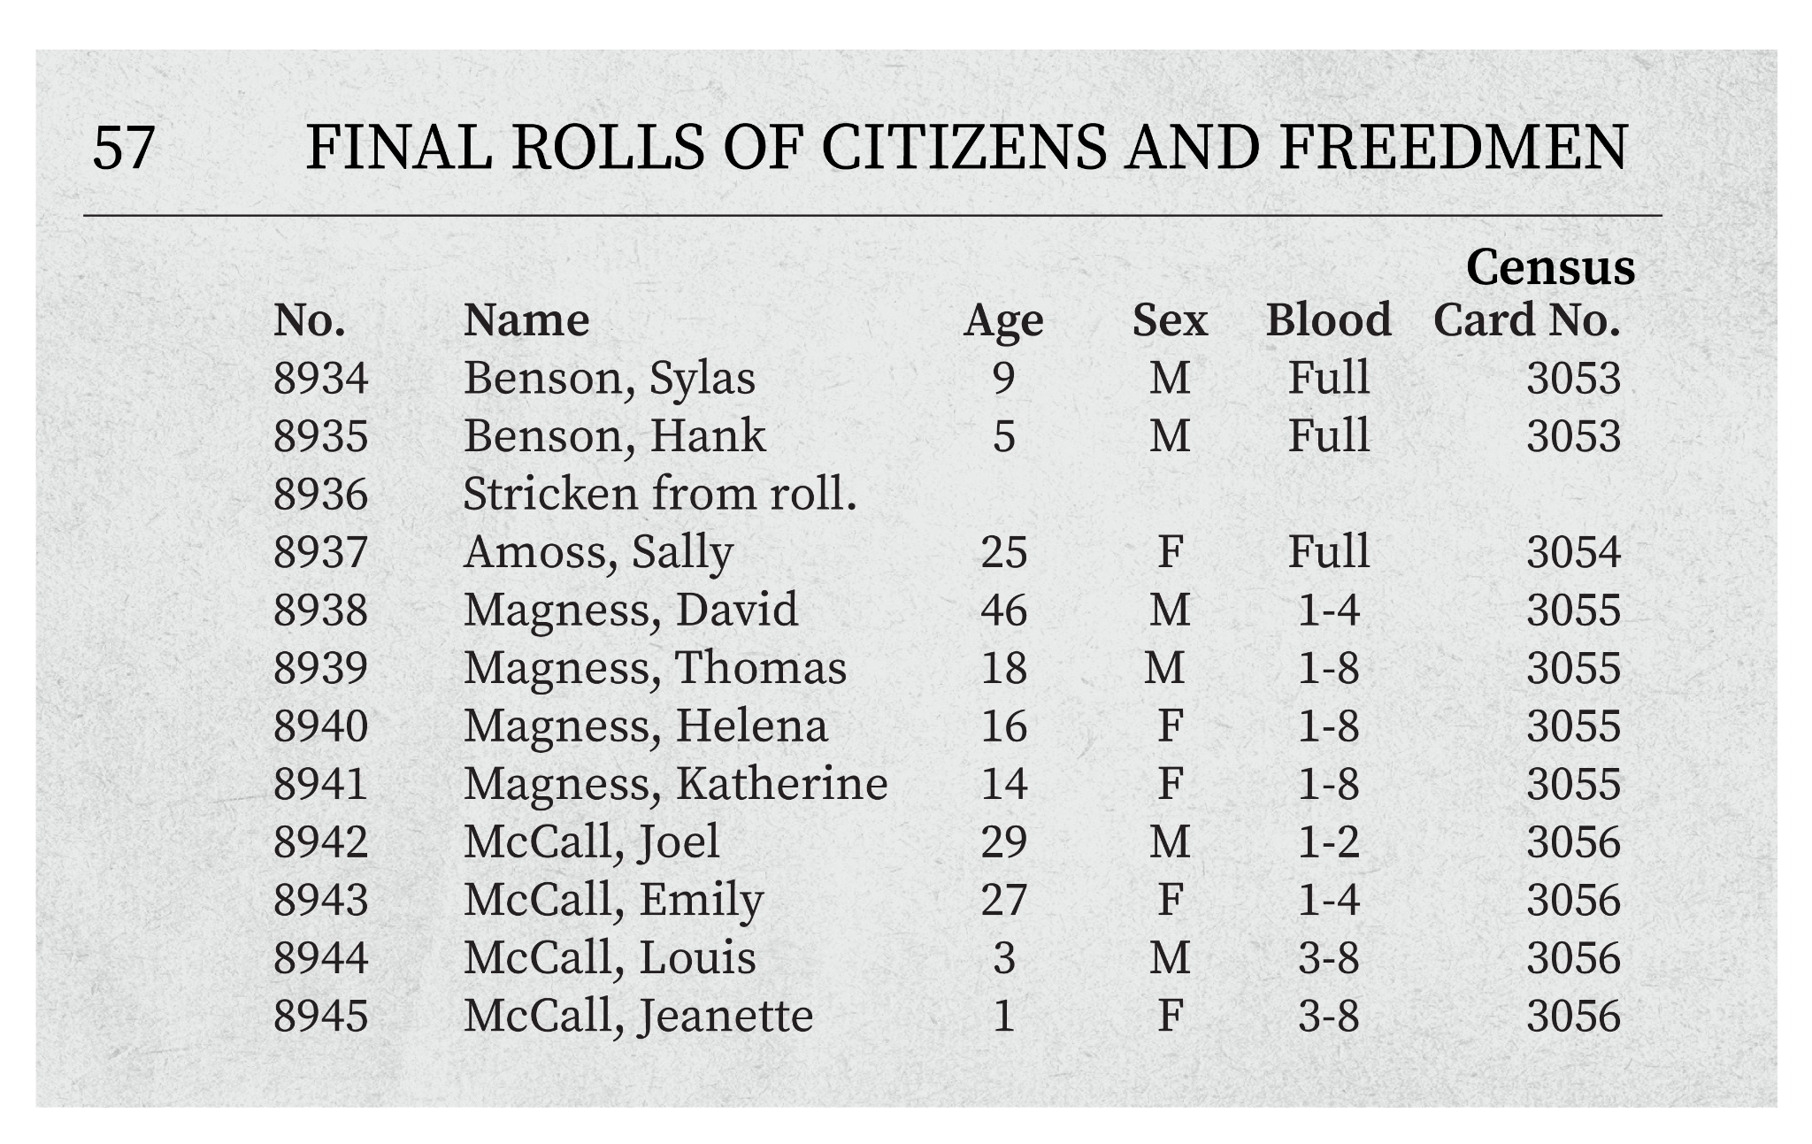
Dawes Roll
Sometimes known as the “Final Rolls”
Created by the Dawes Commission following the Dawes Act
In order to receive land, citizens of the Five Civilized Tribes were to be numbered, registered, and added to the roll
Rolls included:
Name
Age
Sex
Degree of Indian blood
Roll and census card number
Notes:
National Archives and Records Administration. (n.d.). Commission to the Five Civilized Tribes (the Dawes Commission), 1893-1914. National Archives and Records Administration. https://www.archives.gov/research/native-americans/dawes?_ga=2.133420296.725925130.1681154537-1923457199.1677068623

Slide 9
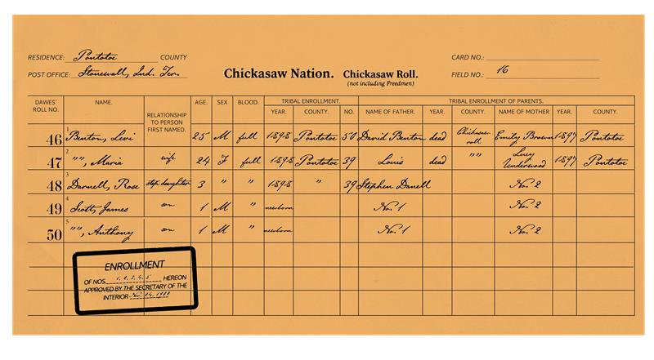
Census Cards
Cards for individuals being enrolled in the Dawes Roll
Questions in between censuses varied, so cards may include some or all of the following information:
Name
Age
Birth date
Sex
Blood quantum
Agency/Reservation Name
Tribe
Marital Status
Family Relationship
Tribe Place of Residence
Roll Number
Notes:
National Archives and Records Administration. (n.d.-d). Indian census rolls. National Archives and Records Administration. https://www.archives.gov/research/native-americans/census/research-indian-census.html

Slide 10
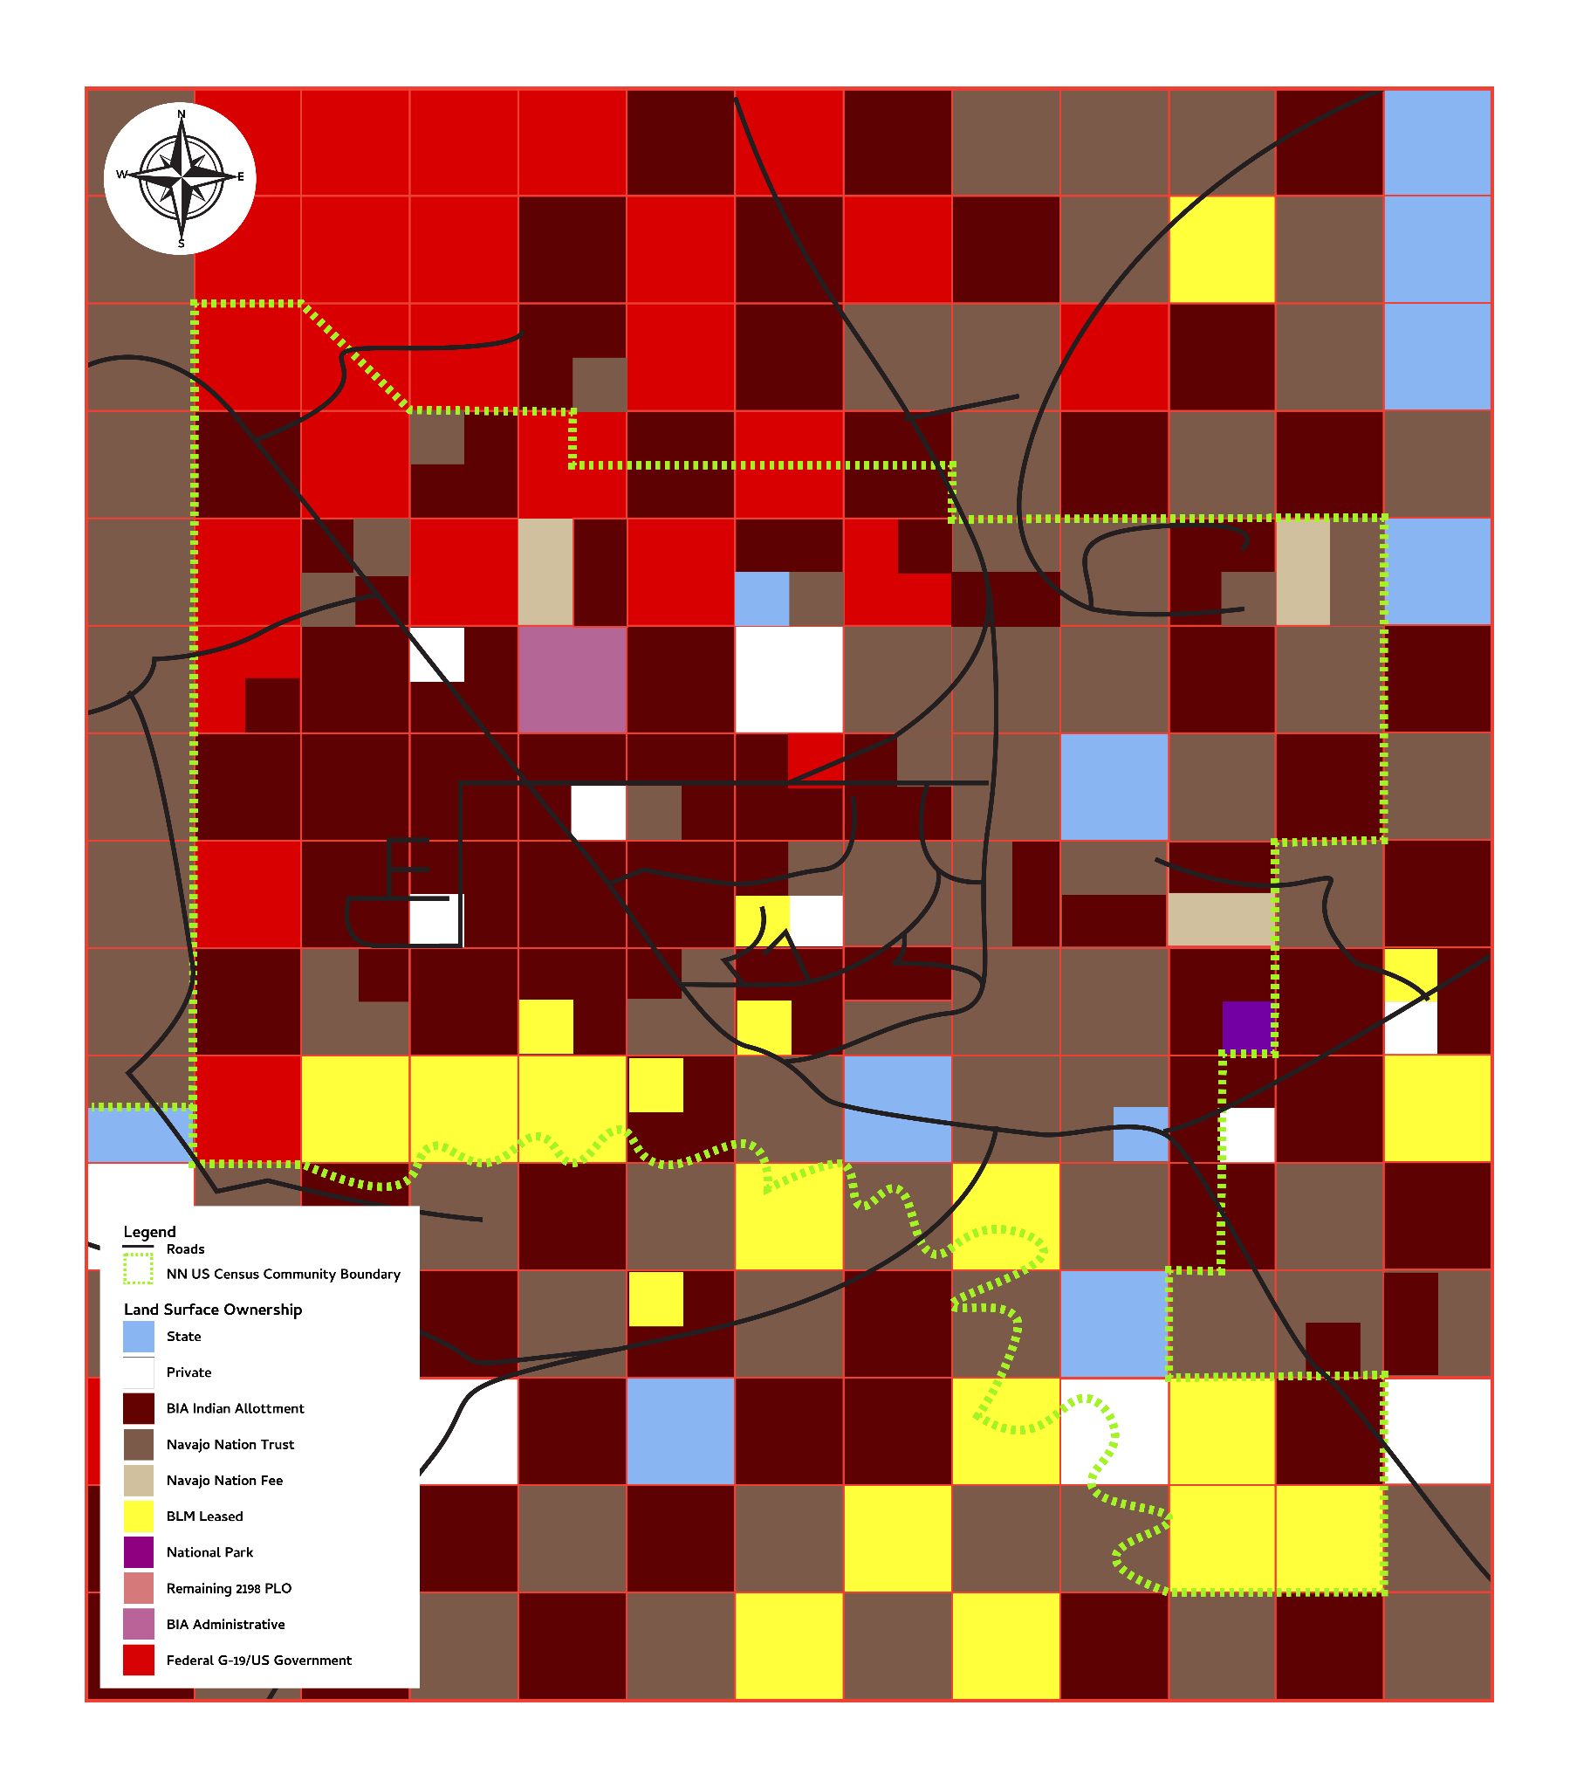
Checkerboarding
Checkerboarding occurs when land ownership is mixed between two or more land owners resulting in a checkerboard pattern;
Land divided in the Dawes Act was sold or transferred to non-Indian parties, but remained within reservation boundaries;
As a result, land trusts and lands owned by tribes, individual Indians and non-Indians are mixed together on the reservation;
Checkerboarding impaired the ability of Indian nations or individual Indians to use land to their own advantage and/or use in traditional manner.

Slide 11
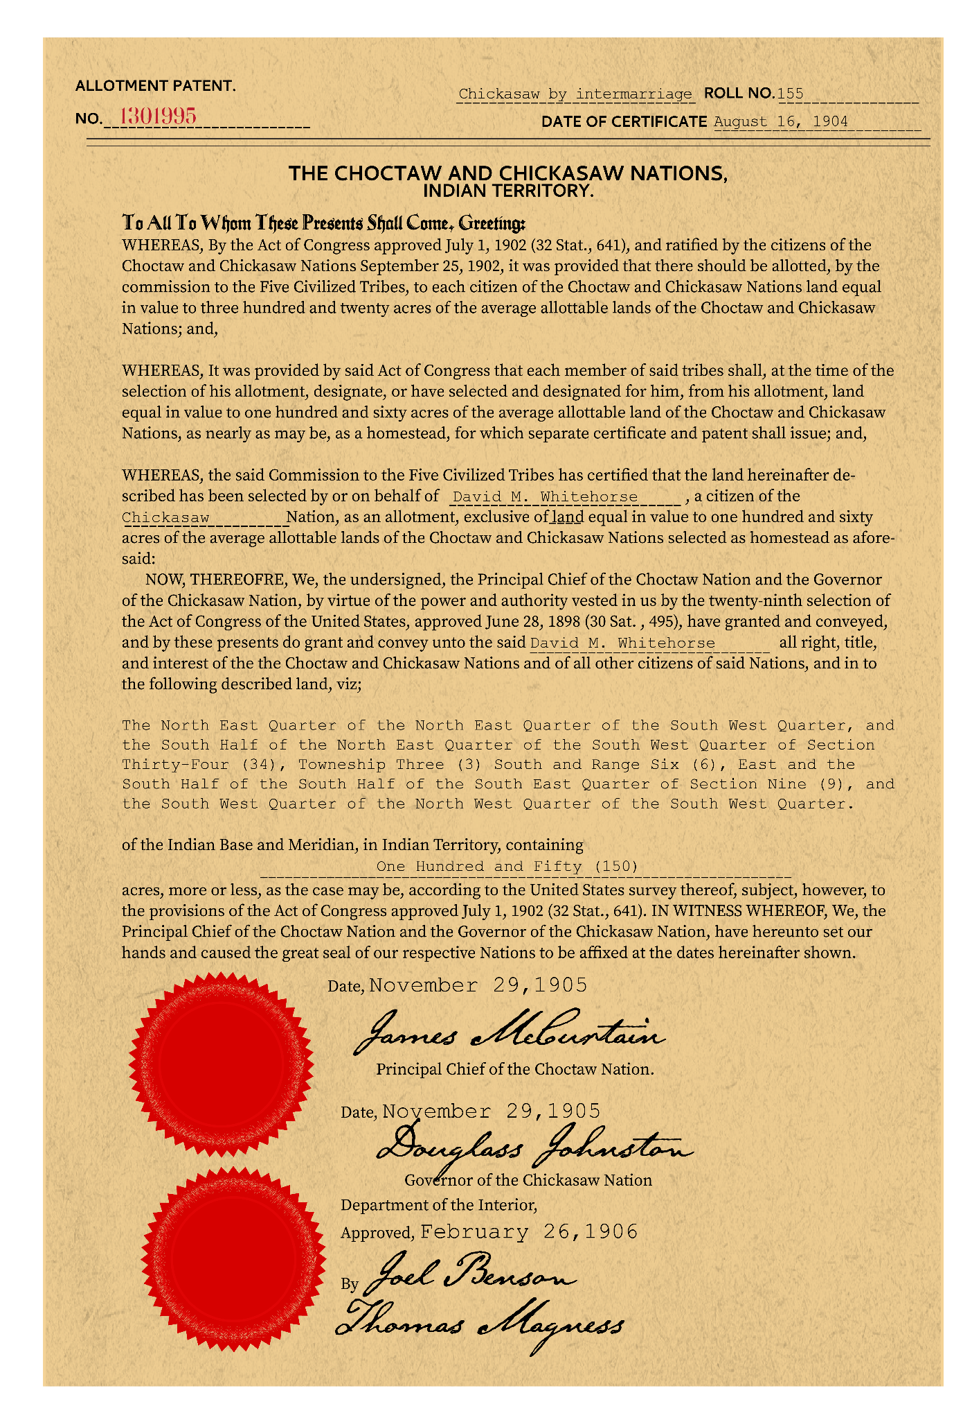
Allotment Documents
Created by the Bureau of Indian Affairs (BIA) following the passage of the Dawes Severalty Act
Allotment records document land, finances, goods, properties disbursed by the BIA, and describe transactions
The records include name of individual/allottee, allotment number, tribe, dates, goods, number of acres, land description, and/or properties being transferred
Notes:
Allotment Patent. (n.d.). https://blogs.lib.ku.edu/spencer/wp-content/uploads/2013/10/RH_MS_P_243.jpg. Retrieved May 11, 2023.

Slide 12
Essential Question
How do laws have a lasting impact on individuals?

Slide 13
Jigsaw-The History of Allotment
Begin by reading “The History of Allotment” introduction as a group. Then in your groups of three, split up the reading.
Each group member will read one of the following sections:
The Dawes Severalty Act of 1887
The Curtis Act (1898)
The Burke Act (1906)
As you read your section, use the Stop and Jot boxes to summarize your section.
Notes:
K20 Center. (2020, September 16). Stop and jot. Strategies. https://learn.k20center.ou.edu/strategy/168

Slide 14
Jigsaw Sharing Out
In chronological order with your group, take turns sharing what you read and your summary.
As takeaways are shared, take notes on what each member read over.
By the end of the activity, your handout should be completed.
Notes:
K20 Center. (2020). Jigsaw. Strategies. https://learn.k20center.ou.edu/strategy/179

Slide 15
H.I.P.P.
Use the following link to access the Allotment Documents: http://k20.ou.edu/dawes
In your groups, you will read through the document set and use the H.I.P.P. acronym to help you answer the questions on your H.I.P.P. Graphic Organizer. As you answer, keep all of the documents in mind.
H is for historical context
I is for intended audience
P is for point of view
P is for purpose
Notes:
K20 Center. (2021). H.I.P.P.. Strategies.https://learn.k20center.ou.edu/strategy/1618

Slide 16
Exit Ticket
How do laws have a lasting impact on individuals?
Notes:
K20 Center. (2020). Bell Ringers and Exit Tickets. Strategies. https://learn.k20center.ou.edu/strategy/125

