Slide 1
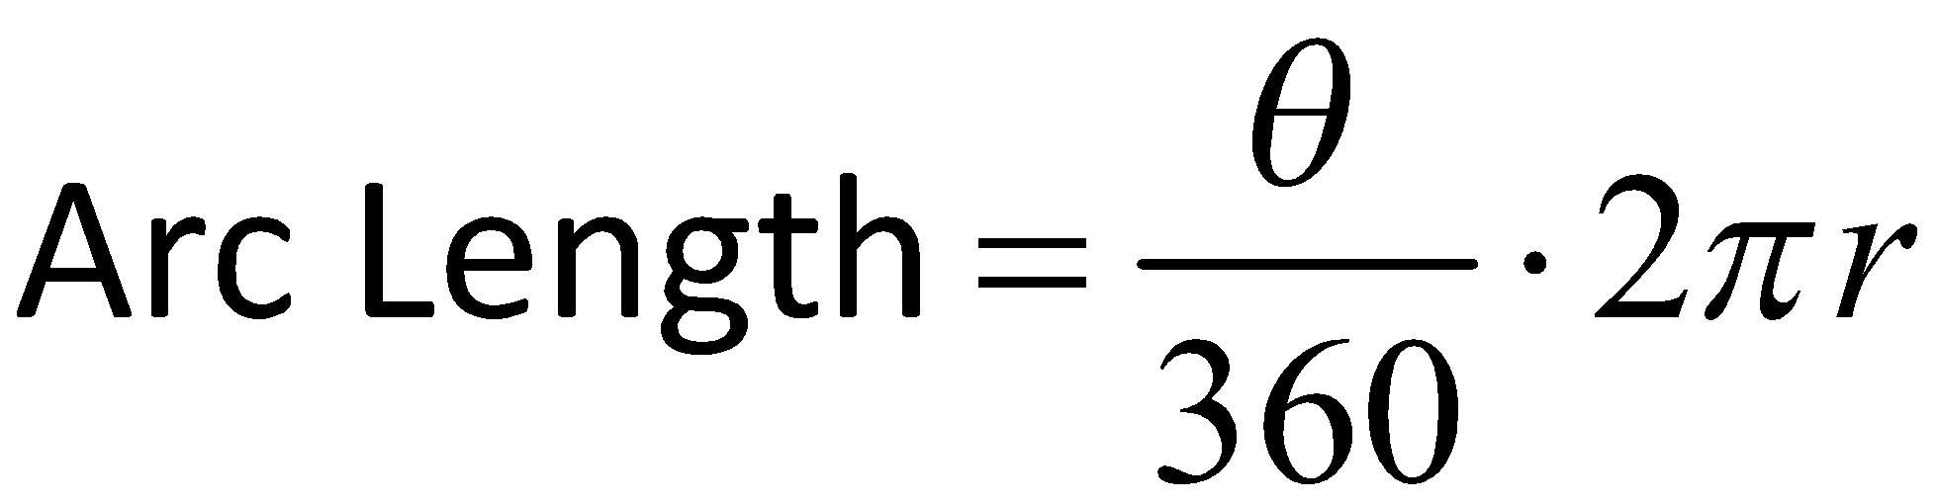
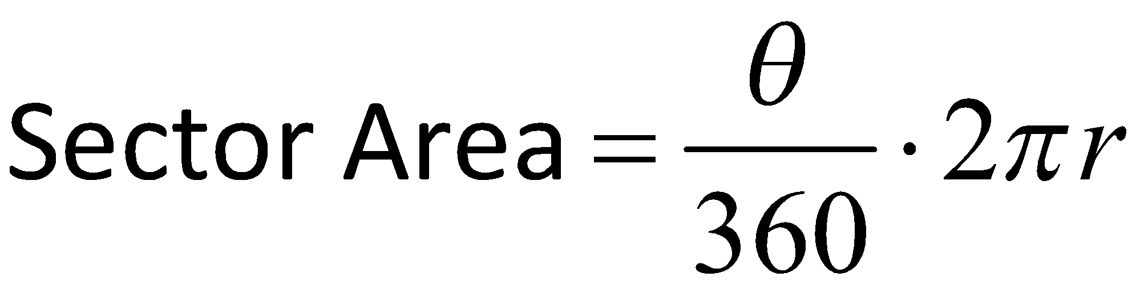
Formulas
A. | 4𝝅
I. | 12𝝅
L. | 7.85
Qu. | 39.27
M. | 225
R. | 40𝝅
D. | 5𝝅
Fo. | 117.81
Answers:

Slide 2
A
A community shares a circular food garden with a radius of 6 meters. If the central angle of the high school’s sector is 120 degrees, what is the arc length?
Answer in terms of pi.
120°
6 m

Slide 3
I
Calculate the sector area of the same part of the food garden from question 1.
Answer in terms of pi.
120°
6 m

Slide 4
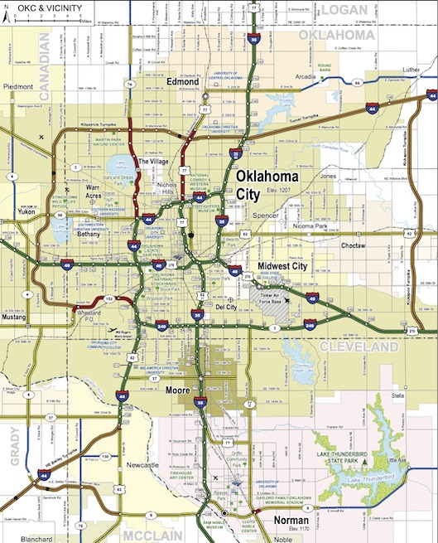
L
In a different area of town, there is a food desert that is part of a circular region with a diameter of 20 miles. If the central angle is 45 degrees, what is the arc length in miles?
Answer in decimal form.
45°
20 mi

Slide 5
Qu
Calculate the sector area of the food desert from question 3.
Answer in decimal form.
45°
20 mi

Slide 6
M
In a circular farmers' market, the section of the market that sells fresh produce has a radius of 8 feet. If the arc length is 10𝝅 feet, what is the central angle?
Answer in decimal form.
10𝝅 ft.
8 ft

Slide 7
R
Calculate the sector area of the farmers' market from question 5.
Answer in terms of pi.
225°
10𝝅 ft.
8 ft
8 ft

Slide 8
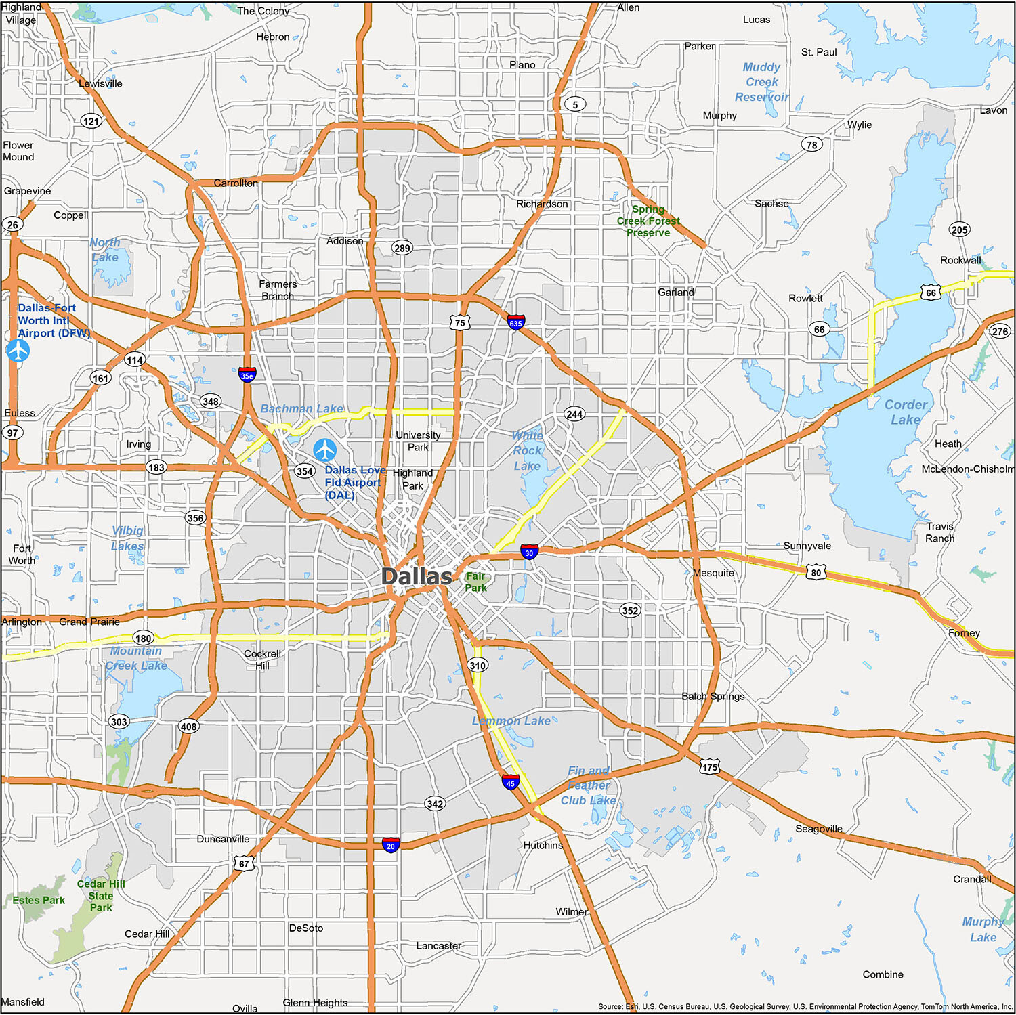
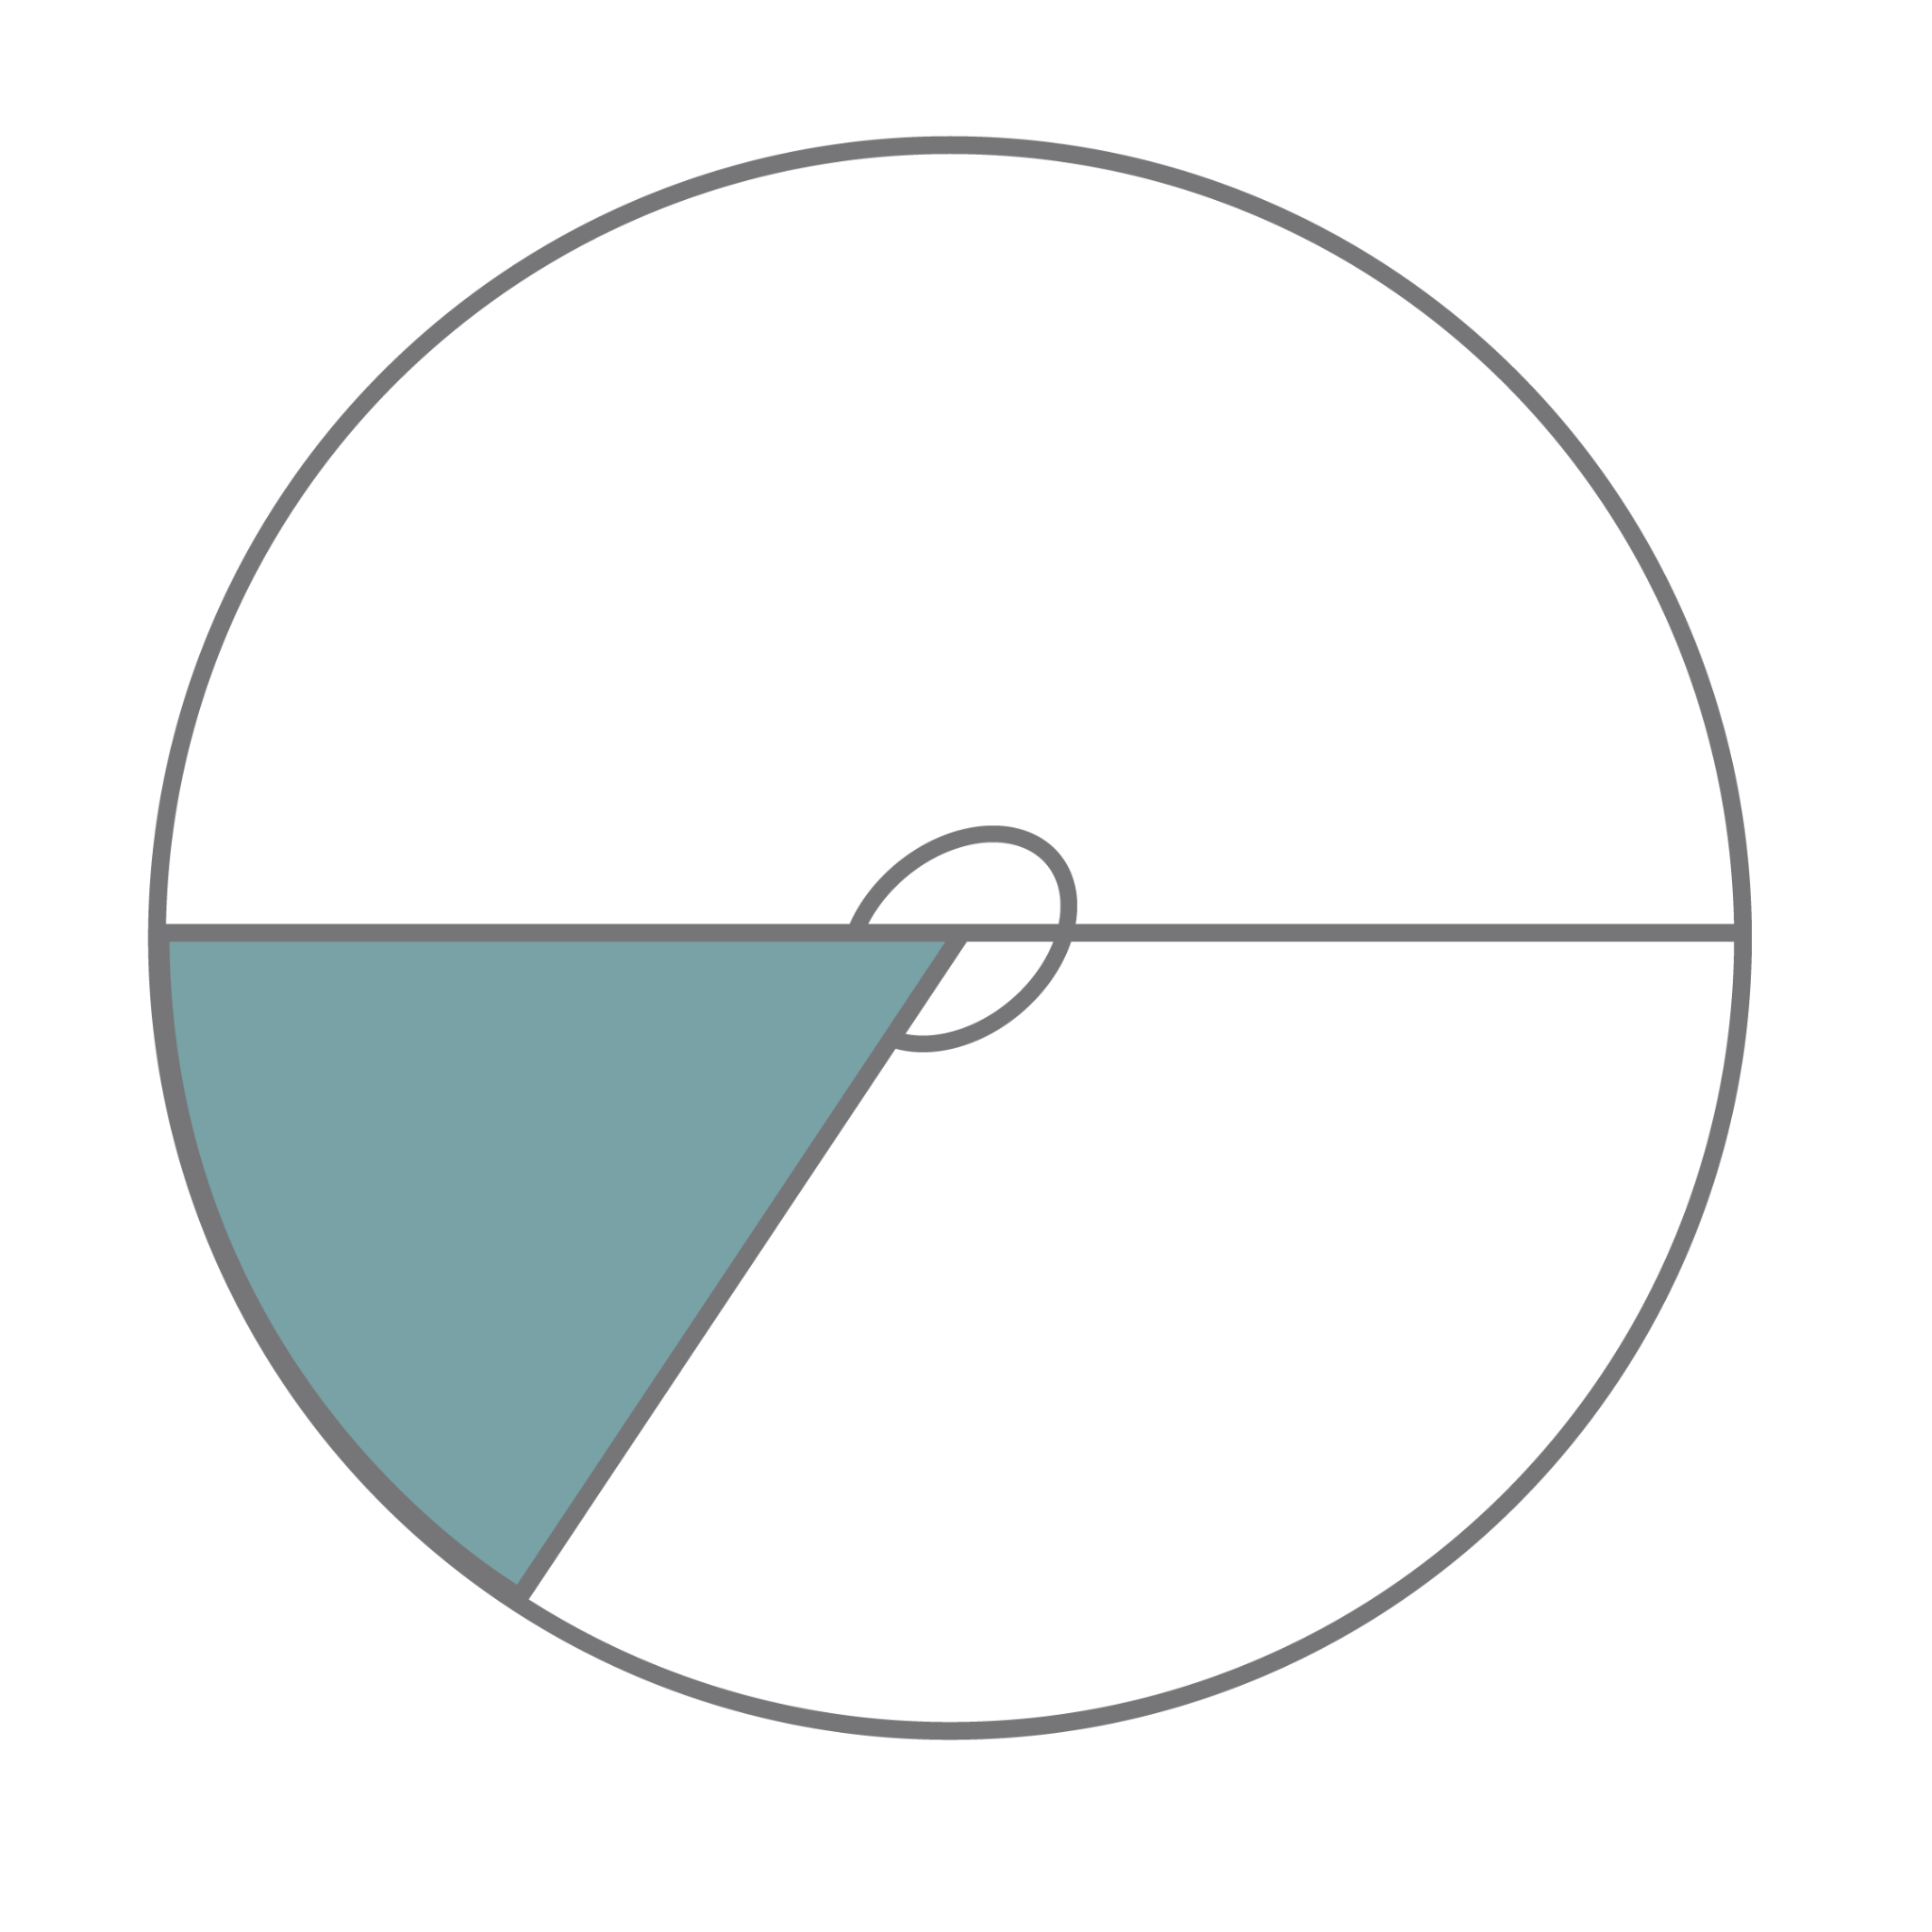
D
In a large urban area, there is a food desert represented by a circular region with a diameter of 30 miles. What is the arc length of the shaded region in miles?
Answer in terms of pi.
30mi
300°

Slide 9
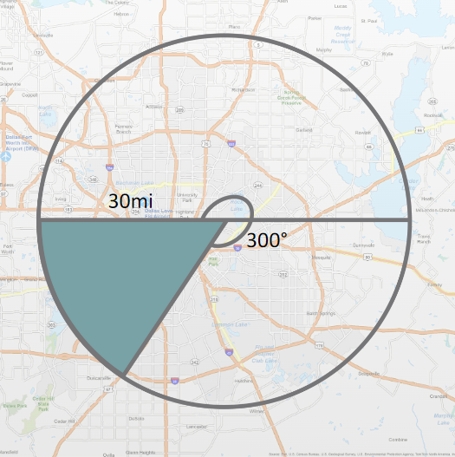
Fo
Calculate the sector area of the food desert from question 7.
Answer in decimal form.

