Slide 2
Edible Oasis
Sector Area and Arc Length of a Circle

Slide 3
Essential Question
How do you calculate the sector area and arc length of any circle?

Slide 4
Lesson Objectives
Create an equation to solve for any sector area and arc length of a circle.
Solve for arc length in terms of pi and decimal form.
Understand what food deserts are and their implications on my community.

Slide 5
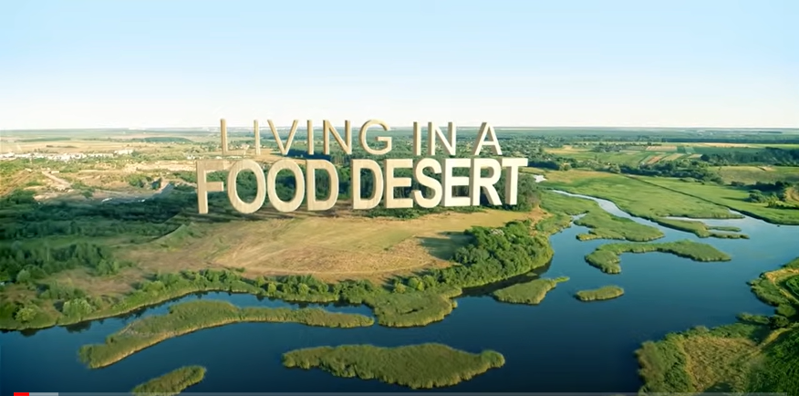
What is a Food Desert?
Notes:
https://www.youtube.com/watch?v=jicYbi-8ZNU

Slide 6

Stand Up/Sit Down
Think of the struggles people who do not have access to fresh food would have.
List as many things that you can think of.

Slide 7

Stand Up/Sit Down
Everyone stand up.
We will go around the room and say our list out loud— only saying one thing at a time.
Mark anything off your list that someone else has already said.
Sit down when everything on your list has been said.

Slide 8

Effects of living in a food desert
Notes:
Stop video at 5 minutes
https://www.youtube.com/watch?v=jicYbi-8ZNU

Slide 9

Is your School in a Food Desert?
Yes
No

Slide 10
Is your school in a food desert?
Mark your school on the map with a dot.
Place a dot at the closest grocery stores to your school.
Use the map key to determine the length of 1 mile, or 10 miles if you are in a rural area.
Draw a line segment from the school to the 1- or 10-mile point.
Place the point of your compass on the school and the pencil on the opposite end of the radius. Sketch a circle.
If the grocery stores are outside the circle, your school is in a food desert.

Slide 11

Discover the equation
With your elbow partner, complete the Arc Length and Sector Area Discovery Activity.

Slide 12

How much land would it take?
It would take 72,843.48 square feet to produce enough vegetables for 1 person for 1 year. How much land would be needed to feed every student in your classroom for one year?
  Design a circular plot of land to represent the amount of area needed to feed the students in your class.
  Equally share this circular plot of land and allocate each student their own slice of the circle. Calculate the sector area and arc length of each slice to determine what the students need to feed themselves for 1 year.

Slide 13
Sample answer—based on a 20-person class
1,456,869.6 Square feet
  (area of the circle)
For each student:
  Arc Length: 213.94 ft
  Sector Area: 72,843.48 sq ft
680.98 ft
18°

Slide 14

How much land would it take? Continued
After calculating the land area needed to feed your class, what did you find
  Surprising?
  Interesting?
  Troubling?
Notes:
Oklahoma uses 75% of their land for agriculture = 20,063,909.6

Slide 15
Vocabulary
Circumference:
Area:
Arc:
Sector:
Arc length equation:
Sector area equation:

Slide 16
Vocabulary
Circumference: The distance around the edge of a circle (perimeter)
Area: The amount of space taken up on a plane
Arc: Part or segment of the circumference of a circle
Sector: Part or portion of the area of a circle
Arc length equation: on next slide
Sector area equation: on next slide

Slide 17
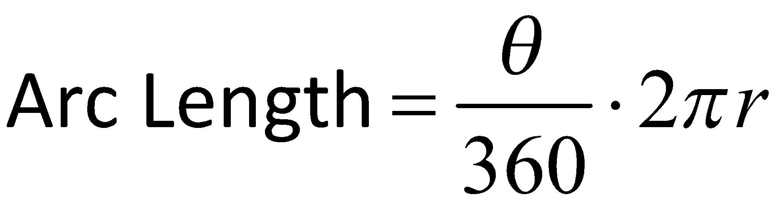
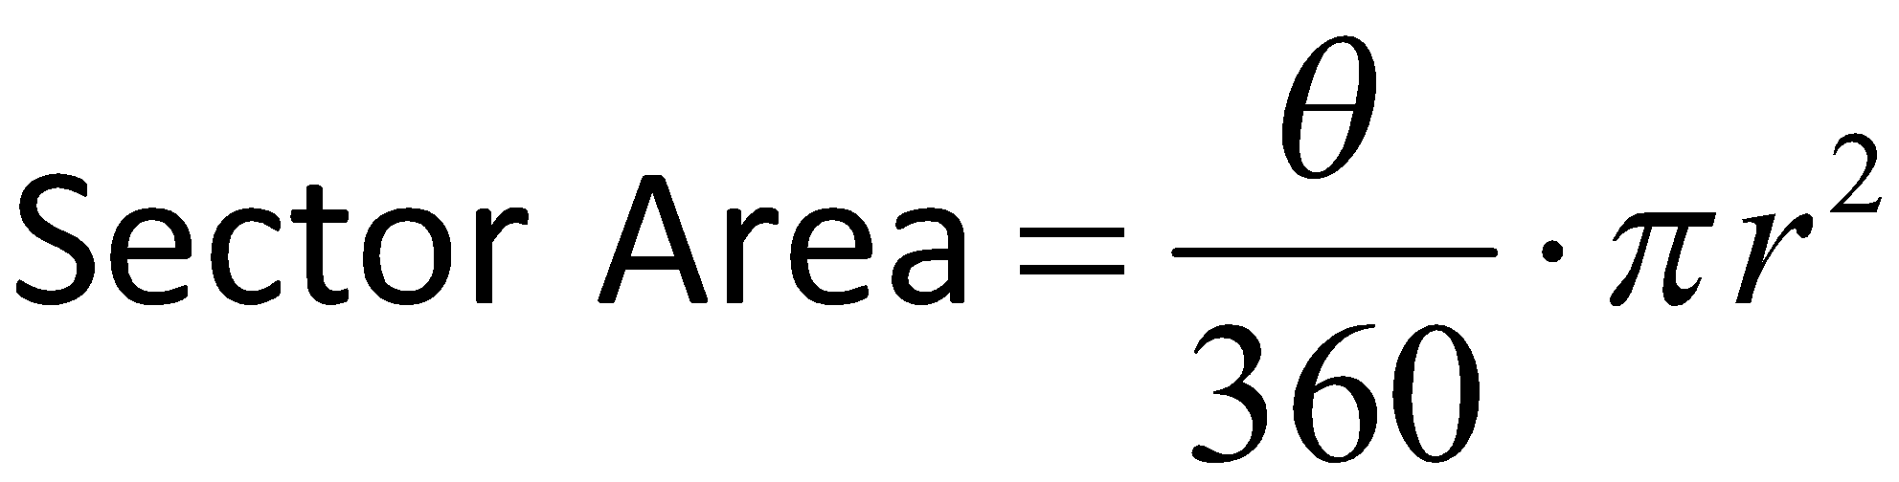
Formula
What is that symbol in the numerator?
What do you notice about the equations?
How are they similar to area and circumference equations of a circle?
Notes:
What is that symbol in the numerator?
That is the symbol Theta, it is a variable in this equation that stands for the central angle of the part of the circle we are measuring. This symbol serves the exact same purpose as any other variable like x.
What do you notice about the equations?
They both have the ratio of part of the circle to the whole.
They both are multiplied by the equation of circumference and area.
How are they similar to the area and circumference equations of a circle?
The arc length equation is multiplied by the circumference equation.
The sector area equation is multiplied by the area equation.

Slide 18

Ex. 1 What is the arc length of the circle?
What steps are you going to take to solve this problem?
16.5 ft
39°

Slide 19
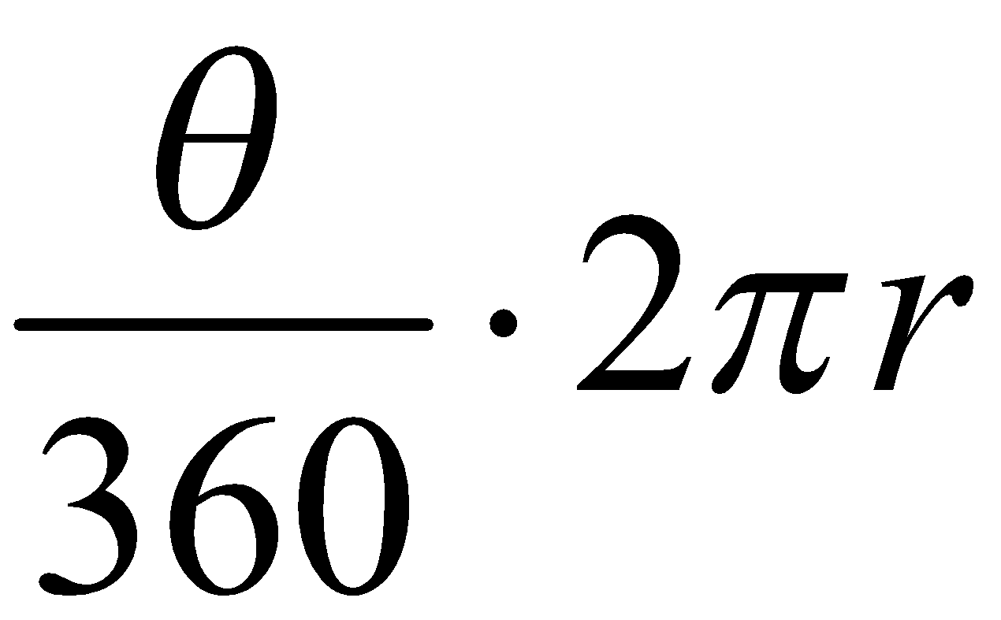
Ex. 1 What is the arc length of the circle?
What steps are you going to take to solve this problem?
16.5 ft
39°

Slide 20
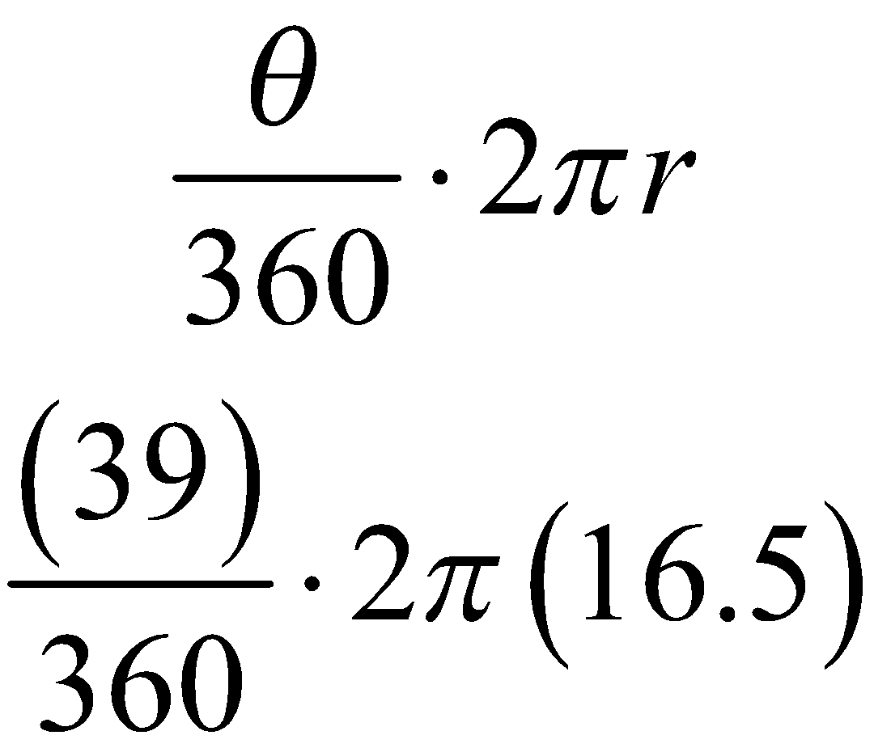
Ex. 1 What is the arc length of the circle?
16.5 ft
39°

Slide 21
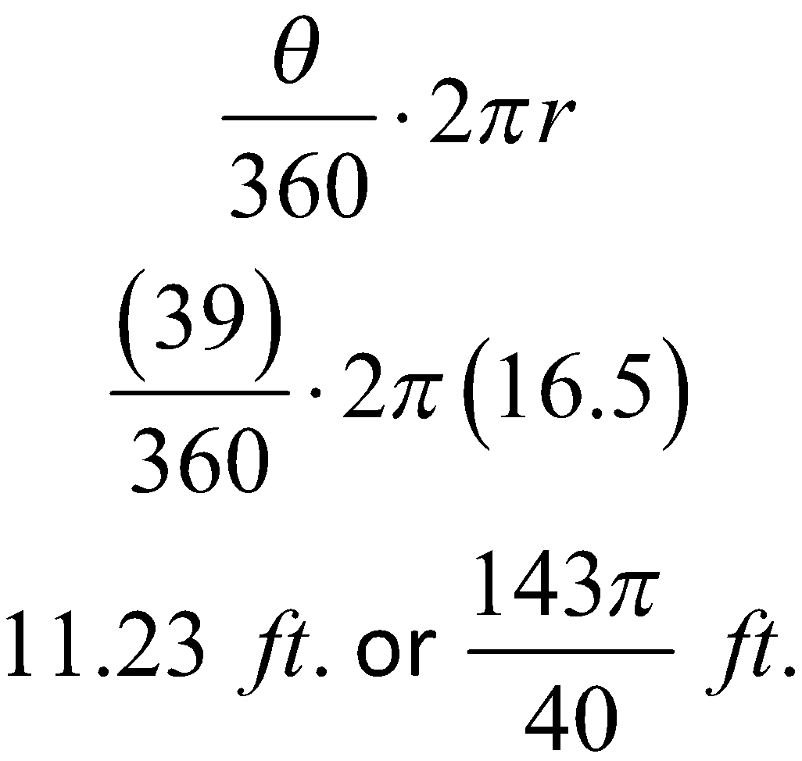
Ex. 1 What is the arc length of the circle?
16.5 ft
39°

Slide 22
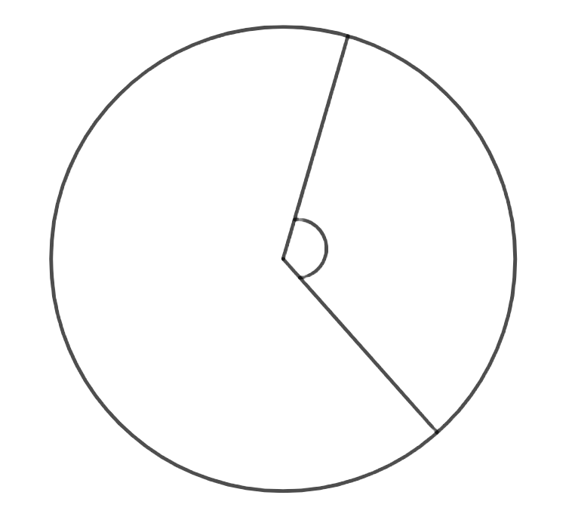
Ex. 2 What is the sector area of the circle?
What are you given?
What are you solving for?
What steps are you going to take to solve this problem?
12 cm
θ
5 cm

Slide 23
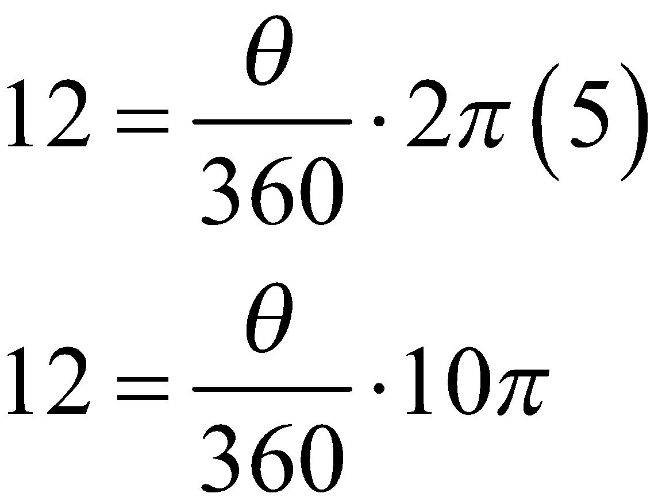
Ex. 2 What is the sector area of the circle?
Find the central angle
12 cm
θ
5 cm

Slide 24
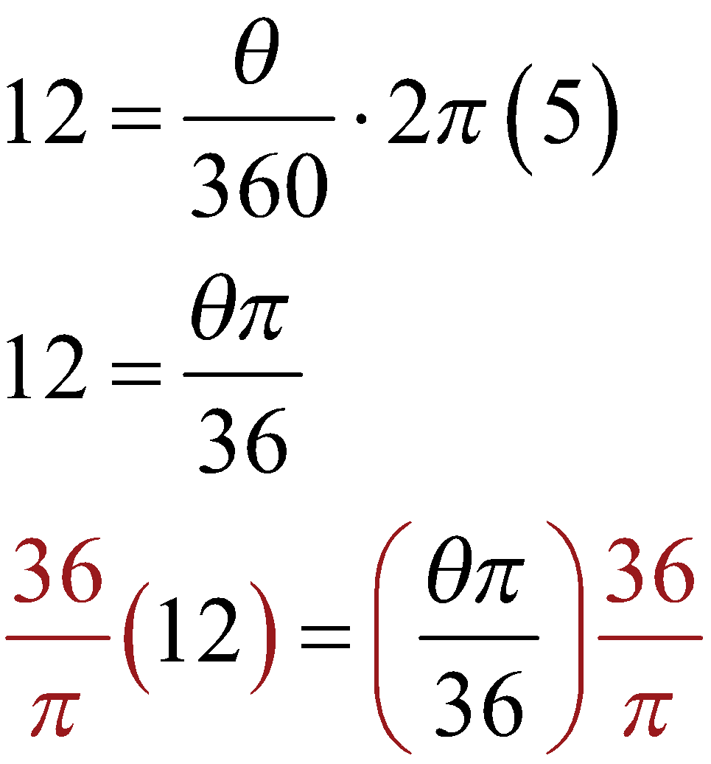
Ex. 2 What is the sector area of the circle?
Find the central angle
12 cm
θ
5 cm

Slide 25
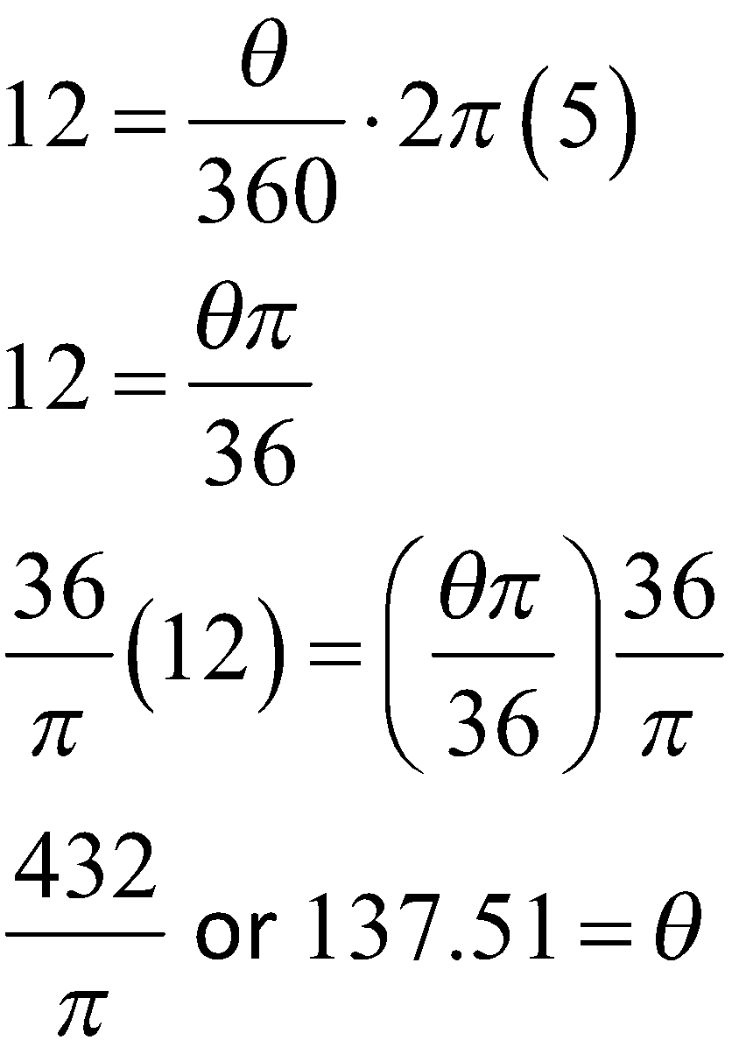
Ex. 2 What is the sector area of the circle?
12 cm
θ
5 cm

Slide 26
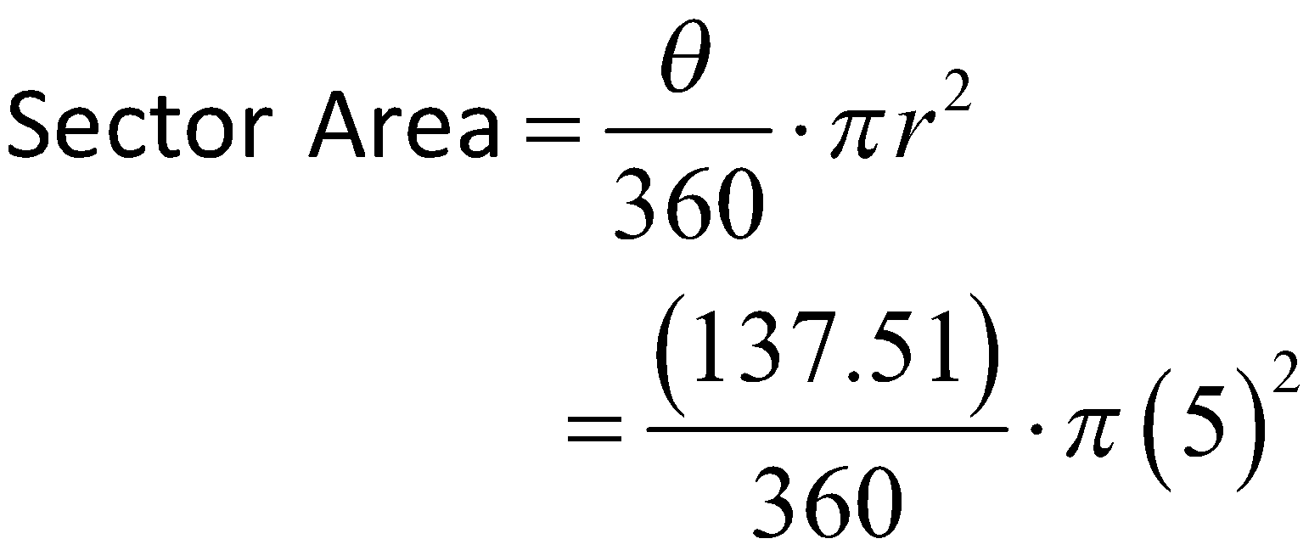
Ex. 2 What is the sector area of the circle?
2. Use Central angle to solve for sector area.
12 cm
θ
5 cm

Slide 27
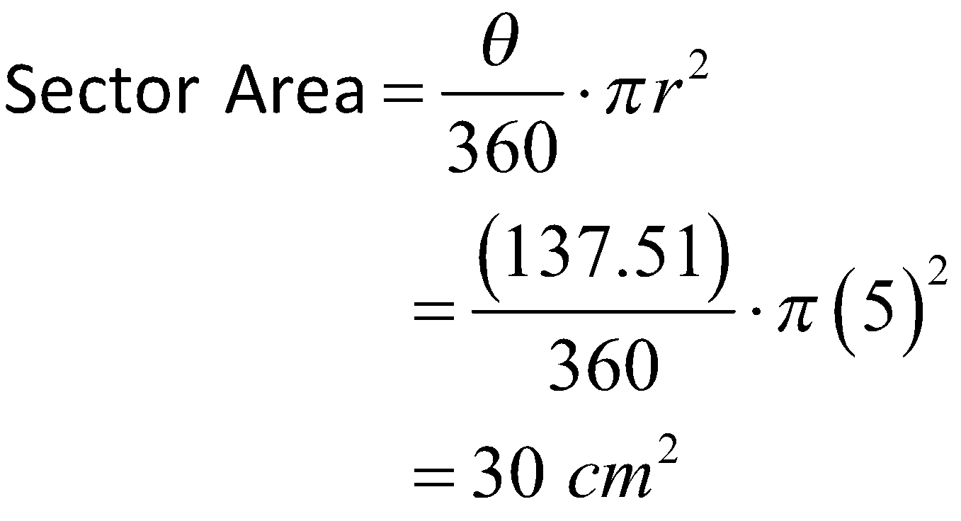
Ex. 2 What is the sector area of the circle?
2. Use Central angle to solve for sector area.
12 cm
θ
5 cm

Slide 28
Scavenger Hunt
Start at any problem in the classroom.
Solve each problem posted around the room.
Write the letter on your answer sheet above the question.
Continue working until you solve the riddle.

Slide 29
Make a Difference
We have learned that living in a food desert can be difficult for people in our community.
Using the map of our town from the beginning of the lesson, decide where you can place a grocery store to eliminate or reduce the food desert in your community.
Write a letter to the Chamber of Commerce asking for this grocery store.
  Include the location of the grocery store.
  Describe how you decided the location of the store.
  Explain why this store is important to add to the community.

