Slide 2
Don’t Just Stand There
The Bystander Effect and How to Overcome It

Slide 3

I Notice, I Wonder
Draw a vertical line down the middle of a piece of paper.
Title the left side “I Notice.”
  Write things you notice about the video as you watch it.
Title the right side “I Wonder.”
  After the film ends, write on that side anything you might be wondering about the video.
Notes:
K20 Center. (n.d.). I notice, I wonder. Strategies. https://learn.k20center.ou.edu/strategy/180

Slide 4
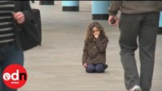
“Little Girl Lost”
“Little Girl Lost” Video
Notes:
On Demand News. (2014, March 24). Little girl lost: More than 600 people ignore lost child in TV experiment [Video]. YouTube.
https://www.youtube.com/watch?v=R5aIpUVAwZs

Slide 5
Bystander Effect
A phenomenon in which people fail to offer needed help in emergencies, especially when other people are present in the same setting.
-American Psychological Association
Notes:
American Psychological Association [APA]. (n.d.). APA dictionary of psychology. American Psychological Association. https://dictionary.apa.org/bystander-effect

Slide 6
Essential Question
What is the bystander effect, and what can we do to prevent it from happening?

Slide 7
Lesson Objectives
Acquire an understanding of the bystander effect and identify different factors that contribute to it.
Determine how the bystander effect has changed because of the emergence of social media.
Identify steps that can be taken in order to prevent the bystander effect from occurring in certain scenarios.

Slide 8

Bystander Effect or Not?
Create a Justified List that indicates whether or not the provided “cases” are examples of Bystander Effect.
Get into small groups.
Access the “Bystander Effect or Not?” Google Slides.
  Type in [insert url]
  Scan QR code
Find your assigned slide.
Notes:
Bitly. (2023, September 14). https://bitly.com/
K20 Center. (n.d.). Justified list. Strategies. https://learn.k20center.ou.edu/strategy/164
K20 Center. (n.d.). Google Slides. Tech Tools. K20 LEARN | Google Slides (ou.edu)
K20 Center. (n.d.). QR Codes. Tech Tools. https://learn.k20center.ou.edu/tech-tool/2449

Slide 9
Bystander Effect or Not?
Analyze the “case.”
Provide your justification and evidence.
  Justification: Explain why your group decided whether the "case" is an example of "bystander effect" or not.
  Evidence: Support your justification by using evidence from the "case" (i.e., describe the images that you see or the words used), or conduct more research on the topic.
Note: You may use text, quotes, images, etc.
Notes:
K20 Center. (n.d.). Justified list. Strategies. https://learn.k20center.ou.edu/strategy/164
K20 Center. (n.d.). Google Slides. Tech Tools. K20 LEARN | Google Slides (ou.edu)

Slide 10


H-Chart/Jigsaw
Read your assigned portion of the handout.
After reading, discuss what you read with your groupmates.
Summarize the main points on the left side of the H-Chart.
Notes:
K20 Center. (n.d.). Jigsaw. Strategies. https://learn.k20center.ou.edu/strategy/179
K20 Center. (n.d.). Paired texts H-chart. Strategies. https://learn.k20center.ou.edu/strategy/132

Slide 11
H-Chart/Jigsaw
Watch the video.
After viewing, summarize the main points on the right side of the H-Chart.
Notes:
K20 Center. (n.d.). Jigsaw. Strategies. https://learn.k20center.ou.edu/strategy/179
K20 Center. (n.d.). Paired texts H-chart. Strategies. https://learn.k20center.ou.edu/strategy/132

Slide 12
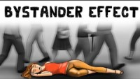
“The Bystander Effect: Examples + Experiments”
The Bystander Effect Video
Notes:
Practical Psychology. (2021). The Bystander Effect (Examples + Experiments). YouTube. https://www.youtube.com/watch?v=GZgIYGaeWy0

Slide 13
H-Chart/Jigsaw
In the middle of the H-Chart, respond to the following question:
  What is the bystander effect and how is it caused?
Notes:
K20 Center. (n.d.). Jigsaw. Strategies. https://learn.k20center.ou.edu/strategy/179
K20 Center. (n.d.). Paired texts H-chart. Strategies. https://learn.k20center.ou.edu/strategy/132

Slide 14
Bystander Effect Scenario
Skim read the Bystander Effect Scenario Script silently to yourself.
Reflect on the following questions as we read through the scene again:
  How would you react if you witnessed this situation in your classroom?
  If you have witnessed a situation like this, how did you react?

Slide 15
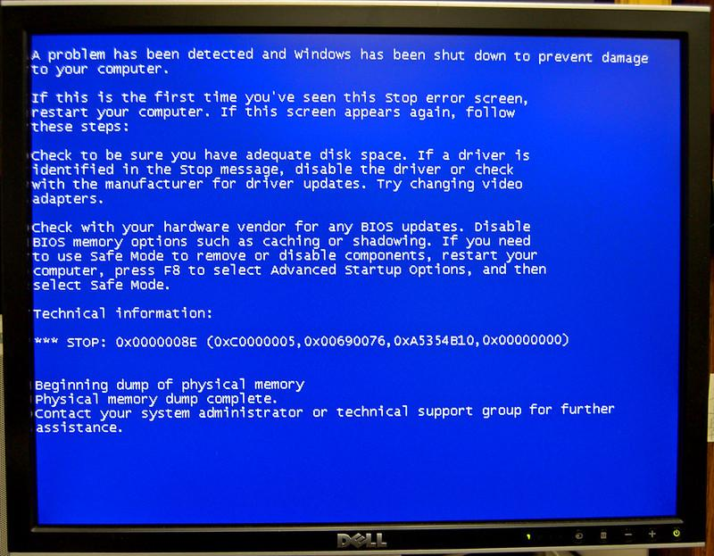
Blue Screen of Death
Notes:
Use as a prop while students act out the scene. We recommend displaying this when the character Josh starts typing on the laptop.
Bain, T. A. (n.d.). Blue Screen of Death. flickr. Retrieved from https://www.flickr.com/photos/andrewbain/2228633614/in/photolist-4oWk8u-5JKGir-zWeTG-dBsLuP-KzRLhY-2ji9Kpq-24X1rQx-3Wa3Z-2jib2LT-5ocny6-2jib2LH-2mNYnVw-rovnk-2j2XqaN-ktQxs-7rmoe3-qYNPcv-hVikNa-hVhCFJ-2jYFHHa-ebcXyi-hVihba-4EpKwS-75jBjz-ebizE7-DsGzXD-hViqvB-ehirrf-6rarVd-t2QY6-dFyh9v-hVirFc-hVhBMu-hVhASd-dFyh7x-2mnGsun-ehcGSP-ehcGPR-ehcGJV-ebcX2r-7FJcsp-hVhALm-hVhipB-hVhGqC-hVhMWq-5tZeHh-ebcWqp-7CfakA-hVhDtA-hVhKT7.

Slide 16

Categorical Highlighting
Highlight parts of the scene according to what concept they exemplify using the key below:
  Pink (diffusion of responsibility)
  Orange (social influence)
  Green (intimidation factor)
  Blue (empathy)
Write in the margins why you chose to highlight each phrase or sentence that demonstrates a concept.
Notes:
K20 Center. (n.d.). Categorical highlighting. Strategies. https://learn.k20center.ou.edu/strategy/192

Slide 17
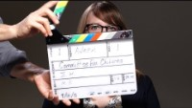
“The Importance of Upstander Power”
“The Importance of Upstander Power”
Notes:
Committee for Children. (2018, October 1). The importance of upstander power [Video]. YouTube. https://www.youtube.com/watch?v=JegGjYtstyw

Slide 18

Exit Ticket
Write a paragraph answering the following prompt:
Now that you know about the bystander effect, what will you do differently if you witness someone in trouble?
Notes:
K20 Center. (n.d.). Bell ringers and exit tickets. Strategies. https://learn.k20center.ou.edu/strategy/125

