Slide 2
How Will I Save for My Future?
A Lesson for Personal Financial Literacy
Standard 5: Saving and Investing

Slide 3
Essential Questions
Is saving money important?
What is the best way to save and invest for the future?

Slide 4
Lesson Objective
By the end of this lesson, you will understand the different types of investments.

Slide 5
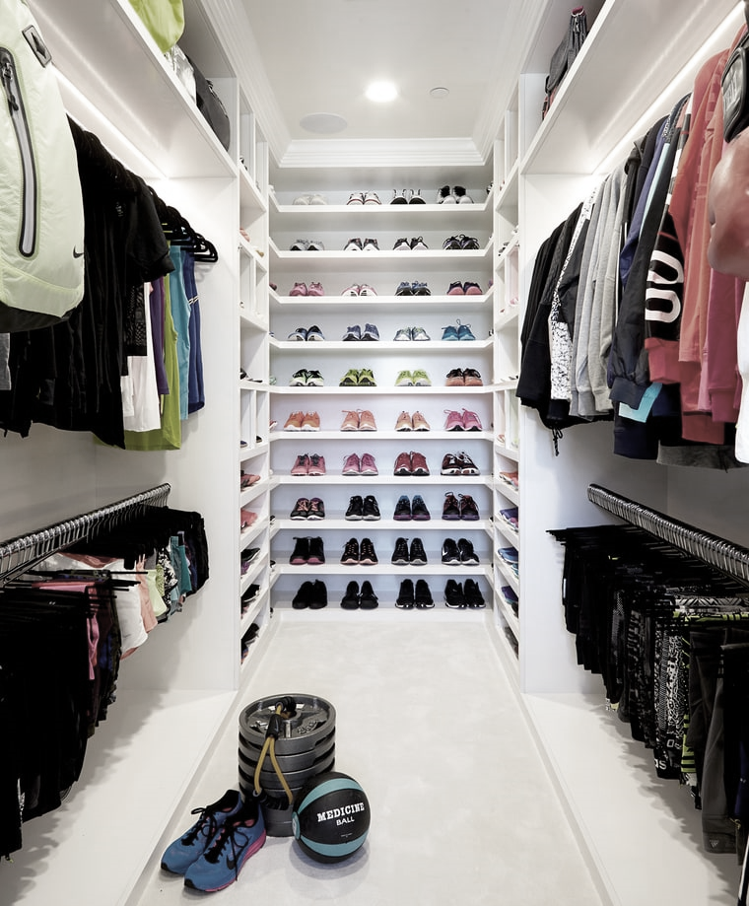
To what extent do you agree or disagree with this statement?
Money looks better in the bank than in your closet.
Notes:
Marquina, S. (2015, July 27). Inside Klohe Kardashian’s fitness closet [Image]. US Magazine. https://www.usmagazine.com/stylish/news/khloe-kardashian-has-a-fitness-closet-and-its-insane-photos-2015277/

Slide 6
Sticky Bars
How often do you save money?
Regularly, like once a month. | Sometimes, when I think about it. | I’m not saving right now.
Place your sticky note in the column that best represents your answer.

Slide 7
Stop and Jot
At each subheading, stop and jot your thoughts in the margins on what the previous header’s paragraphs were about.
For example, after you read about STOCKS, jot in the margins what a stock is and what the risks are.

Slide 8
Frayer Model Definitions
Create a Frayer Model using your assigned vocabulary word.
Investment
Stocks
Stock Market
Bonds
Mutual Funds
Brokers
Market Fluctuations
Diversification
Certificates of Deposit
Portfolio

Slide 9

Frayer Model Example
­­
DEFINITION
Putting aside money so that it can be used at a later time. Usually, saving money in a bank allows the money to earn interest.
CHARACTERISTICS
Being frugal
Not spending for extra things.
Budgeting
The opposite of spending.
SAVING
PICTURE
SENTENCE
Today I started saving money for a car.

Slide 10
How Will You Invest Your Money?
Your great aunt has passed away and left you some money in her will. She has given you $15,000 because you were her “favorite.” You have a few ideas about how to spend your inheritance—maybe college or a car. The money won’t cover all the cost of a car or college, so you would like to invest and save the money for now.
How can you make your money “grow” over time?

Slide 11
How Will You Invest Your Money?
Fill out the graphic organizer.
Create a brief list of the amounts and types of investments you choose.
Enter the website where you found the investment type.
Estimate what you think you might earn.
Explain your reasoning for your choices.

