Slide 2

Celebrating Diwali
Exploring the Festival of Lights through Expository Writing

Slide 3
Essential Question
Why do we learn about other cultures’ celebrations?

Slide 4
Lesson Objectives
Summarize and paraphrase information regarding Diwali
Compose an expository essay exploring one cultural aspect of Diwali

Slide 5
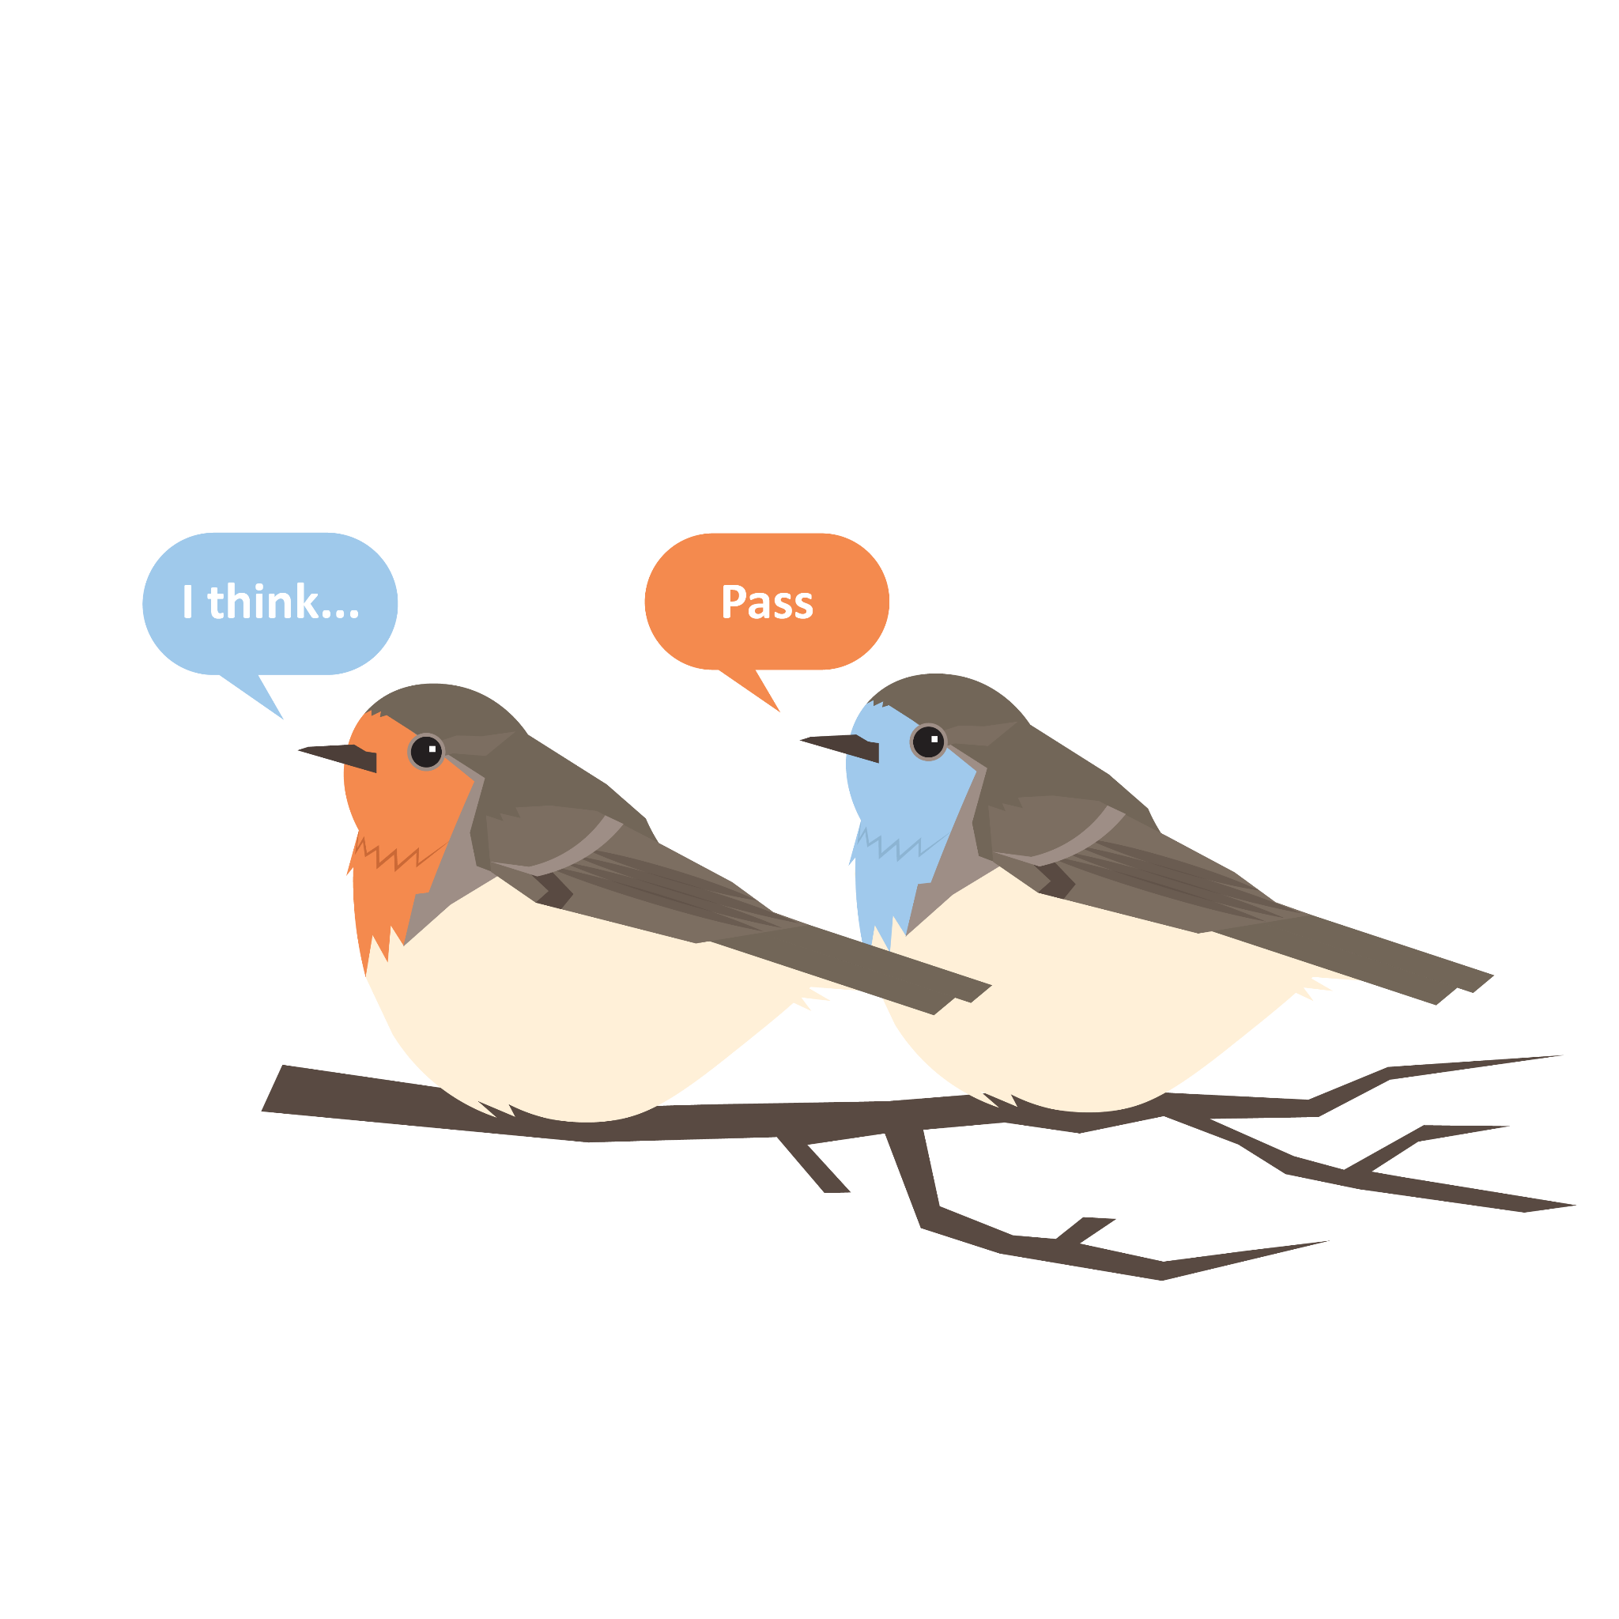
Round Robin
On a sheet of notebook paper, write down as many holidays as you can think of. You have 2 minutes to do this.
Next, we’re going to generate a list as a class.
  Say one holiday from your list.
  If your holiday has been said, say “Pass”.
We’ll continue this process until we’ve listed all of the holidays we know.
Notes:
K20 Center. (n.d.). Round robin. Strategies. https://learn.k20center.ou.edu/strategy/778

Slide 6

Chain Notes
Each group will be assigned a “traditional holiday.”
Answer one question on your sheet of notebook paper about your holiday.
Rotate your paper to the next person in your group.
Answer the next question on your groupmate’s paper.
Repeat this process until all questions have been answered.
Notes:
K20 Center. (n.d.). Chain notes. Strategies. https://learn.k20center.ou.edu/strategy/52

Slide 7


Chain Notes
Round 1: What is this holiday celebrating?
Round 2: Where is this holiday celebrated?
Round 3: What kinds of décor or symbols reflect your holidays?
Round 4: What is typically worn during your holiday?
Round 5: What foods are usually eaten?
Round 6: What other holiday traditions are there that have not already been stated?
Notes:
K20 Center. (n.d.). 1 minute timer. [Video]. YouTube. https://www.youtube.com/watch?v=6ilD555O_RE
K20 Center. (n.d.). Chain notes. Strategies. https://learn.k20center.ou.edu/strategy/52

Slide 8
Review
Summary | Paraphrase
Definition: Minimize someone’s message or work to the most important points. | Definition: Using your own words to restate someone else’s thoughts and ideas.
Characteristics: Generalize overall message Don’t need details from every sentence Should be shorter than the original work | Characteristics: Still keep original intent Can’t just change 1-2 words (that’s Patchwork Plagiarism)
Notes:
Plotnick, J. (n.d.). “Paraphrase and Summary.” University College, University of Toronto, https://www.uc.utoronto.ca/paraphrase

Slide 9
“The Many Legends of Diwali”
Pronounced duh – vaa – lee
Choose one of the following legends and write the title on your handout:
Diwali in Ramayana
Diwali in Mahabharata
Day of Diwali in Jainism
Bandi Chorh Diwas in Sikhism
Notes:
Google Arts and Culture, & Mukherjee, A. (n.d.). The Many Legends of Diwali. Google. https://artsandculture.google.com/story/the-many-legends-of-diwali/0QVxpSl4NnfrEQ?hl=en

Slide 10

“The Many Legends of Diwali”
Access the website:
Type in https://tinyurl.com/ydr9574e (CASE SENSITIVE)
Or scan the
QR code
Complete your handout.
Read through your assigned legend + write a summary.
Read through every day of Diwali + write a summary for every day.
Notes:
Google Arts and Culture, & Mukherjee, A. (n.d.). The Many Legends of Diwali. Google. https://artsandculture.google.com/story/the-many-legends-of-diwali/0QVxpSl4NnfrEQ?hl=en

Slide 11

Rotating Anchor Charts
With your assigned group, use chart markers and your “Diwali Summary and Paraphrase” handout to complete the prompts for each day’s poster.
Rotate with your groupmates to each day’s poster and pick up where the last group left off.
  Keep adding new information!
Time will be reduced each round. We will do this until everyone has visited the Five Days of Diwali (5 posters).
  We will start with 3 minutes!
Notes:
K20 Center. (n.d.). Anchor Charts. Strategies. https://learn.k20center.ou.edu/strategy/2364

Slide 12
Rotating Anchor Charts
With your group, complete as much of the following tasks on your poster as you can within the time given:
Write what that day of Diwali is called.
Write 3-5 sentences paraphrasing the significance of this day.
List traditions.
Incorporate pictures/symbols connected with this day.
After time is called, your group will move to the next day’s poster (i.e. If you start at Day 2, then move to Day 3 etc.).
Notes:
K20 Center. (n.d.). Anchor Charts. Strategies. https://learn.k20center.ou.edu/strategy/2364

Slide 13

Choice Board
Explore Diwali a bit deeper!
Choose 1 creative element from the Creative Choice Board.
Choose 1 item from the Expository Writing Choice Board.
Pick 1 out 4 |  | Pick 1 out 2
Rangoli | Tasting Menu | Process Essay
Fashion | Decor | Compare/Contrast Essay
Notes:
K20 Center. (n.d.). Choice boards. Strategies. Retrieved from https://learn.k20center.ou.edu/strategy/73

Slide 14
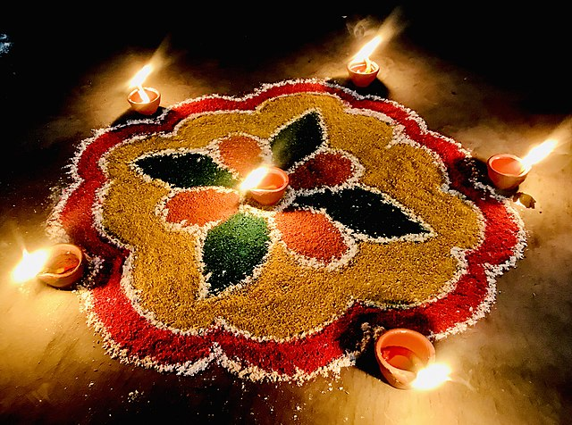
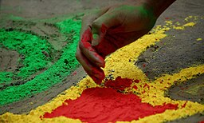
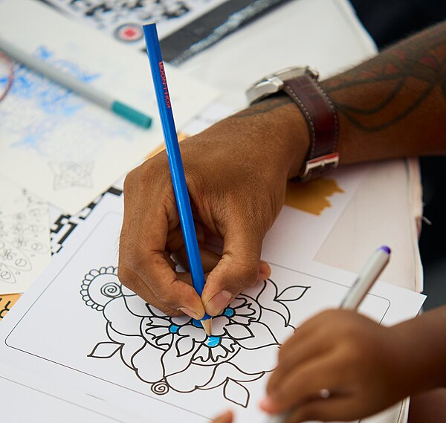
Rangoli - Creating your own Rangoli
Notes:
Gill, N. (2020). Rangoli on Diwali 2020 at Moga, Punjab, India. Wikimedia Commons. Creative Commons. Retrieved from https://commons.wikimedia.org/wiki/File:Rangoli_on_Diwali_2020_at_Moga,_Punjab,_India.jpg.
Fortresseconomist. (2022). Drawing Rangoli patterns. Wikimedia Commons. Creative Commons. Retrieved from https://commons.wikimedia.org/wiki/File:Drawing_Rangoli_patterns.jpg
TechnoAyan(2014). Rangoli Design. Wikimedia Commons. Creative Commons. Retrieved from
https://commons.wikimedia.org/wiki/File:Rangoli_Design.jpg

Slide 15
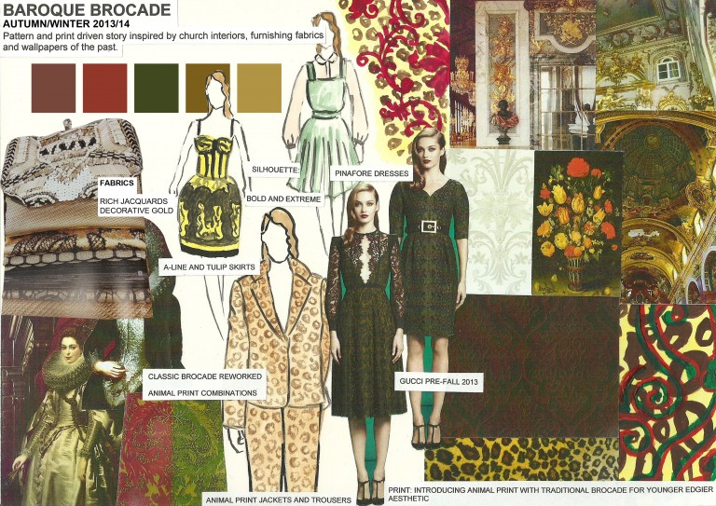
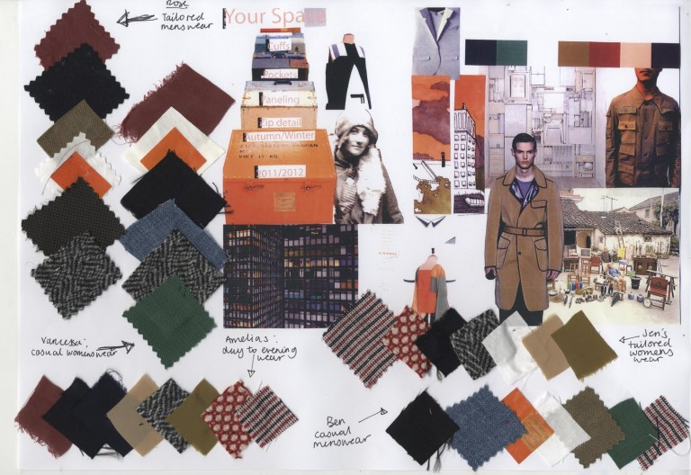
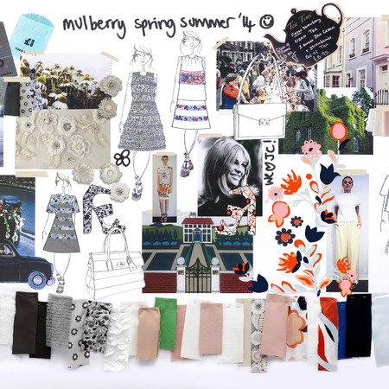
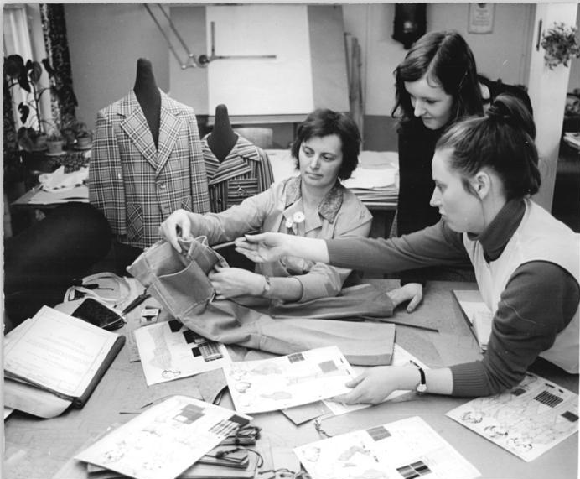
Fashion - Designing your Diwali outfit
Notes:
Aabha. (2016, November 16). The Fashion Design Process. Aart. https://sites.psu.edu/art101/2016/11/16/the-fashion-design-process/
BArchBot(2008). VEB Bekleidungswerk "Steppke" Görlitz, Gestaltung Kinderkonfektion. Wikimedia Commons. Creative Commons. Retrieved from https://commons.wikimedia.org/wiki/File:Bundesarchiv_Bild_183-N0409-0320,_VEB_Bekleidungswerk_%22Steppke%22_G%C3%B6rlitz,_Gestaltung_Kinderkonfektion.jpg

Slide 16
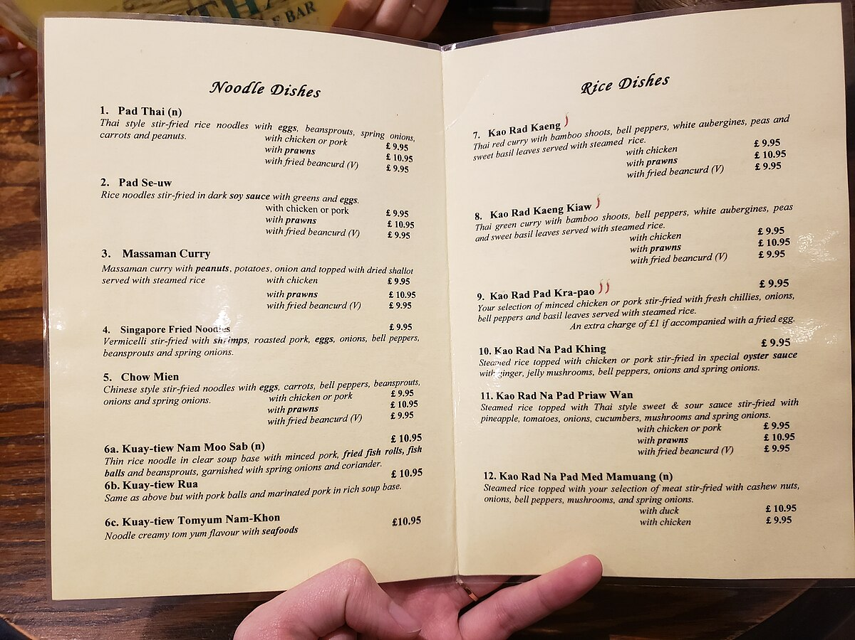
Tasting Menu - Creating Your Own Diwali Menu
Notes:
Li, A. (2023). Food menu of Unithai. Wikimedia Commons. Creative Commons. Retrieved from https://commons.wikimedia.org/wiki/File:Food_menu_of_Unithai.jpg

Slide 17
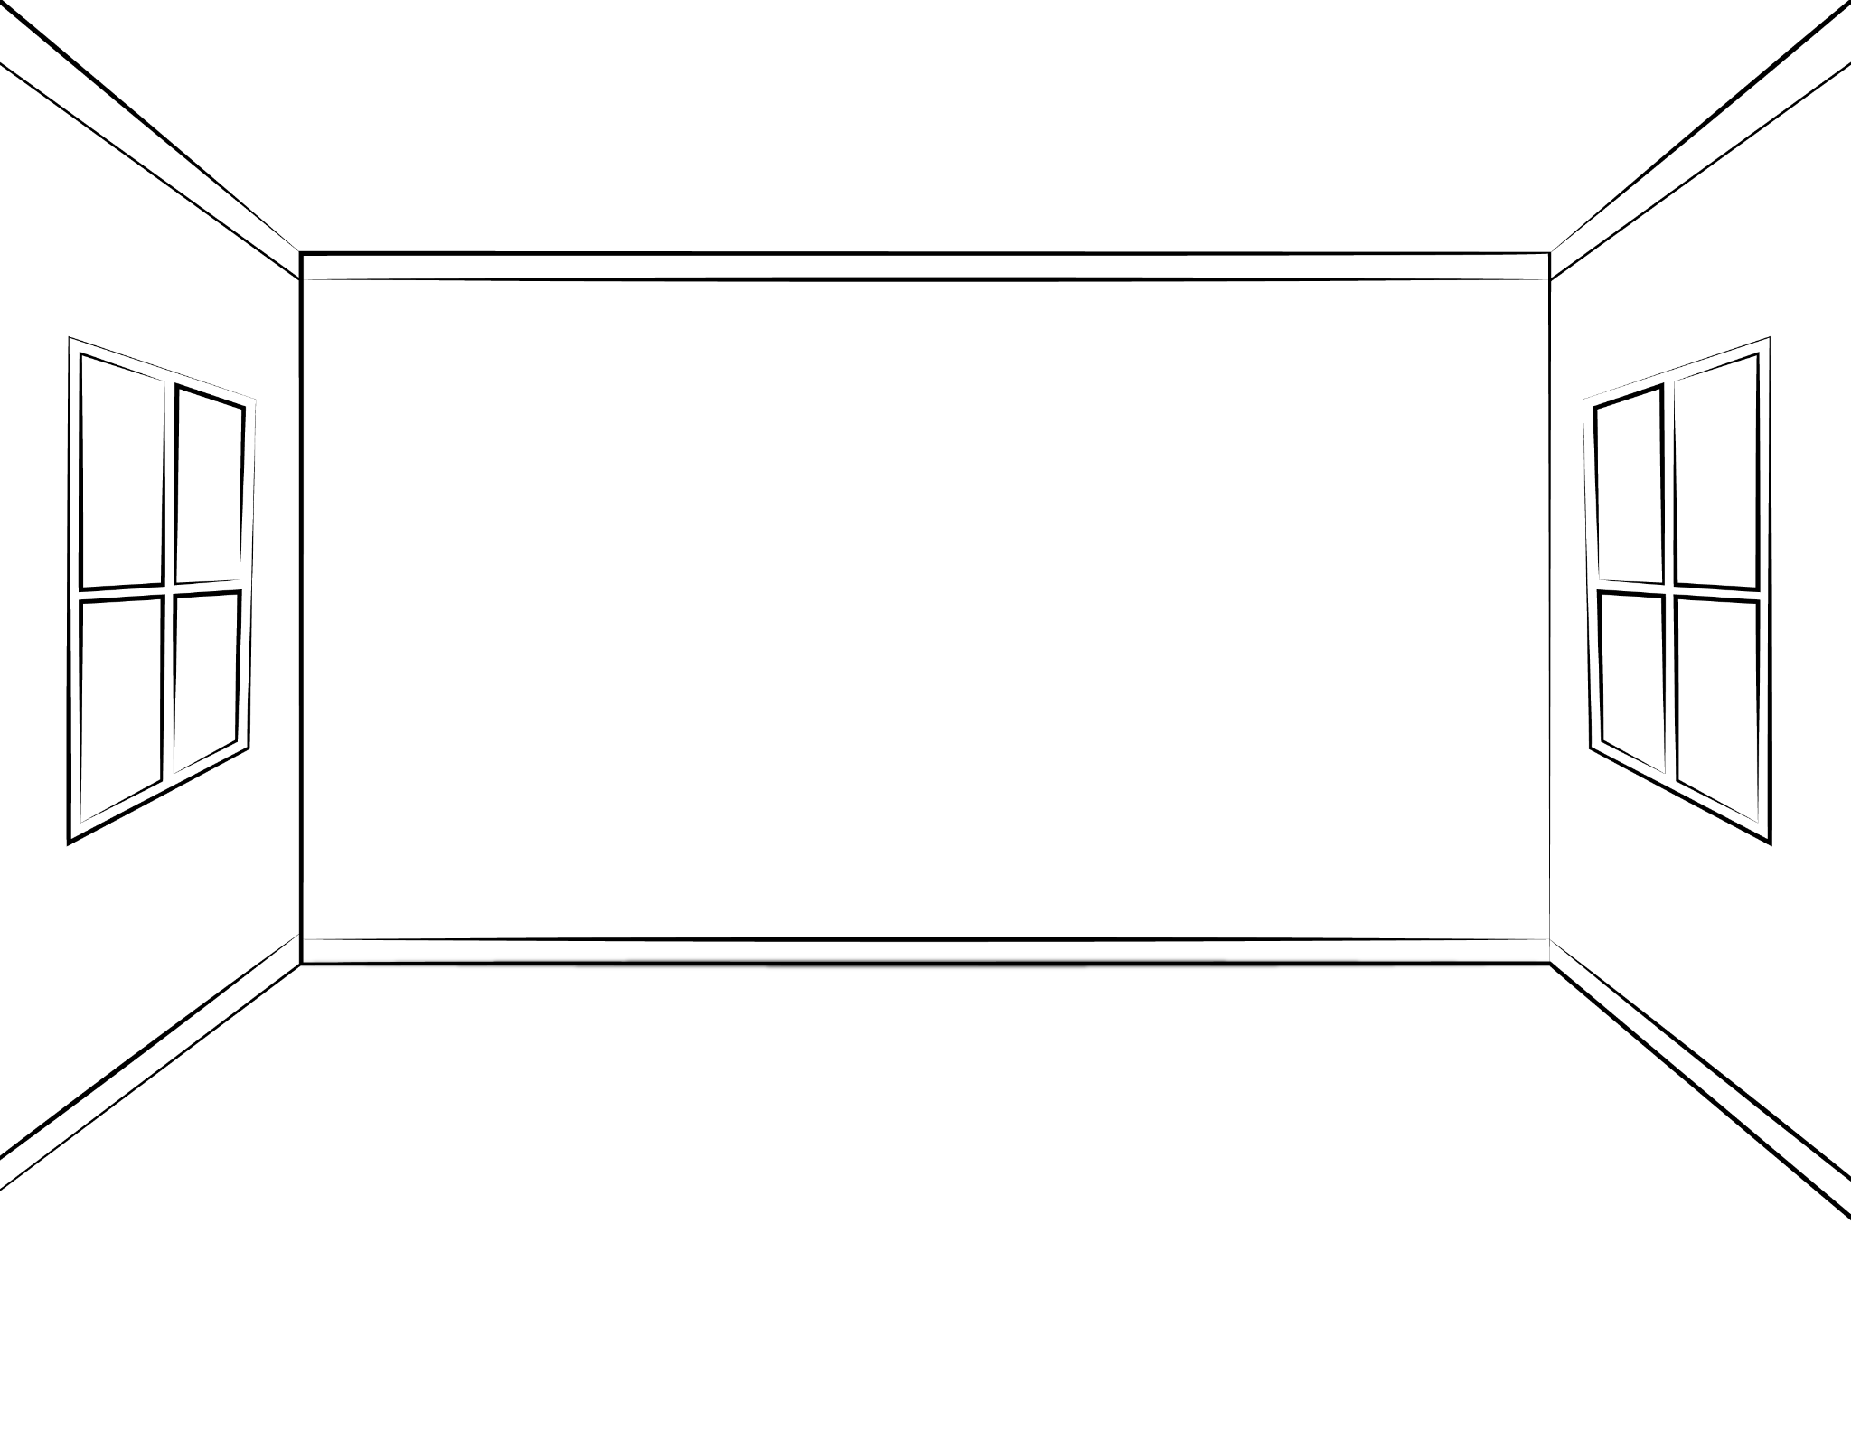
Decor - Designing your space for Diwali

Slide 18
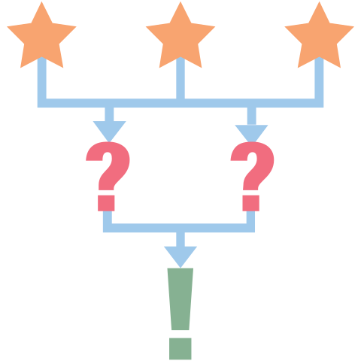
3-2-1
On a sheet of paper reflect on the following:
Three things you learned about this holiday.
Two things you liked about this lesson.
One big takeaway about cultural celebrations.
Notes:
K20 Center. (n.d.). 3-2-1. Strategies. https://learn.k20center.ou.edu/strategy/117

