Slide 2
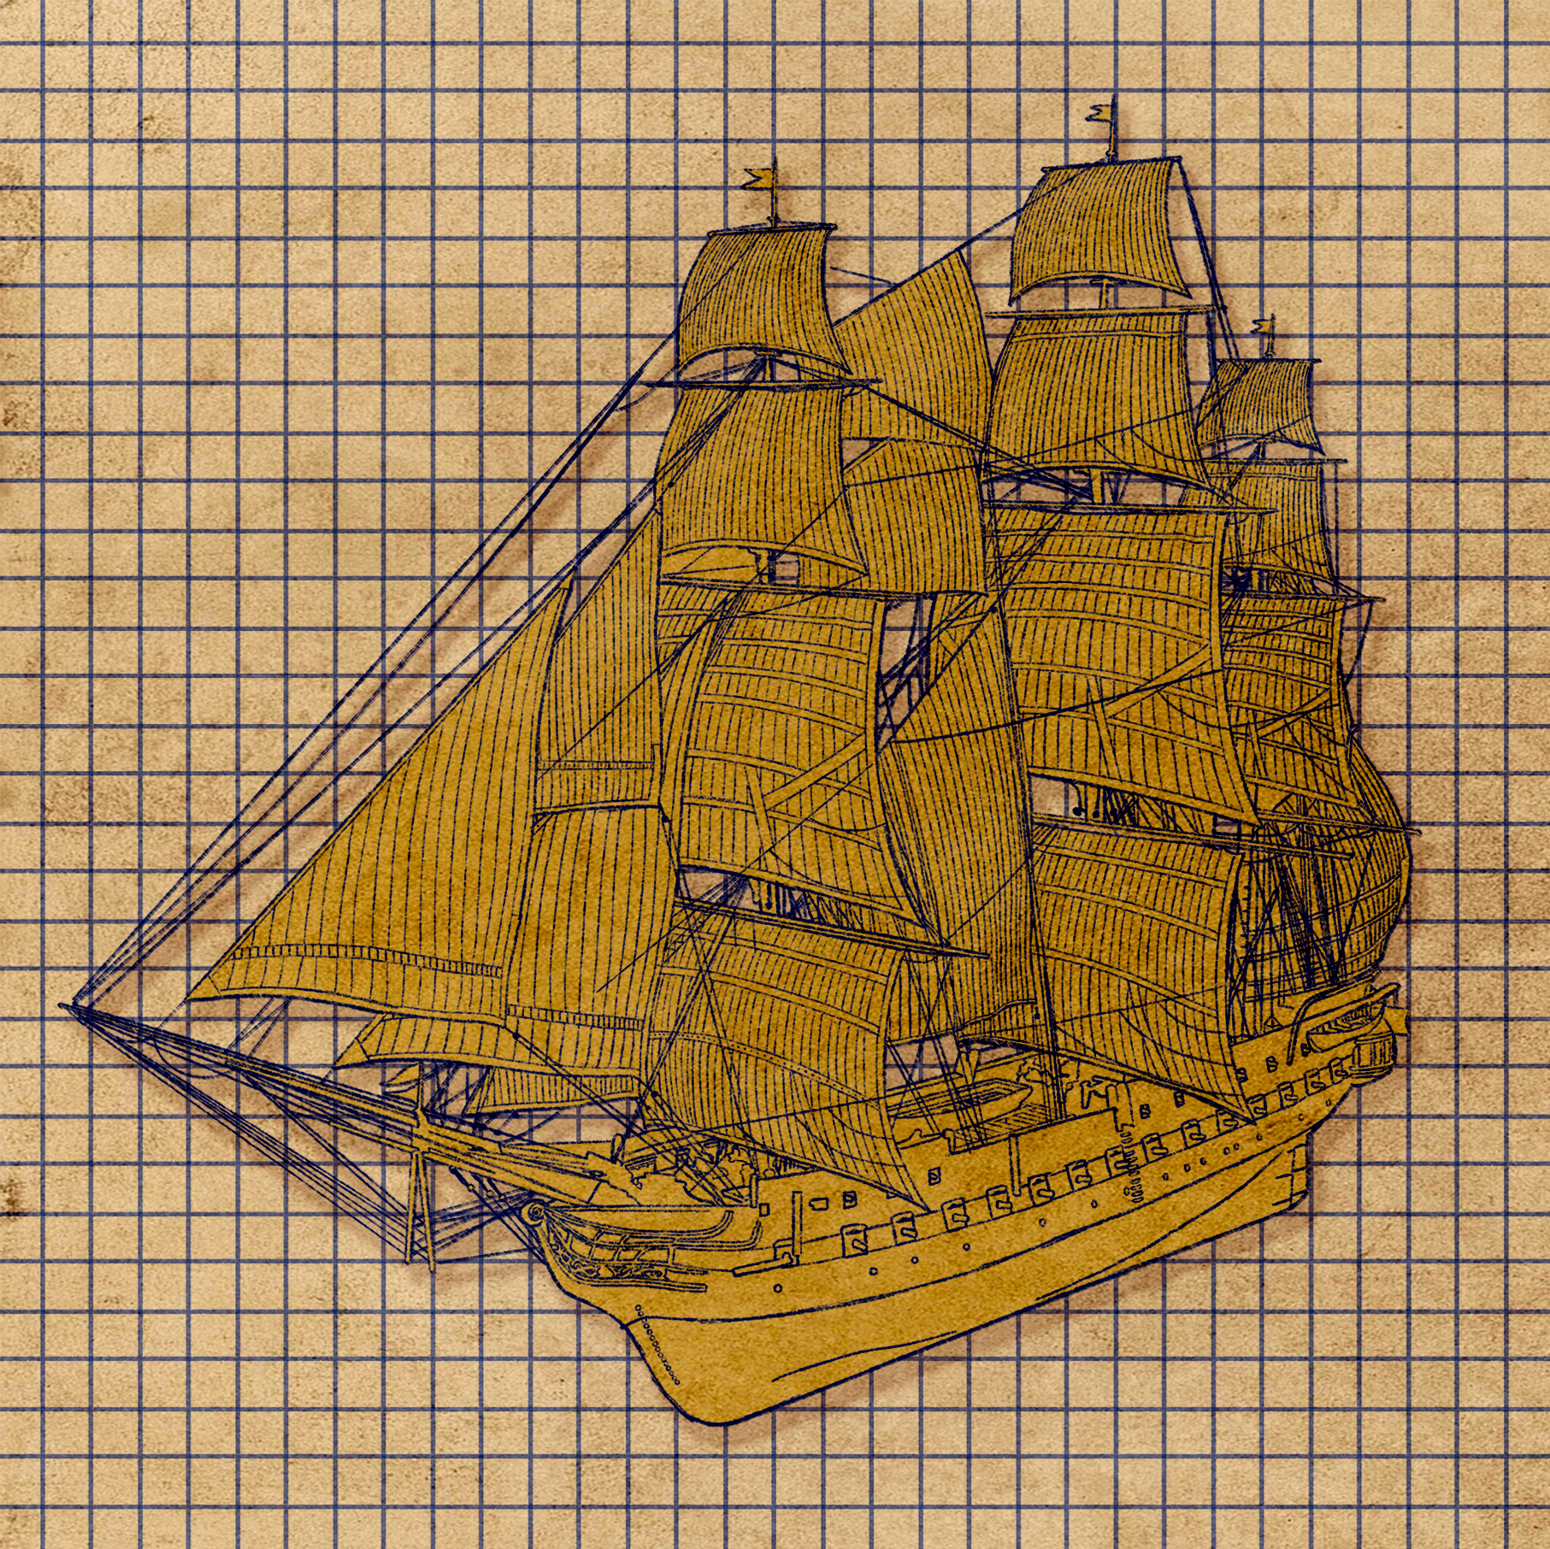
Guns and Ships
The Battle of Saratoga and the French Alliance

Slide 3

Guns and Ships
Notes:
Hamilton. (2020). “Guns and Ships” from HAMILTON [Video]. YouTube. https://www.youtube.com/watch?v=JDL6R2KS3xg

Slide 4

I Think/We Think
In the “I Think” column, use your prior knowledge of the Revolutionary War to interpret and answer the first question of the song:
  How does a ragtag volunteer army in need of a shower, somehow defeat a global superpower?
Notes:
K20 Center. (n.d.). I think / we think. Strategies. https://learn.k20center.ou.edu/strategy/141

Slide 5
I Think/We Think
Share your answers with your table.
Together, come up with a consensus about the meaning of the lines.
Write that in the “We Think” column.
Be prepared to share with the class.
Notes:
K20 Center. (n.d.). I think / we think. Strategies. https://learn.k20center.ou.edu/strategy/141

Slide 6
Essential Questions
How does conflict create change?
What events during the Revolutionary War significantly impacted the course and outcome of the war?

Slide 7
Lesson Objectives
Describe why France decided to help the United States during the American Revolution and explain how that influenced the war.
Examine and Interpret historical information from multiple sources to establish a basic understanding of Revolutionary War dynamics.

Slide 8

Three Sticky Note Activity
For each reading, fill out three Post-It notes:
  Post-it note #1- One word that summarizes the reading
  Post it note #2- A phrase from the reading that seems important.
  Post it note #3- Write a sentence that summarizes the reading.
Notes:
K20 Center. (n.d.). Three Post-it notes. Strategies. https://learn.k20center.ou.edu/strategy/153

Slide 9
Three Sticky Note Activity
Share your sticky note ideas for each reading with your group.
As a group develop a three sentence summary for each reading.
Notes:
K20 Center. (n.d.). Three Post-it notes. Strategies. https://learn.k20center.ou.edu/strategy/153

Slide 10
What is an annotation?
Annotation⁽¹⁾ is a comment that explains in greater detail words or phrases that may be confusing or unknown to the reader; to add notes to a text by giving explanation or making connections to other topics.

Slide 11
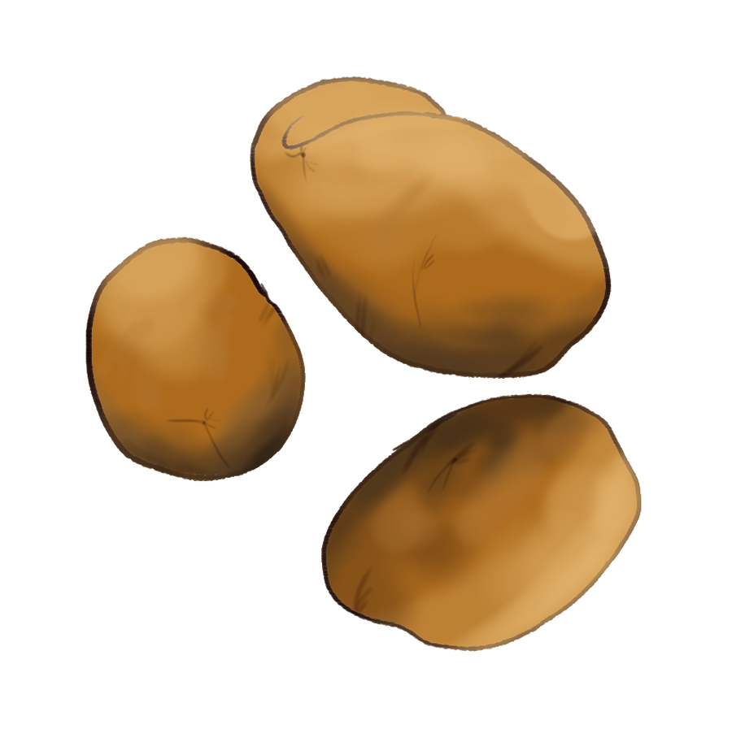
Hot Potato
Why was George Washington feeling both pleased and frustrated about the victory at Saratoga?
OR
Washington says that the news of the victory reached him “by report only.” What does this tell you about communication during the Revolutionary War?

Slide 12
Hot Potato
Washington sends Alexander Hamilton to deliver information in person. Why might face-to-face communication have been important for military decisions at the time?
OR
What strategies did the Patriots use to slow down the British army, and why were these strategies effective?

Slide 13
Hot Potato
How did the geography and environment of New York impact the Battle of Saratoga?
OR
Why is the Battle of Saratoga considered as a “turning point” in the Revolutionary War?

Slide 14
Hot Potato
Compare the two battles at Saratoga (September 19 and October 7). How did the outcomes differ, and what changed between them?
OR
Why was France reluctant at first to help the Americans, and what finally convinced them to join the war?

Slide 15
Hot Potato
How did the French Alliance change the balance of power in the Revolutionary War?
OR
Why was French naval support especially important for the American victory?

Slide 16
Hot Potato
If the Americans had lost the Battle of Saratoga, how might the French have responded differently? How might the war have changed?
OR
How did the involvement of France make the Revolutionary War into more than just a conflict between the colonies and Britain?

Slide 17

30-Second Expert
Choose a topic to present.
  The Battle of Saratoga -OR- The French Alliance
Write a short summary explaining your topic.
Describe how your topic impacted the Revolutionary War.
Practice your presentation at least 2 times to make sure it fits the 30-second time limit.

