Slide 2
Pavlov’s Puppies
Classical Conditioning

Slide 3

Think-Pair-Share
What do you do when you hear your phone ding or vibrate?
What do you do when the bell rings at the end of class?
What do you do when someone sneezes?
How did you learn these three behaviors?
Notes:
K20 Center. (n.d.). Think-Pair-Share. Strategies. https://learn.k20center.ou.edu/strategy/139

Slide 4
Essential Question
How is behavior influenced?

Slide 5
Lesson Objectives
Explain the stages of classical conditioning.
Identify real-life situations where classical conditioning can change behavior.

Slide 6
Conditioning Scenarios
Look at your conditioning scenarios handout and decide which response is appropriate:
  Unconditioned Stimulus (US): A stimulus that leads to an automatic response.
  Unconditioned Response (UR): An unlearned, automatic response that occurs naturally in reaction to an unconditioned stimulus.
  Conditioned Stimulus (CS): A previously neutral stimulus that, after becoming associated with the unconditioned stimulus, eventually triggers a conditioned response.
  Conditioned Response (CR): A learned response to a previously neutral stimulus.

Slide 7
Conditioning Scenario Example
Getting a flu shot (US) hurts and makes a child cry (UR). The child associates the needle (CS) with getting hurt and cries at the sight of the needle (CR).

Slide 8
Conditioning Scenarios
Solutions
  Every time Jim’s computer plays the sound to shut down (US), he offers Dwight a mint (UR). Dwight associates the sound of the computer shutting down (CS) with asking for a mint (CR).
  For every book she reads (UR), the school gives Shawna a pizza, her favorite food (US). Shawna reads more books (CR) so that she can get more tasty pizza (CS).
  During a holiday, festive music is played (US). People are often happy and receive gifts during the holidays (UR). When people hear festive music (CS), they feel happy and ready for the holiday (CR).

Slide 9
Conditioning Scenarios
Solutions
  The first time Katrina went to the beach (US), she got a bad sunburn (UR). Katrina now avoids trips to the beach (CR) because she is afraid of another sunburn (CS).
  When Manuel sees the doctor (US), he gets a piece of candy (UR). Manuel starts to like going to the doctor (CR) because he looks forward to getting candy (CS).

Slide 10
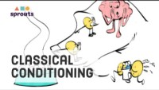
H-Chart
On the left side of your H-Chart, summarize the main points of the reading.
On the right side, summarize the main points of the video.
In the middle, answer the question, “According to classical conditioning learning theory, how can behavior be influenced?”
https://www.youtube.com/watch?v=jd7Jdug5SRc
Notes:
K20 Center. (n.d.). Paired texts H-chart. Strategies. https://learn.k20center.ou.edu/strategy/132
Sprouts (2020). Pavlov’s Classical Conditioning [Video]. Youtube. https://www.youtube.com/watch?v=jd7Jdug5SRc

Slide 11
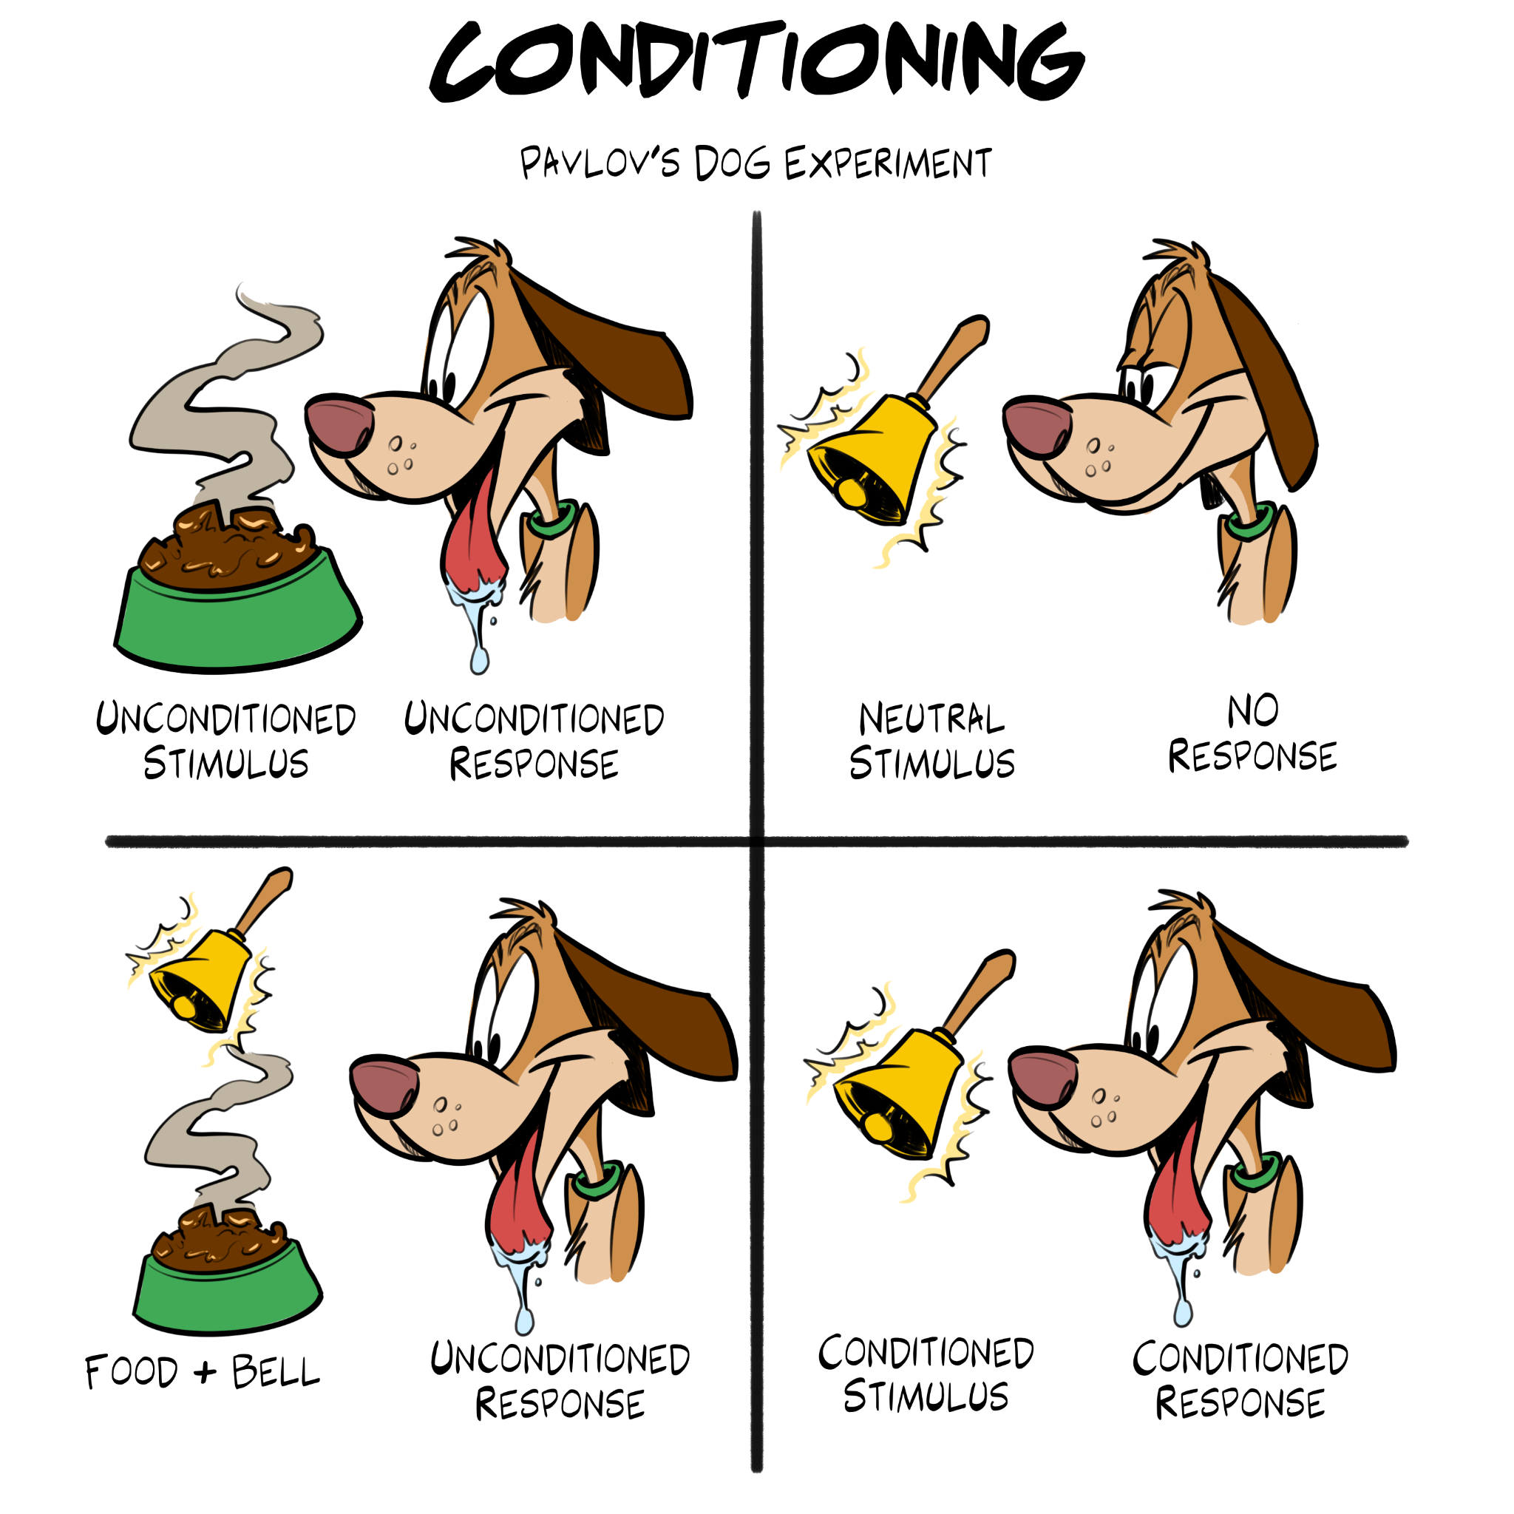
Conditioning Chart
On your graphic organizer, create your own conditioning chart. Use the example as a model.
Come up with your own example of classical conditioning and not one that you have already been shown.
Notes:
K20 Center. (n.d.). Conditioning: Pavlov’s dog experiment. [Image].

Slide 12
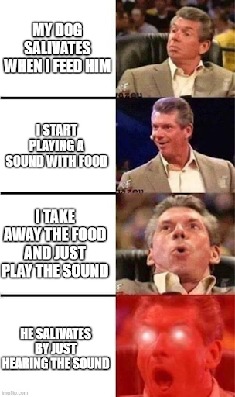
What Do You Meme?
Create a Meme about classical conditioning: https://imgflip.com/.
Be ready to share your meme and rationale with the class.
Notes:
K20 Center. (n.d.). What do you meme. Strategies. https://learn.k20center.ou.edu/strategy/984
Halstied, L. (2023). Pavlov’s puppies meme. [Image].

