Slide 2
WHAT IS TERRORISM?
A World History Lesson

Slide 3
How would you define terrorism?
Write a sentence or two about what terrorism is.
List any examples of terrorism you can think of.

Slide 4
Four Corners activity:
Look at the two pictures on the next slide and determine which one or if both of these represent TERRORISM.

Slide 5
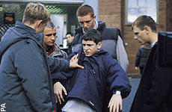
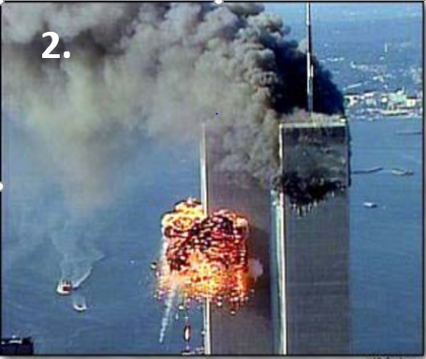
What is Terrorism?
Is it 1,2, or Both?
1.

Slide 6
Are these actions “terrorism”? Answers
Terrorism- An ex soldier blows up a government building with civilians in it.
No- During WW 2, Hiroshima is bombed although there are no specific military targets.
Terrorism- Palestinian (suicide bombers) explode a bomb in a bus.
No- An economic boycott against Iraq results in a lack of food, medicine, and the deaths of civilians.

Slide 7
Are these actions “terrorism”? Answers
5. Terrorism- A political group blows up a Marine defense base in Beirut, 1983.
6. Terrorism- A Japanese cult release poisonous gas in a subway.
7. No- The German Democratic Republic group builds a wall through the center of Berlin so east Berliners are not allowed to travel freely.
8. Simultaneous, coordinated bombings explode a commuter train system in Spain.

Slide 8
Why do individuals or groups commit acts of terror?
With your group, you will research a specific terrorist event.
It is important that your group find out and share WHY this terrorist act occurred.
You will need to present facts about when it occurred, what happened, and how it occurred.
Gather your information from at least 3 reliable internet resources.

Slide 9
Terrorist Events
The Unabomber, 1978-1995.
World Trade Center Towers, 1993
Murrah Federal Building, 1995
World Trade Center Towers, 2001
Madrid, Spain commuter trains, 2004
Attacks in Mumbai, India, 2008
London Bridge and Borough Market, 2017

