Slide 2
Myth Detectives: Discerning the Reliability and Credibility of Sources

Slide 3
Essential Question
Why is it important to discern the reliability and credibility of the information we find?

Slide 4
True or False
PLACE QR CODE OR TECH TOOL IMAGE HERE
Look at the following statements, and determine whether they are true or false…
Paste your own url here
Notes:
The true/false statements below or statements of your choosing can be presented with the provided Google Form which you can copy using this link: https://docs.google.com/forms/d/e/1FAIpQLSezOlvN3qfHNC895BqoU2A1MuhUM8NOB5aQuLrDg7tl7xx9Hg/viewform?usp=sf_link
There are alligators in the sewers of New York.
Tomatoes are not a vegetable.
Napoleon was shorter than the average man.
Dogs only see in monochrome.
You should meticulously check your Halloween candy for razor blades.
Or you can build your own using another tech tool such as Mentimeter, Quizizz, Kahoot, or Plickers. For a non-tech option, have students hold up red and green cards (red for false, green for true) while you read and/or show the statements on slides.

Slide 5
Learning Objectives
Determine the relevance, reliability, and validity of information gathered from various sources.
Analyze the quality, usefulness, and accuracy of resources.
Construct persuasive arguments using the CER (Claim, Evidence, and Reasoning) strategy to report on the accuracy of well-known legends.

Slide 6
Find Your Partners
Number off 1-5.
Group according to your number.
Select a Group Leader.

Slide 7
Group Roles
The Group Leader organizes research and presentation assignments.
All group members examine websites and record relevant information supporting the argument using the RAVEN Research Graphic Organizer.
Each group member contributes to the group presentation.

Slide 8
Select Your Topic
Next to the “team names” below are some of the topics of interest that you can reseach.
Aces = Alligators living in the sewers of New York.
Kings = Tomatoes are not vegetables.
Queens = Napoleon was shorter than the average man.
Jacks = Dogs see only in monochrome.
Tens = Check your Halloween candy for razor blades.
Notes:
You may use this grouping strategy or your own.
Be sure to change the statements if you are using different myths than those on the provided google form or on this slide

Slide 9
The Task: Find Reputable Evidence
Research the myth your group has been assigned.
Find at least 3 different sources.
Put your sources in the RAVEN Research Info Graphic Organizer under the tab whose name matches your group name.
Write notes from your sources in each column.

Slide 10
RAVEN
Relevance: Is the information relevant to your topic? Does it provide useful and applicable information?
Authority: Who is the author and what are their credentials? Are they an expert in the field?
Verifiability: Can you verify the information from other reliable sources? Are there citations or references provided?
Evidence: What evidence does this source provide that supports a true/false judgment on the myth you are researching?
Neutrality: Is the information presented in an unbiased and objective manner, or is there a clear bias or agenda?

Slide 11
[paste your own short url here]
RAVEN Research Info Graphic Organizer– Google Sheet
Notes:
Make a copy of this spreadsheet and then make a short url for your students to access and edit: https://docs.google.com/spreadsheets/d/1r5_jj3IKIviB5dWb94kEqbtxOLNYe79TpKZ5JWWgxtg/copy

Slide 12
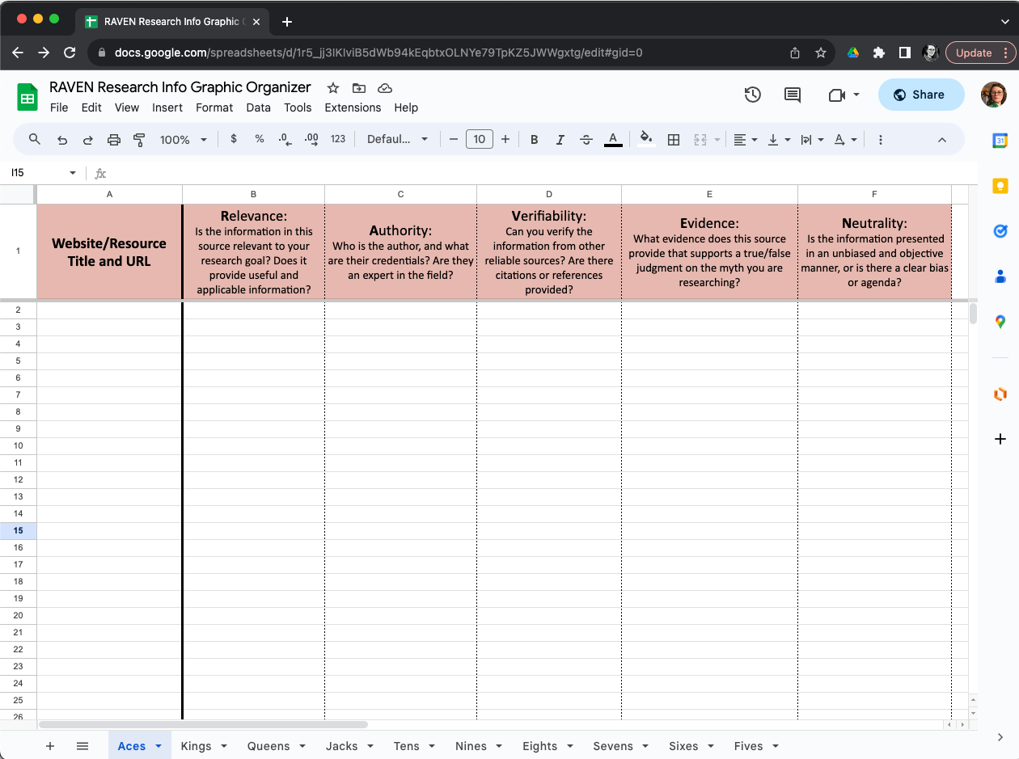
RAVEN Research Info Graphic Organizer
Notes:
Each group has its own tab at the bottom of the spreadsheet.

Slide 13
Muddiest Point
Which part of the RAVEN criteria did you have the hardest time answering?
What about your source made this part difficult?
Notes:
K20 Center. (2020). Muddiest point. Strategy. https://learn.k20center.ou.edu/strategy/109

Slide 14
Fact. Opinion. Reasoned Judgement.
Facts are objective and can be verified.
Opinions are subjective and based on individual viewpoints.
Reasoned judgments involve critical thinking and the synthesis of information to arrive at a well-informed conclusion.

Slide 15
Claim – Evidence – Reasoning (CER)
Claim: Clearly state whether your group believes the legend is true or false.
Evidence: Present the evidence you gathered during research, such as historical facts, expert opinions, or any other sources you deemed reliable using their RAVEN graphic organizer.
Reasoning: Explain why the evidence you found supports your claim.
Remember that your argument must be supported by evidence (not opinion).
Notes:
Introduce the strategy.

Slide 16
Example CER
Claim -- Chromebooks are better school technology tools than laptops.
Evidence -- Most applications on a Chromebook are web-based and store data online.
Reasoning -- Since data is stored online, students can use any device to access it. This prevents loss of student work and provides students the opportunity to work both from school and home.
Notes:
Example of another technology topic and possible evidence and reasoning.

Slide 17
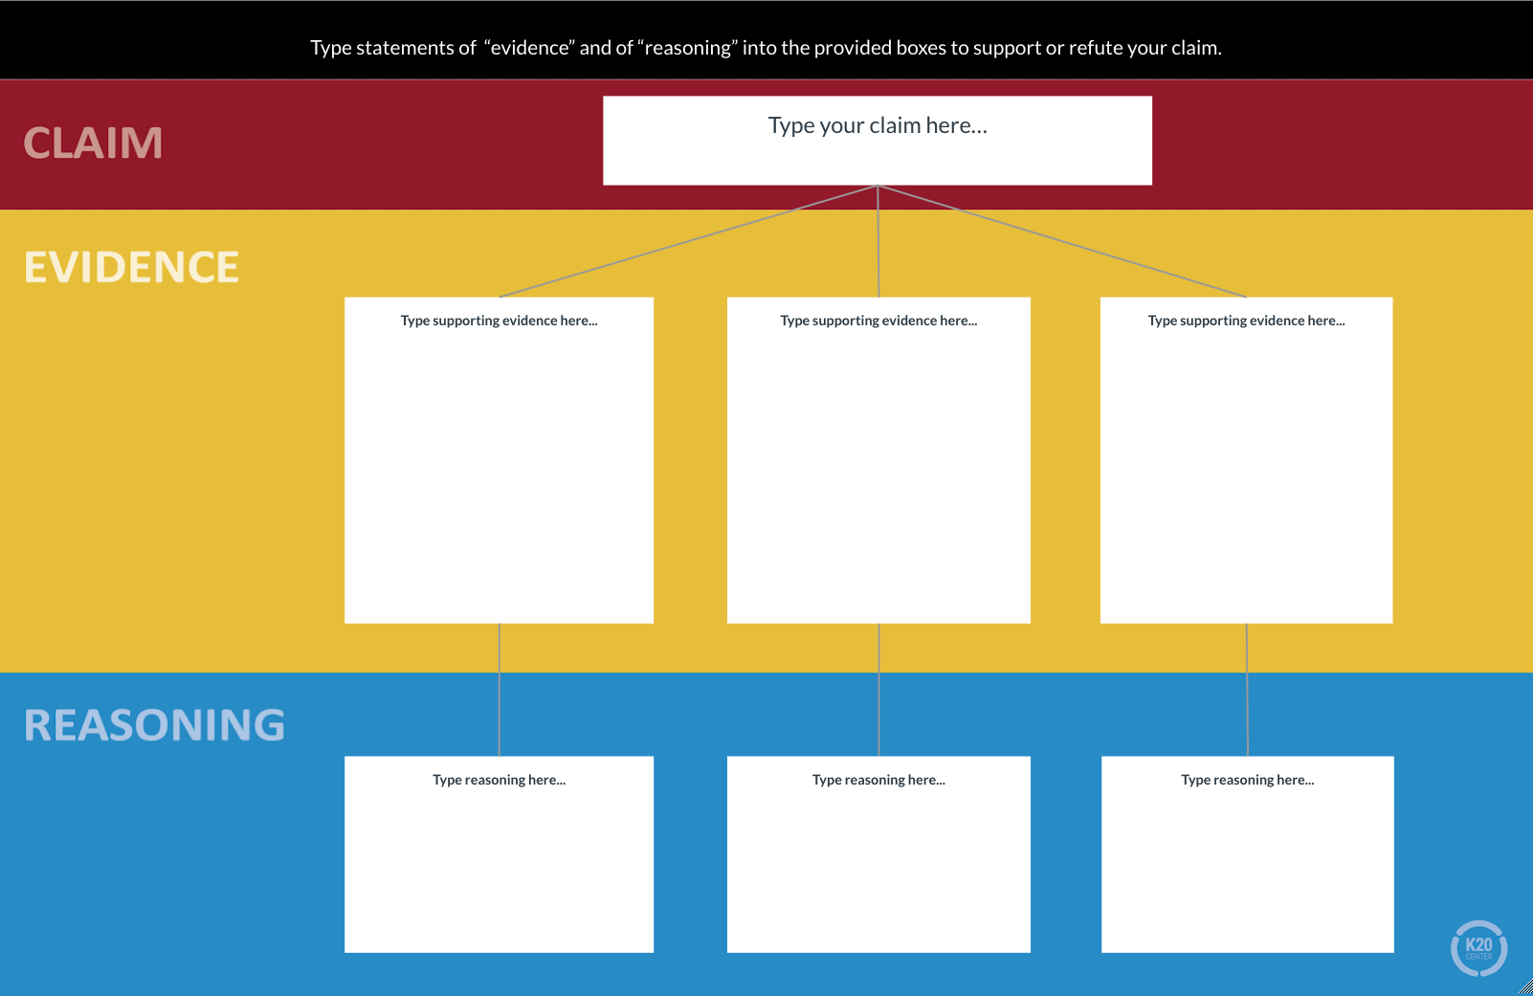
Notes:
Introduce template and show how participants should organize their research into a supported argument using CER.
https://docs.google.com/drawings/d/1ESpPzZOKlBcos0sGbac_Vy9MSL2VvjY0h35CYlahEvg/copy

Slide 18
Present Your Argument Maps

Slide 19
Public Service Announcement (PSA)
How do we know when information is reliable?
With your group, create a PSA on the importance of recognizing reliable information and credible sources.
Use Canva to create your PSA.
Be creative!

Slide 20
Notes:
1 minute

