Slide 2
Burn Ban?
Texas v. Johnson

Slide 3
Quote
I disapprove of what you say, but I will defend to the death your right to say it.
-Evelyn Beatrice Hall

Slide 4
Essential Question
How is free speech protected in the Texas v. Johnson decision?

Slide 5
Lesson Objectives
Analyze the Supreme Court case Texas v. Johnson.
Explain how the decision in Texas v. Johnson protects free speech.

Slide 6
Commit and Toss
Is it important to have freedom of speech? Why or why not?

Slide 7
Texas v. Johnson
Read the case summary.
Complete the graphic organizer with details from the court case.

Slide 8
Texas v. Johnson
What was the case about?
How did the court decide?
How did the decision impact free speech?
What about flag burning did the court decide constitutes “speech?”
What about this case makes it different from other free speech cases?
Why did the state of Texas think flag burning should be illegal?

Slide 9
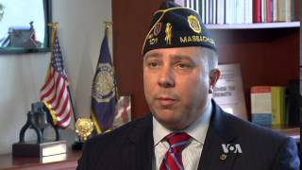
Constitutional Amendment?
Should an amendment be added to the U.S.
Constitution to ban burning the United States flag?
https://youtu.be/DmDm5iRFBE0?si=rlchFdcf2QxSO-kG
Notes:
Landmark US flag burning case marks 25th Anniversary. YouTube. (2014a, June 20). https://youtu.be/DmDm5iRFBE0?si=rlchFdcf2QxSO-kG

Slide 10
Constitutional Amendment?
Should there be a constitutional amendment to
ban burning the United States flag?
Make a claim. (Do not yet explain your reasoning.) | 2. Read the claim in the first box. Add something to support that claim.
3. Read the claim in the first box. Make a counter-argument or provide evidence that challenges the claim. | 4. Read boxes 1-3. Summarize the three boxes in your own words.

Slide 11
Texas v. Johnson
Respond on notebook paper:
How is free speech protected in the Texas v. Johnson decision?

